Slide 1

OOoAuthors
  Introduction to OOoAuthors:
  What it is and why the German team chooses it

Slide 2
Content
A short history about OOoAuthors
Aims of OOoAuthors
The people behind OOoAuthors
The German Team: Why did we chose OOoAuthors?
How to start a new language project
How to contribute to OOoAuthors
FAQs

Slide 3
A short history
June 2003: Daniel joins the Documentation Project
October 2003: Set up of "Starter Guide" project by Daniel
January 2004: OOoAuthors is born
April – July 2004: Relationship between Doc-Project and OOoAuthors clarified
September 2004: Jean and Janet agree to be editors
October 2004: First batch of chapters from OOoAuthors posted at Docs
February 2005: German language team starts... :)

Slide 4
Aims of OOoAuthors
Writing high-quality documentation
Providing tools that simplify the work of writers and reviewers
Providing a supportive environment for writers and reviewers
Writing with a focus on clarity and ease of understanding
Focus on the user guide and FAQs

Slide 5
The people behind OOoAuthors
Here the people behind this project:
Agnes Belzunce
Nicu Buculei
Daniel Carrera
Sigrid Kronenberger
Peter Kupfer
Marko Möller
Iain Roberts
Janet Swisher
Jean Hollis Weber
Linda Worthington
and many more....

Slide 6
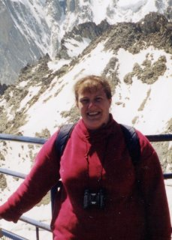
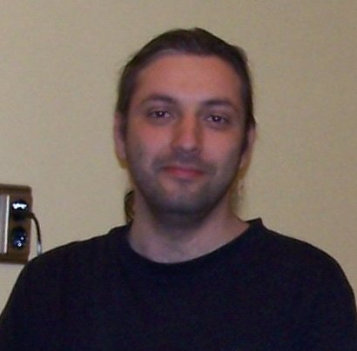
Agnes and Nicu
Agnes, 39, works in a paint factory She works as reviewer at OOoAuthors. At the end of February 2005 she started the French folder, starting with the translation of the pre-published chapters of the User's Guides. Beside her regular job, she
likes computers, and of course, all about Open Source software.
Nicu, 32, is sysadmin in a small aviation company. He Co-Leads the Romanian NL project, is involved in the Open Clip Art Library (OCAL) and works with OOo and Inkscape. He made our logo (thanks!) and is
the main reviewer for the Romanian documentation.

Slide 7

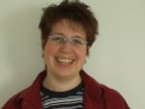
Daniel and Sigrid
Daniel, 26, is a mathematician. He is one of the founders of OOoAuthors and the user guide. He enjoys writing about OOo and the OpenDocument format. When not occupied cheering for Free Software and Open
Standards, Daniel likes to relax reading Wikipedia.
Sigrid, 33, is studying Microsytems Technology, after working 13 years as secretary. She is doing the translation of existing documents in English, German
and French. She also reviews English chapters.

Slide 8
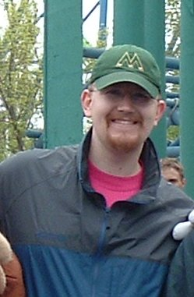
Peter
Peter teaches physics at an Illinois high school. He works at OOoAuthors because he likes doing volunteer work and wanted to give back to the community but is not a programmer. He works mostly on the Calc guide, but tries to keep his hands in everything. He works with documentation
because he believes that free software should have free documentation.

Slide 9
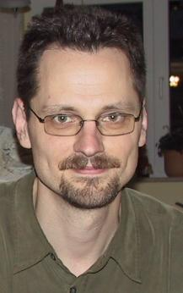
Marko
Marko, 35, is a sysadmin. He is one of the authors of the German install guide for OOo 2.0 and one of the founders of the Germanphone Section of OOoAuthors. He enjoys learning how things work and finally finding ways to make them better
and more comfortable.

Slide 10
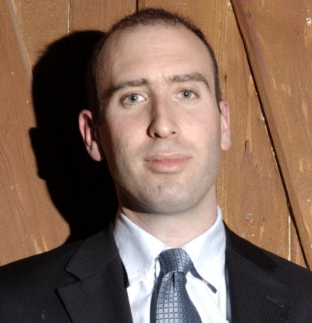
Iain
Iain lives in Manchester, England. He runs Axiom Tech, a company specialising in OSS IT. He's involved with OOoAuthors because he enjoys it, can contribute while learning useful skills and it's a good way
to help if programming isn't your strong point. He's working on a project to get students aged 15-17 contributing to OSS through coding, documentation, testing, etc. He's also the North West regional representative for the Open Source Consortium, a grouping of over 100 UK open source companies.

Slide 11

Janet
Janet is the sole technical writer at Enthought, Inc., a software firm in Austin, Texas, USA. Enthought recently began hosting the OOoAuthors website. Janet uses OOo
professionally to create documentation for other open source software that Enthought supports. She is the editor for the Writer Guide, and helps to maintain the style guide and the OOoAuthors site. In other spare time, she practises the Japanese martial art of Aikido.
The picture was taken from http://openclipart.org

Slide 12
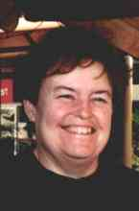
Jean and Linda
Jean has nearly 30 years of experience as a technical writer and editor. Jean is retired and lives in tropical Australia. In addition to working with OOoAuthors, she gives talks at conferences and travels a lot.
Linda, 40, is a Freelance Graphics Designer, Website Developer & Designer, who became interested in OOo over a year ago. She is currently authoring, editing and maintaining
several guides at Authors. Her husband, employed by Red Hat, showed her the light about Free Software and Open Standards and she is now a die hard advocate for Linux and Open Source. The picture was taken from http://openclipart.org

Slide 13
The German Team
Why did we choose OOoAuthors?
  First we've tried to organise the translations with IssueZilla... Have a look at issue 42931 :)
  Since it's obvious, that it's easy to lose track, which document needs to be reviewed, which is the last version of a fixed document...
  OOoAuthors is more suitable for collaborative work on different documents.
  The decision to use OOoAuthors was a common decision of the whole team. :)

Slide 14
The German Team
How did we get started with OOoAuthors?
The start was quite easy:
  Marko announced that a few people are interested in translating documents.
  Daniel granted Marko the author-role, created the /de/-folder and gave Marko manager-access for this folder.
  With the new folder we started translating the files :)

Slide 15
How to contribute?
Contributing is easy:
  Register yourself on the OOoAuthors-site, subscribe to authors@user-faq.openoffice.org, send a mail at the mailinglist, tell us your login-name and ask for the author-role.
  When the author-role is granted to you by the managers, you'll be informed.
  We recommend that you start for the beginning with reviewing an existing chapter.
  When you feel comfortable, you can write your own chapter
  The last two points are suggestions, no rules. :)

Slide 16
How is the work organised?
When you are logged in, you can see on the left side the review-list.
Pick one of the chapters and download it.
Set the status of this document to "retract".
Send a mail to the mailinglist and tell the others, which chapter you're reviewing.
When you've finished your review, upload the file in the feedback-folder.
Send a note to the mailinglist, that you've uploaded the file. So the maintainer of the chapter can have a look at your changes.
That's all. ;)

Slide 17
very short FAQs
Why do I have to register once more at OOoAuthors?
  Because OOoAuthors is located on a different server. It wasn't possible, to use Plone on the existing software-infrastructure of CollabNet.
Is there a cooperation between OOoAuthors and OpenOffice.org?
  Yes, of course. OOoAuthors writes the documentation for OpenOffice.org. When a chapter is ready for publishing, it is also posted on the site of the OOo-doc-project. Most of the authors are also involved in the "main" OpenOffice.org-project.

Slide 18
very short FAQs
What license do OOoAuthors use?
  After a lot of deliberation and research we decided on a dual GPL and Creative Commons Attribution License. We felt that this would fit best in the open source spirit and minimize the potential problems for us in the future. The details of this decision are documented on this page: http://oooauthors.org/authors-license.odt

Slide 19
☺ ☺ ☺ ☺ ☺
  Thanks for your attention ;)

