Slide 1
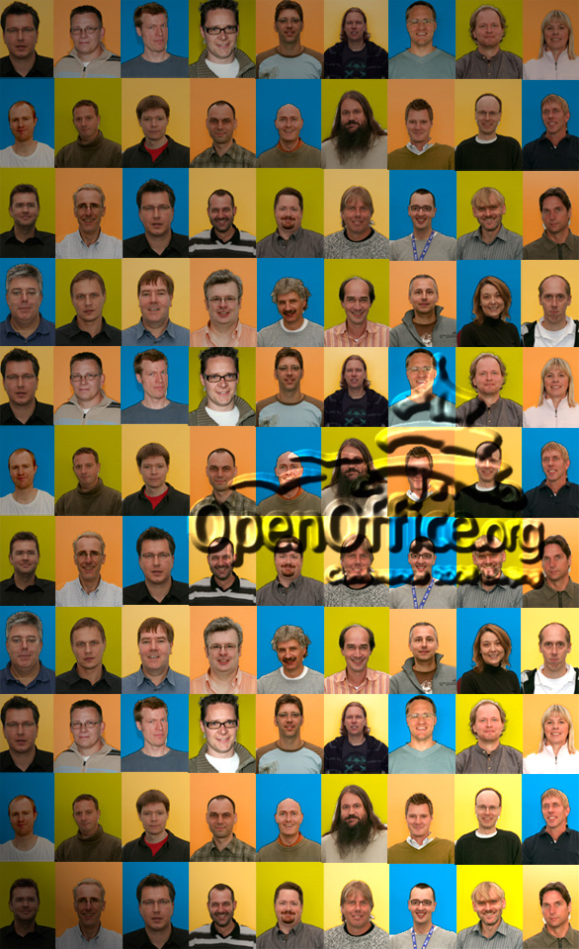

OpenOffice.org
- What influence does it (and you) have on the future?
OpenOffice.org
Conference 2008 Beijing
Fredrik Haegg
Software Engineer
Sun Microsystems
28

Slide 2
Prophezising the future?
Perhaps a better title:
“What would the world look like without OpenOffice.org?”

Slide 3

So what can we talk about?
1 – Microsoft
2 – Linux / EEEPC
3 – ISO/OOXML vs ODF
4 – OOo spread and OOo 3.0
5 – India
6 – What people think
7 – Two things which will be in focus
28

Slide 4
Microsoft
Claims OOXML as “superior”
But will still support ODF in future Office-update?
  Be nice: not supporting ODF means loosing customers
"This is not about any one document format 'winning' — it is about enabling customers to evaluate and use document formats that make the most sense for them," wrote Matusow in a blog post. "It is that we want our customers to have the most positive experience possible when using our product."
(Jason Matusow, Microsoft)
http://www.zdnet.com.au/news/software/soa/ODF-finally-defeats-OOXML-in-document-format-war-/0,130061733,339289195,00.htm

Slide 5
Microsoft
And if we're critical:
“In Microsoft's announcement, the company said it was adding native support for ODF due to increasing pressure from customers "and because we want to get involved in the maintenance of ODF".” - Tom Espiner, ZDNet UK
http://news.zdnet.co.uk/software/0,1000000121,39422248,00.htm

Slide 6
Microsoft actually helps us
Vista
  Too soon
  Want to buy new hardware?
“Companies won't likely skip Vista because "a lot of our customers will upgrade roughly a third or a quarter of their computers" per year, Ballmer explained.”
http://adtmag.com/article.aspx?id=23455

Slide 7
Microsoft actually helps us
Windows XP goes “End of Life”.
  Mainstream support: April, 2009
  Security patches until April 2014
Office 2007
  Education, Licenses, Migration-Costs, new hardware.

Slide 8
What does Microsoft think of us?
Steve Ballmer, CEO Microsoft, Oct. 17th, 2008:
“Ballmer denied that Google was Microsoft's most significant competition. Microsoft's main challenges are the open source business model and getting good at advertising for the consumer market, he explained.”
"We get more competitive pressure from OpenOffice and StarOffice."
http://adtmag.com/article.aspx?id=23455

Slide 9
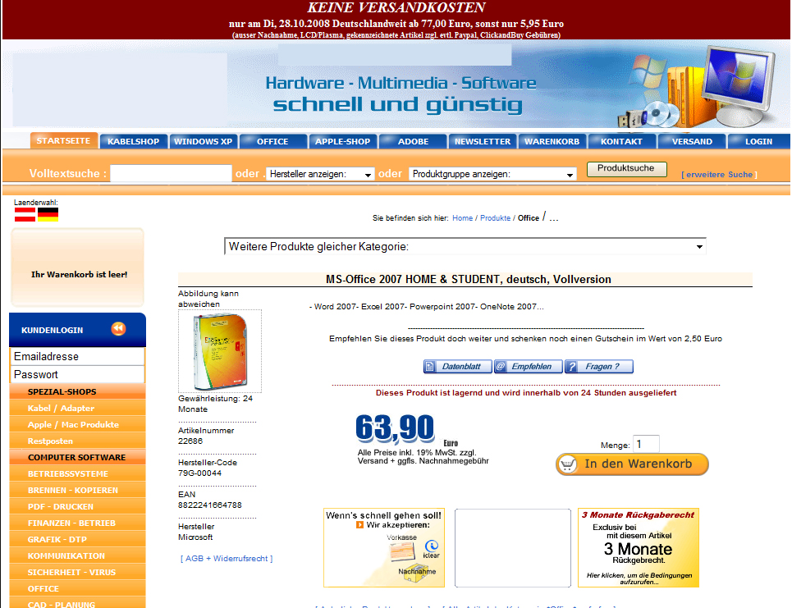
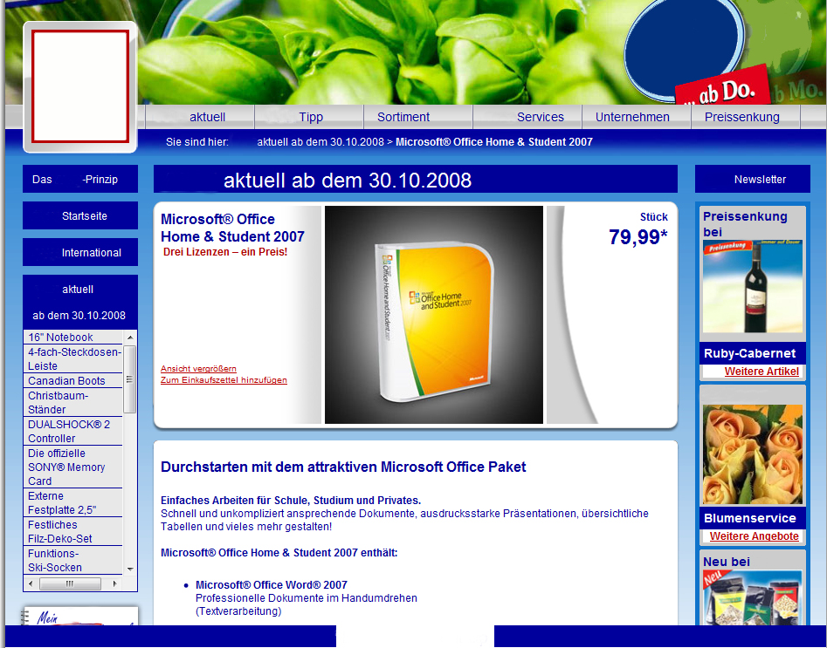

MS scared by how OpenOffice.org succeeds?
  “Anti-Piracy-Campaign” at the time for OOo 3.0 -release

Slide 10
...and Linux gains ground...
“Microsoft is feeling the heat from Linux in the budget mobile market where products like the Eee PC are changing all the rules. Asus has sold thousands of Linux-based Eee PC laptops in the US and anticipates selling between three million and five million this year.”
“Motorola, which has already sold over 9 million Linux-based handsets, expects as much as 60 percent of its phone lineup to be Linux-based within the next few years.”
http://arstechnica.com/news.ars/post/20080104-evaluating-prospects-for-linux-growth-in-2008.html

Slide 11
...and Linux gains ground...
“Linux went from 1.25 percent in May of 2007 to 2.02 percent in March of 2008. That is 61.6 percent increase in market share in nine months. [Put another way,] that is 82 percent annual growth in installed computers.”
http://news.cnet.com/8301-13505_3-9910263-16.html

Slide 12
OOXML vs ODF
Governments File Appeals Against OOXML Standardization (ISO)
“By the deadline last night, we had received three appeals, from Brazil, India and South Africa" Jonathan Buck, spokesman for IEC. (IDG)
http://www.pcworld.com/businesscenter/article/146468/india_and_brazil_file_appeals_against_ooxml_standardization.html

Slide 13
OOXML vs ODF
“Representatives in Brazil, South Africa, Venezuela, Ecuador, Cuba and Paraguay issued their angry manifesto in response to the ISO's recent approval of Microsoft's Office Open XML (OOXML) document format.” (the Inquirer)
http://www.theinquirer.net/feeds/rss/generic/en/GB/inq/latest/gb/inquirer/gb/inquirer/news/2008/09/02/iso-ooxml-support-criticised
From the South African appeal:
“We believe that there is an important question of principle involved and that the reputation of ISO/IEC is indeed at stake. There has been speculation about the need to revise the directives around fast track processing. While such revision might indeed be necessary, we cannot accept the outcome of a process in which the existing directives have not, in our opinion, been applied.”
http://www.groklaw.net/article.php?story=20080901220545193

Slide 14
OOXML vs ODF
Governments File Appeals Against OOXML Standardization (ISO)
“Some very significant bodies of the Brazilian Government and government-owned corporations have just signed an agreement to adopt Open Document Format as their standard format for the exchange of electronic documents.”
(M.Thompson, Oxford Internet Institute, University of Oxford)
http://people.oii.ox.ac.uk/thompson/2008/08/28/brazilian-government-adopts-odf/

Slide 15
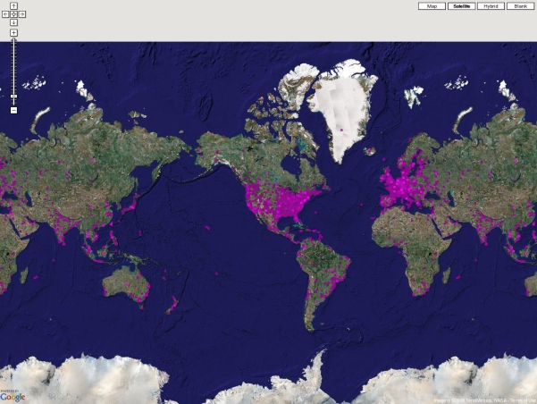
OpenOffice.org -Spread

Slide 16
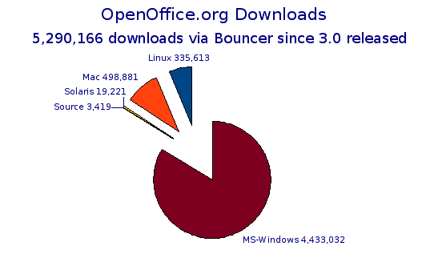
OOo 3.0
OOo 3.0 downloaded with a rate of approximately 400'000-500'000 per day.
(Date: 26.October)

Slide 17
India: over 20000 schools have migrated
(Case studies by Prof. Dass of the Indian Institute of Management)
Has the adoption of OpenOffice.org created new jobs?
Has the adoption of OpenOffice.org had and Educational benefits?
Has the adoption had any other benefits?
If you migrated from another Office-Suite – for what did you use the money you saved?
We would also like to know what kind of effects you belive OpenOffice.org will have on the end-users you represent?
Last but not least – what would you or your Organization like to be different with OpenOffice.org?

Slide 18
India: over 20000 schools have migrated
Has the adoption of OpenOffice.org created new jobs?
“The local support personnel got job due to Open Office migration.”

Slide 19
India: over 20000 schools have migrated
Has the adoption of OpenOffice.org had any Educational benefits?
“Yes. The employees are freely experimenting all the open office tools. Without open office they would not have tried the tools.
Over 20000 schools have been provided with open office and hence in the area of education, open office has made a great stride.
Government officials and students alike come to understand that a free office suite is far superior in user satisfaction as compared to the proprietary/paid one.”

Slide 20
India: over 20000 schools have migrated
Has the adoption had any other benefits?
“It has saved the embarrassment of the subordinates
(Government officials) using pirated Microsoft office products.
Virus issues have been completely done away with as open office running Linux OS is stable, secure and free from viruses.
The built in pdf writer is a great advantage which is not available in Microsoft office.
Upgrading to newer versions of open office is free and it is easy as well. The upgraded version support the documents created using the earlier versions and hence there is no migration issue. Migration is not felt at all in view of the seamless backward compatibility support available in open office.”

Slide 21
India: over 20000 schools have migrated
If you migrated from another Office-Suite – for what did you use the money you saved?
“The funds saved have been deployed in upgrading the computer hardware from CRT monitors to TFT monitors in the first phase, and from TFT monitor systems to laptops in the second (current) phase.
A portion of the savings is also deployed in providing linux and open office training to the users.”

Slide 22
India: over 20000 schools have migrated
We would also like to know what kind of effects you believe OpenOffice.org will have on the end-users you represent?
“It gives a feeling of absolute freedom. Freedom from the need to continuously upgrade the office suite. Freedom from continuous investments on the office suite upgrades and assurance on availability of backward compatibility support for all documents created in the last 10-12 years.”

Slide 23
India: over 20000 schools have migrated
Last but not least – what would you or your Organization like to be different with OpenOffice.org?
“We wish to run open office only under Linux environment. We want open office to be the default office suite for the use in Government and all academic institutions, including the Government and private institutions.”

Slide 24
What people think
“Office 2007 on my EeePC 900 is much faster than StarOffice or OpenOffice.”
“The interface and graphics cannot compare to Office 2007..”
“Yep, MSOffice programs opens faster. I guess the main reason is that OOo opens the whole office suite at once (if you already have Writer running, starting Calc or Impress is a matter of seconds or less). That probably also explains the heavier RAM consumption.”
“Open office is a PIG on CPU/RAM. Not to mention poor MS Office compatibility and stability problems.”
“OOo has improved steadily and with OOo3 compability problems are rare.”
“I personally found OpenOffice easier to get to grips with than MS Office, and find it a bit more straightforward to use.”
“When you can print a chart without printing the spreadsheet I'll take another look.”
http://forum.eeeuser.com/viewtopic.php?pid=425665
http://lifehacker.com/5046897/a-first-look-at-openofficeorg-30#viewcomments
http://www.infoworld.com/article/08/05/16/Can-OpenOffice-3-beta-replace-MS-Office_1.html

Slide 25
Two things which will be in focus
Performance
and
User Interface
More info: “User Experience”

Slide 26
The world is changing...
And you are an important part of it.
Every single keystroke has been important to reach the point where we are now.

Slide 27
Discussion
Meet the Sun experts here in Beijing.
Visit our Sun booth!
20%
57%
15%

Slide 28

End
Fredrik Haegg
fredrik.haegg@sun.com
28

