Slide 1


Slide 2

ODF Accessibility:
Perspectives on Past & Future
Donald Harbison
IBM

Slide 3
Agenda
Introductions
  Don Harbison: IBM Open Standards Program
  Xing Li: IBM Lotus Symphony Accessibility Developer
  Malte Timmermann: Sun Microsystems Accessibility Developer
Accessibility challenges and market dynamics
  Government actions
  ODF document accessibility: past, present and future outlook
Demonstrations
Panel Discussion

Slide 4



Accessibility is About All of Us
World population: 6 Billion*
Worldwide Number Disabled: ~1 Billion (16%)*
U.S. Population: 281M*
U.S. Number Disabled: 54M* (19%)*
Traditional Disabilities
Other “Disabilities”
20% of WW & US
Population is disabled
ESL
Aging
Novice Computer Users
Blind
By 2010, 60% of US population
will be over the age of 35
~25% of US households do not
own a computer
Mobility
Deaf
17.9M people speak a language
other than English at home
Poor hearing
Language
Cognitive
Failing Vision
Color Blind
Temporary Disabilities
“Disabilities” are no longer confined to traditional definitions,
especially with the growing need to embrace aging workforces and citizens.
Source: 1. Population Reference Bureau, United Nations. Source: 2. Forrester Study Commissioned by Microsoft
Notes:
[1] Baseline Assessment Inclusion and Disability in WorldBank Activities Report – June 2002.
[2] National Organization on Disability, http://www.nod.org/content.cfm?id=1348
[3] Centers for Disease Control and Prevention, http://www.cdc.gov/mmwr/preview/mmwrhtml/mm5206a2.htm
=================================================
1

Slide 5

Accessibility benefits a wide range of people
Know the facts
People with disabilities:
More than $1 Trillion in aggregate annual income
More than $220 Billion in disposable income annually
Twice the spending power of teens and 17x’s the spending power of “tweens”
Mature consumers:
1 in 4 over age 50 and 1 in 2 over 65 have a disability
People aged 50+ spent nearly $400B In 2003
People with low literacy:
900+ million illiterate people represent 25 percent of the world’s youth and adults
Non-native language speakers:
Nearly 47M people speak a language other than English at home

Slide 6
Accessibility market adoption & evolution
Societal transformation Making accessibility everyone’s issue
All people
Responsive Increasing social
relationships relevance
Cross culture
Low literacy, non-native language speakers
Usable Access Expanding the market
Mature population
Compliance Meeting the needs a single group
People with disabilities

Slide 7

Continued Growth for Future Evolution
Our vision
Societal Transformation
Seamless private/public value net collaboration
Inclusive societal participation
Effective
Business Models
Collaborative
Innovation
Sense & respond preferences
Adaptive human-business experience
Effective personal interaction
Improved user satisfaction
Usable
Access
Responsive
Relationships
Compliance
Effective Human
Interaction
Regulatory & legal mandates
Standardization of technical interfaces/APIs

Slide 8
Environmental influences are driving change
The Market
Technology Evolution
Industry Actions
Market Environment
Policy and Litigation
Notes:
Key messages:
Why is it so important for us to expand the definition of accessibility?
A number of global, social, industry and market trends are converging to create a unique opportunity to build the business case for enabling human ability through accessibility.

Slide 9
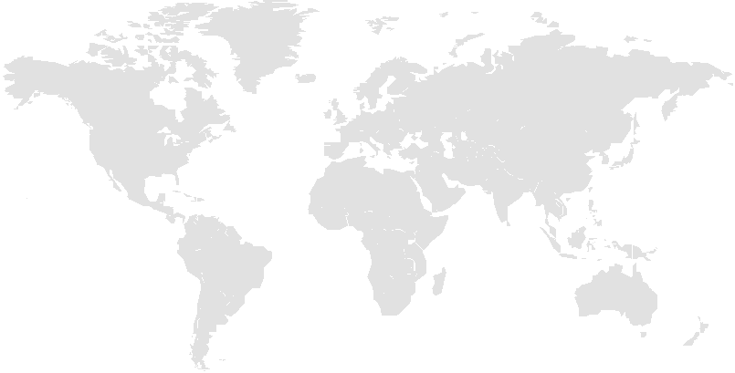
Majority of laws affect public sector; private sector laws emerging
Accessibility is now becoming a worldwide imperative
Europe
  Sweden – Guidelines for computer accessibility, 1998
  Spain – Accessibility for computer platforms, 1998
  - Mandate for accessible government websites by YE2005
  UK – DDA: Web accessibility, public & private sector, 1999
  - public procurement - 2005
  Germany – Barrier Free Decree, 2002
  Ireland – IT accessibility guidelines, 2002
  Italy – ICT accessibility & government procurement, 2004
  Switzerland – Public sector Web accessibility, 2004
  European Union – Procurement Directive, 2004
  Netherlands – Web accessibility, 2003
  Portugal – Web accessibility – 1999
  - Investigating software accessibility legislation – 4Q05
Americas
Canada
Canadian Human Rights Act
Ontarians with Disabilities Act – 2005
United States
Americans with Disabilities Act (ADA) - 1990
Section 508 of Rehabilitation Act - 1998
States are enacting similar legislation
Massachusetts – Open Document Format decision has fueled heated debate due to lack of accessibility - 2005
Brazil
Gov’t Decree affects public sector - 2004
New policy triggers litigation and legal inquiries
Arkansas: State accounting system (SAP) inaccessible to blind employees
Pennsylvania: Web portal (SAP) inaccessible to blind.
Southwest Airlines: Online reservations / ticketing inaccessible
Met. Atlanta Rapid Transit Auth: Inaccessible Web site
Bank of America: Inaccessible Web sites and ATMs
America Online: Software incompatible with screen readers
Ramada and Priceline fined by State of New York
Target: Inaccessible Web site
Asia Pacific
Japan
JIS standards, Government & industry cooperation, 2004
China
Law of the PRC on the Protection of Disabled Persons – Provisions on employment, public services, transportation and legal sanctions, 1991
Extending law to cover IT accessibility by YE2006
Australia
DDA: Web accessibility, public & private sector – 1996
India
Begun process to add IT accessibility to existing law - 2005
Notes:
1

Slide 10

Global trends
Increasing government legislation
affects business around the world…
Canada*
U.S.
Brazil*
European Union*
UK*
Italy*
Switzerland*
Spain*
Portugal*
Netherlands*
Germany
Sweden
Ireland
Japan*
China*
Australia
India*
Legislation actions between 2005-2008 indicated in red and marked with a star

Slide 11
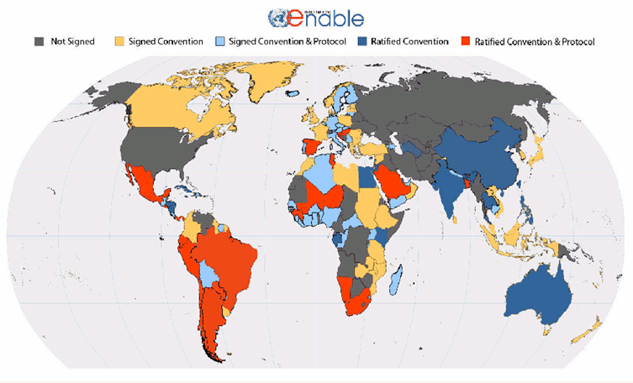
Ratification of the UN Convention on the Rights of PWDs
Argentina*
Austria*
Australia
Brazil*
Bangladesh
Chile*
Croatia
China*
Cuba*
Ecuador
Egypt
El Salvador
Gabon
Guinea
Honduras
Hungary
India
Jamaica
Jordan
Kenya
Mali
Mexico
Namibia
New Zealand*
Nicaragua
Niger
Panama
Paraguay*
Peru
Philippines
Qatar
San Marino
Saudi Arabia
Slovenia
South Africa
Spain
Tunisia
Thailand*
Turkmenistan*
Uganda*
UN Convention on Rights of *PwDs – May 2008
Web Accessibility Standards - WCAG 2.0
*PwD – Persons with Disabilities
135 Signatories, 40 Ratifications
* = signed in last 60 days
Notes:
For example: Global trends and the UN convention on Rights of PwD
Mandated ICT Applications:
E-Government, Education, Employment, Consumer Services, Media & Internet, Freedom of Expression, Emergency Response, Culture and Leisure

Slide 12
New US and EU Accessibility Legislation in early stages of Impacting
Product Compliance Requirements
Europe
Netherlands – Law for accessible gov’t websites 2006
UK- public procurement – 2005, WCAG 1.0, ATAG 1.0, UAAG 1.0
Spain- Decree for hardware, software, and Web standards – 2007 Mandate for accessible government websites 2005
EU - Mandate 376 to develop standards and certification scheme – ’10 to ’11 Looking to strengthen procurement directive
EU is leaning toward third party certification scheme and accessibility labeling
Americas
United States
Section 508/255 Refresh: '09 – '10
ADA Restoration Act 2009
Accessible Telecomm Bill: '09 – '10
Canada
Ontarians with Disabilities Act – 2005
Developing standards 2005 and beyond
Asia
China
Law on the protection of PwDs – extended law to cover IT accessibility in 2007
New web standards 2008
India
Adding IT accessibility to National policy for PwDs in 2006
*PwD – Persons with Disabilities
135 Signatories, 40 Ratifications
* = signed in last 60 days
Notes:
For example: Global trends and the UN convention on Rights of PwD
Mandated ICT Applications:
E-Government, Education, Employment, Consumer Services, Media & Internet, Freedom of Expression, Emergency Response, Culture and Leisure

Slide 13




Worldwide Human Ability and Accessibility Center
London
Stuttgart
Boston
Paris
Beijing
Raleigh
Tokyo
Austin
Sao Paulo
Sydney
IBM Human Ability & Accessibility Center
A Corporate Function
Standards
Project Office
Technology
Solutions
Strategy
Marketing
- CI 162
Notes:
1

Slide 14
ODF Accessibility – Initial Problem
In Federal Government bids software must be accessible by Persons with Disabilities.
  Section 508 – US Rehabilitation Act
Now becoming important for States, e.g.Commonwealth of Massachusetts
  Also California, Texas, Minnesota
ODF Accessibility issues were highlighted by Microsoft lobbyists in Massachusetts.
Leaders from IBM worked with the ODF TC to form the Accessibility SC (see next slide).
OASIS ODF AccSC was formed and responded very quickly.

Slide 15
Committee Formed
IBM – Rich Schwerdtfeger (co-chair), Dr. Chieko Asakawa, Dr. Hiro Takagi, Pete Brunet
Sun – Peter Korn (co-chair), Malte Timmerman
Design Science – Steve Nobel
The Paciello Group – Mike Paciello
Capital Accessibility – Janina Sajka
Institute of Community Inclusion – David Clark
Royal National Institute for the Blind – Dave Pawson
New member: Duxbury Systems (Braille translators)

Slide 16
GAP Analysis & Solution
The Accessibility Subcommittee (AccSC) was formed in January 26, 2006.
A GAP analysis was conducted.
Comparison to W3C WCAG 1.0 and the Microsoft Office suite
Nine issues were identified and submitted to the TC during May 2006.
ODF V1.1 becomes OASIS standard in February 2007
  SP2 MS-Office 2007 will support 1H/2009
  Supported by Lotus Symphony V1
OASIS Accessibility Guidelines for Developers – Spring 2008

Slide 17
ODF Accessibility Check-and-Fix tool for Symphony 1
Accessibility Research
Tokyo Research Laboratory
Notes:
1

Slide 18
Overview
Goal
  Provide a seamless authoring environment to generate accessible office documents based on open standards.
Approach
  Integrate simple and effective accessibility check-and-fix wizard into
  IBM’s office editor, Symphony (and Notes 8).
Current status
  Research prototype is on TAP (This version only supports Notes 8.)
    http://w3.tap.ibm.com/myTAP/offering/viewoffering.wss?offeringId=OFF50896
  Recently we ported the prototype to Symphony 1
Notes:
1

Slide 19
Characteristics of ODF Accessibility Check-and-Fix wizard
The first integrated accessibility check-and-fix tool
for ODF Documents
Allow authors to generate accessible office documents
  e.g., screen reader users can access these documents with Symphony
Provide simple and intuitive UI like a “spell checker”
  Zero learning curve
Main target is word processor documents.
  Accessibility criteria for word processor documents is built on Web accessibility criteria.
  Accessibility criteria for presentations and spreadsheets are not well established yet.
    Experimentally does support Presentations and Spreadsheets.
Basic accessibility check items from ODF accessibility guidelines are supported.

Slide 20
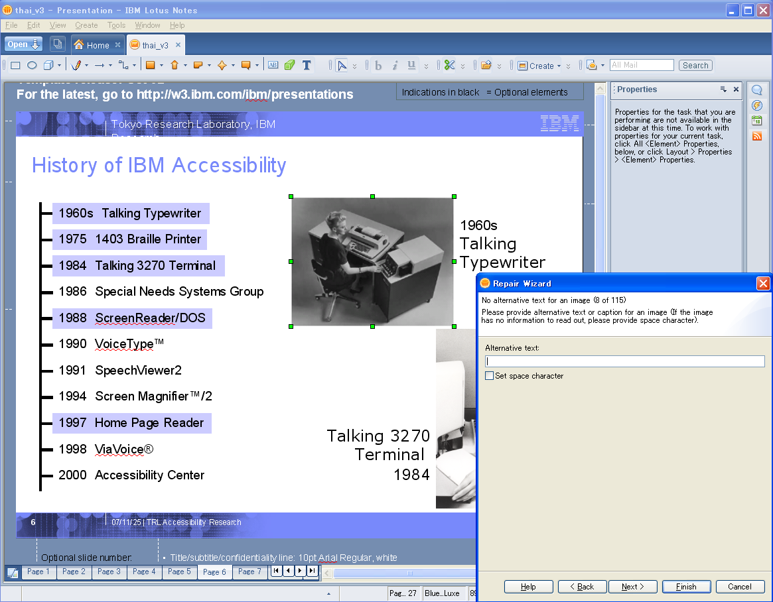
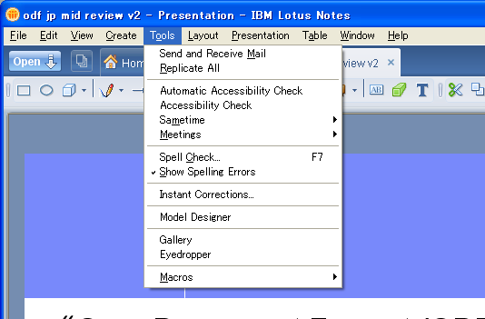
Screenshots (1)
Synchronize with SODC view
Launch from Tools menu

Slide 21
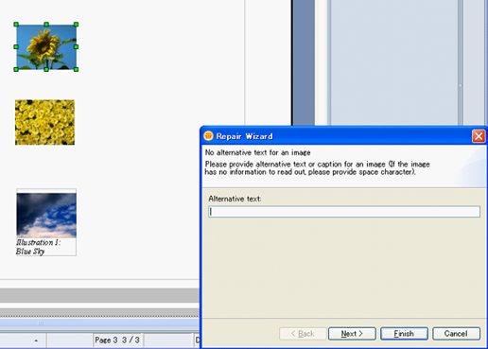
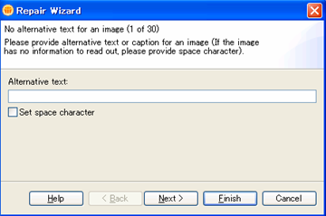
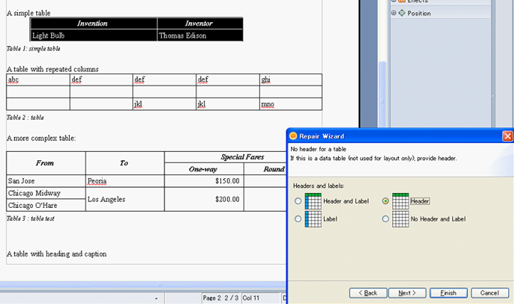
Screenshots (2)
Synchronize
Alternative text
Synchronize
Table header
Notes:
1

Slide 22
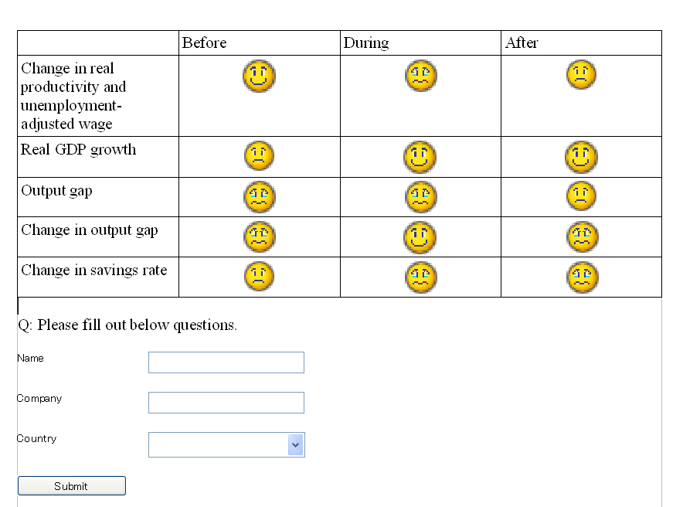
Example: check-and-fix result of word processor document
Images without
alternative text
Before
fix
Form controls without labels
Table Headers
as labels for each cell
After
fix
Images with ALT
Target document
Labels are associated with Form controls

Slide 23
Implemented Check Items (Alt Text)
Focus on important and Wizard friendly check items
(Check function for spreadsheet (.ods) is experimental implementation)
Notes:
1

Slide 24
Implemented Check Items (Table)
Focus on important and Wizard friendly check items
(Check function for spreadsheet (.ods) is experimental implementation)
Notes:
1

Slide 25
Implemented Check Items (Form)
Focus on important and Wizard friendly check items
(Check function for spreadsheet (.ods) is experimental implementation)
Notes:
1

Slide 26
Architecture overview
Symphony 1 / Lotus Notes 8
ODF Accessibility Check & Fix tool
soffice.exe
Documents,
Presentations, Spreadsheets (Experimental)
Highlight
targets
(UNO)
Fix Wizard
5. Highlight
targets
(DOM)
UNO
Utilities
Save,
Open
(UNO)
6. Repair
(DOM)
ODF
Parser
and
ODF DOM
APIs
8.Open
(UNO)
1.Save
(UNO)
(DOM)
4. Report
Errors
7. Export
(File)
Accessibility
Checker
ODF
File
ODF
file
3. Check
(ODF DOM)
2. Parse
(File)
Notes:
1

Slide 27
aDesigner for ODF
aDesigner is an application that helps designers ensure that their content and applications are accessible
  Donated to Eclipse Accessibility Tools Framework (ACTF) project
  Supports checking various types of contents (HTML, Flash, ODF, GUI applications)
aDesigner for ODF function supports three modes
  Blind Simulation
    Visualize blind usability (Reaching time, navigability, etc.)
    Simulate usability for HTML documents converted by ODF documents
  Low Vision Simulation
    Weak eyesight, color vision deficiency, cataracts
    Detect color combination problems.
  Room Simulation
    Simulate presentation mode in different types of meeting rooms (small room, large room, auditorium)

Slide 28
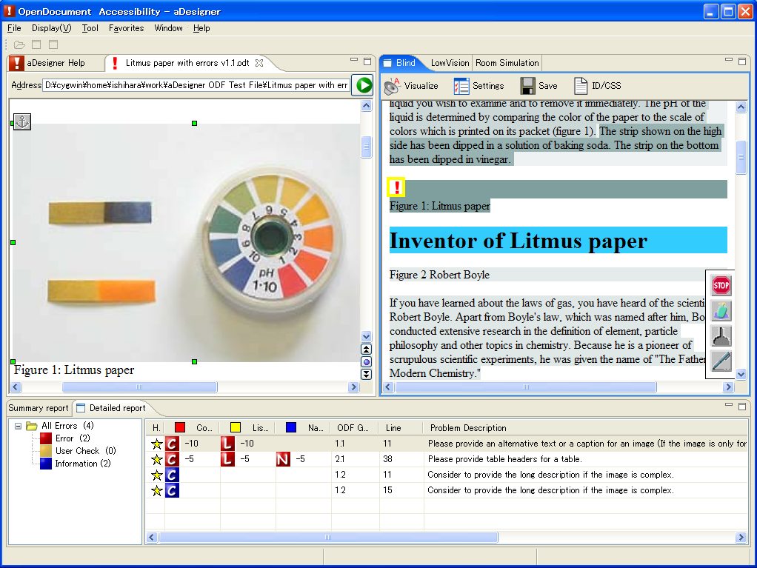
Blind Simulation mode in aDesigner ODF
Visualize the time required by a voice browser to read (the darker area requires longer time)
Heading tag
Synchronize in ODF editor and simulation view by selecting error

Slide 29
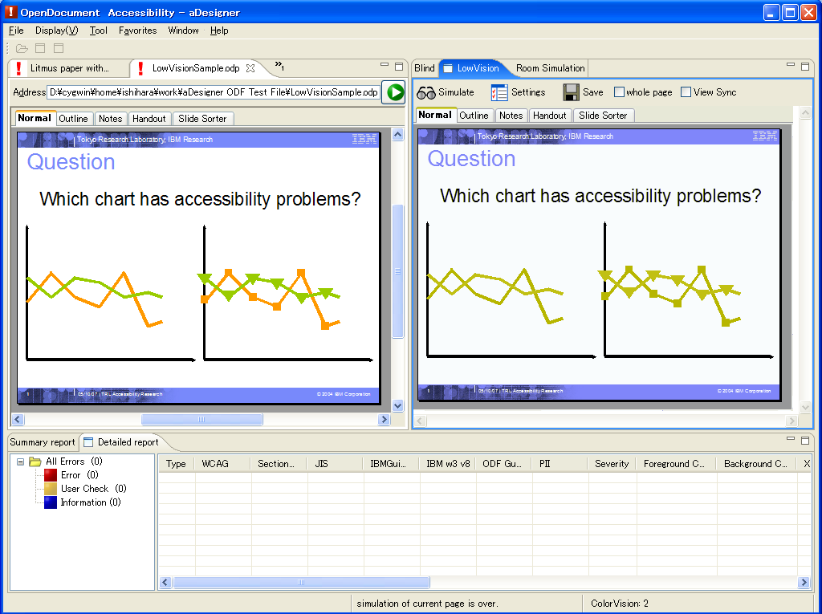
Low Vision Simulation mode in aDesigner ODF
Setting panel
Eyesight
Simulation result
Color vision
deficiency
Crystalline lens
transparency
Quick simulation

Slide 30
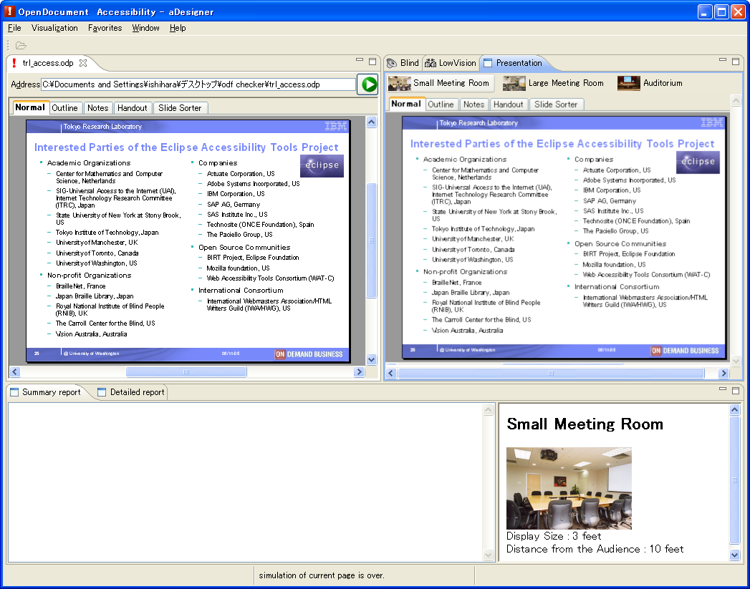
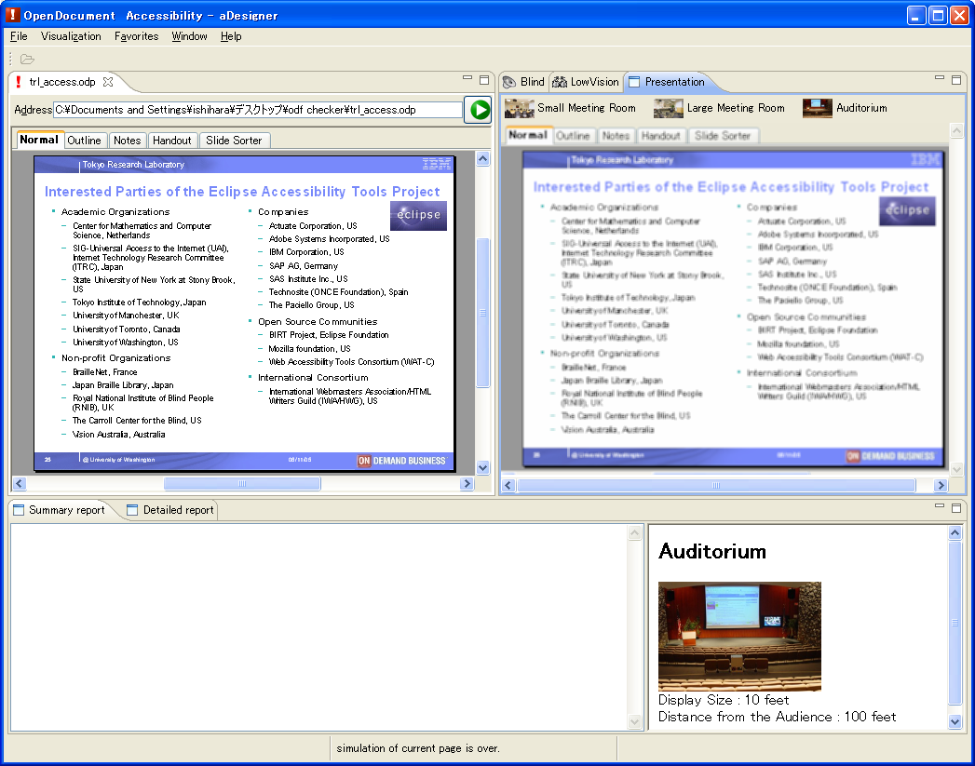
Room Simulation mode in aDesigner ODF
Run simulation for different rooms
Simulation result
Simulation setting

Slide 31
How to Improve Accessibility of Presentations

Slide 32
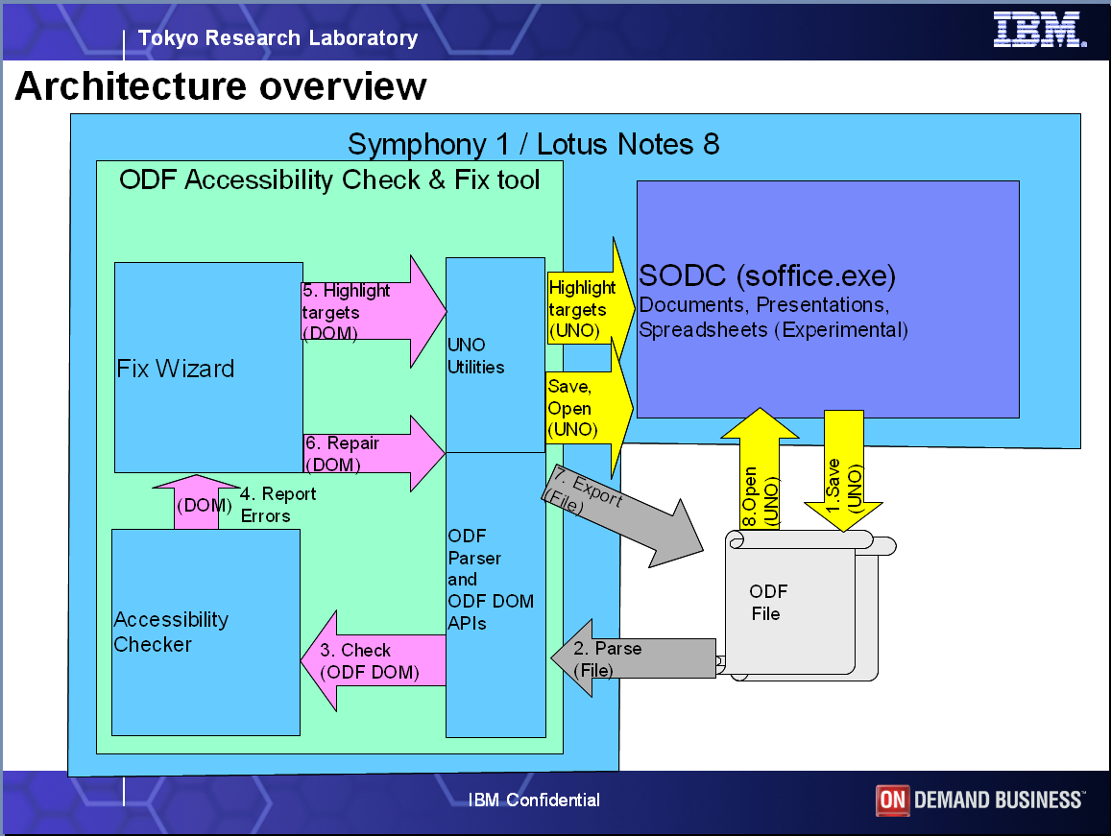
Difficulties in improving accessibility of presentations
How to improve the accessibility of graphical presentations?
  Add alt?
  Reordering?

Slide 33
To realize the accessible Presentations
Long term challenge: Establish accessibility criteria for presentations
  Research and development accessibility enablement technologies for presentations
  Making consensus among industry through activities of ODF Accessibility Sub committee
Short term solution: Enhance check-and-fix wizard
  Adding alternative text for semantically grouped objects and adding descriptions to presentation page are possible solutions to make presentations accessible.
  Provide wizard to group graphical objects
    Implement automatic grouping algorithms to provide grouping candidate
    Integrate with existing alternative text adding wizard
  Provide option to add accessibility descriptions to the page
  Integrate with HTML export function
    Omit graphical objects if the page has descriptions for accessibility

Slide 34


