Slide 1
The present and future
of Pootle
Wynand Winterbach | OOoCon 2008
Notes:
Messages that we want to impart:
We have listened to your comments
We responded with architectural and interface improvements.
We are working on a higher level now
We are working with Mozilla and we had a successful GsoC.
We are at the forefront
In the FOSS world, we are #1 in localization.

Slide 2
Background
I am a programmer at Translate.org.za
  Translate.org.za is an NGO
  Focusses on FOSS localization
Translate.org.za is responsible for:
  The Translate Toolkit
    Used for years by many OOo localizers
  Pootle
    The web app used by most OOo localizers
Notes:
Messages that we want to impart:
We have listened to your comments
We responded with architectural and interface improvements.
We are working on a higher level now
We are working with Mozilla and we had a successful GsoC.
We are at the forefront
In the FOSS world, we are #1 in localization.

Slide 3
Overview
What happened since our last talk at OOoCon?
Roadmap for Pootle
Improvements (including OOo improvements)
ODF document translation
Notes:
Messages that we want to impart:
We have listened to your comments
We responded with architectural and interface improvements.
We are working on a higher level now
We are working with Mozilla and we had a successful GsoC.
We are at the forefront
In the FOSS world, we are #1 in localization.

Slide 4
The last two years
Technical improvements
A lot is faster:
  Searching
  Reading PO files
  Statistics computation
  Uploading files
  Uploading & downloading ZIP files
Memory usage is down
Interface improvements
Notes:
Searching:
we support Lucene and Xapian
Reading PO files:
tweaks to existing code, working to integrate gettext's super fast code
Statistics computation:
stats are stored in database, making future stats queries on a file very fast
Uploading + ZIPS:
Much faster. We have already identified many bottlenecks. Will be even faster in the next version.

Slide 5
The last two years
Community
Working with Mozilla on the next generation of Pootle
  Mozilla will start using Pootle for its localization
OLPC is using Pootle for L10n
Pootle had a successful Google Summer of Code project
We are busy winning over some other big players

Slide 6
Roadmap
Replace Pootle's substructure
  Mozilla is helping to shift Pootle onto Django
  Faster, Handle more users
Prettier
  Mozilla's designers are doing great things
Improved authentication
  Mozilla's branch already has LDAP support
  OpenID
Remember false positives with quality checks

Slide 7
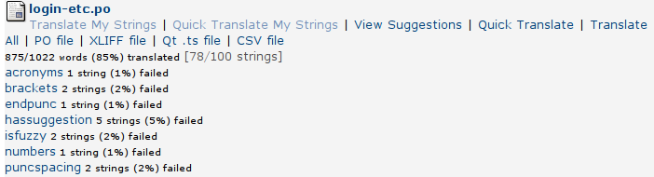
Quality Checks
Pootle runs a number of quality checks on translations:
  Check that punctuation in the target matches the source
  Check that variable names are not translated

Slide 8

Quality
Language aware quality checks
  Check that quotes (“”) become guillemets («»)
  Check that fullstops are correctly converted

Slide 9
Quality Checks
Pootle now has language aware quality checks
  Aware of language-specific punctuation
  Aware of special features of a language
    In Afrikaans, 'n is always lowercase
      'N man is wrong
      'n Man is correct
    Easy to add new checks
      Especially if you tell us about them
Fewer false positives

Slide 10
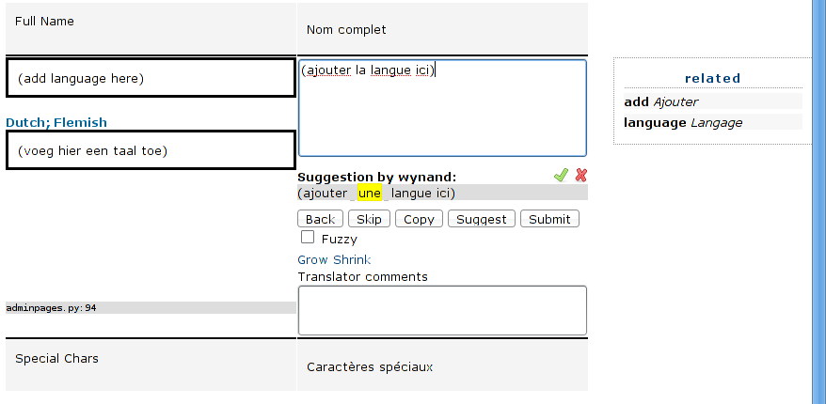
Translation help
Support for displaying alternative source

Slide 11
Translation help
Accept or reject suggestions easily

Slide 12
Translation help
Terminology brings consistency

Slide 13
Improvements for OOo
Quality checks specific to OOo
  Pootle is smarter about dealing with OOo variables
Better escaping for help files
Pootle deals much better with large projects

Slide 14
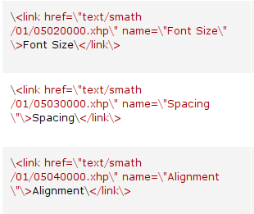
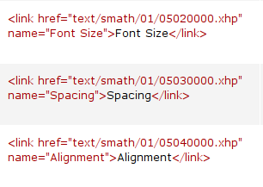
Improvements for OOo
Help file improvements
The old
The new

Slide 15
Workflow help
Supports many FOSS version control systems:
  CVS, Subversion, Darcs, git, Bazaar, Mercurial
Supports offline work
  Upload your files when you're done
Review incomplete work
  Pootle will display only untranslated & fuzzy strings

Slide 16
XLIFF
What is it?
  XML Localization Interchange File Format
  Very general (offers much more than PO)
  The future
How do we support it?
  oo2xliff & xliff2oo: convert SDF files to XLIFF
  Pootle has native support for XLIFF
  Translate.org.za is joining the XLIFF technical committee

Slide 17

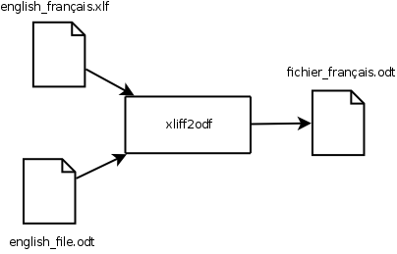
XLIFF
Our support
odf2xliff
xliff2odf

Slide 18
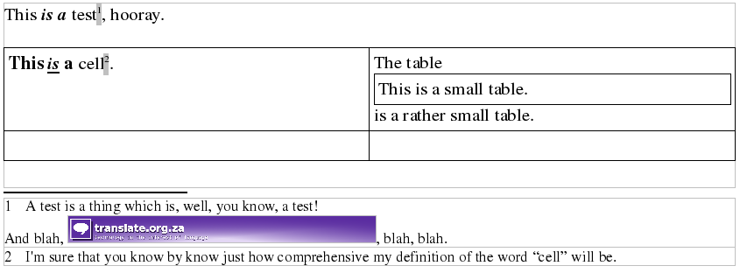
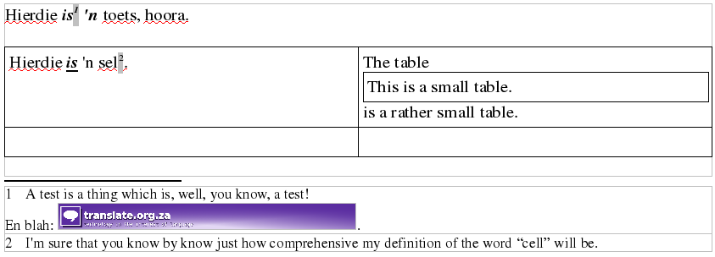
XLIFF
Our support

Slide 19
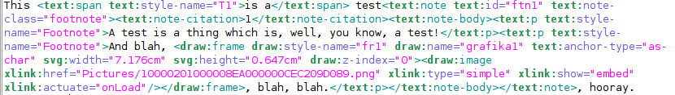
XLIFF
Our support

Slide 20
OOo template translation
The ODF-XLIFF project
  Extract translatable strings to XLIFF
  Generate translated ODF documents using translated XLIFF documents.
Easy maintenance of template translations
  Manage translations through Pootle
  Re-use previous translations
  Benefit from quality checks

