Slide 1
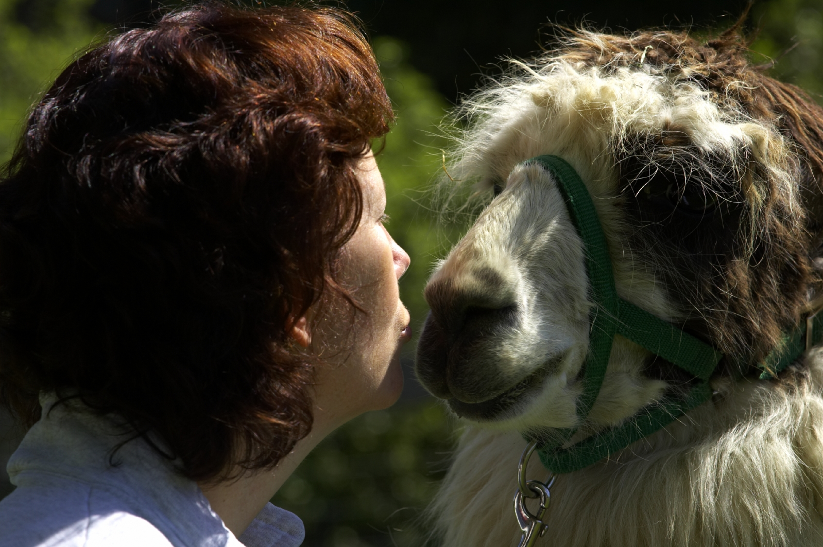

YOU DON'T LOVE ME YET
Stephan Bergmann
  Software Engineer
    Sun Microsystems, Inc.
19

Slide 2

YOU DON'T LOVE ME YET
―Roky Erickson
– The story so far:
— What has changed?
— Why did you do that?
— And now its broken!
– The road ahead
19

Slide 3
OpenOffice.org 3
...comes in three layers:
  Top layer is brand specific (plain OOo, BrOffice, StarOffice, ...).
    The user should only have to interact with this layer.
  Middle layer is generic OOo basis.
    The bulk of the files goes here.
  Bottom layer is UNO Runtime Environment (URE).
    Could serve other applications, too.
Multiple brand layers (OOo 3, SO 9) share a basis layer.
Multiple basis layers (3.0, 3.1) share a URE layer.

Slide 4
Layers? What Layers?
For the average user, nothing changes:
  OOo still comes as a single installation set.
  All the executables are still found in
  C:\Program Files\OpenOffice.org 3\program.
  It still sometimes behaves silly and crashes.

Slide 5
Oh, Layers!
Only when you dig deeper than the graphical frontend will you notice the changes.
  “Where is that libvclli.so I want to replace with a freshly built bugfix version?”
  “I can no longer debug soffice.bin from msdev!”
  “My Python application that starts OOo in the background no longer works. What a shame.” (“Yes, I know. I'm sorry.”)
  “I told it to install to C:\MyOOo. It actually installs to C:\MyOOo\OpenOffice.org 3. Keep it short, man!”
  ...

Slide 6
Why?
A simple, modular code base would have many benefits:
  If you want to use only part of it, you should also only need to build, test, ship, and install part of it.
  If you produce multiple products, you should build, test, ship, and install common parts just once:
    Different products like URE, OpenOffice.org, OpenOffice.org SDK, BrOffice, StarOffice, StarOffice SDK, StarSuite contain common parts.
    Some parts are independent of platform (unxlngi6, unxsols4, wntmsci10, etc.).
    Some parts are independent of locale (en-US, de, ja, etc.).
    Some parts do not change across versions.
(from OooCon ’07)

Slide 7
Because!
Concrete packages contain full paths, and some are shared across products: the shared parts can only have one path
  no way to have the basis in /opt/openoffice.org3.0 or /opt/staroffice9
But can't we keep everything together?
  multiple products would be thrown together in one directory tree
    products could not have files with identical names (e.g., soffice)
    the products' names could not be reflected in the single tree's pathname
(from FOSDEM ’08)

Slide 8
A Means to an End
It is important to remember that splitting OOo into three layers was a means to an end, not an end in itself.
  Platforms that have no requirement for the split do not need the split (Windows, Mac OS X).
  However, it is also considered important to keep OOo and its source code as uniform as possible across the various platforms.

Slide 9
The Good, the Bad, and the Ugly
On average Unix (Linux, Solaris: ELF, packages like RPM, DEB), the split works well.
  Ready to reap the benefits.
On Mac OS X with a single dmg installation file, there comes no benefit from splitting.
  Still internally has three layers (for consistency).
  Move to other packaging formats in the future?
On Windows, splitting apparently works against the platform.
  DLL hell, here we come!

Slide 10
Packages (Linux, Solaris)
Different products (OOo, BrOffice, StarOffice, ...) share packages with identical names and identical content.
  At the moment, packages are still built multiple times.
  At the moment, should-be identical packages sometimes still vary slightly.
I just discovered Novell publishes identically named packages with (I assume) slightly different content.
  Can cause problems if you install multiple products on one machine.
  How shall we handle this?

Slide 11
ELF Libraries (Linux, Solaris)
Symbolic links between layers (basis-link, ure-link).
RPATH $ORIGIN/../basis-link/program and $ORIGIN/../ure-link/lib in OOo ELF files will find libraries.
Extension UNO components are guaranteed to have available preloaded URE libraries without having to specify where to find them.

Slide 12
Mac OS X Libraries
Symbolic links between layers (basis-link, ure-link).
@loader_path/../basis-link/program and @loader_path/../ure-link/lib in Mach-O files will find libraries.
Extension UNO components are guaranteed to find URE libraries through @executable_path/urelibs symbolic link.

Slide 13
Windows Libraries
Fake symbolic links between layers (basis-link, ure-link text files).
Wrapper executables extending PATH ensure EXEs and DLLs (including extension UNO components) find libraries.
  Prior experiments with mis-using /DELAYLOAD hooks failed.
  Extending PATH fails when system directories happen to contain DLLs with same names (C:\Windows\libxml2.dll comes before URE layer libxml2.dll from PATH in Windows DLL search order).
    Mainly a problem with external DLLs (libxml2.dll, python23.dll).

Slide 14
Windows Assemblies
An assembly bundles one or more DLLs.
  It has a unique tag (name, version, publicKeyToken).
  A DLL/EXE has a manifest declaring that it depends on a specific assembly version.
Private assemblies are part of an application installation.
  They must reside in the same directory as the EXE.
Shared side-by-side assemblies are available globally.
  They must reside in C:\Windows\WinSxS.

Slide 15
Shared Side-by-Side Assemblies
Turn libxml2.dll into a side-by-side assembly:
  Add a libxml2.manifest stating “this is version 1.0.0.0 of libxml2.dll used by OpenOffice.org.”
  Specify /MANIFESTDEPENDENCY when linking against libxml2.dll.
  When installing OOo, install libxml2 assembly into C:\Windows\WinSxS, instead of installing libxml2.dll into C:\Program Files\OpenOffice.org 3\URE\bin\libxml2.dll.
    We already do that for the Microsoft.VC90.CRT assembly.
  During building (and for smoketest OOo installations done while building), ensure libxml2 assembly is present as private assembly in every directory where it is needed.

Slide 16
Really!?
Do that for all external DLLs (< 40).
Things become more and more baroque.
Are we working against the platform? (An executable and its DLLs typically are in the same directory on Windows.)
Or is this the way the external libraries should already have been packaged in the first place, by their respective maintainers?

Slide 17
Layer Free Windows?
For some time, we shared layers on Windows, too.
  Abandoned it as it had no real benefits.
  Now every product contains private copies of all three layers (similar to Mac OS X).
Lumping together the three layers would not be trivial, however.
  For example, unify $URE_LAYER/bin with $BASIS_LAYER/program without symbolic links!
Cross-platform consistency has its merits, too.

Slide 18
Was It Worth the Pain?
If nothing else, it forced the code to be more explicit about where it finds things.
  Similar to the infamous Java class path cleanup (which unearthed gems like Thread.getContextClassLoader).
  Still, I at least consider being explicit a Good Thing. (“You pedantic party-pooper!”)
After all, it was a necessary first step for the specific way to modularity we chose to walk on.

Slide 19
Explicit dlopen
dlopen(“foo”) with no slash in filename works in implementation-defined manner:
  Relative to calling code's location on Linux, Solaris.
  Relative to current working directory on Mac OS X.
rtl_loadModule(“foo”) calls (i.e., dlopen(“foo”) calls) in OOo source code failed for Mac port.
  Mac port added complicated patch to rtl_loadModule.
Calls failed on all platforms after layer split.
  rtl_loadModule now requires a full path.
  No complicated patch for Mac OS X needed any more.

Slide 20
Onwards
Get Windows DLL handling under control.
Reorganize the build process so that packages for multiple products are only built once.
  That is, finally bring in the harvest.
Reorganize the build process so that independent parts can be built independently.
  Can ease the experience of working on OOo code for newcomers and experts alike.
  Novell is also working on this.

Slide 21

I LOVE YOU SO MUCH IT HURTS
―Floyd Tillman
19

