Slide 1


Slide 2

ODF Perspectives
Panel discussion
OASIS ODF Adoption TC

Slide 3
About...

Slide 4
OASIS ODF Adoption TC
“Collaborating to increase the demand for and availability of products that conform to the OpenDocument Format”
http://www.oasis-open.org/committees/odf-adoption

Slide 5
ODF Interop and Conf.TC
“Supporting the creation of interoperable ODF applications”
http://www.oasis-open.org/committees/oic

Slide 6
Agenda

Slide 7
Agenda
17:45 – Intro (Don Harbison)
17:50 – Theoretical view (Rob Weir)
18:05 – Practical view (Bart Hanssens)
18:20 – Panel self-intro
18:30 – Break / thinking time
18:45 – Q&A (audience and panel)
19:15 – Closing remarks
19:30 – End of session

Slide 8
Panelists

Slide 9
Jeremy ALLISON
Linux Evangelist @ Google
SAMBA
http://tuxdeluxe.org/taxonomy/term/21

Slide 10
Bart HANSSENS
Interoperability expert @ Fedict, Belgium
Tests with ODF plug-ins for MS-Office
Chair OASIS ODF Interop. and Conf.TC
http://www.fedict.belgium.be

Slide 11
Don HARBISON
Program Director @ IBM
Open source and open standards
Linux strategy
Chair OASIS ODF Adoption TC
http://www.ibm.com

Slide 12
Jun MA
Beijing RedFlag2000
http://www.redoffice.com.cn

Slide 13
Florian REUTER
Novell
http://florianreuter.blogspot.com

Slide 14
Malte TIMMERMAN
Tech.Architect @ Software Engineering, Sun
StarOffice / Sun MS-Office plug-in:
  Accessibility
  Architecture
  Online Help
  Performance
  Security
http://blogs.sun.com/malte

Slide 15
Rob WEIR
ODF Architect, IBM
Co-Chair OASIS ODF TC
US delegate ISO/IEC JTC1/SC34
Member INCITS v1 & INCITS Executive Board
http://www.robweir.com/blog

Slide 16
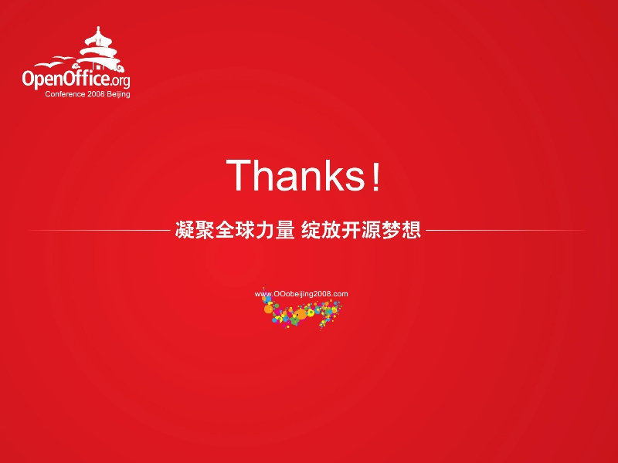

Slide 18
ODF Interoperability - Theory
Rob Weir
IBM

Slide 19
What is Interoperability?
“Interoperability means the ability of information and communication technology (ICT) systems and of the business processes they support to exchange data and to enable the sharing of information and knowledge.”
IDABC's “European Interoperability Framework”
http://ec.europa.eu/idabc/servlets/Doc?id=19529

Slide 20
Problem #1
Complexity of Application-to-Application interoperability

Slide 21
Many ODF Implementations
Sept Solutions
OpenOffice
Google Docs
RedOffice
Symphony
KOffice
MS Office
With N editors, there are N*(N-1) interoperability paths

Slide 22
App2App interop doesn't scale

Slide 23
And don't forget the non-editors
Before:
Paper
A single document
can easily be touched by a dozen different applications from different vendors during its lifetime.
The ultimate destination of your document is unknown to you and likely unknowable.
Search Engine
Web
Now:
Web Service
Database

Slide 24
Problem #2
Interoperability means different things
to different people.

Slide 25
Thinking in terms of control
User-to-User visual fidelity is high here
Control of the Author
JPEG
Modern WYSIWYG Editors are caught in the middle
PDF
ODF
HTML
interoperability with business
processes is high here
DITA
Control of the Receiver

Slide 26
Traditional Trade-offs
Visual Richness of authoring environment
Power
Ability to say anything
Pixel Perfection
High Fidelity
Accessibility
Universality
Ability of everyone to understand
Structure
Semantic richness
Not a Law of Nature, but a tendency. The glory goes to those who can solve both problems at once.

Slide 27
Two Big Challenges
Many ODF Implementations
Need for ODF to provide interoperability in two dimensions:
  Ad-hoc, traditional, visual fidelity
  Structured, data-oriented, business process

Slide 28
Things that cause problems
Application issues
  Implementation defects
  Functional subsets
  Functional supersets (extensions)
Standard issues
  Specification errors
  Undefined behaviours
  Implementation-defined behaviours

Slide 29
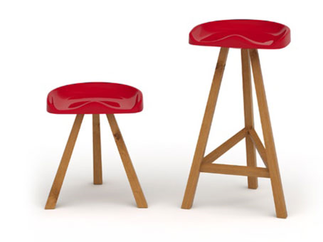
The Solution?

Slide 30
A powerful pattern
Standard
Test Suite
Reference Implementation

Slide 31
A powerful pattern
The standard contains the definition of a conformant document
  (but the standard may have errors or ambiguities)
The test suite exercises and validates each feature of the standard
  (but the test suite may have errors or omissions)
The reference implementation is written to the standard, and tested with the test suite
  (but the implementation may have errors or missing functionality)

Slide 32
Checks and Balances
A test case fails. What is the cause?
  An error in the application?
  Is it an error in the test suite?
  An error in the standard?
Identify the cause of the failure
Fix
Continue until you have a complete test suite and a reference implementation that passes all of the test cases.

Slide 33
This can move us from this...
Sept Solutions
OpenOffice
Google Docs
RedOffice
Symphony
KOffice
MS Office
With N editors, there are N*(N-1) interoperability paths

Slide 34
...to this
Sept Solutions
Google Docs
OpenOffice
Open Standard
Open Test Suite
Open Reference Implementation
Symphony
RedOffice
KOffice
MS Office
With N editors, there are N interoperability tests

Slide 37
ODF Interoperability in Belgium
Bart HANSSENS
Interop Expert @ Fedict (BE)

Slide 38
About...

Slide 39
Fedict in Belgium
Belgium:
- Brussels / EU
Fedict:
- Fed.Gover. ICT
- eGov projects

Slide 40
ODF Guideline
Editable text / spreadsheet / presentations
Mandatory between departments
Optional:
- within departments
- towards citizens / other governments

Slide 41
Goal: Interoperability
About:
- YOUR documents
- Working together
- Long term benefits
NOT just product hopping

Slide 42
Our motivation
Different governments:
- federal
- regional
- local
Departments:
- suite of choice

Slide 43
Challenges
Legacy formats <=> ODF
Different software:
- different versions
- different feature sets
Users: Just Make It Work !

Slide 44
Getting started

Slide 45
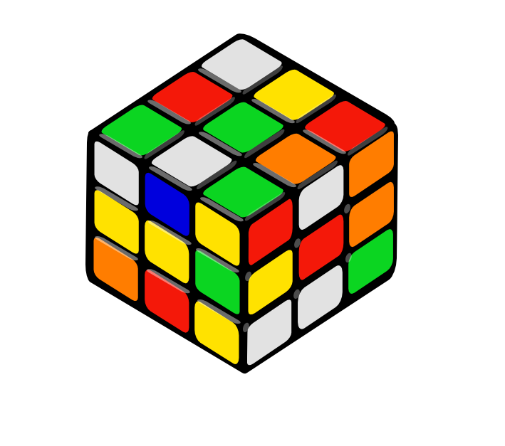
A few ODF solutions
OpenOffice.org
MS-Office + plug-in:
- Sun
- MS / Clever Age
(MS-Office 2007sp2)

Slide 46
Plug-ins
Sun :
- http://www.sun.com/software/star/odf_plugin
- Based upon OpenOffice.org
Microsoft, Novell, Clever Age, … :
- http://odf-converter.sourceforge.net
- Based upon .NET & XSLT

Slide 47
Why focus on MSO-ODF ?
Reality check:
- most users are using MS-Office
- even with plug-in (some) conversion is done
Remember: choice !

Slide 48
The plan
1 – test real documents
2 – file bug reports
3 – ...
4 – profit !

Slide 49
Results

Slide 50
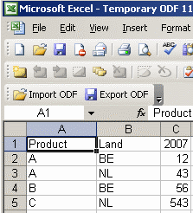
Plug-ins
Benefits:
- no additional suite
To be improved:
- performance
- interop issues

Slide 51
The Good
Interoperability is increasing:
- feature set (ODF templates, ...)
- usability (open with double-click)
- lots of bug fixing
Reading OK for most documents

Slide 52
The Bad
Round-tripping needs to improve
Tables-in-tables
Forms:
- data types => string
- some controls are gone

Slide 53
The Ugly
Formula exchange
Needs work:
- Complex pivot tables
- Complex charts
- Gradients

Slide 54
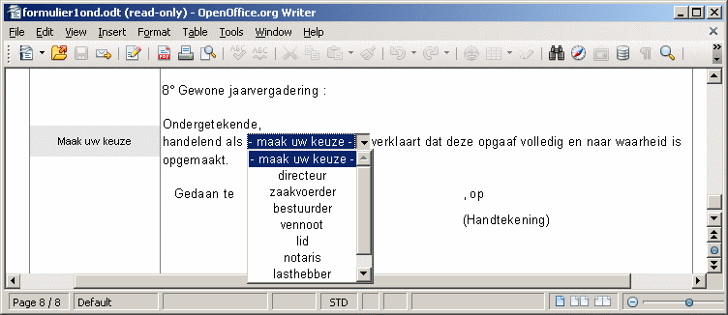
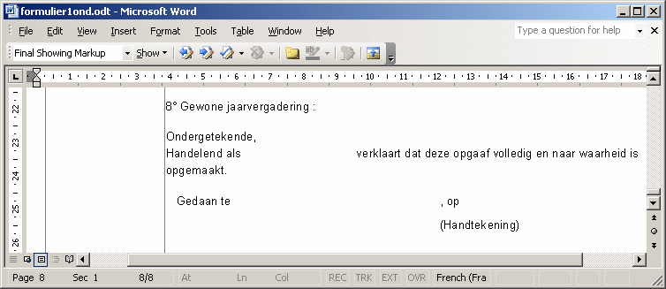
OOo 3
Sun ODF
plug-in

Slide 55
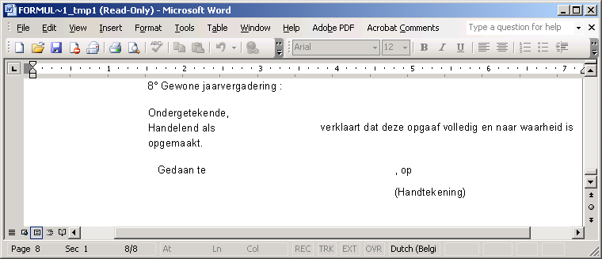
OOo 3
MS
converter

Slide 56
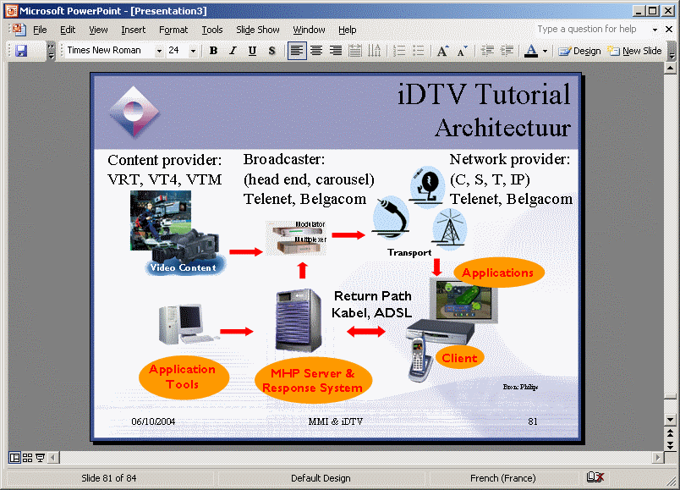
Sun and MS plug-ins

Slide 57
Formula exchange
Custom namespace
Example:
oooc:=NOW()-DATE(1977;5;1)

Slide 58
What's next ?

Slide 59
Open questions
Scripting / macros ?
Database files ?
(do we want this ?)

Slide 60
Waiting for ODF 1.2
We want:
- digital signatures
- OpenFormula
We wait for:
- standardization
- multiple implementations

Slide 61
Conclusion ?

Slide 62
Conclusion
It's about choice and YOUR documents
Implementations are getting better
Test with “real” documents

