Slide 1

OOo Website Updates
Matthias Müller-Prove
Sun Microsystems
Nov-26, 2007

Slide 2
www.openoffice.org
September 2007
Notes:
by MMP, based on whiteboard at kickoff, 26-Jul-2007
with ideas from Per Eriksson

Slide 3
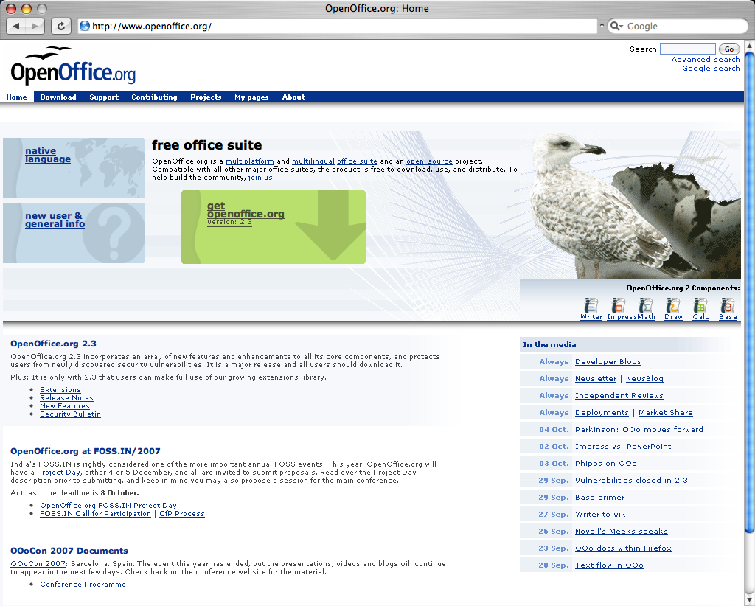
Notes:
Per Erikson18-Aug-2007:
If you analyze the first page as it is today, by looking at the place that the different content on the first page take, it would mean that the following is important to us:
Latest news (~ 20%)
In the media (~ 20%)
An egg and a seagull (~ 20%) :-)
White space (~ 15%)
Support (< 1%)
Contributing (< 1%)
Projects (< 1%)
About (< 1%)
I think that support is widely requested by the user. So why does it cover about less than 1% of the area?
Same thing with contribution. I think it's important, but according to the current first page, the white space is far more important than information on contributing.
The user needs alternatives, and a good first page can work as an important portal for contributors as well, powering the contributor with the tools needed for the every day tasks.

Slide 4
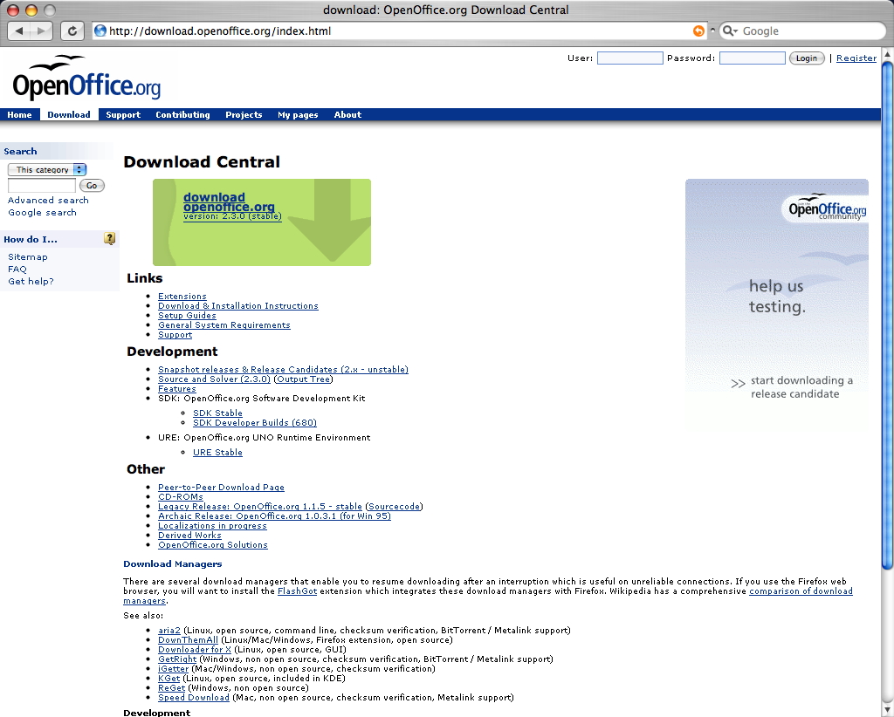

Slide 5
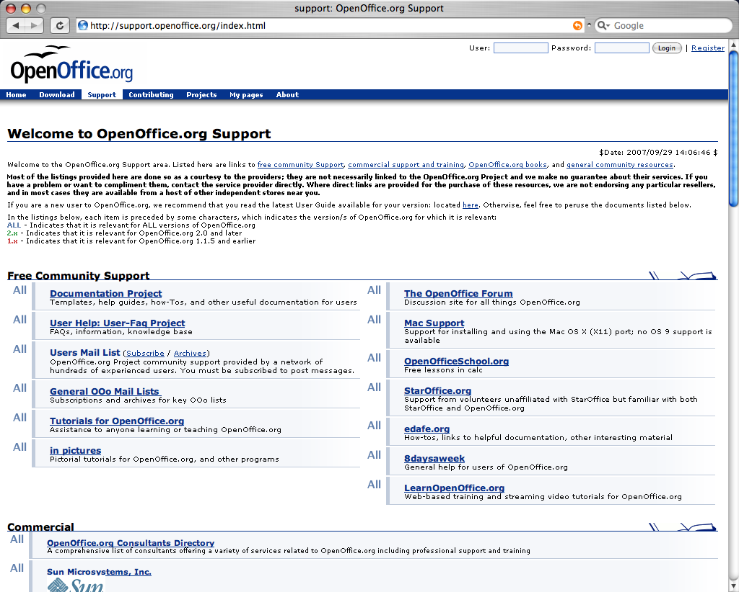

Slide 6
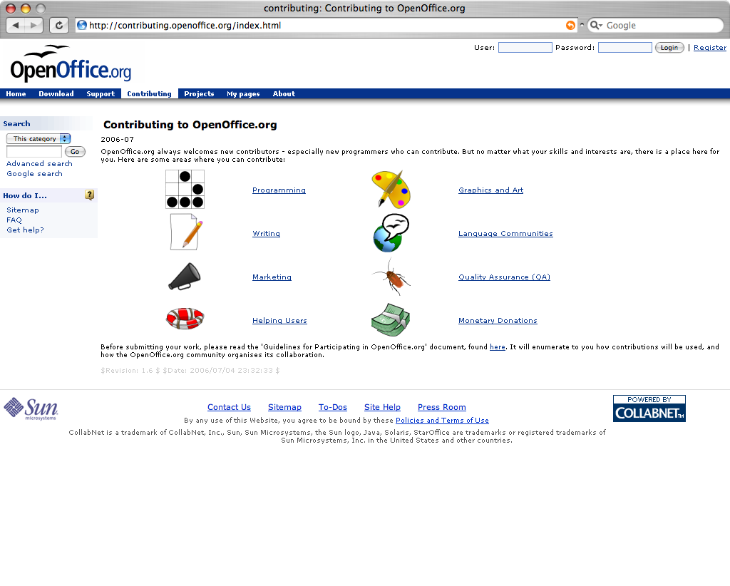

Slide 7
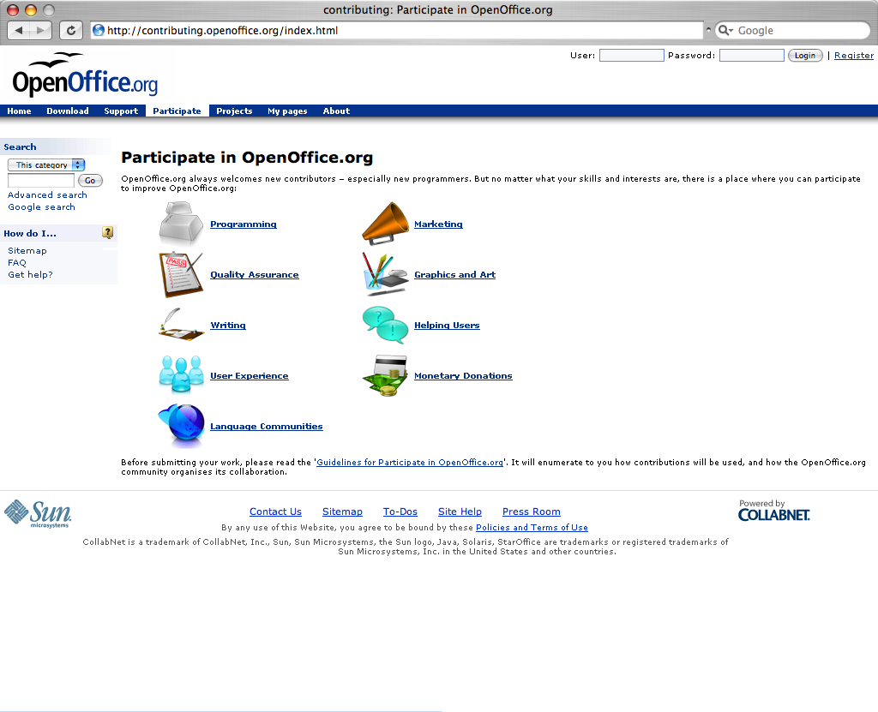

Slide 8
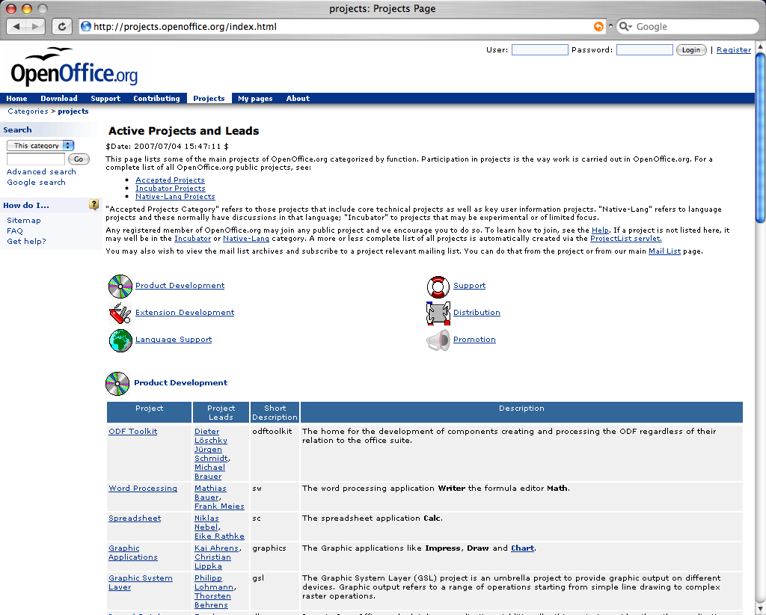

Slide 9
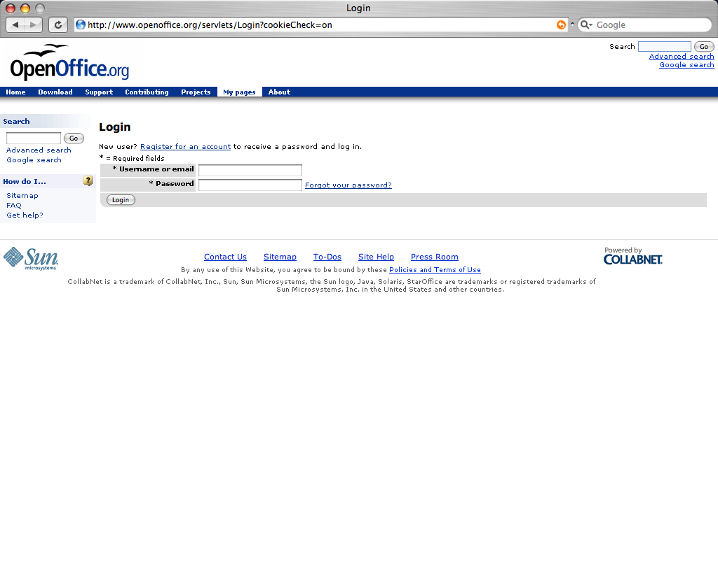

Slide 10
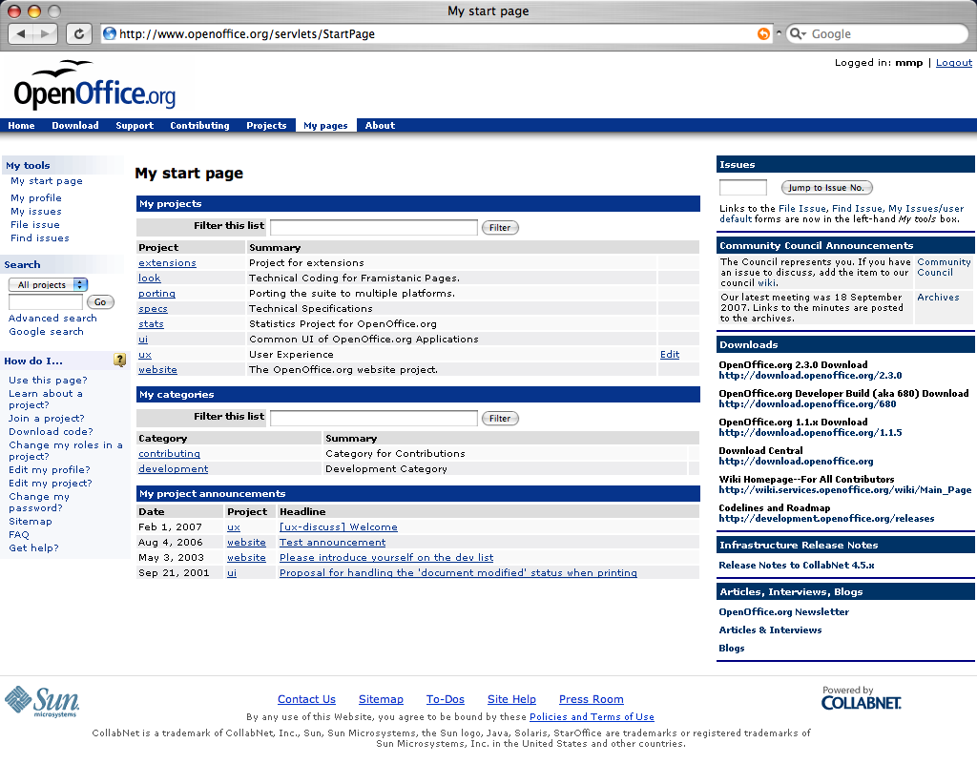

Slide 11
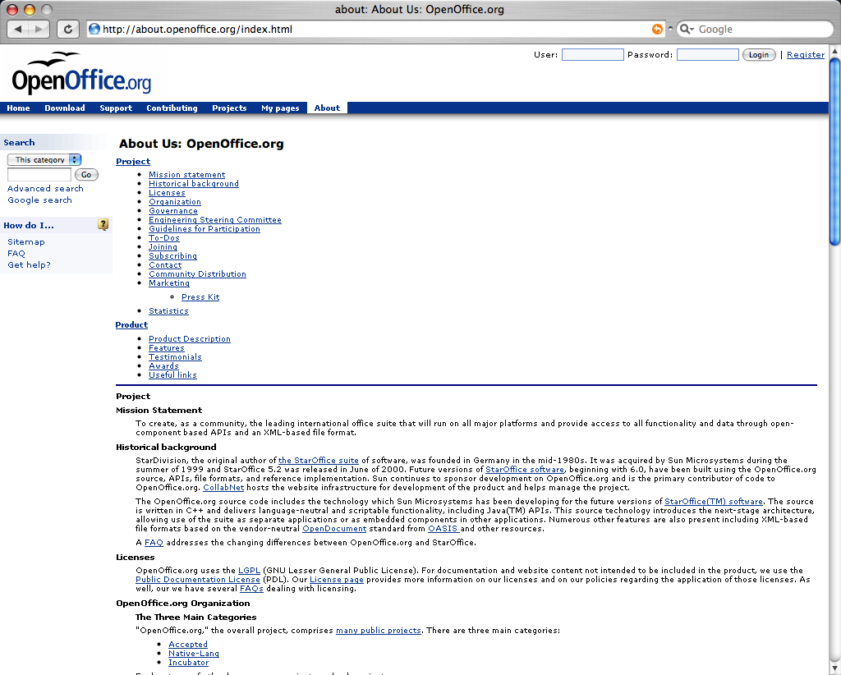

Slide 12
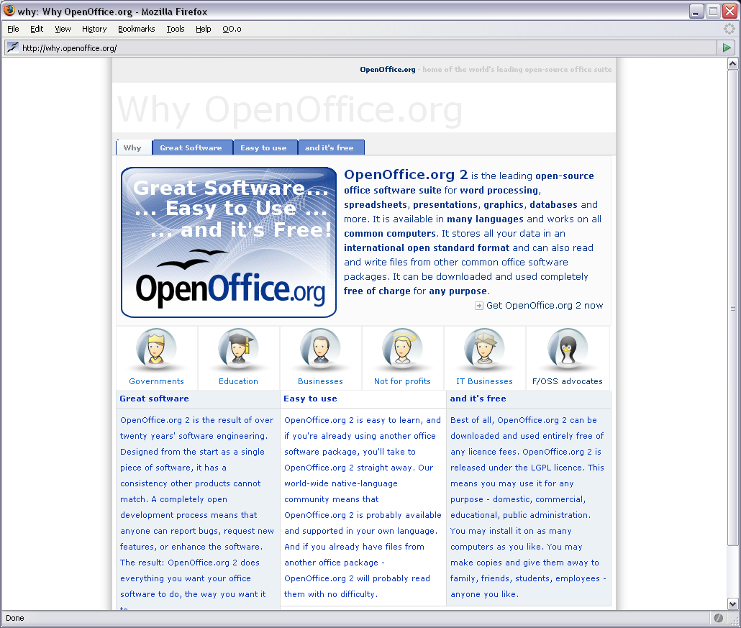

Slide 13
Download Experience OOo

Slide 14
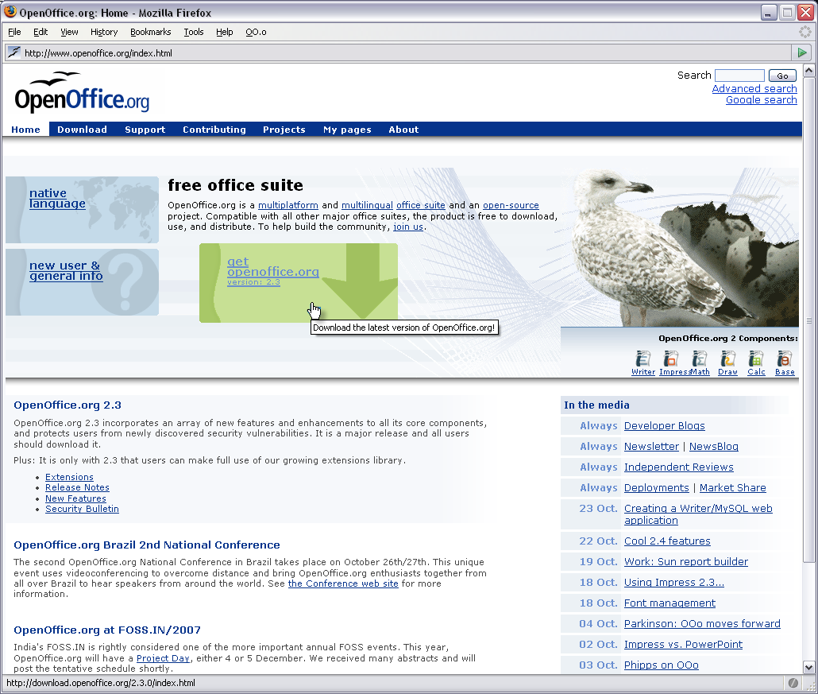

Slide 15
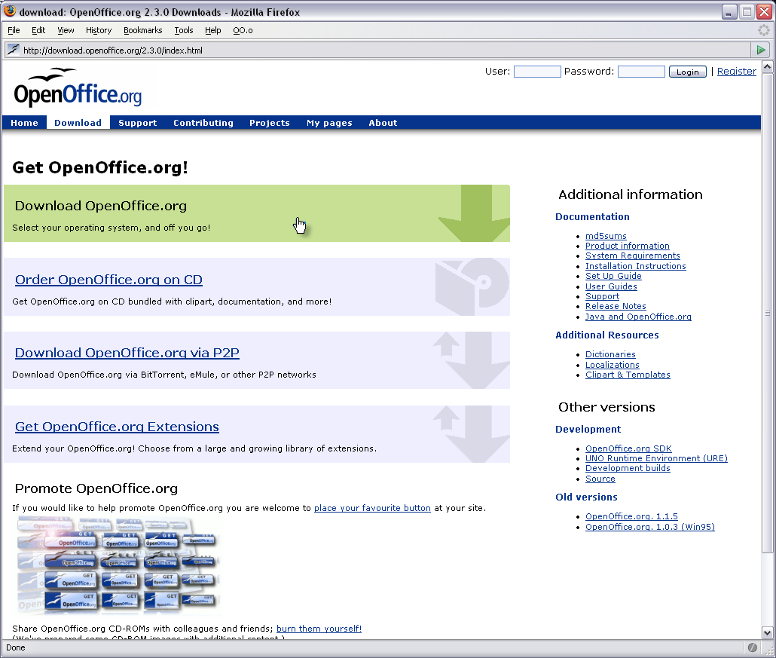
Notes:
Mario Tirnanic 25-Oct-2007: Whilst "Download Openoffice.org" is clearly indicated in the green rectangle at the top, the other options are both underlined, and in blue. As such, the latter are obviously links. The former, lacking an underline, is not an obvious link.
I would strongly suggest replacing the current green block with one that has "openoffice.org" underlined.

Slide 16
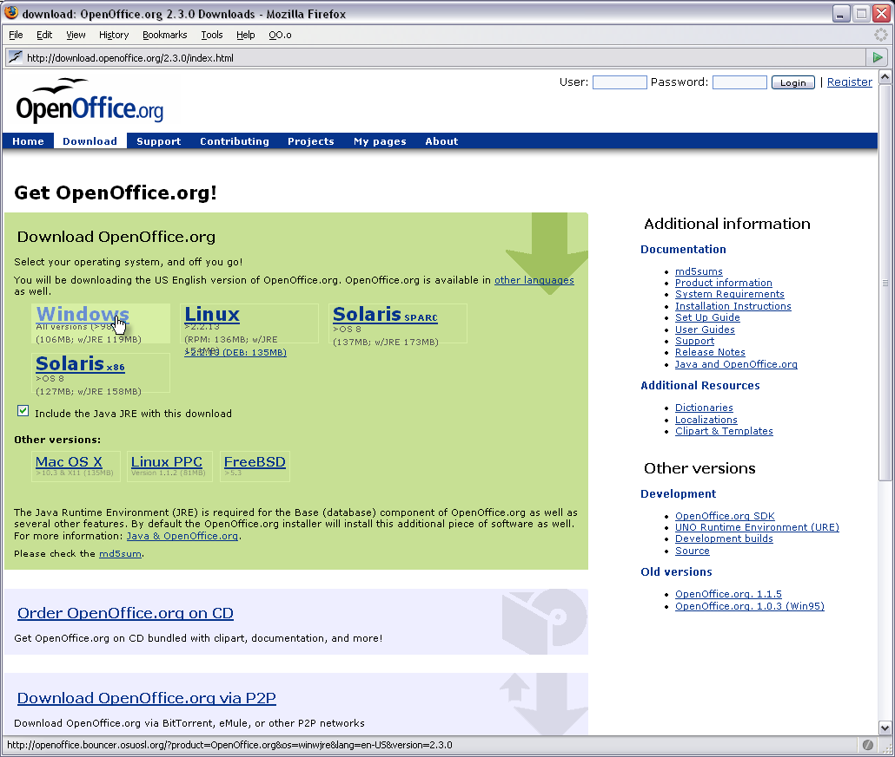

Slide 17
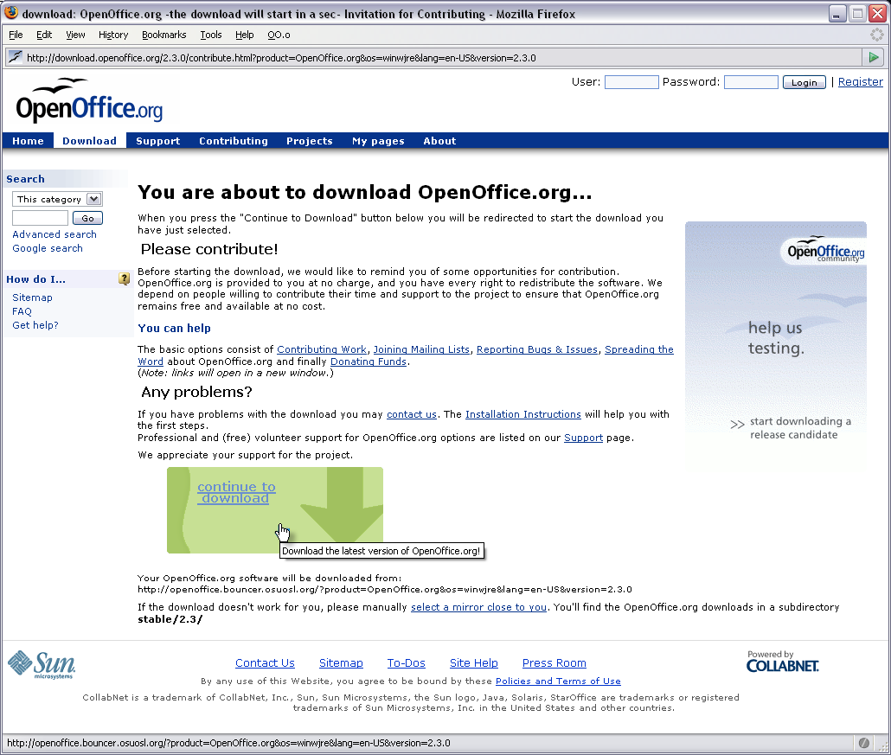

Slide 18
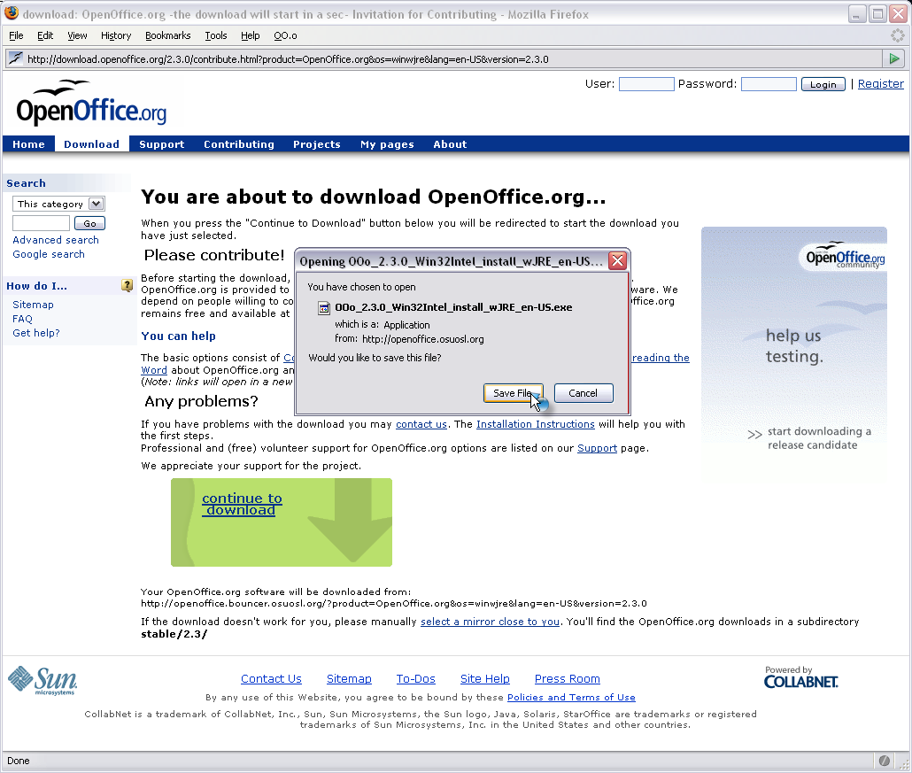

Slide 19
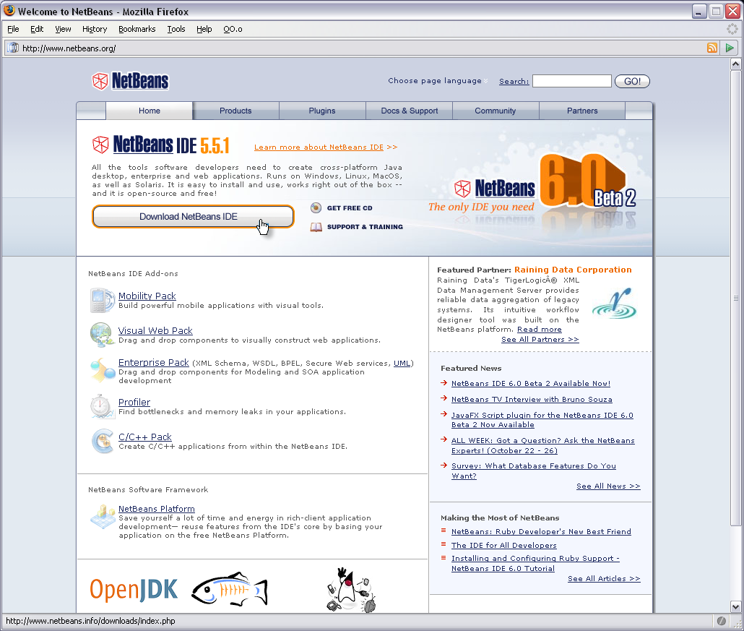

Slide 20
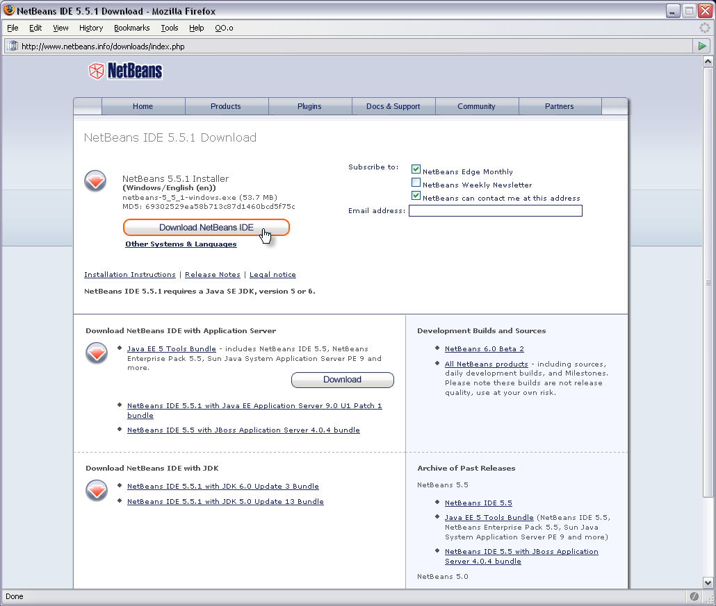

Slide 21
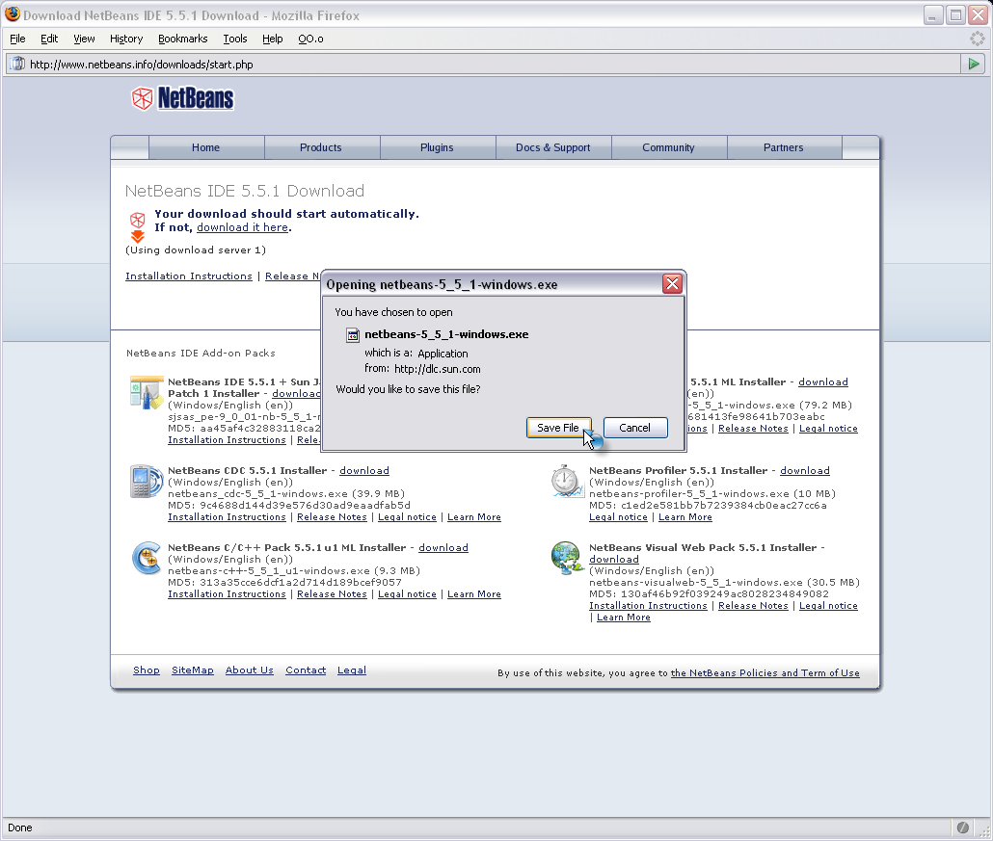

Slide 22
OOo Website Updates
Matthias Müller-Prove
  mprove@sun.com

