Slide 1
  Visual Identity of OpenOffice.org
  Now and in Future
  Discussions and design concepts
  at the OpenOffice.org Art Project
  h
  presented by
  Bernhard Dippold
  (bedipp@openoffice.org)
Notes:
- My name is Bernhard Dippold, as you can read (if not, I'll have some problems with my presentation, as it is mainly visually based).
- You may call me Bernard (ou Bernard, s'il vous plait), but it would be great, if you didn't forget the “h” when you write my name in mails etc.
- So that's my first “take-home message”:(click)
I'm Bernhard with the flashing “h”
- Visual Identity is becoming more and more important while OOo is recognized by a broader audience.
- I'd like to tell you what the OOo Art Project is actually doing in preparation of OOo3, a work previously done by individuals or Sun employees.
- And that's my second “take-home message”:
Art Project is significant!

Slide 2

Agenda
What does Visual Identity mean?
Does OOo have a Visual Identity?
What are the branding bugs of OOo?
  main branding bug: our Logo
  consistent bug: the gulls
  version specific bugs: horizon, waves, wiregulls
What is to be done for OOo3?
  logo update – must or must not?
  early decision on branding bugs
  new icons?
Artwork coordination between projects
Notes:
What I want to tell you:
- a short abstract about Visual Identity in general
- questioning our OOo Visual Identity:
- is it comparable to commercial companies?
- who are the people we want to attract?
- look back in the past to the graphical elements defining the Visual Identity (called “branding bug” - I don't know why they got that name)
- I want to show the work actually done at the Art Project WRT OpenOffice.org 3
- and finally I'll have a more general look at the Art Project, it's positioning in the community and possible optimizations.

Slide 3
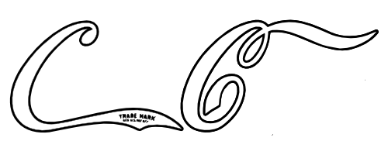






What is Visual Identity?
Do you recognize this?
That?
Or that?
Why?
  Because you know the entire logo!
Notes:
I'll give you a few seconds to find out, which company is meant by the graphics I'll show you.
Ready?
(3 examples) (click)
Why was it that easy for you to recognize the companies?
(click)
Because you did know them before!

Slide 4
What is Visual Identity?
You recognize the composition of
  a special font
  a reproducible shape
  an impressive color
None is really special as single item, but the composition is unique.
If the company didn't advertise their logos by repeated presentation, you wouldn't have recognized them.
For a successful advertising, a unique design is crucial.
Artwork is significant!
Notes:
Each of these logos consist of standard characters, but they use fonts different from the ones we are used to nowadays.
But did you know that Coca Cola's typewriting was a generally used bookkeeper font at the end of the 18th century?
In addition to the font there has to be a certain shape and coloring creating together a unique symbolism.
Only by repeated presentation the logo will be imprinted so good, that you recognize it when you are shown only some parts.
Repeating a bad design doesn't work either (if it is not a really bad design), so the quality of the design is crucial as well – it must be unique and of course it should provide positive feelings.
That means (click) Artwork is significant!

Slide 5


Do we have a Visual Identity?
NO – for the broader public: Most of them don't even know our program and community.
PERHAPS – for people already interested in computers and IT.
YES – for most people reading computer magazines, Linux users and everybody knowing what “OpenSource” means.
What should be done to
improve this situation?
(Art Project's Point of View)
Notes:
What about the Visual Identity of OpenOffice.org?
- even if our program and community is going to become more attention in general, the broader public has never heard of OpenOffice.org
So they don't associate anything with our logo.
- People with general interest in computers and information technology may know that there is an alternative to MS Office. They'll probably remember the logo when they've seen it once or twice.
- Heavy computer users (even if they are not involved in OOo) know a bit more about OOo. Even if they probably don't know exactly what is means (the leader of the computing department at my hospital confuses OpenSource with OOo), they'll recognize the logo and perhaps additional bugs too.
So let's find out, what is our goal looking at these three different target groups.

Slide 6
What should be done?
Do we have a Visual Identity?
NO – for the broader public: Most of them don't even know our program and community.
General marketing efforts – based on
  wording: “OpenOffice.org” contains all we need.
  collateral artwork: prove professionalism.
PERHAPS – for people already interested in computers and IT.
PERHAPS – for people already interested in computers and IT.
YES – for most people reading computer magazines, Linux users and everybody knowing what “OpenSource” means.
intensify knowledge, use their curiosity by
  recognition of the logo in unexpected situations.
  introduction of additional bugs for the next time.
YES – for most people reading computer magazines, Linux users and everybody knowing what “OpenSource” means.
YES – for most people reading computer magazines, Linux users and everybody knowing what “OpenSource” means.
keep informed, invite to join the community
  become familiar to our bugs – explain OOo to others
Notes:
The first group is the main target for general markting efforts:
- “OpenOffice.org” works, if it is explained
- as “open” in the sense of free and open minded
- as “Office” comparable to MS Office and others
- as “.org” associated with Internet, downloadable, perhaps non-commercial
These explanations work without a specially designed logo – but we want the people to recognize OOo later on. Therefore it's not only necessary to design eye-catching posters and banners, they should be consistent with our style.
The second group needs information about OOo, and if we can attract their curiosity we're about to win. If they recognize our logo in an uncommon surrounding, they'll remember it. And if they see it the first time and understand the wording, they'll remember it too.
We can introduce additional bugs they recognize the next time (hopefully)
People already knowing OOo will recognize the logo and perhaps one or another of the bugs. If we're able to keep their interest by additional informations when they see logo or bugs, it's great. And if they start to explain them to other people they are already part of the community.

Slide 7

By what is OOo recognized?
Our main branding bug:
Notes:
Ooops – what's that?

Slide 8
What should be done?
Do we have a Visual Identity?
NO – for the broader public: Most of them don't even know our program and community.
General marketing efforts – based on
  wording: “OpenOffice.org” contains all we need.
  collateral artwork: prove professionalism.
PERHAPS – for people already interested in computers and IT.
intensify knowledge, use their curiosity by
  recognition of the logo in unexpected situations.
  introduction of additional bugs for the next time.
YES – for most people reading computer magazines, Linux users and everybody knowing what “OpenSource” means.
keep informed, invite to join the community
  become familiar to our bugs – explain OOo to others
Notes:
Of course this is the most important slide in my presentation – at least from marketing POV
But you do know the three target groups and want to go on with the branding bugs for OOo – don't you?

Slide 9
By what is OOo recognized?
Our main branding bug:
Notes:
damn – my laptop seems not to be satisfied with what I said up to now:

Slide 10
What should be done?
Do we have a Visual Identity?
NO – for the broader public: Most of them don't even know our program and community.
General marketing efforts – based on
  wording: “OpenOffice.org” contains all we need.
  collateral artwork: prove professionalism.
PERHAPS – for people already interested in computers and IT.
Our Artwork is significant!
intensify knowledge, use their curiosity by
  recognition of the logo in unexpected situations.
  introduction of additional bugs for the next time.
YES – for most people reading computer magazines, Linux users and everybody knowing what “OpenSource” means.
keep informed, invite to join the community
  become familiar to our bugs – explain OOo to others
Notes:
Then I'll repeat what you should already have learned:
Our Artwork is significant!

Slide 11



By what is OOo recognized?
Our main branding bug:
Additional bugs:
  consistent throughout the versions:
RGB
6, 52, 140
  gulls our color: OOo-blue
  version specific bugs
Notes:
finally it goes off all right...
That's what you all know – without or with version designation (by the way, we'll have to create a new logo with only OpenOffice.org 2 because the next release will be Ooo2.1).
But do you all know – and use the official positioner wherever you may do it?
For people not knowing all the meanings of that positioner (if you are like me not a native English speaker) I'll cite it's author, Steven Shelton(posted to dev@marketing on 08-12-05):
1. Open – repetition from the logo and meaningful in many ways: open source, open standard, open developing process, open ended usage... And with the punctuation the reader is kept in ambiguity – which meaning is the right one? Answer: All of them.
2.For business
- designed for mainstream business users, professional, reliable, easy to use, familiar
- open source for business reasons (easy to be customized for special needs)
- its supporters gain money with derived products, add-ons, support and so on
3. it's the phrase you read at the windows, when a new business is opening, OOo is ready for business users, mature and stable
Additional graphical elements used through all versions are the gulls and the special blue tone. I didn't provide examples, but you find them quite often (if you look for them).
Version specific bugs derive mainly from the splash screens:

Slide 12





Version specific branding bugs
derived from the splash screen:
OpenOffice.org 1.0
  blue horizon
Notes:
Ooo1.0 had the blue horizon - at first just lines in different blue tones,
later on with a more wavy aspect when Lee Corbin replaced the logo because it used the wrong font and didn't mention the version.
Artwork kept the primary horizon lines, as they are easily recognized.
Our own favicon kept this lines for quite a long time – it's just half a year ago that we changed it...

Slide 13


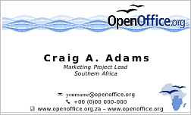


Version specific branding bugs
OpenOffice.org 1.1
  blue waves
Notes:
Ooo1.1 showed waves (I don't know the expression the artists used for it)
They have been broadly used– as well the sinus waves as the water like waves.
Here on business cards and wallpapers, but I remember webpages still using it...

Slide 14

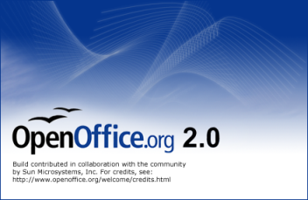




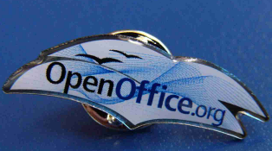
Version specific branding bugs
OpenOffice.org 2.0
  blue-to-white gradient
  “wire gulls”
Notes:
OOo 2.0 shows the wire gulls on a blue-to-white gradient.
Even if the wire gulls are problematical in small items (the line width is too small to be reproduced in the right way), they are widely used and easily recognized

Slide 15
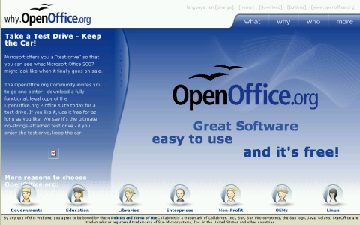

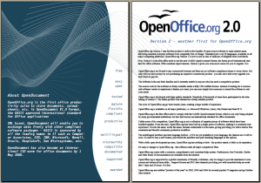
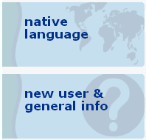

Version specific branding bugs
OpenOffice.org 2.0
  mirrored “S-curve” from icons:
Notes:
Another graphical element used in OOo2 is the mirrored S-curve from the icons.
You may find it now on book covers, websites, and other stuff, but Maarten Brouwers was the first as he used it for the buttons on our main homepage.

Slide 16


What is to be done for OOo3?
Logo update – must or must not?
  present logo: Frutiger condensed
  30 years old commercial high quality font
  - possible problems with additional artwork (positioner), documentation etc.
  alternative: Bitstream Vera Sans condensed to 78%
  - poorer kerning, plump characters, square dots
  Issue 69157: We create our own typeface (based on Bitstream Vera Sans)
  more artistic designed logo?
  shiny, modern versions have been
  discussed at the Art Project
Frutiger Vera Sans
Notes:
We had vivid discussions about the necessity of a new logo font during the last years.
Frutiger, the present font, is commercial and therefore you can't give it away with the logo to people interested in supporting us with additional artwork.
BitStream Vera Sans is an open liciensed font, but it's Kerning could be optimized (sometime the space between the characters is too wide) , the vertical lines are broader and the dots are not rounded.
For the moment we'll keep Frutiger and replace it ASAP with a Bitstream Vera based new font including these optimizations.
There have been discussions on implementing more “modern”, shiny versions of the logo. If this is interesting for you (and if I have the time to), I'll come back to the point later on.
A more shiny version of the logo modifies the colors to a lighter tone in some parts of the logo, we're not quite sure if we want it to become official logo – in that case together with the “normal” one for “standard usage”, normal paper, Black/White printer etc.

Slide 17




What is to be done for OOo3?
updated / new branding bugs?
  gulls with cloddish wings – update with the logo
  define new branding bugs before the splash screen is designed
    consistency in visual impression
    usability in different sizes (for marketing, website, documentation)
    design of marketing material etc. in time
Notes:
What is to be done in preparation of OOo3?
Consistent bugs should only be modified in a way recognized by the visitor, if there exist a really good reason to do so. Minor modifications and optimizations are possible – that's what I want to present here: If you use the gulls as graphical elements in larger scale, the right wings of them look cloddish (click). With minor modifications they become more symmetrical (click) without a change in the visual impression (click / click).
Did you see the difference when I showed you this slide? And now(click)?
Implementation of new branding bugs allows us to be much more creative. They should nevertheless be consistent to the general impression of OOo in the past and be scalable even to small sizes – the wiregulls have been quite a negative example.
These branding bugs have to be designed before the splash screen is created, so the artists have an advice what should be part of the splash screen and (even more important) other marketing materials can be finished before the release (except the CD-Art this didn't work at all for OOo2..)

Slide 18




What is to be done for OOo3?
version specific bugs for OOo3: Proposals
How could this become a splash screen?
Notes:
Just a few thoughts for such bugs:
A movement coming from the mirrored S-curve and ending with the gulls wings can be done with just a couple of lines.
A similar movement is possible with the gulls too (click)
Both parts can be combined (click)
And added to the logo (click)
If you wonder how a splash screen could be created using these bugs, her is a possible combination: (click)

Slide 19

What is to be done for OOo3?
...just one possible combination:
Notes:
It's still work in progress, I know that some people like the rainbow part (in component colors), others don't.
There are different impressions on the ripped-open paper, too, so there will be a vivid discussion ...
First reaction have been mainly positive, but all comments are welcome – best place would be art@marketing.openoffice.org.

Slide 20

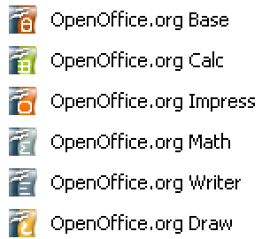


What is to be done for OOo3?
design new icons?
  colors are not very distinctive
    Writer and Math:
    Impress and Base:
  recognition in
  small scale
  (16x16 px)
  tendencies to replace the original icon set
    Aqua style on Mac
    Crystal style on KDE
    Tango style (KDE / GNOME ...)
Notes:
Do we need new icons?
I think: YES:the actual icons are not very distinctive,. Writer and Math use nearly the same color, Impress and Draw are quite similar, too.
In small sizes especially the component icons differ in the color only – the symbols are nearly unreadable.
Another point is, that on several platforms special icon themes are used and that Mac or KDE users like their aqua or crystal style. As they don't think our present icons fit to these styles they created their own icon sets – in most parts quite different from ours.

Slide 21
What is to be done for OOo3?
Our goal: Design a set of icons that
  allows adaption to the different styles by minor modifications (different shading etc)
  can easily be recognized as OpenOffice.org
    distinct from any other application
    similar to the previous icon set
    includes OOo branding bug(s)
  contains icons being distinguishable from each other
    catchy and self-explanatory symbols
    distinct colors
    ... especially in small scales
Notes:
For Visual Identity reasons we'd like them to use our icons, but therefore our icons should be adaptable to their styles with only minor modifications (we could provide).
The icons should be different from any other application, recognizable as OOo by the same or similar symbols to the previous version and by containing one or more of our branding bugs.
As important as the common OOo impression is the necessity to differentiate between the components:
- The usage of self-explanatory symbols and colors quite different from each other.
And we must remember the problem with small icon sizes...

Slide 22



What is to be done for OOo3?
icons - work in progress:
  general shape
    component icons: globe
    or dome
    document icons: component icon with wavy paper
Notes:
Th reach this goal there is still some work to do, but I'd like to show you, what we have already done:
Component icons as globes or as domes,
document icons as combination of the component icons with a wavy sheet of paper.
Main aim will be to have the component symbols as large as possible, so they will stay recognizable in smaller scales.

Slide 23







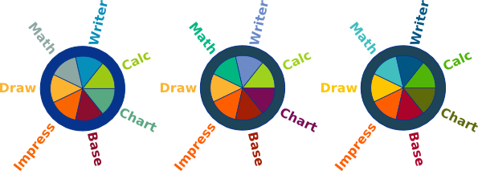
What is to be done for OOo3?
icons - work in progress:
  symbols
  small sizes
  colors
Notes:
We think about modifying the Calc symbol because the table it shows is misinterpreted as window in many cases.
For the new Chart module there exists a symbol even if the document type is not supported in the moment. But as the Chart people don't see any difference to Math they think about establishing a full component with independently usable Chart document. Even if this will take place later on, we start discussion about the right color and symbol.
As I told you already, small icons are especially problematical, so we have a very close look at them.
You see that icons with a large symbol are more easily recognizable – but we have to remember that they can be positioned on different backgrounds, so the amount of visible color is important as well.
WRT the colors – we try to keep the main colors and modify them a bit to make them more distinct. For Chart we did try new colors, but the previous version used the dark olive green.

Slide 24
How will OOo3 look like?
We don't really know by now
  You've been shown some ideas and concepts
    logo update
    new icons
    branding bugs
  If you want to be involved in this development
    join art@marketing.openoffice.org
    comment proposals by other Art Project members
    submit your own designs and optimize others
    take part in our decisions
High quality artwork is important for OpenOffice.org's positioning in public!
Notes:
I hope you got an impression of what we are working on in preparation of OpenOffice.org3
I'm sorry if you thought I would be able to show you the finalized look of OOo3 – but in my eyes this is even better:
YOU may join us at the art project and have your ideas and thoughts included in the final concepts.
Subscribe to art@marketing.OOo, join our discussions and show us your ideas. You don't need to be an artist – a draft of your ideas could be taken over by somebody else (or you find out that you have more skills than you thought).
The more contributors we have, the better the final artwork will be – and
Good artwork is important for OpenOffice.org

Slide 25
More work at the Art project
Art Project consists of about 20 (more or less) active project members
  different artistic backgrounds
  progressive or conservative, vivid discussions
  decisions on official artwork, Style Guide
  lots of contributions from sketches and drafts to finalized high quality artwork
    logos in different formats
    CD/DVD labels and cases
    web buttons and banners
    poster and flyers
    merchandise, business cards
    brochures, templates etc.
    website design
Notes:
If anybody joins the Art Project it will be visible, that we do much more than preparing Ooo3.
We discuss (vivid and friendly!), decide which artwork may be called “official” and will have to update our Style Guide to fit the criteria to be found for OOo3.
Besides of that we create lots of artwork and present it (unfortunately up to now not instantly after it's design) at our galleries – as official, previous or additional artwork.

Slide 26
Artwork among OOo projects
Art Project is a subproject of the OpenOffice.org Marketing Project
  right position in many cases:
    requests for web buttons, CD labels or stickers
    posters for booths, flyers etc.
  sometimes directly involved in other projects' work:
    why.openoffice.org -> website.openoffice.org
    icon design -> ui.openoffice.org
    CD art -> distribution.openoffice.org
    flyers, templates -> documentation.openoffice.org
  on the other hand artwork done in other projects or by individuals:
    clipart (documentation.OOo)
    native-language artwork (native-lang projects)
    t-shirts, posters, ad's (individuals or external groups)
Notes:
Artwork is part of many activities inside OOo
Most of them are related to marketing – that's where the Art Project is positioned up to now.
But we don't stay there designing web buttons and banners, posters, CD labels and so on.
Some of our activities are strongly connected to other projects:
At the Why webpage John presented just before me should we work together with the website project.
The icons should be discussed with UI, for CD-Art and OEM labels the distribution project should be informed.
We create templates, but cliparts are done by the documentation project.
And once and again we find out about artwork being created by individuals or inside the native-lang projects we would have needed long time before.

Slide 27
Artwork among OOo projects
How could this be optimized?
  involvement of the Art Project in development of graphics based webpages, clipart galleries etc.
  better information about the Art Project in other projects (especially native-language projects)
  easy to be updated artwork galleries with different sub-galleries
    official artwork
    previous artwork (already in process)
    additional artwork
    native-lang artwork (to be included)
Would it be reasonable to have an independent Art Project?
Art Project is significant!
}
Notes:
Is there a chance to optimize this situation?
I don't really know, but in my eyes the Art Project must be better known among the other projects (at first the responsible people there, but in principle by everyone creating a design for his own or in the need of any artwork)
We must work together with website, UI, documentation , distribution and all the native- lang projects I'm sure there is created some great artwork. Even if it is not translated to English, we can use it and redistribute it to other projects
Adding a fourth category to the galleries with untranslated native-lang artwork would help, I think.
But my final question is: Would it be reasonable to move the Art Project out of the position as subproject of the Marketing Project ?

Slide 28
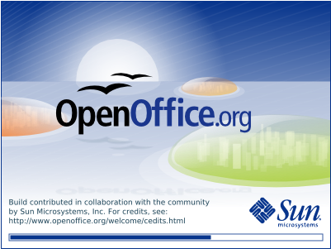
Thank you for your attention!
and thanks to all the Art Project members:
I wouldn't have been able to tell you
anything without their contributions...
Maarten Brouwers Adam Pribyl Alexandro Colorado André Wyrwa Chad Smith Christian Zwahlen Cristian Driga Damir Prizmic DCMP Don Jewett Ger Roderick Singleton Gerry F B Ong Graham Lauder J David Eisenberg Joe Lackner John Cotterill John Mc Creesh Kazunari Hirano Lars D Nooden Peter Hillier-Brook Peter Mitchell Rex Hollingsworth Sakari Koivunen Sebastien Lanteigne Steve Clement Steven Pauwels Steven Shelton The Digital Pioneer and several others...
Notes:
Thanks for your attention!

