Slide 1

OpenOffice.org
Extensions Infrastructure
What it is –
What it can –
What is planned
Jürgen Schmidt
  Technical Lead Software Engineering
  StarOffice/OpenOffice.org
    Sun Microsystems

Slide 2
About the speaker
started working on the project in 1997
one of three initial developers who have started to develop the first version of UNO
today – technical lead at Sun Microsystems and responsible for programmability capabilities in StarOffice/OpenOffice.org
project lead of the api.openoffice.org project

Slide 3




Excursion to other Applications
Extension Support – YES
  Easy and smooth (e.g. drag and drop)
  Huge extension base
Extension Support – YES
  Complete platform to build applications on top of it
  Rich Client Platfrom (RCP)
  Growing extension (modules/plugin) base
Extension Support – YES
  Complete platform to build applications on top of it (RCP)
  Solid extension (plugin) base

Slide 4
Excursion to other Applications
Common Features
Versioning
  version number and unique identifiers
Dependencies
  to a specific application version
  to other extensions or modules/plugins
Online Update
  manually update checks
  automatically checks

Slide 5
What makes extensions interesting?
User view
  Adjust the applications to personal needs
  Extend the applications with new functionality
  Easy to update
Developer view
  Easy start with the project
  No core knowledge required
  Early feeling of success ➜ motivating
  Encapsulated working area ➜ programming against stable, documented API's
  Reuse of existing functionality
  Integration of connectors/interfaces to other applications

Slide 6
Extensions in OpenOffice.org (StarOffice)
What it is
Script/Macro Libraries
  Basic, Python, Java, JavaScript
Functional enhancements ➜ UNO components
  Completely new functions with new IDL type definitions
  Implementation of special Service Provider Interfaces
    Calc Add-Ins, Add-Ons, Filter
    ... and more
Non code content
  Templates
  Gallery items

Slide 7
Extensions in OpenOffice.org (StarOffice)
Extension Package Format (since OO.org 2.0.4)
Zip container (.oxt)
  Formerly .uno.pkg and .zip
META-INF/manifest.xml
  Content description
  Description of installable items
description.xml
  License
  Dependencies
Content

Slide 8

Extensions in OpenOffice.org (StarOffice)
Extension Package Format (since OO.org 2.0.4)
Content of an example oxt extension package:
SOCalculatorAddon.oxt
  SOCalculatorAddon.uno.jar
  description.xml
  Addons.xcu
  ProtocolHandler.xcu
  calculator_16.bmp
  calculator_26.bmp
  registration/license_en-US.txt
  registration/license_en-GB.txt
  registration/license_de.txt
  META-INF/manifest.xml

Slide 9
Extensions in OpenOffice.org (StarOffice)
Simple License Feature (since OO.org 2.0.4)
Accept or reject ➜ install or do nothing
Simply display the content of the license file without any formatting
Plain UTF8 format
Support of localized license files
  Matching algorithm to find the best fitting license
  Vendor has to define a default as fallback if the matching algorithm failed
Control flag for user and shared mode
  User mode ➜ every user has to accept the license
  Shared mode ➜ only one person has to accept the license when installed in the shared layer

Slide 10
Extensions in OpenOffice.org (StarOffice)
Extension Package Format (since OO.org 2.0.4)
Example Content of a description.xml
<?xml version="1.0" encoding="UTF-8"?>
<description xmlns="http://openoffice.org/extensions/description/2006"
xmlns:xlink="http://www.w3.org/1999/xlink">
<registration>
<simple-license accept-by="admin" default-license-id="de">
<license-text xlink:href="registration/license_de.txt" lang="de" license-id="de"/>
<license-text xlink:href="registration/license_en-US.txt" lang="en-US"/>
<license-text xlink:href="registration/license_en-GB.txt" lang="en-GB"/>
</simple-license>
</registration>
</description>

Slide 11
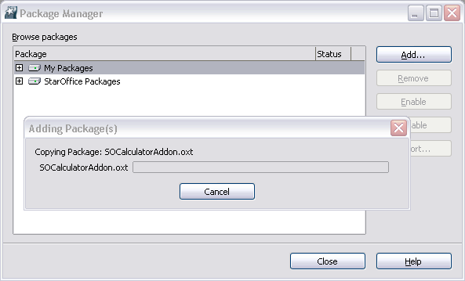
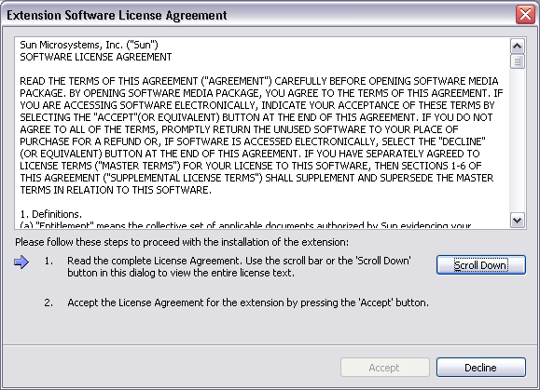
Extensions in OpenOffice.org (StarOffice)

Slide 12




Extensions in OpenOffice.org (StarOffice)
OO.org 2.0.4
OO.org 2.0
OO.org < 2.0
OO.org 2.0.3
OXT
UNO.PKG
ZIP

Slide 13
Extensions in OpenOffice.org (StarOffice)
What is planned in the future
OpenOffice.org 2.1
  Online update for extensions
    Searching for updates
  Unique identifiers and versioning for extension packages
  Real dependencies on demand
  System integration
    mime type registration
    double click on oxt file to install
  renaming of “Package Manager” to “Extension Manager”
  Improved toolkit
    New controls

Slide 14
Extensions in OpenOffice.org (StarOffice)
What is planned in the future
Later
  Redesign of the extension manager UI (simplification)
  Signing of extension packages (encryption?)
  Automatic notification for updates
  Support of extension options in the Tools ➜ Options dialog
    New category Extensions + single entry per extension
  Extendable help
    Smooth integration of extension help in the existing help system
  Localization support (maybe earlier)
    New resource framework – especially for the usage with the toolkit
  Extended license framework on demand
    interface (hook) to support existing license frameworks

Slide 15



Vision
... you remember the keyword RCP (Rich Client Platform)
OpenOffice as a collection of extension packages
Easy update for small parts of the office
Small deployments possible (e.g. writer only)
UNO
Runtime
Environment
Extension
some
infrastructure
+
+
Extension
...
Extension

Slide 16
Join the extension project
to get more info about the ongoing work
visit the project extensions.openoffice.org
subscribe to the mailing list dev@extensions.openoffice.org
subscribe to the mailing list dev@api.openoffice.org
give feedback
get started

Slide 17

OpenOffice.org
Extensions Infrastructure
Questions?
Jürgen Schmidt
  juergen.schmidt@sun.com

