Slide 1


Slide 2

Making the New Notes
Community
 Cooperation 
Concepts
Christoph Noack OpenOffice.org User Experience
Max Odendahl OpenOffice.org Development
Christian Jansen Sun Microsystems

Slide 3




Making the New Notes
Community
Cooperation
Concepts

Slide 4
Making the New Notes
Community
Cooperation
Concepts

Slide 5
Introduction to Notes2
Notes2 is an activity to improve the existing notes functionality in OpenOffice.org Writer
Notes2 has been developed with major community involvement
Notes2 solved about 100 issue tracker entries
Notes2 has been rewarded in the “OpenOffice.org Community Innovation Program Awards” (Technical, Core)
First results are contained in OpenOffice.org 3.0
Question: Do you remember the past?

Slide 6
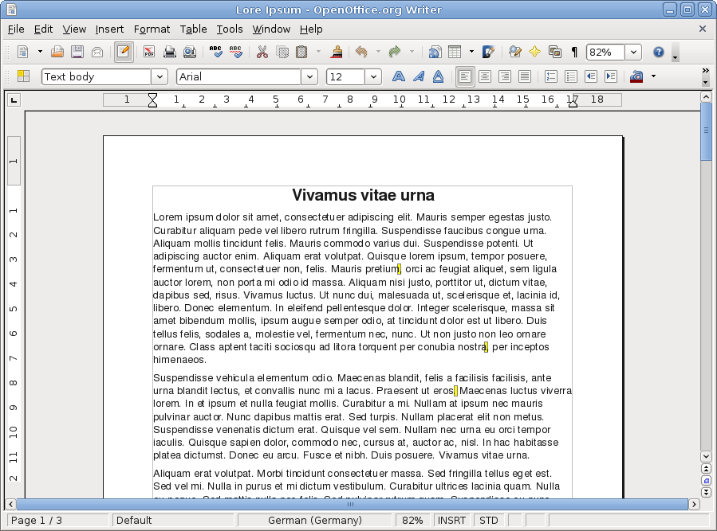

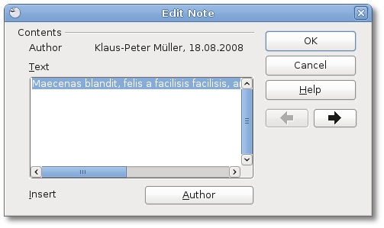
Notes in Previous Versions
Result:

Slide 7
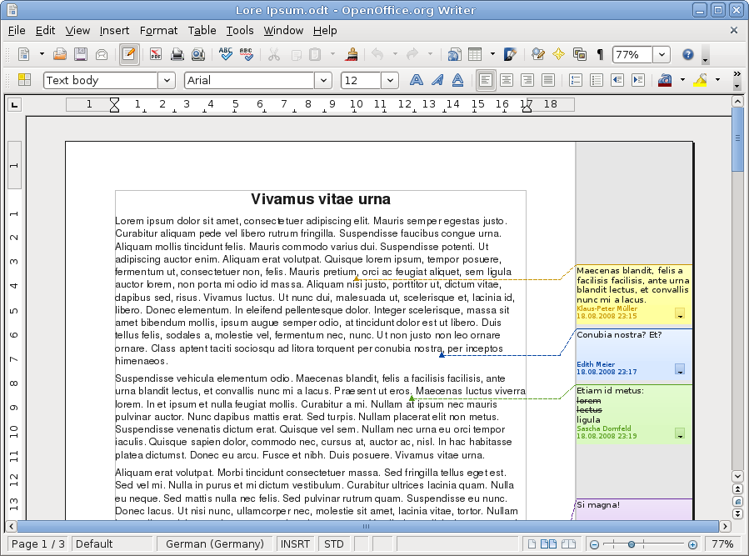
Notes in OpenOffice.org 3.0
Result:

Slide 8
Start of the Activity
06/2002 | Issue 6193 requests improvements for the notes handling in Writer
03/2007 | Mathias Bauer proposes to start an activity within Google Summer of Code
 | Max Odendahl applies for the GSOC and gets accepted (Student of Computer Sciences)
04/2007 | Christoph Noack joins the team after being asked by the User Experience project lead (UX community member)
05/2007 | An implementation team is made up (i-Team “Notes2”)

Slide 9






The Implementation Team
User Experience
Development
Quality Assurance
Christoph Noack
Community
Max Odendahl
Community
Éric Savary
Sun Microsystems
Mentor
Mentor
Documentation
Christian Jansen
Sun Microsystems
Mathias Bauer
Sun Microsystems
Uwe Fischer
Sun Microsystems
… supported by the whole OpenOffice.org community!

Slide 10
Making the New Notes
Community
Cooperation
Concepts

Slide 11
Working Steps
Cooperation does mean: “come together, clarify what to do, work on it, realize something useful”
The “working steps” show one classic approach
Problem
Concepts
Design
Test and Feedback
Requirements
Engineering
Code
Development
Sounds easy? Let's look at the first step...

Slide 12
Understanding the Problem
An IRC chat was the first “official” team meeting. Oh dear...
We did not know each other (personal goals, previous work in the community, skills, ...)
We knew the single issues of the notes, but lacked understanding for the common goal
We had no agenda, we just started to discuss
Experience:
A face-to-face kick-off meeting or phone conference in the first phase may be helpful
Formulating a project goal helps to keep the focus

Slide 13
Requirements Engineering
Roadmap and design concepts are based on requirements (collection of information, prioritization, definition of terms)
Information sources:
  Use cases (“brainstorming”)
  Competitor analysis (different office applications)
  Requests for enhancements (issue tracker entries, feedback on community mailing lists)
  Experience of the implementation team
Question: Do we have some examples for that?

Slide 14
Requirements Engineering
Working with Use Cases
Example
Requirement StR 49: If the user exports a document, he wishes to be informed if notes are not visible.
Use Case: User A edited a document and filtered some notes. Then, he sends the document via e-mail. Thus, he wishes to be informed of information which is not visible.
Comments: Alternative is to change the default; deactivate the export of notes.
High-level requirements:
Identify the stakeholders
Collect use cases in the document life cycle
Experience:
Judges facts, not preferences
Very good completeness
Effort may be high, you need to convince others
Source: http://wiki.services.openoffice.org/wiki/Notes2
Hint: It also helps to look at the competition.
Notes:
ID: StR 49
If the user saves a document in a non-standard document format and the document contains notes information which is suppressed in the current view, the user wishes, that OOo informs him that there is suppressed information
UseCase: The user A filtered some of the notes information during the editing of the document. At the end, he exports the document to a PDF file to send it via e-mail. The original document contains some private information in the notes he does not want to export. Therefore user A wishes to be informed about that if he exports the document.
Comments:
Alternative: Deactivate the export of notes information per default, if it is exported.
Refer also to StR 44

Slide 15
Requirements Engineering
Competitor Analysis
Word processor “Softmaker TextMaker 2006”
Notes.tmd - Textmaker
Notes similar to Microsoft Word 2003
Example:
Page contains many notes → notes not really usable (overlay, cut-off)
Similar behavior in first Apple Pages
Menu and Toolbar
Nunc ac erat vel nisi mollis vestibulum. Donec purus tellus, eleifend non, pulvinar et, porttitor eu, lacus. Nam dictum arcu at justo. Proin semper tempus nisl. Morbi a arcu ac metus interdum consequat. Praesent aliquet imperdiet est. Nunc quis risus id nunc posuere blandit. Aliquam cursus, ante ac interdum convallis, leo felis congue nulla, sed faucibus lacus dui tempus ante. Duis viverra augue sit amet turpis. Donec ac lacus vel massa sollicitudin aliquet.
Etiam aliquet dolor quis elit. Pellentesque adipiscing tellus sed sem. Quisque sit amet quam non dui viverra ornare. Integer nec risus ut risus lobortis vestibulum. Proin hendrerit, pede vel commodo cursus, felis enim egestas mi, ut aliquet enim nisi sit amet elit. Nulla facilisi. In auctor volutpat leo. Nam vitae nibh a arcu dapibus aliquet.
Maecenas turpis. Donec quam. Sed ipsum libero, viverra eget, fringilla vel, auctor eget, ipsum. Curabitur egestas facilisis lectus. Duis dignissim lectus vel velit. Fusce congue velit eget neque. Integer consequat. Fusce nec purus ut justo consequat commodo.
Comment [2007-10-27]:
Comment [2007-10-27]:
Comment [2007-10-27]:
Comment [2007-10-27]:
Comment [2007-10-27]:
Comment [2007-10-27]:
Comment [2007-10-27]:
Comment [2007-10-27]:
Comment [2007-10-27]:
Comment [2007-10-27]:
Comment [2007-10-27]:
Comment [2007-10-27]:
Comment [2007-10-27]:
Comment [2007-10-27]:
Comment [2007-10-27]:
Comment [2007-10-27]:
Comment [2007-10-27]:
Comment [2007-10-27]:
Comment [2007-10-27]:
Comment [2007-10-27]:
Comment [2007-10-27]:
Comment [2007-10-27]:
Comment [2007-10-27]:
Comment [2007-10-27]:
Comment [2007-10-27]:
Comment [2007-10-27]:
Comment [2007-10-27]:
Comment [2007-10-27]:
Comment [2007-10-27]:
Comment [2007-10-27]:
Comment [2007-10-27]:
Comment [2007-10-27]:
Comment [2007-10-27]:
Comment [2007-10-27]:
Comment [2007-10-27]:
Comment [2007-10-27]:
Comment [2007-10-27]:
Status Bar
Finding: Robust and scalable functionality required

Slide 16
Requirements Engineering
Competitor Analysis
Presentation program “Microsoft Powerpoint 2003”
Notes are handled like small graphic objects
Example:
  Click on anchor to open note window
  Select text → text looks being editable
  Pressing 'Del' removes the note!
ju1
Joe User
2007-10-27
Nunc ac erat vel nisi mollis vestibulum. Donec purus tadolom.
mollis vestibulum
Del
ju1
Joe User
2007-10-27
Nunc ac erat vel nisi mollis vestibulum. Donec purus tadolom.
Finding: Be clear in communicating different states to the user

Slide 17
Communication
Channels
Remote collaboration can work well!
The tools are not that important (but we re-think their use)
Face-to-face | Very positive, although it was a bit too late...
Phone Calls | Good for the discussion of single topics (better if we had an online-whiteboard)
Chat | Rated good if used between few members Never used again by the whole team
E-Mail | Very good for discussion of single topics Decisions shold be officially published
Issue Tracker | Good to manage mid-term to long-term issues
Wiki | Very good!

Slide 18
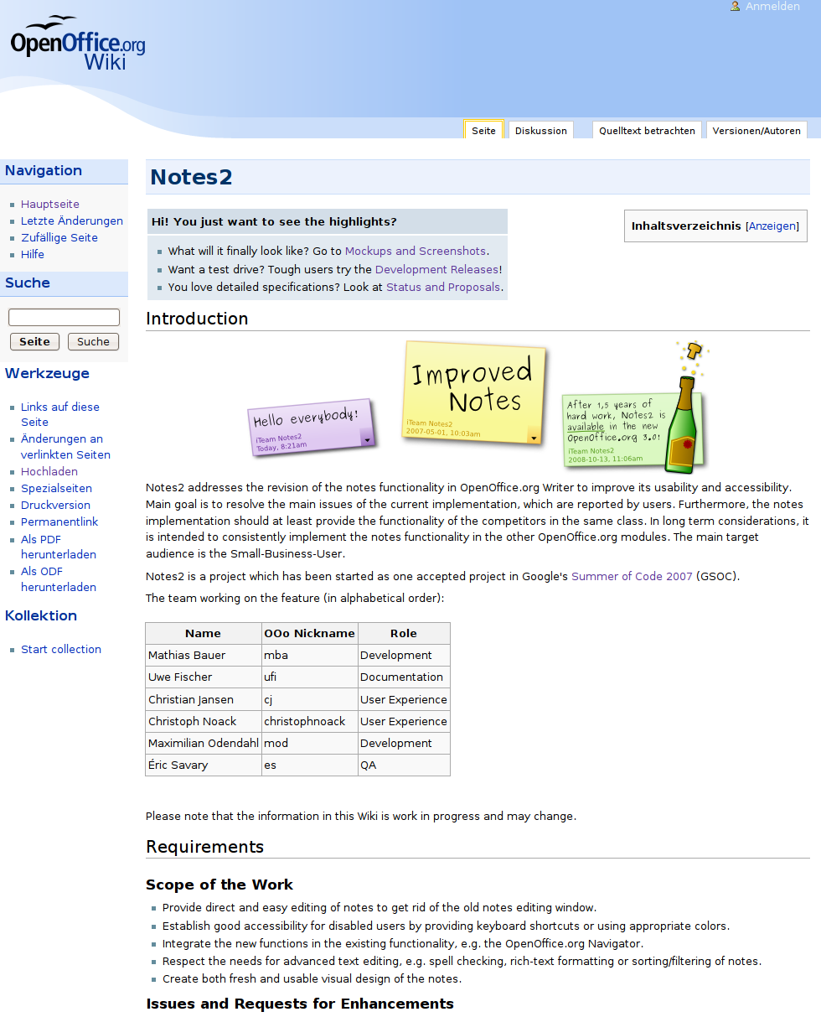
Communication
Wiki
Store common knowledge, e.g.:
Project details
Goals and requirements
Development roadmap
Proposals, concepts, mockups
Experience:
Great for getting feedback
Use it as soon as possible
Care about the structure
Source: http://wiki.services.openoffice.org/wiki/Notes2

Slide 19
Communication
Discussions and Decisions
Examples: procedure, roadmap planning, design decisions
Experience:
Decisions should not be made by the whole team in general → establish guidelines accepted by the team
Planning for a certain release didn't work well → define minimum feature and quality requirements
The foundation provides a certain set of capabilities → identify technical constraints as soon as possible

Slide 20
Making the New Notes
Community
Cooperation
Concepts

Slide 21
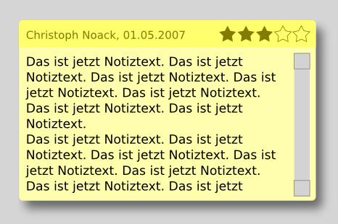

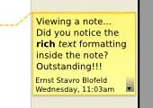
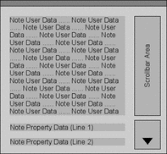
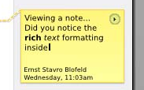
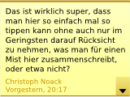
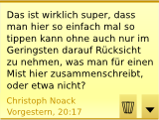
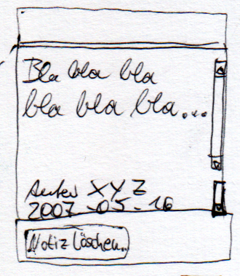
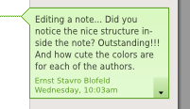
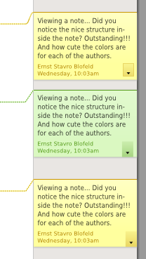
Design Proposals
“Notes Window”
Visual evolution of the note window and the options buttons
/+------------+
/ | notes text |
----/ | notes text |
| notes text |
: :
| Author/Dat |
+------------+

Slide 22
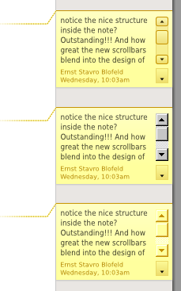
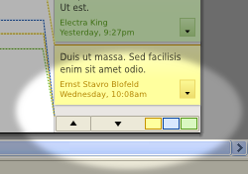
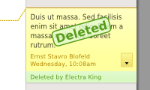
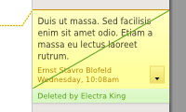
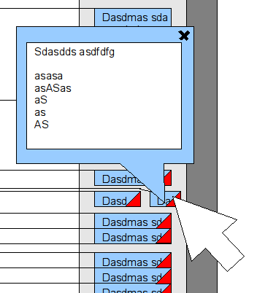
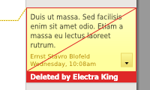
Design Proposals
“Advanced Text Editing”
Much text inside note window | Many notes on one document page | Deleted notes for change tracking

Slide 23
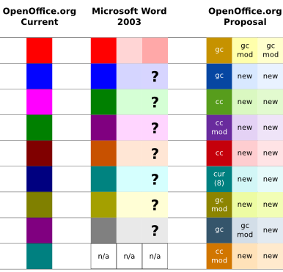
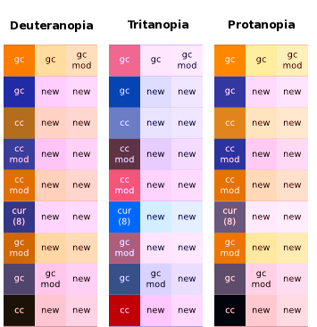
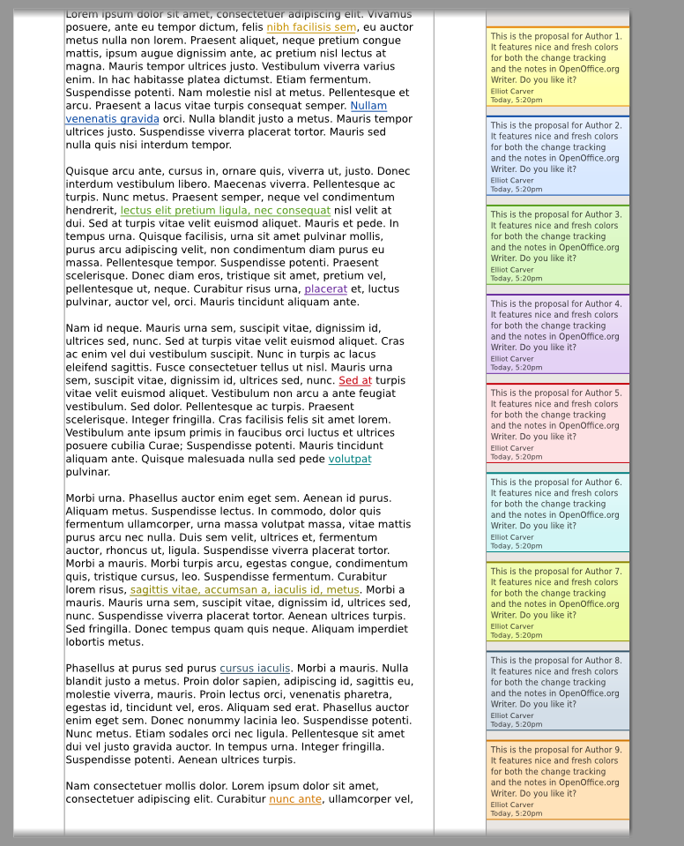
Implemented Design
“Colors”
Notes author colors are based on other OpenOffice.org colors
Definition of Colors | Accessibility Check | Display Check
Result: New colors are consistent, fresh, accessibility tested

Slide 24
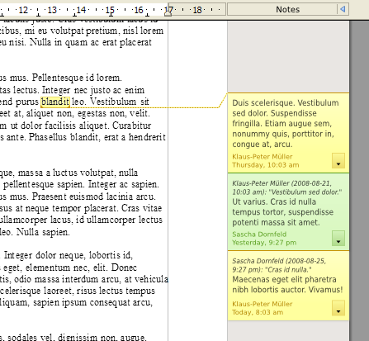
Features Being Worked On
Grouping of notes belonging together
“Reply-To-Note” to answer existing notes
Better integration with change tracking comments
Improved anchors, e.g. new anchors for text areas (e.g. referring to words)
The framework is now ready for advanced functionality.

Slide 25
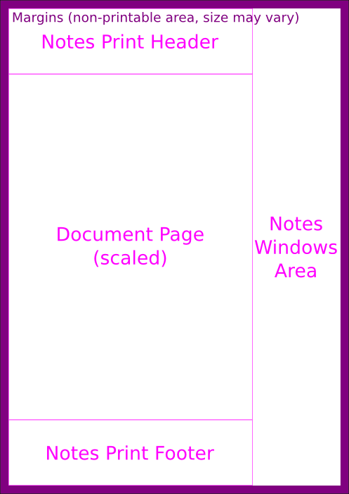
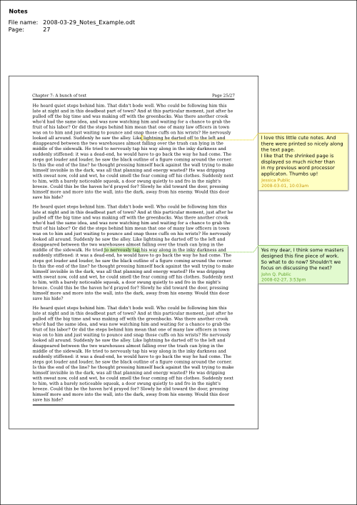
Ideas for Future Versions “Printing”
Printing has still room for improvement
Specification drafts available for:
  Printing notes windows next to document
  Printing notes text only
There are still many other ideas... Help is appreciated.

Slide 26
Making the New Notes
Community
Cooperation
Concepts

Slide 27
Summary
Community
Success? A feature improvement at least...
We think, the community does have impact!
Collaboration
Remote collaboration does work!
Working has been much fun and sometimes exhausting!
Concepts
Not everything is perfect, yet. There will be improvements!
Many ideas still flying around.
And now? Start your project and share your experience!

Slide 28


OpenOffice.org User Experience Team
ux.openoffice.org

