Slide 1

OOo Website Structure
Matthias Müller-Prove
Sun Microsystems
July-26 – Nov 19, 2007

Slide 2
What's the current site structure?

Slide 3
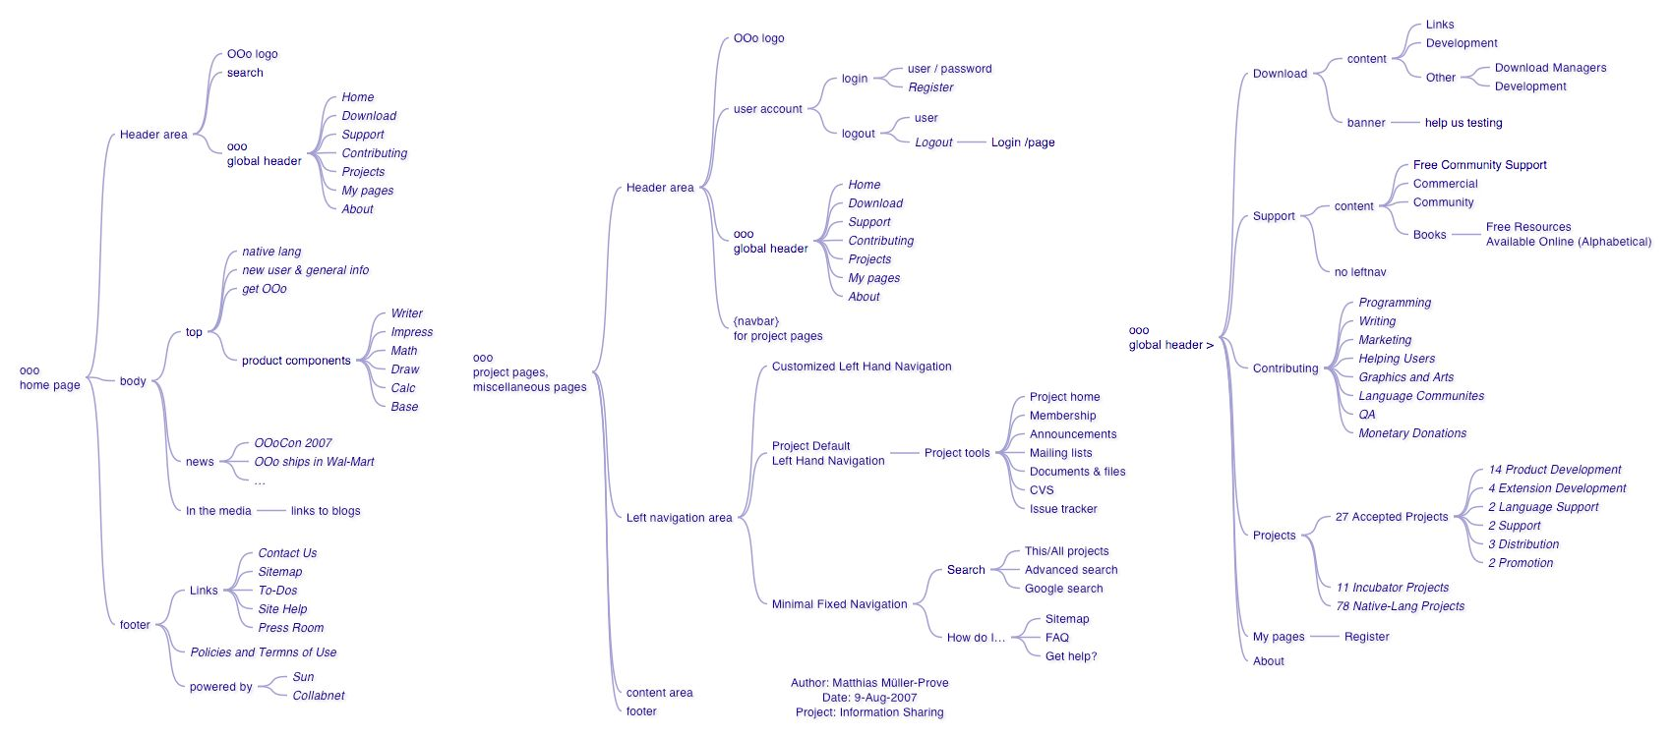
Site Map 1
Site Map 1

Slide 4
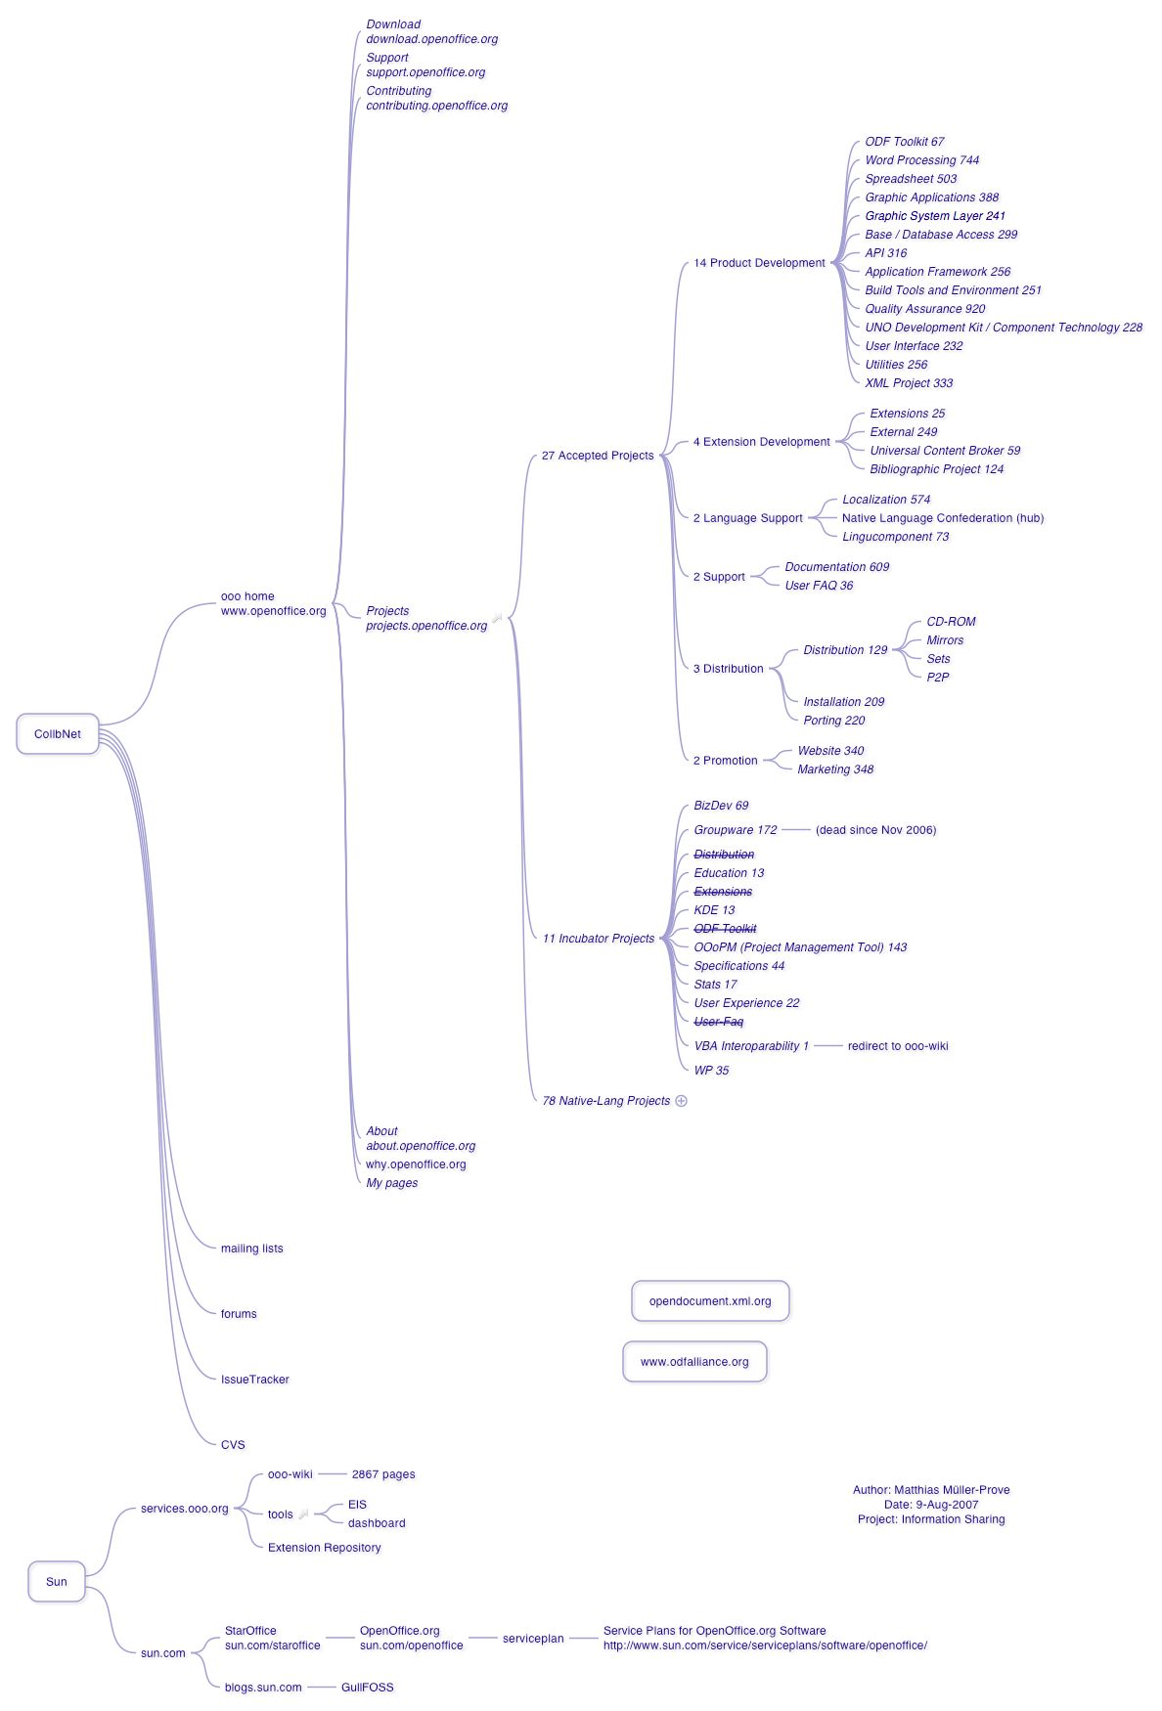
Site Map 2

Slide 5
What's the future site structure? /MMP
In the eye of Matthias

Slide 6
Information Architecture MMP-IA1 /24-Oct-2007
Community
End Users
home
“portal”
On www.openoffice.org
to support the community
On portal.openoffice.org
to promote the product
contribute
projects
wiki
why/about
download
support
On
wiki.services.openoffice.org
On
download.openoffice.org
extensions
forums
On
extensions.services.openoffice.org
On users.services.openoffice.org

Slide 7
What's the future site structure?
/Maarten Brouwers
Guiding Principle: “portal=homepage=why¨

Slide 8
Information Architecture MURB-IA1 30-Oct-07
Community
End Users
home*
On www.openoffice.org
home for everyone, most space reserved for end-users
development
portal
news
get openoffice*
support
why/about
On blog.openoffice.org?? RSS ticker on mainpage
contribute
extensions
forums
projects
On
extensions.services.openoffice.org
On users.services.openoffice.org
wiki
main links
“hinting”
On
wiki.services.openoffice.org
* Some bits (or totally) hosted at portal.openoffice.org
to make advanced server side scripting possible

Slide 9
OOo Website Structure
Matthias Müller-Prove
  mprove@sun.com

