Slide 1




OpenOffice.org 2.0
Everything you need in an office productivity suite
  Writer - a word processor for creating dynamic documents
  Calc - a spreadsheet for analysing data
  Impress - for designing eye-catching presentations
  Draw - for producing dramatic illustrations
  Base – database access made easy
  supports standard XML (OpenDocument) and legacy (MS-Office) file formats
  creates portable document format (.pdf) files
and it’s completely free!

Slide 2
OpenOffice.org writer
The powerful word processor
  Wizards to produce standard documents such as letters, faxes, agendas, minutes.
  Styles and Formatting to put the power of style sheets into the hands of every user.
  AutoCorrect dictionary, which can check your spelling as you type.
  AutoComplete to make typing easy
  Text frames and linking for newsletters, flyers, etc. .
  Table of contents, index for complex documents
  OpenDocument and MS-Word .doc format compatibile

Slide 3
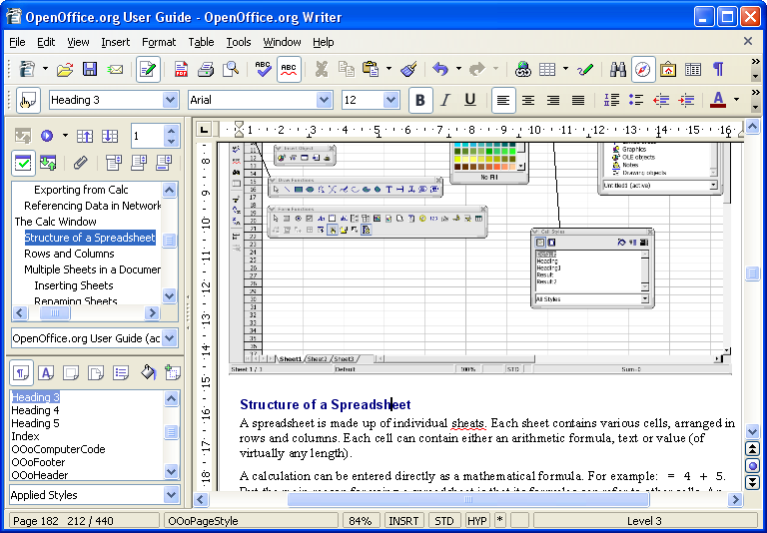

Slide 4
OpenOffice.org calc
The full-featured spreadsheet
  Natural language formulas let you create formulas using words (e.g. "sales - costs").
  Hundreds of spreadsheet functions with built-in expert help
  Scenario Manager allows "what if ..." analysis at the touch of a button.
  Powerful graphics to extract the meaning from your numbers
  Pull in data from external databases with DataPilot technology
  OpenDocument and MS-Excel .xls file format compatibility

Slide 5
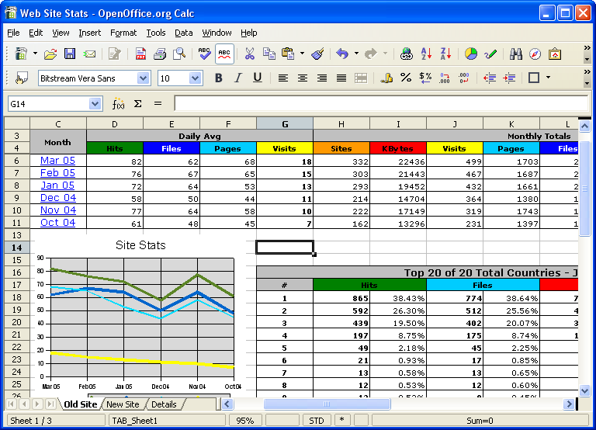

Slide 6
OpenOffice.org impress
Impress your audience
  Master Pages and Layouts simplify the task of preparing your materials.
  Complete range of Views are supported: Normal / Outline / Slide Sorter / Notes / Handouts to meet all the needs of presenters and audiences.
  Easy-to-use drawing and diagramming tools to spice up your presentation.
  Slide show Animation and Effects to bring a presentation to life.
  Fontworks provides stunning 2D and 3D images from text.
  OpenDocument and MS-Powerpoint .ppt file format compatibility

Slide 7
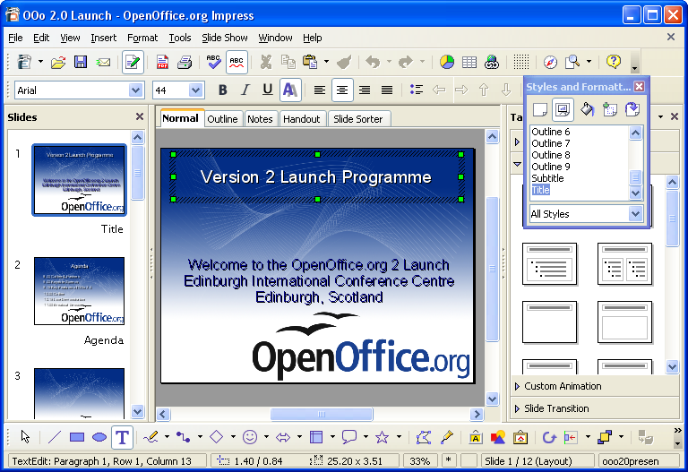

Slide 8
OpenOffice.org draw
Stunning Graphics Tool
  Single click access to common drawing objects
  Arrange objects, rotate in two or three dimensions with the 3D controller
  Smart connectors for flowcharts, organisation charts, network diagrams etc
  Sophisticated rendering for photorealistic images
  Import graphics from all common formats (including BMP, GIF, JPEG, PNG, TIFF, and WMF)
  store drawings in OpenDocument format

Slide 9
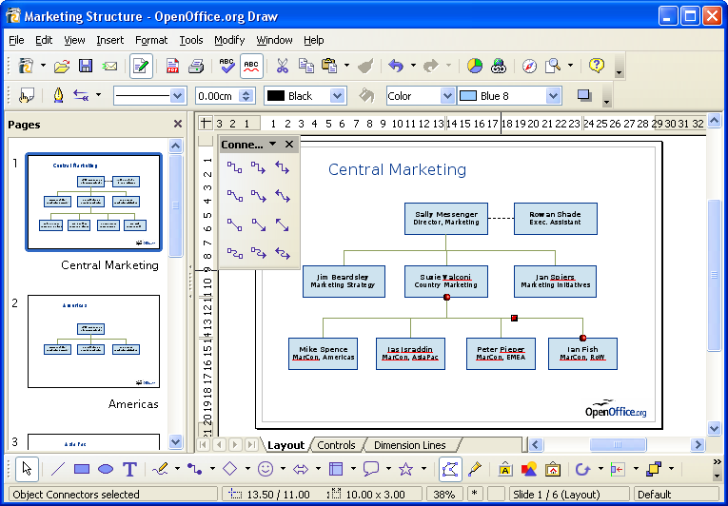

Slide 10
OpenOffice.org base
Database Access made easy
  Use Wizards to create 'instant' database applications
  View a table in an editing grid and add, change, and delete records
  Drag and drop data into other OpenOffice.org applications
  Create powerful queries to show your data in new ways, including summaries and multi-table views
  Create and modify tables and indexes
  Use the built-in HSQLDB database or access existing ODBC or JDBC compliant databases

Slide 11
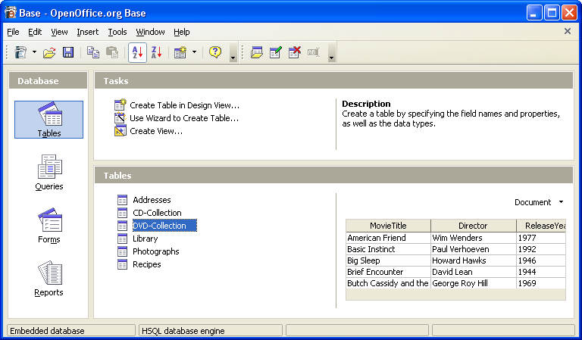
OpenOffice.org base

Slide 12
The complete office suite
OpenOffice.org was designed as a single package - not put together from a collection of bought-in packages
Consistent easy-to-use ‘look and feel’
Open any document from any application
Common ‘learn once use everywhere’ tools like the Help system, Navigator, and Styles and Formatting
Information can be transferred easily between all the packages
One single installation gives you all the office software you need - no hidden costs in the future

Slide 13
How free is ‘free’?
Free to use - e.g. download via the internet
Free from licence fees
Free to give away to friends, family, employees, students...
Free to choose the computers you use: Microsoft systems, Linux systems, Sun Solaris, and Mac OS X under X11
Free up your hard disk - Microsoft Office format documents take up to twice the disk space!
Free for developers to enhance with open-source code, published APIs and file formats
You're free to use your legacy Microsoft Office files

Slide 14
Get OpenOffice.org
Download from http://download.openoffice.org/ or local mirrors
Local CD-Distributors (see web site)
Watch for magazine covers etc
Ask your friends!
included free in many Linux distributions

