Slide 1
  OpenOffice.org and GNU/Linux distributions
  René Engelhard <rene@debian.org>

Slide 2

Agenda
OpenOffice.org (non-)popularity
(http://popcon.debian.org)
Are we “Open Source”?
Architectures
Building and Libraries
(Packaging) Issues
What should we do?

Slide 3
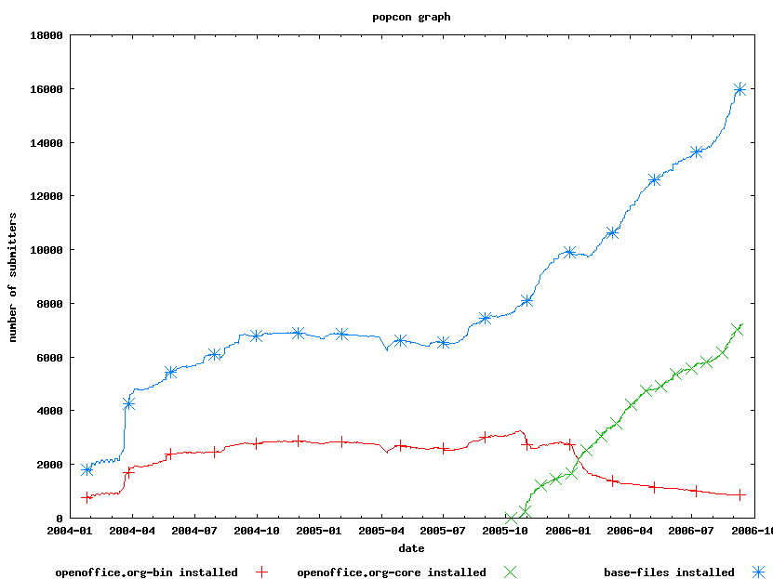
OOo popularity

Slide 4
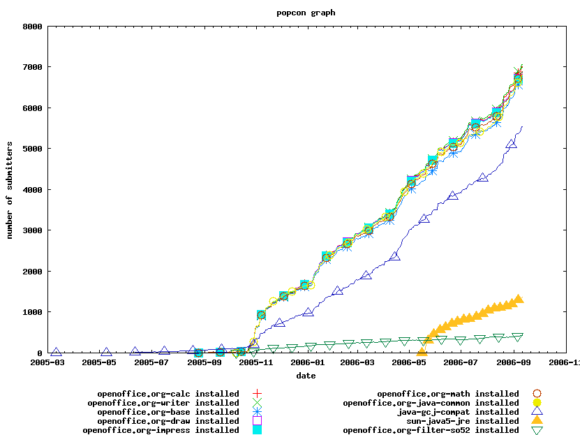

Modules' popularity
~7043 people installed all components
30 more installed writer, -base not often installed
(-313)?
-> Java
  People often
  just install 1
  component
  for e.g.watching a .doc

Slide 5
Background: Debian
free GNU/Linux distribution
project; founded 1993 by Ian Murdock
three archive sections
  main: must meet the “Debian Free Software Guidelines” (which basically is the “Open Source Definition)
  contrib: must also be free software but can also (build-)depend on non-free things or things not in Debian at all (Example: mplayer-using mozilla plugin)
  non-free: stuff not free

Slide 6
Developer Survey
Contributor survey showed that many contributors do expect that OpenOffice.org contains no proprietary software
Documentation also is important for those
“We should help people climbing the open source ladder and become evangelists” (Erwin Tenhumberg, “What OS lovers want”).
  That means, though, that we really should provide a suitable environment for “evangelists” -> make OOo and its contents completely free.

Slide 7
FOSS
OpenOffice.org is a “Open Source” project
  can we really say this? Still: non-free parts
    external/common, Issue open since years, solution exists since months
    Developers Guide / XML Spec
    illegal or at least questionalble legality/license (of) hyphenation patterns
    usage of non-free gpc (thankfully optional now)
    Need of proprietary JMF (now partially solved due to GStreamer)
  Open Source also means that the build must be able to do using free tools and libraries

Slide 8
external/common/*.jar
Issue 21678
Sun proprietary
“normal” xalan, xerces, xt exist
Issue open since ~3 years, retargeted to various releases
still unfixed
no progress visible in the issue although there is a solution available: Use “normal” xt... - and build it during the OOo build if necessary (Issue 59985)

Slide 9
hyph_{da,en,it,nl,ru}*
Can we:
  take a hyphenation pattern with non-free license from TeX and re-license it under (L)GPL? -> NO (but done on some dicts at stardiv)
  take a GPLed hyphenation pattern and put it under LGPL for OOo? -> NO (done on stardiv)
  base on a LPPLed hyphenation pattern and redistribute without following LPPs clauses? -> NO
Novells lawyers asked, no answer yet
Removed from the source and binary pkgs

Slide 10
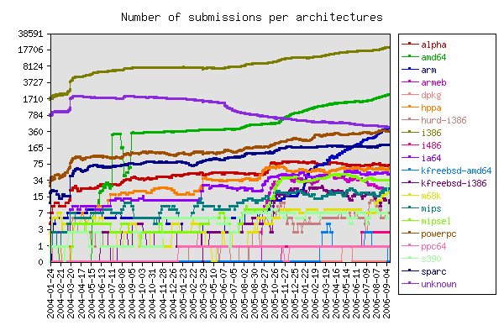
Architectures

Slide 11
Architectures
There's not only i386 on the world
Debian supports i386, powerpc, mips, mipsel, sparc, arm, alpha, ia64, amd64, hppa
  for OOo currently: i386, powerpc, sparc
  (1.1.x also had s390)
Sun only does Linux/i386, no tests on other platforms, no visible participation in amd64 porting
OOo got a bad reputation for no stable x86_64 version yet

Slide 12
FHS
/opt not allowed for distris, only for big “third-party” packages
config should be in /etc (or /opt/etc) (and *only* config) and arch-indep stuff in /usr/share/...
  sofficerc a symlink makes OOo segfault (Issue 55065). Hardlink not possible. Ugly workaround needed.
  different config layers the solution?
public UNO libraries should be in /usr/lib
  symlink breaks with $ORIGIN

Slide 13
LFS Support
OpenOffice.org 1.1.x installer broke on large disks (Issue 26865)
easy fix (build with -DLARGEFILE_SOURCE -D_FILE_OFFSET_BITS=64)
would have been a good fix for 2.0.0..
  didn't happen, reluctant to make this only in my build
  still not resolved
  kr thinks it won't even change external ABI
can we fix it? (Even if not determined to be needed it makes sense to have it)

Slide 14
Building
slow, especially with many languages
  helpcontent2
  binfilter
  officecfg (also with xsltlproc, which improves build time and should be used per default
installation fails

Slide 15
Libraries
OpenOffice.org uses (almost) all their libraries internally
  even getopt, readdir_r parts from glibc
  makes package size bigger than needed
  contains bugs/misses features in new versions
  sometimes not buildable
--with-system-* already there mostly
  Problem: Feature patches to the libraries
Build everything if possible instead of shipping binary only things (unowinreg.dll)

Slide 16
Packaging
OpenOffice.orgs packaging through the installer bad and inconsistent
  nothing happened
  bugs not cared about
  upgrading packages not easily possible (file conflicts)
lots of mvs in debian/rules (error-prone)

Slide 17
Packaging
Examples:
  most .res files in -coreXY, some in -calc binfilter res in e.g. calc when binfilter is in -coreXY (Issue 40383)
  some base files into -coreXY when they belong into base (Issue 68252)
  Mozilla plugin doesn't work when enabling globally
    admins do not want to change every users' user account to enable/disable the plugin, especially since the user can change that
      disabled completely :(

Slide 18
ooo-build
common patch repository for many distros
often accused at being a fork
needed because some important fixes do not get accepted upstream
testbed for patches
  better quality once patch enters OOo CVS
backporting important patches from development
adding patches which make sense/are really needed, but get not accepted upstream....

Slide 19
What should we do?
Brainstroming...
  create a team consisting of Suns REs/important Sun people and distribution packagers for coordinating? Meeting(s)?
  handling important packaging issues quicker?
  no feature patches in-tree
  confdigure/installer options enabling FHS compliancy when wanted
  keep internal libs up-to-date to avoid diverging and conflicts or just use the systems one where rock-stable (libc, zlib, ...)
  start embracing the FOSS philosophy

Slide 20

Questions?

