Slide 1


Slide 2

Funding the project
- the networked way
André Schnabel
project member / OOo germanophone project

Slide 3
About the speaker
André Schnabel
Joined OOo Project in 2002
  former Co-lead of the germanaphone project
  former lead of Quality Assurance
  member of the Community Council
  working on QA and l10n
Founding member of OOo Deutschland e.V.
  Former member of executive committee
  Supervisory board member

Slide 4
Agenda
Ways of funding the project
Current status and structure
Current ways of funding
Problems
How to proceed?

Slide 5
Ways of funding
Options
  Personal / direct contribution
  Direct sponsoring
  Central funds management
  Networked funds management
What is the “natural way”?

Slide 6
Current status
NPOs
Community Council
Accepted
Team OOo e.V.
Incubator
Native Lang
documentation
documentation
OOo D e.V.
education
de
fr
EducOOo
Friends of OD
(OOoAuthors)
CUSOON
it
many others
PLIO
...

Slide 7
Current status direct sponsoring
Direct contributions
  Companies pay full time contributors
  Private contributions
Equipment / materials
  Test / build machines for dedicated developers
  Marketing and merchandising materials

Slide 8
How it works
Some examples / explanations

Slide 9
Team OOo – short history
Founded 2003-02-19
Initial (pragmatic) purpose: organization of OOoCon03/04
Purpose as defined in the Charter
  Funding the OpenOffice.org project and spreading use of the OOo Software
  Further independent developers of OOo software
  Support the Community Council
  ...

Slide 10
Team OOo – short history
Only existing legal entity for the project for several months
Promoted by the project as official entity to receive donations and manage funds
Close relationship to the Community Council (managing funds and budgets as defined by the council)
Problem: only few information available
see www.teamopenoffice.de

Slide 11
OOo Deutschland e.V. reasons
Situation in 2004
  several offers for donations to the project could not be accepted
  Sponsors asked for tax relief
  At this time
    Team OOo was unresponsive
    Sun Germany was unresponsive

Slide 12
OOo Deutschland e.V. reasons
Situation in 2004 (cont.)
  Merchandising at CeBit 04
    Several 100 (maybe 1000) EUR of donations collected
    No formal accounting
    Donations (partially) lost for the project
  Increasing commitment at fairs and FOSS-events
    Private expenses up to several 100 EUR per year
    Missing materials (flyer, poster, equipment)
    Unclear legal situation

Slide 13
OOo Deutschland e.V. conclusion
Found a association
Principles
  Support the project (initially cost reimbursement and infrastructure)
  Provide help for “logistics”
  Create a legal entity (that fits to local law)
  Reach business
  Bind and grow active members
  Achieve charity status

Slide 14
OOo Deutschland e.V. founding
Founded at OOoCon 2004 (2004-09-23, Berlin)
Founding members:
  Core members of germanophone project
  Both Co-Leads
  Both marketing contacts
Founding happened after discussion with Team OOo e.V.

Slide 15
OOo Deutschland e.V. initial problems
Accusations to be not open (only little public information)
Accusations to try to get control on the project
Accusations to split the project
Escalation some moths later (triggered by other events)
  Small number of project members left
  One Co-Lead left the project

Slide 16
OOo Deutschland e.V.
Today
113 members (but only few active)
~30.000 EUR annual budget (~50% from small donations)
Project and association exist in parallel, sharing core members and supporting each other
Growing Contacts to business and administration growing
www.ooodev.org

Slide 17
OOo Deutschland e.V. activities
Cost reimbursements for project members
Provide infrastructure
  2 dedicated servers acting as buildbot, hosting QATrack, bittorrent seed, available for other small projects
  Computes for building and testing OOo
Prepare and finance marketing materials
Event sponsoring / own events
  QA Weekend, Project Weekend
  Business user day (planned)

Slide 18
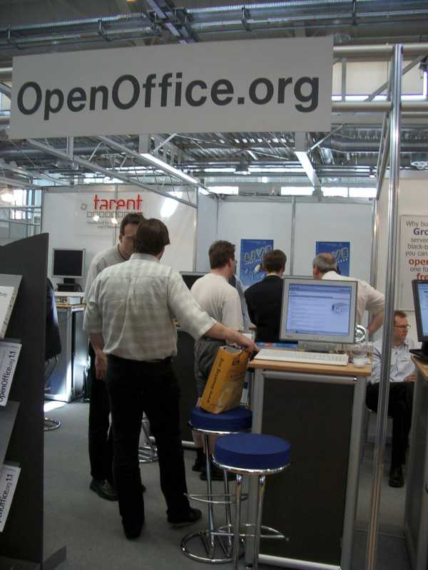
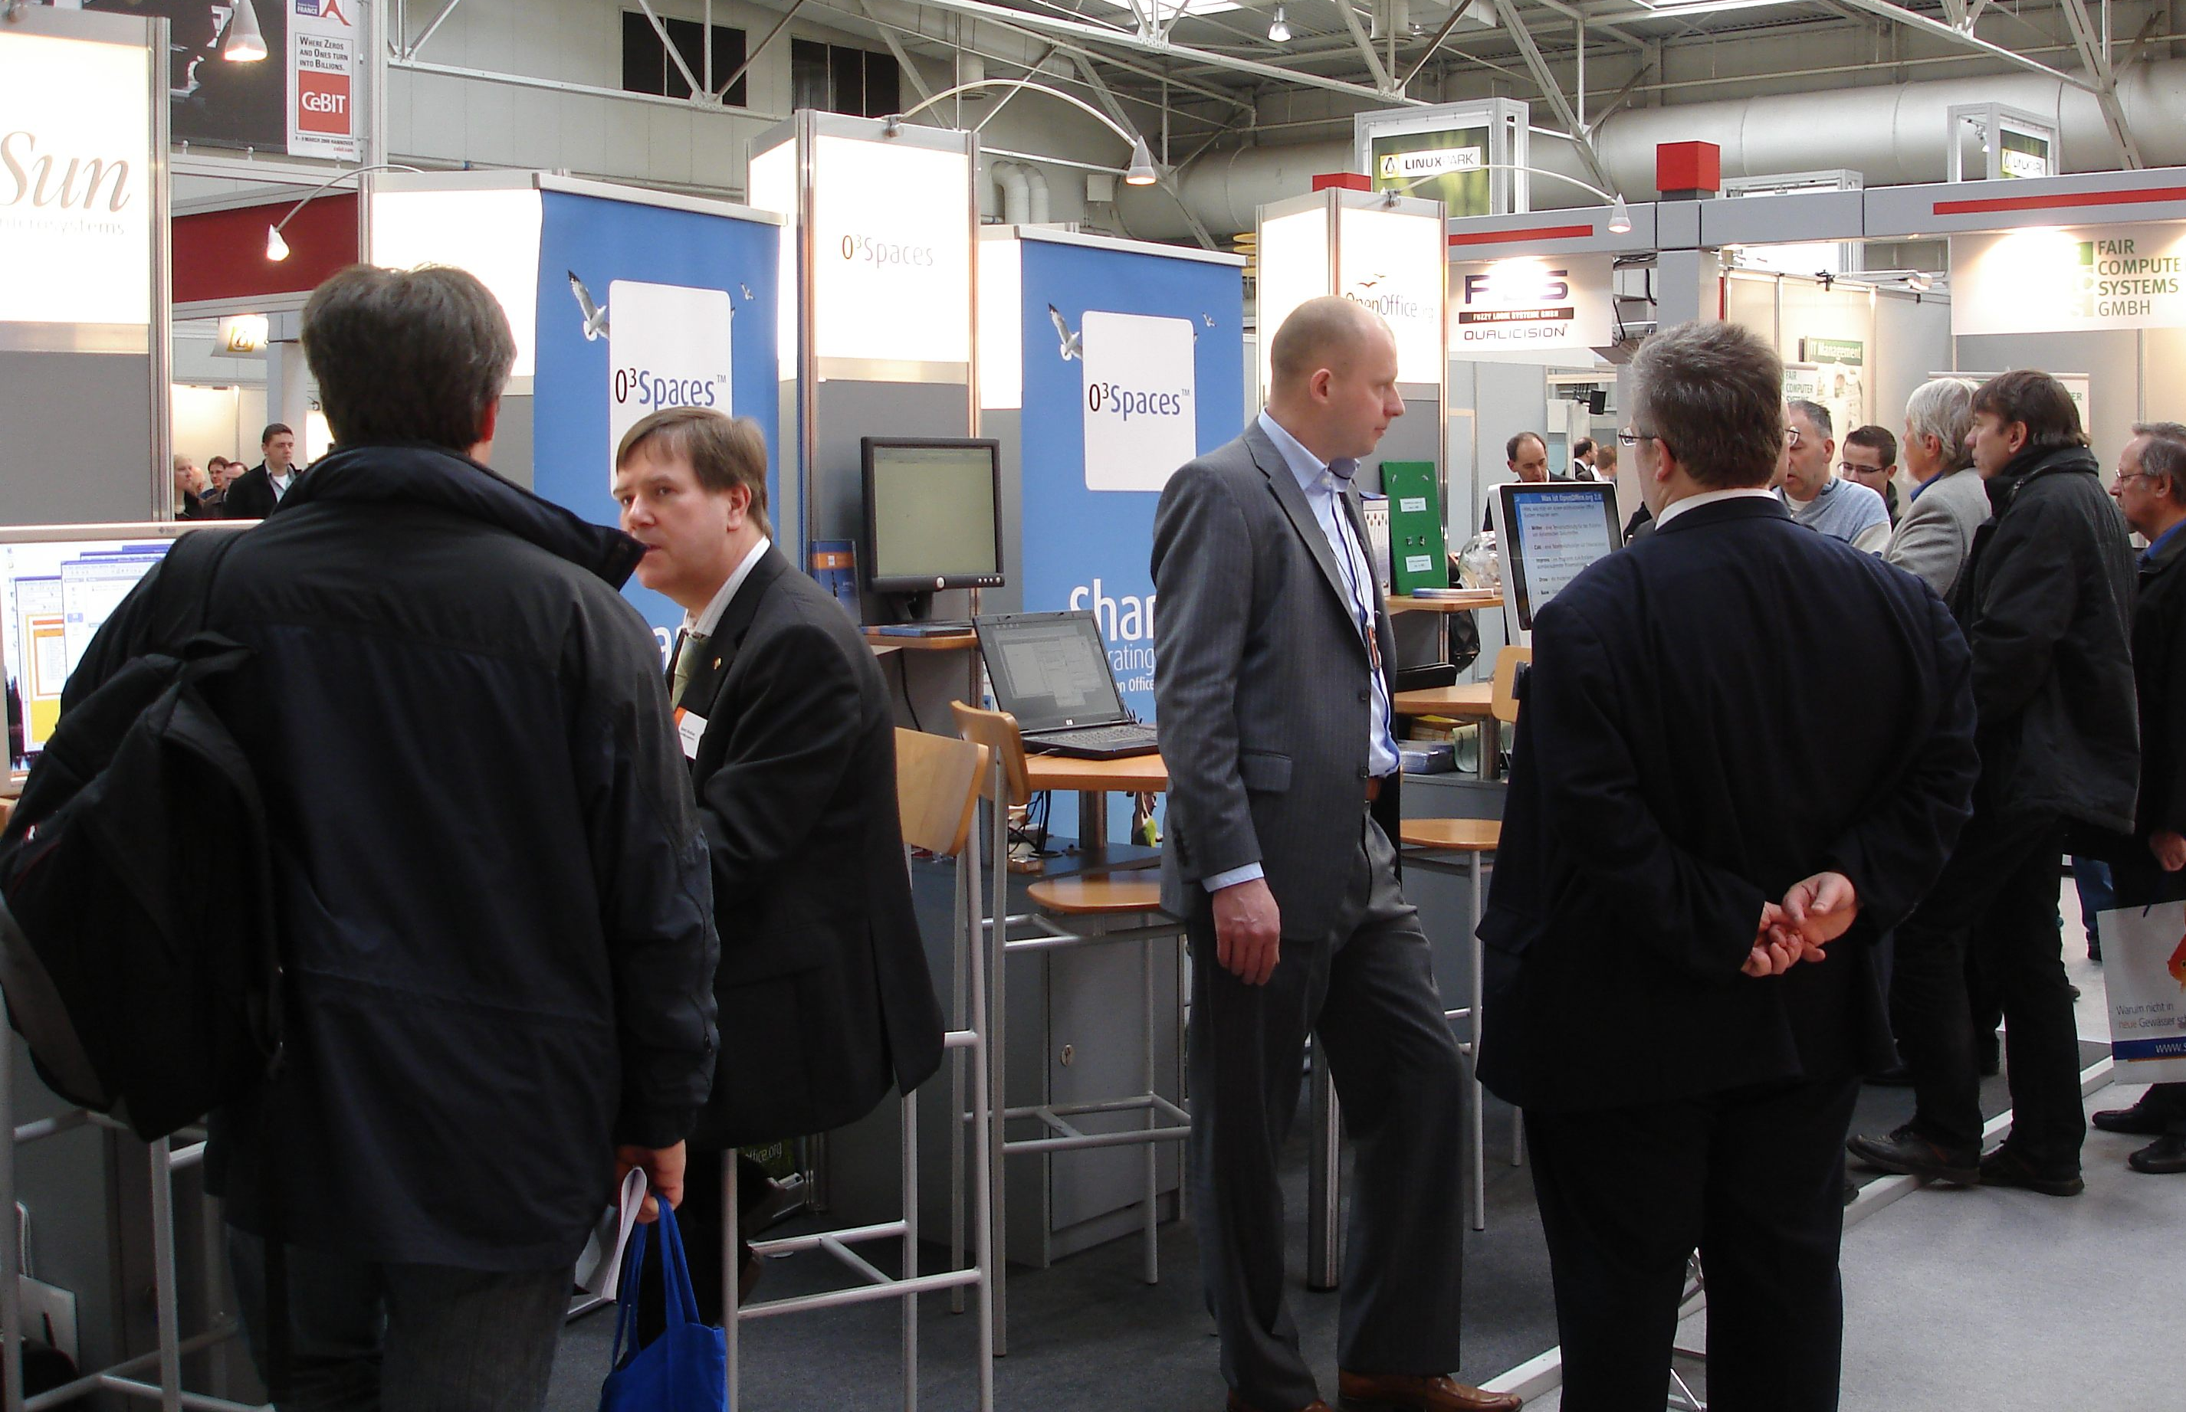
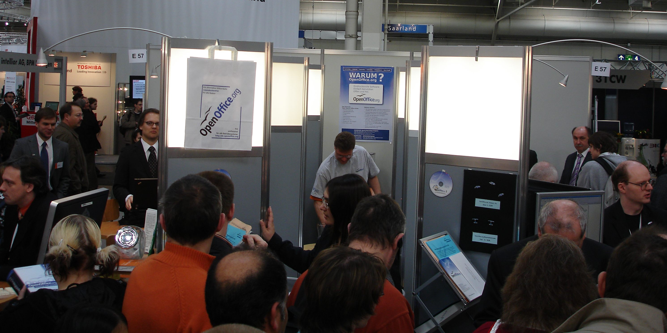
OOo Deutschland e.V.
Fairs and booths
2005
vs. 2008
2005

Slide 19
OOo D. e.V. Current troubles
How to spend money wisely?
Get more active volunteers
Main workload is still on a handful of people
Double workload for core members (project + association)

Slide 20
Other Examples
CuSOOn
association des clubs utilisateurs StarOffice et OpenOffice.org nouveaux
French NPO
Supports the francophone project in marketing and development
Close relation to the french community
Provides point of contact for business and administration
http://www.cusoo.org/

Slide 21
Other Examples
PLIO
Associazione Progetto Linguistico Italiano OpenOffice.org
PLIO is the Italian native lang project (and Italian nlp is PLIO)
Better opportunities
  To receive donations
  In legal areas
  To have a well defined structure
http://www.plio.it/

Slide 22
Other Examples
EducOOo
Education and OpenOffic.eorg
French NPO to support the education project
Find (and educate) new developers for OOo
Opportunity to legally run traineeships / internships
Focus on pedagogical use of OOo
http://www.educoo.org/

Slide 23
OpenOffice.org project
Back to the project

Slide 24
Current problems
Ways to request funds is often unknown
  We need to promote the budget system
Mixed local legal restrictions
  Like taxes, insurances
Cultural diversity
  One global entity cannot drive local activities

Slide 25
Current problems
Missing local communities for English speaking countries
  Working on the internet is great
  meeting face to face has a different quality
International or continental cooperation is missing or low

Slide 26
How to proceed?
Spread information about associations and funding
Provide help for creating new associations
  Document DOs and DONTs
Share ressources
  Run shared activities
  Share funds?
Include associations in the project
  Own subproject / dedicated mailinglist

Slide 27
Discussion
Better now than later
Better later than never

Slide 28

Copyright © 2008, André Schnabel
Public Documentation License Notice
The contents of this Documentation are subject to the Public Documentation License Version 1.0 (the "License"); you may only use this Documentation if you comply with the terms of this License. A copy of the License can be found at http://www.openoffice.org/licenses/PDL.html.
The Original Documentation is "Funding the project - the networked way".
The Initial Writer of the Original Documentation is André Schnabel Copyright © 2008. All Rights Reserved.
Initial Writer contact(s): andreschnabel@openoffice.org
Contributors are:

