Slide 1


Slide 2

Improving and Maintaining Performance of OO in Long-term Development
Heng Li
Performance project Leader of OOo
RedFlag2000 Software CO.,LTD

Slide 3

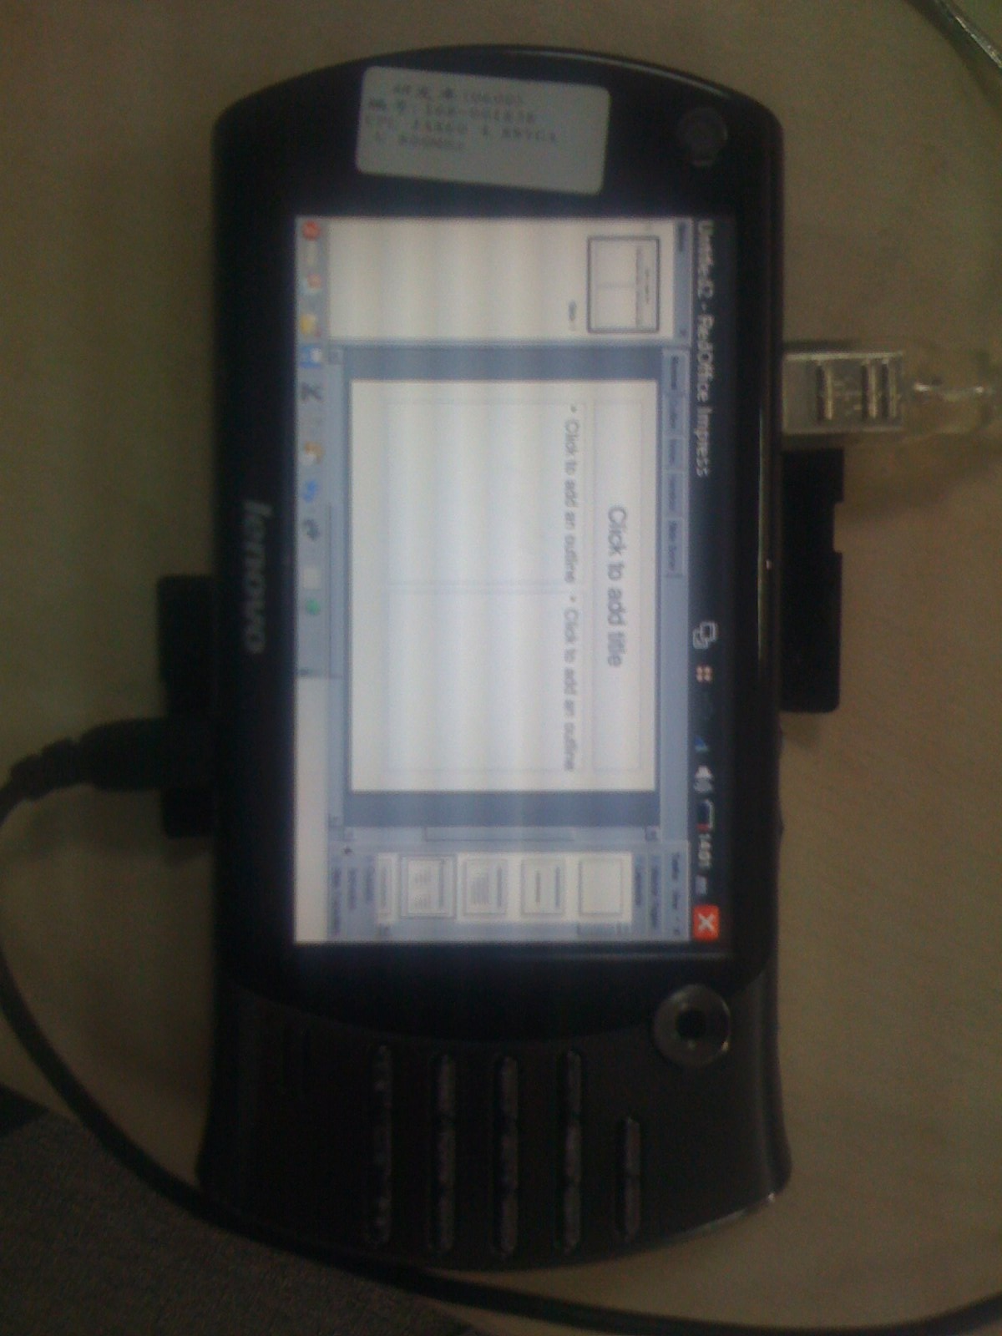
Fast and Small

Slide 4
BenchMark Results
From Andrew Z

Slide 5
Influence on performance
Hardware
  Multi-Core Supporting
Development Skill
  Framework,Algorithm
Toolchain
  Compiler,Linker,Testtool,profiling

Slide 6
Obvious Performance Problems
Cold Start
  So many library need be loaded
  Multiplatform and multi-language support
Warm Start
Load/Save
Processing of large document

Slide 7
Traditional Flow of Optimizing
Create
Benchmark
Find out
Hotspots
Get the
Reason
Evaluating
effect
Retest
With Benchmark
Make
Changes

Slide 8
Differences in OOo
OOo was huge
  8 million lines code
  More than 150 modules
  At least 300 thousand functions
OpenSource Development and CWS

Slide 9
Both Refactoring and Optimizing
To Simplify OOo's structure
  Simplification can save space, but be not faster
Optimize the code and algorithm in new structure
To plan to refactor framework for following versions
  Thread framework
Optimizing obvious hotspot in certion version

Slide 10
Performance RoadMap
Description of OOo framework from performance veiw
Clear interactivity in hotspots
Easy to predict effect of optimizing
Accurately defining benchmark and measure effect of change
Easy to understand profiling report

Slide 11
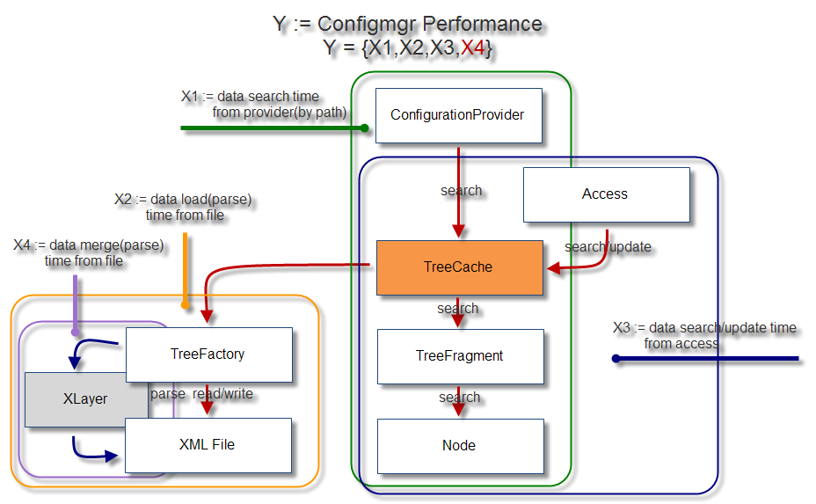
Example of Configmgr

Slide 12
Demonstration of Tools
Benchmark
  Code Level
  Macro
  Extensions
  Statistic Tools
Profiling
  Valgrind

Slide 13
Resources
http://wiki.services.openoffice.org/wiki/Performance
http://tools.openoffice.org/performance/index.html
performance@tools.openoffice.org
http://www.frontendart.com/ooomo.php

Slide 14
Thanks for
Matthias Huetsch
Malte Timmermann
Michael Meeks

Slide 15
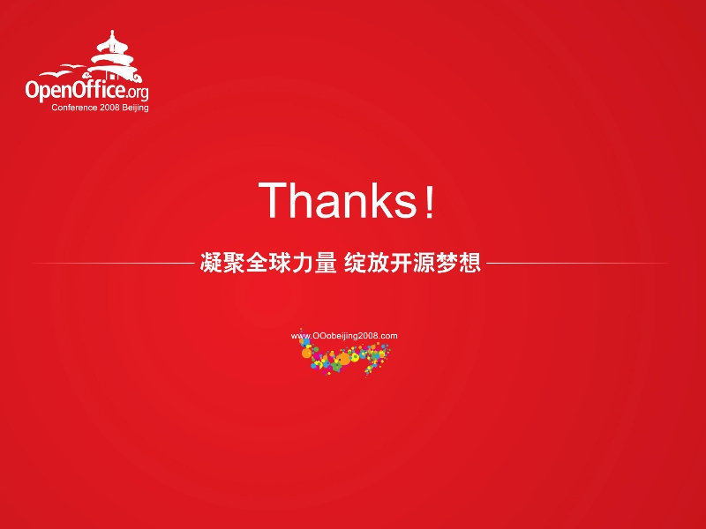
www.OOoBeijing2008.com
http://marketing.openoffice.org/ooocon2008/

