Slide 1


Slide 2

Running OOo on Mobile Internet Device
Xiuzhi Cheng chengxiuzhi@redoffice.com
Beijing RedFlag 2000

Slide 3

Agenda
MID Profile
Basic office requirements
Design and implementation
    Bootstrap process
    Menubar and Toolbar
    Document thumbnails arrangement Styles
    Dialog Box
Issues and future tasks
Summary

Slide 4
Terminology
MID
Mobile Internet Device, is term used by several vendors, including Intel, ARM and TI to describe a multimedia-capable handheld computer providing wireless Internet access
OOo
OpenOffice.org, the most famous cross-platform opensource office suit
RedOffice
Based on OpenOffice.org , designed by RedFlag 2000 team since 2001
D-BUS
D-Bus is a system for low-latency, low-overhead, easy to use interprocess communication (IPC). Please see:
http://dbus.freedesktop.org/doc/dbus-specification.html#introduction

Slide 5
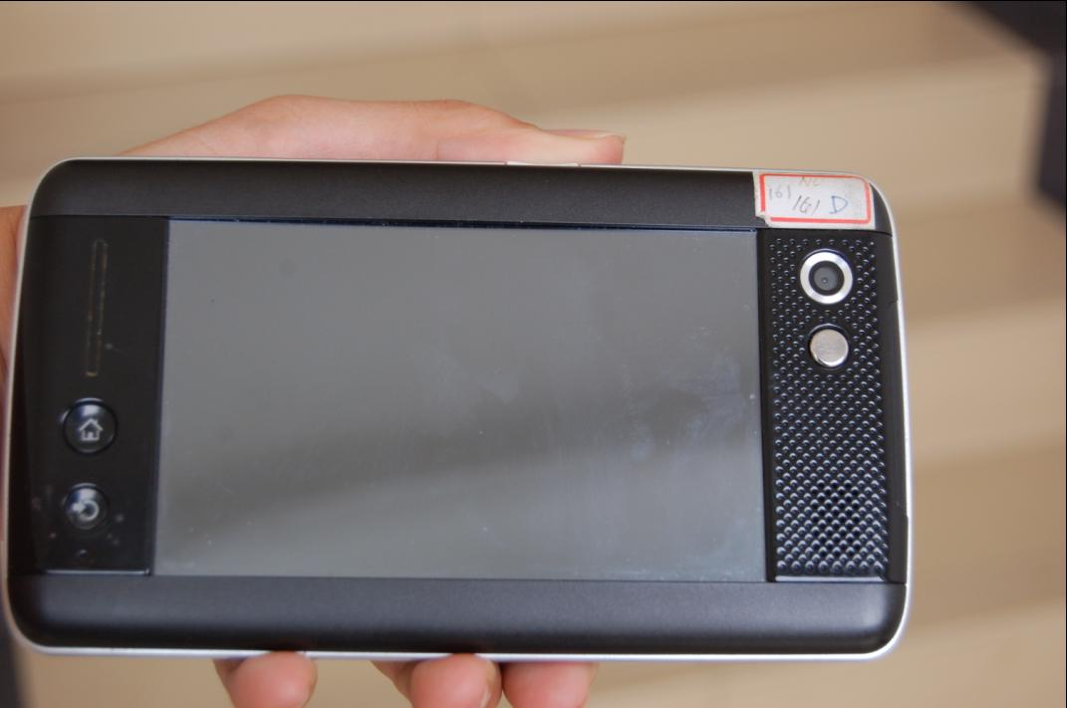
MID Product

Slide 6
Hardware & Software of MID
Screen Size and resolution: 4.81'' WVGA 800x480 TFT touch screen
CPU: Intel Silverthorne, 800MHz 512K L2 400/533 FSB 45nm
Memory: On-board SDRAM design, 512MB DDR2 533MHz SDRAM
HardDisk: PATA(Parallel Advanced Technology Attachment) interface, SSD (solid state disk): 4G
Input Device: Stylus touch pen
OS: Linux, based on China's Red Flag Linux known as Red Flag MIDINUX

Slide 7
Basic Requirements
More editing and reading area should be left for end users because the small screen size and lower screen resolution on MID.
Redesign the UI to make the MID Office interface more friendly on MID OS, such as Menu, Toolbar, Dialog, workflow.

Slide 8
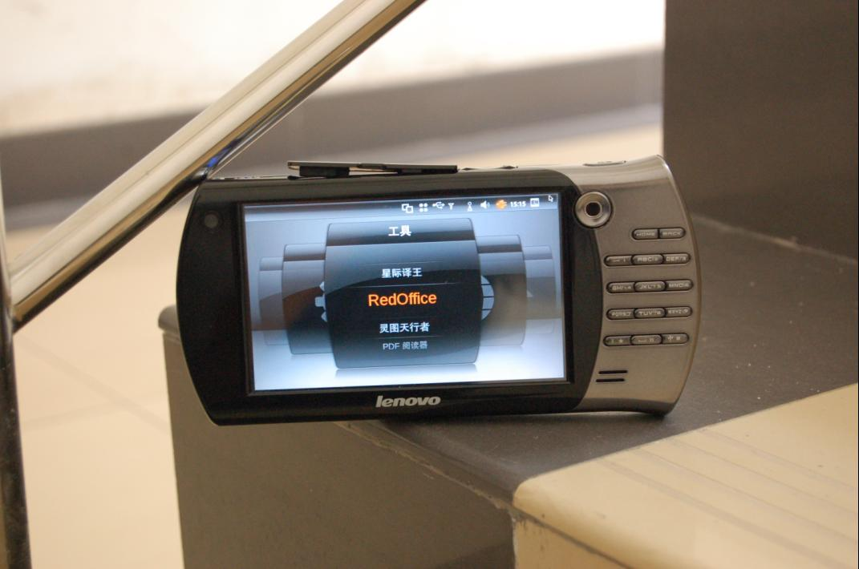
RedOffice on MID

Slide 9
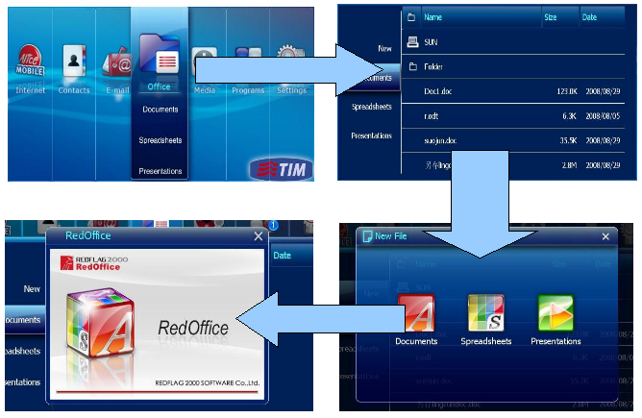
Office Bootstrap Process

Slide 10
Redesign the Menubar and Toolbar
Issues:
It is too big to MID if we display Menubar and Toolbars at the same time.
Ideas:
  Removed the original Menubar, a new root menu button added to Toolbar in order to trigger the whole pop-up menu.
  The relationship of OOo multi-level menu remains
  Cut off less frequently used menu items
  Put the new designed Toolbar on the top of the screen.

Slide 11
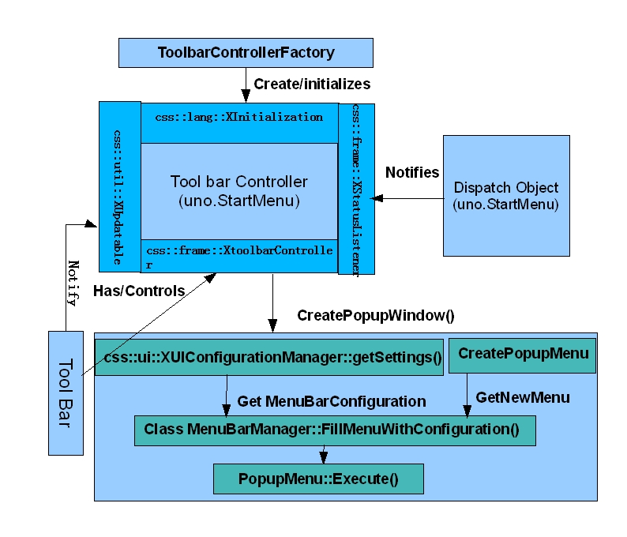
Implementation

Slide 12
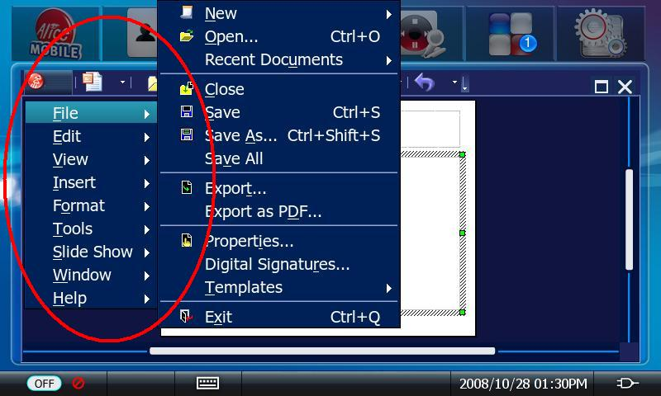
Snapshot of combing
Menubar and Toolbar

Slide 13
Customized Toolbar
Issues:
Toolbar button look very small
Solutions:
  Only keep one Toolbar with seven popular buttons
  End-user can customize these seven buttons if they dislike these default buttons
  The max button number of Toolbar is seven
  Change the alignment of Toolbar from “left-align”to “justified” to make the UI more elegant

Slide 14
Toolbar reorganization
Idea: Toolbar buttons can be handled by modifying the toolbar configure files with the suffix.xml in source dump . The configure xml file define what the toolbar contains sub-items,what functions the button do, as well as whether it can be visible or not. By this way, we can achieve the custom toolbar.
For example:
<?xml version="1.0" encoding="UTF-8"?>
<toolbar:toolbar xmlns:toolbar="http://openoffice.org/2001/toolbar" ">
<toolbar:toolbaritem xlink:href=".uno:DesignerDialog" toolbar:visible="false"/>
<toolbar:toolbarseparator/>
<toolbar:toolbaritem xlink:href=".uno:StyleApply" toolbar:visible="false"/>
<toolbar:toolbarseparator/>
<toolbar:toolbaritem xlink:href=".uno:CharFontName" />
<toolbar:toolbarseparator/>
<toolbar:toolbaritem xlink:href=".uno:FontHeight" />
</toolbar:toolbar>

Slide 15
Implementation
In toolbox.cxx
Change the width of toolbar button in ToolBox::ImplCalcItem(){
Rectangle aScreen = GetDesktopRectPixel();
rUmpcBtnWidth = (aScreen.GetWidth() - (UMPC_MAXBUTTON_NUMBER*2*UMPC_SEPARATORBUTTON_WIDTH) - 10) / (UMPC_MAXBUTTON_NUMBER + UMPC_SYSBUTTON_NUMBER);
rUmpcBtnHeight = UMPC_ITEMBUUTTON_HEIGHT;
}

Slide 16
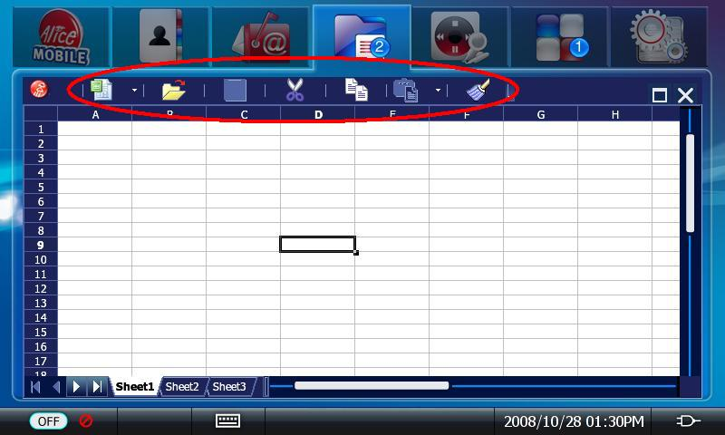
New Toolbar after Cutoff

Slide 17
Arrangement of editing documents
  The thumbnails with Redflag2000 logo of documents would be arranged on the screen in a special order when pressing one Function key down as RedOffice is running.
  Return to editing mode - press one of thumbnails
  Close the document - press close icon in the upper right corner of its thumbnail.

Slide 18
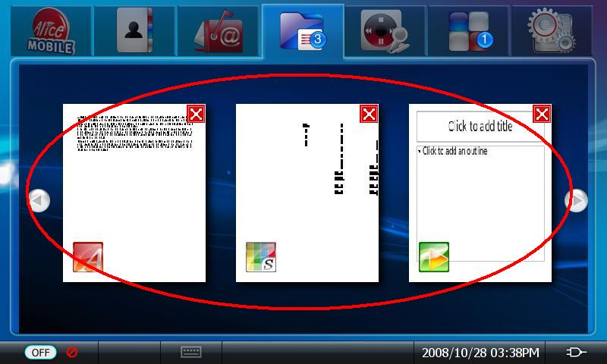
Arrangement Style: Array

Slide 19
Arrangement styles：
Array and Random
Array Style:
The thumbnails are arranged from left to right in one line on the screen. There is two arrows to handle the theme pages down and up.
Random Style:
The thumbnails are arranged randomly on the screen. They Can be covered each other. User can move the theme by drag and drop.

Slide 20
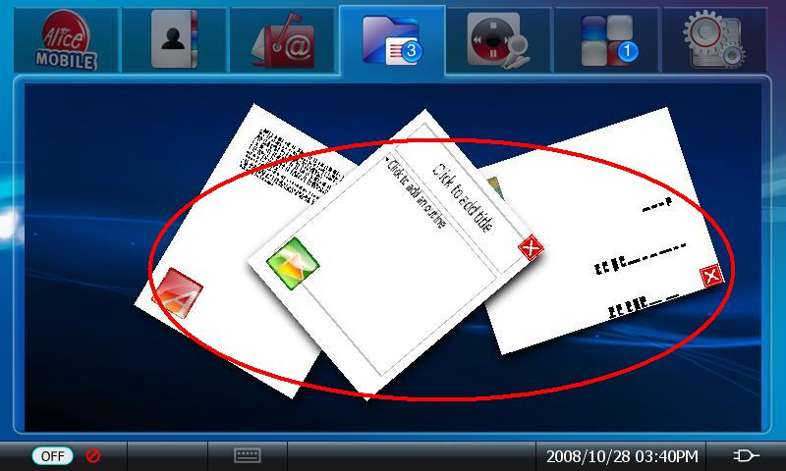
Arrangement Style: Random

Slide 21
D-bug message
A message consists of a header and a body. If you think of a message as a package, the header is the address, and the body contains the package contents. The message delivery system uses the header information to figure out where to send the message and how to interpret it; the recipient interprets the body of the message.
Both header and body use the same type system and format for serializing data. Each type of value has a wire format.

Slide 22
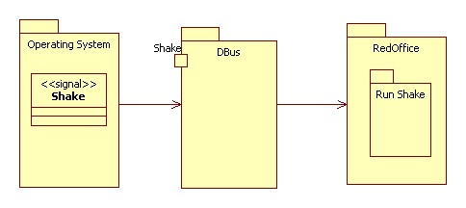
Principle of Implementation

Slide 23
Step 1:
Receiving the message from OS.
The system will send a message “shaked”to OOo by D-bus when user is willing to do shaked arrangement.
OOo need add a module to support the the D-bus message access.
Creating a new thread to monitor the D-bus message. The process to D-bus message cycle is built in this thread. It can filter “Shaked”message from system D-bus messages ,and communicate to UNO services. Then OOo will trigger the operation of”shaked assignment”by UNO service.

Slide 24
Step 2:
Get the thumbnails from office and then arrange these thumbnails randomly on screen
Firstly, the thumbnails should be get. It can be achieved by print the current page to an virtual device and transfer them to meta format, then re transfer to the format that we need.
Secondly, arrange the thumbnails by the rule “random”. Every document has one thumbnail

Slide 25
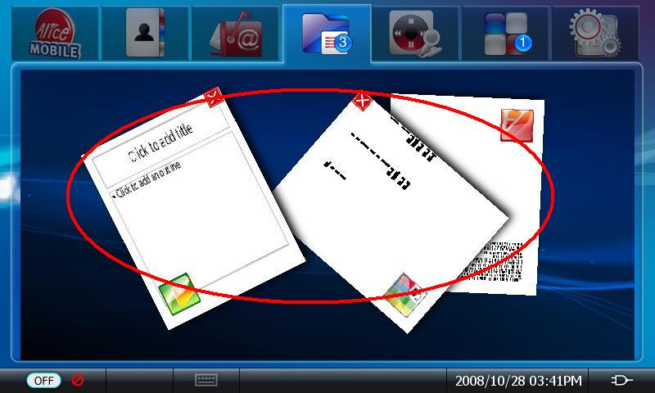
Arrangement Style: Random

Slide 26
Dialog issues
As the screen size limitations, some OOo dialogs are too big to MID, out of the MID screen while they can display on Desktop PC correctly.
Even worse MID can not support mouse and can not move Dialog by drag and drop.
The number of the Dialog effected depends on the screen size/resolution.

Slide 27
Solution of improvement Dialog
Solution 1 :
Change the positions of items on dialog or cut off some items to make the size smaller.
disadvantage:Too many dialog boxes must be resized. The number is uncertain to different screen size.
Solution 2:
Reform the dialog class: add a scroll bar on the big dialogs class.

Slide 28
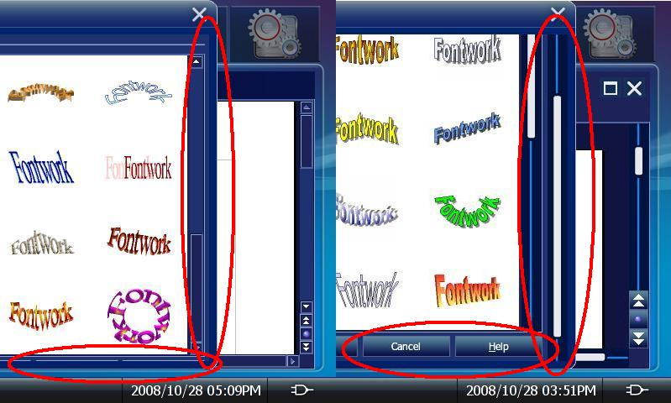
  Before
  After

Slide 29
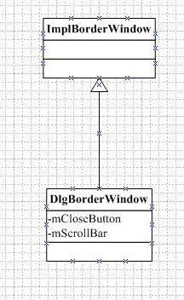
Implementation of the new Dialog -1
Step1: Create class DlgBorderWindow
class DlgBorderWindow : public ImplBorderWindow
{ ScrollBar mScrollBar;
PushButton mCloseButton;
public:
DlgBorderWindow( Window* pParent,
WinBits nStyle = 0,USHORT nTypeStyle = 0 );
~DlgBorderWindow();
DECL_LINK(ScrollHdl,void *);
DECL_LINK(CloseDialog,void *);
};

Slide 30
Implementation of the new Dialog -2
Step2 : Use DlgBorderWindow instead of ImplBorderWindow in the Dialog Init method.
void Dialog::ImplInit( Window* pParent, WinBits nStyle )
{...
ImplBorderWindow* pBorderWin = new ImplBorderWindow( pParent, nStyle, BORDERWINDOW_STYLE_FRAME );
DlgBorderWindow* pBorderWin = new DlgBorderWindow( pParent, nStyle, BORDERWINDOW_STYLE_FRAME );
...}

Slide 31
Disable function keys
To avoid the conflicts to Midinux function keys, all function keys of the RedOffice are disabled.
This can be done by delete the items in the configure:
<accel:acceleratorlist >
<accel:item accel:code="KEY_Q" accel:mod1="true" xlink:href=".uno:Quit"/>
<accel:item accel:code="KEY_O" accel:mod1="true" xlink:href=".uno:Open"/>
<accel:item accel:code="KEY_OPEN" xlink:href=".uno:Open"/>
<accel:item accel:code="KEY_P" accel:mod1="true" xlink:href=".uno:Print"/>
<accel:item accel:code="KEY_S" accel:mod1="true" xlink:href=".uno:Save"/>
<accel:item accel:code="KEY_N" accel:mod1="true" xlink:href=".uno:AddDirect"/>
<accel:item accel:code="KEY_W" accel:mod1="true" xlink:href=".uno:CloseWin"/>
<accel:item accel:code="KEY_F4" accel:mod1="true" xlink:href=".uno:CloseWin"/>
</accel:acceleratorlist >

Slide 32
Issues and ToDos
Size:
  The OOo size is too big to MID: need cut off OOo features.
Performance:
  OOo runs slowly on MID, e.g. Bootstrap speed.
Display refresh:
  Refresh issues on MID.

Slide 33
Summary
To make RedOffice run smoothly on MID, Some improvements must to be done such as UI,Dialog and other workflows of application
After the efforts and series of improvement, RedOffice can run on MID stably
Many challenge need to overcome, such as the huge size of office, performance and so on.

Slide 34
Q & A

Slide 35

www.OOoBeijing2008.com
http://marketing.openoffice.org/ooocon2008/

