Slide 1

Seamless UI Integration of Extensions into OpenOffice.org
Carsten Driesner
OpenOffice.org Framework Project Lead
Sun Microsystems, Inc.
<Nummer>

Slide 2
Overview
What's the purpose of this presentation?
Addons.xcu – A short introduction
What features are available?
  Introduction
  Examples
  How to use or implement it
  Planned improvements.
Future outlook

Slide 3
What's the purpose of this presentation?
Some months ago I looked over the OpenOffice.org extension repository.
What I found out?
  Overall the quality of extensions is good.
  User interface integration could be better.
What could help extension developers?
  A cookbook regarding user interface integration.

Slide 4
Addons.xcu – A short introduction
Central OpenOffice.org configuration file (XML based) to define certain user interface aspects for an extension.
  Define menus and toolbars
  Define and associate custom images to commands
  Merging for menus and toolbars
Normally every extension with a user interface contains an Addons.xcu file.
It will be enhanced in the future.

Slide 5
What features are available?
Popup Menu Controller
Complex Toolbar Controller
Toolbar and Menu Merging
Accelerators
Context Menu Interception

Slide 6
Popup Menu Controller
What's a popup menu controller?
  A popup menu controller manages the content of a popup menu which is part of the OpenOffice.org menu bar.
When should one use a popup menu controller?
  Whenever the content is dynamic or only known at runtime.
  If you want to exchange an existing popup menu controller.

Slide 7
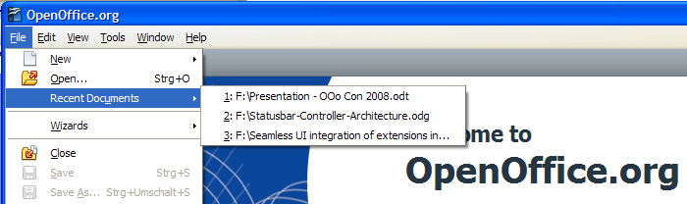
Popup Menu Controller
Examples
  The recent file list (File – Recent Documents)
  Create a new document (File – New)
  Available toolbar list (View - Toolbars)

Slide 8
Popup Menu Controller
How to implement a popup menu controller?
  Two different parts are needed.
    1. Add your popup menu controller to the Controller.xcu configuration file.
    2. Implement the UNO com.sun.star.frame.PopupMenuController service.

Slide 9
Popup Menu Controller
Sample Controller.xcu
<?xml version='1.0' encoding='UTF-8'?>
<!DOCTYPE oor:component-data SYSTEM "../../../../../component-update.dtd">
<oor:component-data oor:name="Controller" oor:package="org.openoffice.Office.UI" xmlns:oor="http://openoffice.org/2001/registry" xmlns:xs="http://www.w3.org/2001/XMLSchema" xmlns:xsi="http://www.w3.org/2001/XMLSchema-instance">
<node oor:name="Registered">
<node oor:name="PopupMenu">
<node oor:name="org.openoffice.Office.MyNewPopupMenuController" oor:op="replace">
<prop oor:name="Command">
<value>org.openoffice.Office.MyExtension:MyCommand</value>
</prop>
<prop oor:name="Module">
<value/>
</prop>
<prop oor:name="Controller">
<value>org.openoffice.office.myExtension.ControllerImplementationName</value>
</prop>
</node>
</node>
</node>
A very simple format for controller registration.

Slide 10
Popup Menu Controller
UNO Service: com.sun.star.frame.PopupMenuController
There are two central interfaces.
module com { module sun { module star { module frame {
interface XPopupMenuController : com::sun::star::uno::XInterface
{
void setPopupMenu( [in] com::sun::star::awt::XPopupMenu PopupMenu );
void updatePopupMenu();
};
}; }; }; };
module com { module sun { module star { module awt {
interface XMenuListener : com::sun::star::lang::XEventListener
{
[oneway] void highlight( [in] com::sun::star::awt::MenuEvent rEvent);
[oneway] void select( [in] com::sun::star::awt::MenuEvent rEvent);
[oneway] void activate( [in] com::sun::star::awt::MenuEvent rEvent);
[oneway] void deactivate( [in] com::sun::star::awt::MenuEvent rEvent);
};
}; }; }; };
Comprehensive tutorial is available here:
  http://wiki.services.openoffice.org/wiki/Framework/Tutorial/Popup_Menu_Controller

Slide 11
Popup Menu Controller
Planned improvements for OpenOffice.org 3.1
  Enhanced UNO AWT* menu API (Mainly done by community member Ariel Constenla Haile)
    Support for images (get/set/remove/rotate/mirror)
    Get/set tool tip and help text
    Get/set keyboard shortcut information (accelerators)
    New style services for ease of use
  New UNO service for simple access to custom images (Mainly done by Shi Zhoubo from RedFlag 2000)
    Retrieve your custom images via command URL
* Abstract Window Toolkit

Slide 12
Complex Toolbar Controller
What's a complex toolbar controller?
  An implementation which manages all aspects of a single toolbar item.
When should one use a complex toolbar controller?
  If you want to provide a set of functions / values at one place.
  The user should be able to enter information.
  To sum up:
    Whenever a simple button doesn't provide enough flexibility.

Slide 13
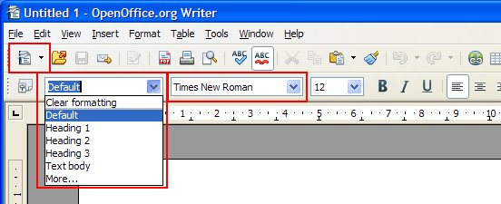
Complex Toolbar Controller
Examples
  Apply Style Combo Box (Formatting Bar)
  Font Name Combo Box (Formatting Bar)
  New Document Button (Standard Bar)

Slide 14
Complex Toolbar Controller
How to implement a complex toolbar controller?
  Two different parts are needed. Extensions providing a user interface integration already have both of them.
    Add a controller type property to your Addons.xcu
    Extend your protocol handler implementation
    If you want to receive notifications from the toolbar control implement: com.sun.star.frame.XControlNotificationListener

Slide 15
Complex Toolbar Controller
Sample Addons.xcu
<?xml version='1.0' encoding='UTF-8'?>
<oor:component-data xmlns:oor="http://openoffice.org/2001/registry" xmlns:xs="http://www.w3.org/2001/XMLSchema" oor:name="Addons" oor:package="org.openoffice.Office">
<node oor:name="AddonUI">
<node oor:name="OfficeToolBar">
<node oor:name="org.openoffice.Office.example.Search" oor:op="replace"> <prop oor:name="URL">
<value>org.openoffice.Office.example.Search:SearchText</value>
</prop>
<prop oor:name="Title">
<value xml:lang="en-US">Search Text</value>
</prop>
<prop oor:name="Context" oor:type="xs:string">
<value>com.sun.star.text.TextDocument</value>
</prop>
<prop oor:name="ControlType" oor:type="xs:string">
<value>Combobox</value>
</prop>
<prop oor:name="Width" oor:type="xs:long">
<value>200</value>
</prop>
</node>
</node>
</node>
</oor:component-data>
Just two additional properties to define a combo box with a certain width.

Slide 16
Complex Toolbar Controller
Sample code (C++) to set a list
// The command "SetList" currently supports only one parameter
Sequence< NamedValue > aArgs( 1 );
// create a sequence of strings for the dropdown menu
Sequence< rtl::OUString > aList( 3 );
aContextMenu[0] = rtl::OUString::createFromAscii( "Entry 1" );
aContextMenu[1] = rtl::OUString::createFromAscii( "Entry 2" );
aContextMenu[2] = rtl::OUString::createFromAscii( "Entry 3" );
// argument is called "List"
aArgs[0].Name = rtl::OUString::createFromAscii( "List" );
aArgs[0].Value <<= aList;
// initialize control command
com::sun::star::frame::ControlCommand aCtrlCmd;
aCtrlCmd.Command = rtl::OUString::createFromAscii( "SetList" );
aCtrlCmd.Arguments = rArgs;
com::sun::star::frame::FeatureStateEvent aEvent;
aEvent.FeatureURL = aURL;
aEvent.Source = (::com::sun::star::frame::XDispatch*)this;
aEvent.IsEnabled = bEnabled;
aEvent.Requery = sal_False;
aEvent.State <<= aCtrlCmd;
// send command via statusChanged to the control
xControl->statusChanged( aEvent );
More information:
  http://wiki.services.openoffice.org/wiki/Framework/Article/Generic_UNO_Interfaces_for_complex_toolbar_controls

Slide 17
Complex Toolbar Controller
Planed improvements
  Currently we have no plans.
  The design is very flexible therefore enhancements can be done very easily.
  This is a very good playground for people who want to help us.
Feedback is required from developers.
  What do you miss?

Slide 18
Toolbar and Menu Merging
What's toolbar and menu merging?
  A feature for extensions to manipulate toolbars and menu bars without writing any code.
When should one use toolbar and menu merging?
  If you want to add a your commands into existing user interface elements.
  If you want to exchange or remove items from existing user interface elements.

Slide 19
Toolbar and Menu Merging
Examples (use case)
  Your content management system should be available for OpenOffice.org. Loading and storing functions should be seamlessly integrated.
How to use toolbar and menu merging?
  Add your merging instructions into the Addons.xcu file.
    There are different sections for Toolbar and Menu Bar merging.

Slide 20
Toolbar and Menu Merging
Sample Addons.xcu to insert a toolbar item to the standardbar
<?xml version='1.0' encoding='UTF-8'?>
<oor:component-data xmlns:oor="http://openoffice.org/2001/registry" xmlns:xs="http://www.w3.org/2001/XMLSchema" oor:name="Addons" oor:package="org.openoffice.Office">
<node oor:name="AddonUI">
<node oor:name="OfficeToolbarMerging">
<node oor:name="org.openoffice.test.testcomponent" oor:op="replace">
<node oor:name="T1" oor:op="replace">
<prop oor:name="MergeToolBar">
<value>standardbar</value>
</prop>
<prop oor:name="MergePoint">
<value>.uno:Open</value>
</prop>
<prop oor:name="MergeCommand">
<value>AddAfter</value>
</prop>
<prop oor:name="MergeContext">
<value/>
</prop>
<node oor:name="ToolBarItems">
<node oor:name="B1" oor:op="replace">
<prop oor:name="URL">
<value>.uno:CloseDoc</value>
</prop>
<prop oor:name="Title">
<value>Close Document</value>
</prop>
</node>
</node> </node> </node> </node> </node> </oor:component-data>
More information about merging:
  http://wiki.services.openoffice.org/wiki/Framework/Article/Addon_Menu_Toolbar_Merging

Slide 21
Toolbar and Menu Merging
Planned improvements
  No plans for improvements.
  The design is very flexible therefore enhancements can be done easily.
Feedback is required from developers.
  What do you miss?
  Did you encounter performance issues?

Slide 22
Accelerators
What are accelerators?
  An accelerator key is a key or set of keys that performs a predefined function.
When should one use accelerators?
  Whenever you want a seamless integration of your extension into OpenOffice.org. There are several users who prefer to use accelerators to execute commands.

Slide 23
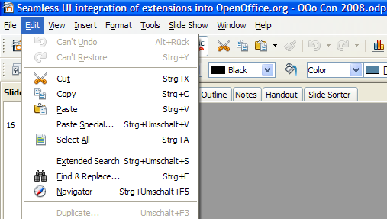
Accelerators
Example (use case)
  Your extended search function should be accessible via an accelerator.

Slide 24
Accelerators
How to define accelerators?
  There are two steps needed to register accelerators.
    Add a job to your extension to start your accelerator registration code.
    Use the user interface configuration API to register your accelerators.

Slide 25
Accelerators
Sample code (C++) to add an accelerator (CTRL+SHIFT+S) to the global accelerator configuration.
...
// Create the global accelerator configuration service
Reference< com::sun::star::ui::XacceleratorConfiguration > xGlobalAccelCfg(
m_xServiceManager->createInstance(
::rtl::OUString("com.sun.star.ui.GlobalAcceleratorConfiguration")),
UNO_QUERY_THROW );
// set key event to define the accelerator
com::sun:star::awt::KeyEvent aKeyEvent;
aKeyEvent.KeyCode = com::sun::star::awt::Key::S;
aKeyEvent.Modifiers = com::sun::star::awt::KeyModifier::SHIFT|
com::sun::star::awt::KeyModifier::MOD1;
// associate the accelerator with a command
xGlobalAccelCfg->setKeyEvent(aKeyEvent, rtl::OUString::createFromAscii(“.uno:Open”));
// store the changes in the configuration
xGlobalAccelCfg->store();
...
More information can be found here:
  http://wiki.services.openoffice.org/wiki/Framework/Tutorial/Accelerators

Slide 26
Accelerators
Planned improvements for OOo 3.1
  Accelerators are stored in the configuration (Cooperation with Wu Yan from RedFlag 2000).
  Extensions can add, remove or replace accelerators using a configuration file.
Sample Accelerators.xcu
<?xml version="1.0" encoding="UTF-8"?>
<oor:component-data xmlns:oor="http://openoffice.org/2001/registry" xmlns:xs="http://www.w3.org/2001/XMLSchema" oor:name="Accelerators" oor:package="org.openoffice.Office">
<node oor:name="PrimaryKeys">
<node oor:name="Global">
<node oor:name="V_MOD1" oor:op="remove"/>
<node oor:name="V_SHIFT_MOD1" oor:op="replace">
<prop oor:name="Command">
<value xml:lang="en-US">.uno:Paste</value>
</prop>
</node>
</node>
</node>
<node oor:name="SecondaryKeys">
<node oor:name="Global">
<node oor:name="V_MOD1" oor:op="replace">
<prop oor:name="Command">
<value xml:lang="en-US">.uno:Paste</value>
</prop>
</node>
</node>
</node>
</oor:component-data>

Slide 27
Context Menu Interception
What's context menu interception?
  A feature to manipulate context menus. You can add, remove and exchange menu items. Additionally it's possible to completely prevent that context menus are shown.
When should one use context menu interception?
  If your extension wants to add context dependent functions to a menu.
  If you want to suppress a certain or all context menus.

Slide 28
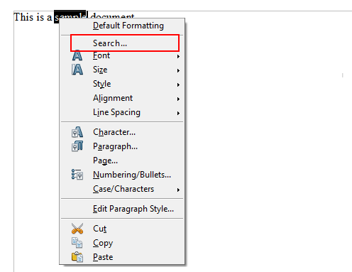
Context Menu Interception
Examples (use case)
  You want to add your search function to the Writer. Adding this function to a context menu looks natural.

Slide 29
Context Menu Interception
How to use context menu interception?
  There are several steps needed to have a working context menu interceptor.
    Add a job to your extension to receive events when a new frame is created (OnViewCreated).
    Implement a frame action listener to receive frame action events. That's necessary to register your interceptor on certain events (e.g. component attached)
    Implement a context menu interceptor that manipulates context menus.

Slide 30
Context Menu Interception
Very simple sample code to modify a context menu
ui::ContextMenuInterceptorAction SAL_CALL MyContextMenuInterceptor::notifyContextMenuExecute(
const ui::ContextMenuExecuteEvent& rEvent )
throw (uno::RuntimeException)
{
// The action trigger container is also a factory for sub containers and entries
uno::Reference< lang::XMultiServiceFactory > xFactory( rEvent.ActionTriggerContainer,
uno::UNO_QUERY);
// Create a simple menu entry using "com.sun.star.ui.ActionTrigger"
uno::Reference< beans::XPropertySet > xMenuEntry( xFactory->createInstance(
::rtl::OUString::createFromAscii("com.sun.star.ui.ActionTrigger")), uno::UNO_QUERY);
// Initialize label and command URL for the entry
::rtl::OUString aLabel = ::rtl::OUString::createFromAscuu("Search...");
::rtl::OUString aCommandURL = ::rtl::OUString::createFromAscii(
"org.openoffice.Office.Example:Search");
// Initialize label and command URL for the entry
xMenuEntry->setPropertyValue(::rtl::OUString::createFromAscii("Text"), uno::Any(aLabel)));
xMenuEntry->setPropertyValue(::rtl::OUString::createFromAscii("CommandURL"),
uno::Any(aCommandURL)));
// Insert entry to the third position
rEvent.ActionTriggerContainer->insertByIndex(2, uno::Any(xMenuEntry));
// Provide information to the framework how to proceed
return ui::ContextMenuInterceptorAction_EXECUTE_MODIFIED;
}
More information about context menu interception:
  http://wiki.services.openoffice.org/wiki/Framework/Tutorial/Context_Menu_Interception

Slide 31
Context Menu Interception
Planned improvements (no target yet)
  Every context menu should have a unique identifier.
    E.g. “private:resource/contextmenu/spellcheck”
  Convert resource based context menus to XML files.
  Provide context menu merging via Addons.xcu file.

Slide 32
Future outlook
Docking window support for extensions (Cooperation with RedFlag 2000)
  Integrate modeless UNO dialogs into docking windows
  Layout manager support for docking windows.
Context menus defined by XML files.
  Merging via configuration files.
Extended UNO AWT.
  More controls
    Grid control
  Access to more features/functions.
    Retrieve system properties
    Notifications when settings has been changed (colors, fonts).

Slide 33
Q & A
Meet the Sun Experts at the Sun Booth.
<Nummer>

