Slide 1


OpenOffice.org Extensions Repository – resumé after 1 year
Juergen Schmidt
StarOffice/OpenOffice.org
Sun Microsystems, Inc

Slide 2
Agenda
Impressions
The repository – at the beginning and today
Overview Extensions Infrastructure
Summary

Slide 3
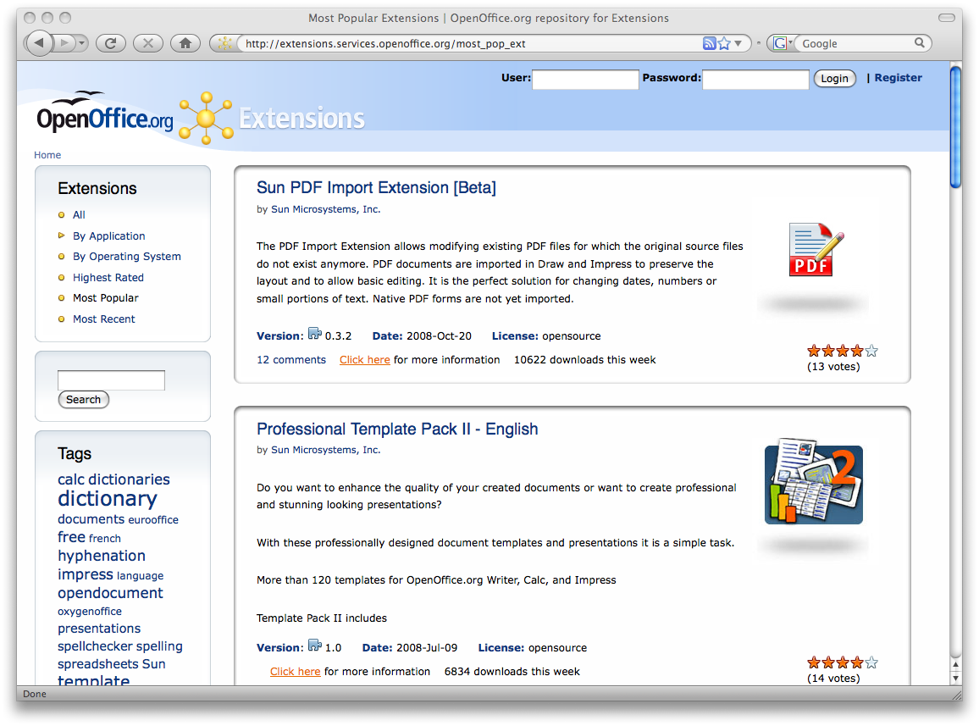

Slide 4






















Slide 5
The repository – at the beginning and today
Idea, I can't remember it exactly ...
Start August 2007
  With the new design
Repository for
  Real code extensions
  Dictionaries
  Templates
  Galleries

Slide 6
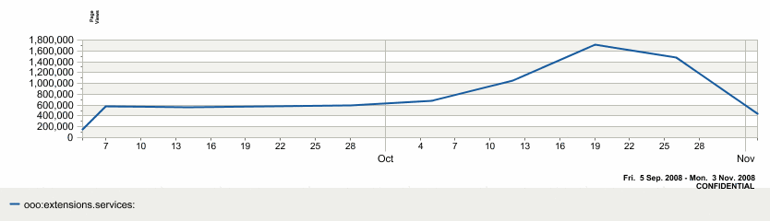
The repository – at the beginning and today
Localization is in progress
Today we have already 200 extensions
~400000-600000 page views a week

Slide 7
The repository – at the beginning and today
At least 3 new extensions per month (since August 2007)

Slide 8
Overview Extensions Infrastructure
New Extension Manager UI in OO.org 3
  New fresh design
  Support of own extension icons
  Localized display name
  Publisher name and link
  Description
    Coming with OO.org 3.1(hopefully)
    In the meantime the Extension Tooltip feature can be used
  Options button
    If an integrated options page is supported

Slide 9
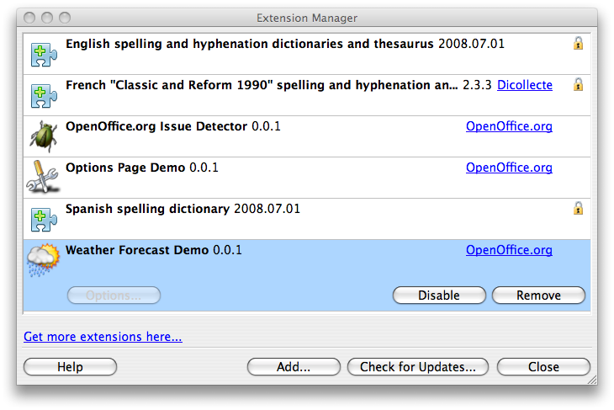

Slide 10
Overview Extensions Infrastructure
Integrated help support
  Own dialogs
  Options pages
  Useful but not yet planned or scheduled
    Help support for new calc add-in functions
    Help support in all service provider interfaces (SPI)
Dependencies
  Minimal version dependencies
  Maximal version dependencies (OO.org 3.1)

Slide 11
Overview Extensions Infrastructure
Visions and future plans
  Template repository
    Online
    Easy to use
  Office integration
    New template dialog
    Online, offline support
    Favorites
    Reconfigurable repository (?: intranet usage - without public net access)

Slide 12
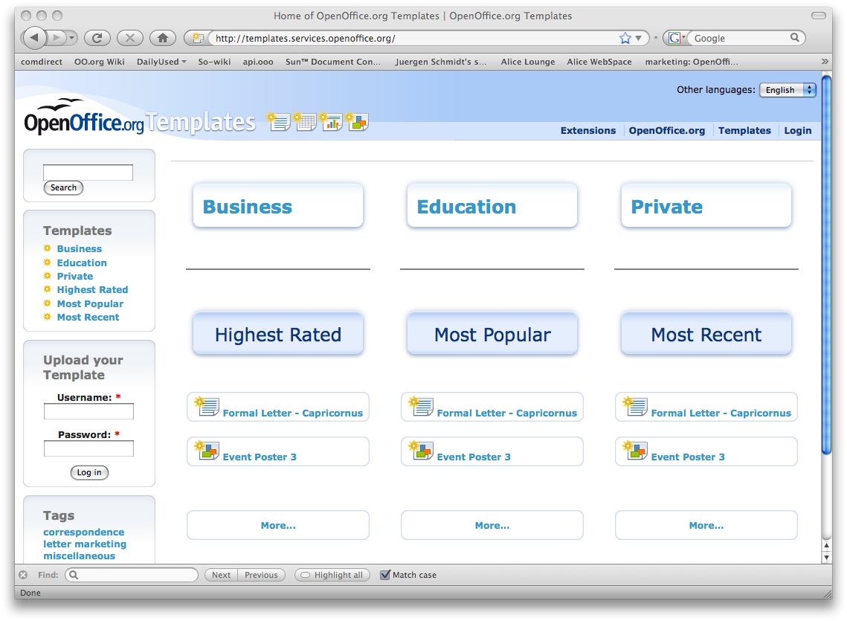

Slide 13



Overview Extensions Infrastructure
Visions and future plans
  Extended extension manager
    Recommendation of popular extensions (like Firefox)
    Browsing of all extensions
    Suggestion based on tags
Professional Template Pack II -
English
User A who has installed this
extension has also installed ...
An OxygenOffice Extra -
English Templates
Professional Template Pack -
English
de.OpenOffice.org -
German Templates

Slide 14
Summary
Extension repository
  Is growing (3 per month → should grow faster ...)
  Localization work is ongoing
Template repository
  Coming soon → content required
  More fine grained than template extensions
Extension manager
  Many ideas → realization is open
Overall integration via extension become better and better

Slide 15
Q & A
Meet the Sun experts here in Beijing.
Visit our Sun booth!
20%
57%
15%

Slide 16

Thank You for your attention!
Juergen Schmidt
juergen.schmidt@sun.com

