Slide 1
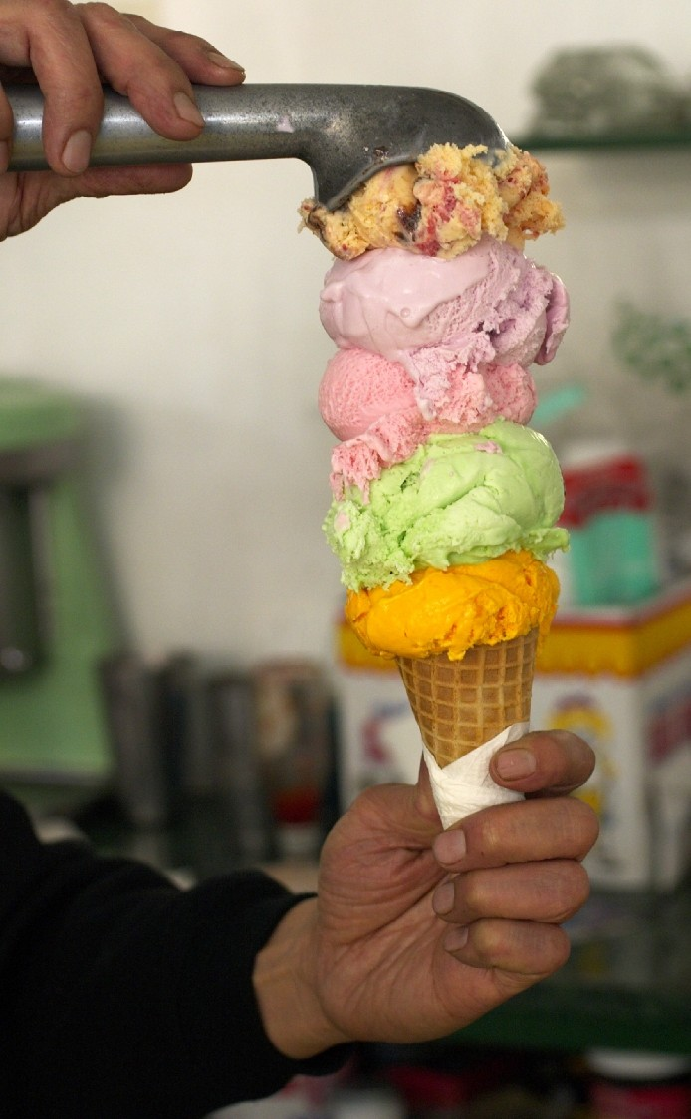


State of the
Project
Frank Loehmann
OOo Project Lead User Experience
Sun Microsystems
<Nummer>

Slide 2
Agenda
The User Experience Team in Beijing
State of the OOo User Experience (UX) project
OOo 3.0 usability improvements
OOo surveys
Direct user feedback program
What's next? Renaissance!
Q&A

Slide 3
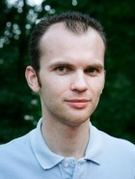
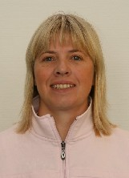
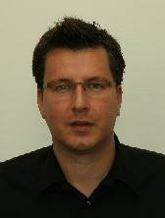
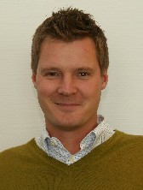
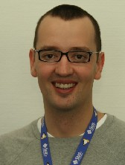
The User Experience Team in Beijing
Christoph Noack
OOo UX Project Co-Lead
Interaction Designer
Human-Machine-Interaction
OOo Volunteer
Bettina Haberer
User Experience Engineer
Sun Microsystems
Frank Loehmann
OOo UX Project Lead
User Experience Engineer
Sun Microsystems
Christian Jansen
User Experience Engineer
Sun Microsystems
Andreas Bartel
User Experience Engineer
Sun Microsystems

Slide 4
State of the UX Project
UX project became an official OOo project in March
New project leads since then:
  Lead: Frank Loehmann, Sun Microsystems
  Co-lead: Christoph Noack, OOo volunteer
Involved in all UI and feature changes on OOo
190 UX team members today (+130 people in 2008)
Relaunched homepage: http://ux.openoffice.org
And a new team blog: http://ux.openoffice.org/blog/
Very active mailing list: discuss@ux.openoffice.org

Slide 5
OOo 3.0 Usability Improvements
Highlights
  Writer
    New Notes
    Zoom Slider for Writer (Calc, Draw, Impress in OOo 3.1)
  Calc
    Solver
    Collaboration
    General usability improvements
  Draw/Impress
    New Presenter Console (additional extension)
  and many more...

Slide 6
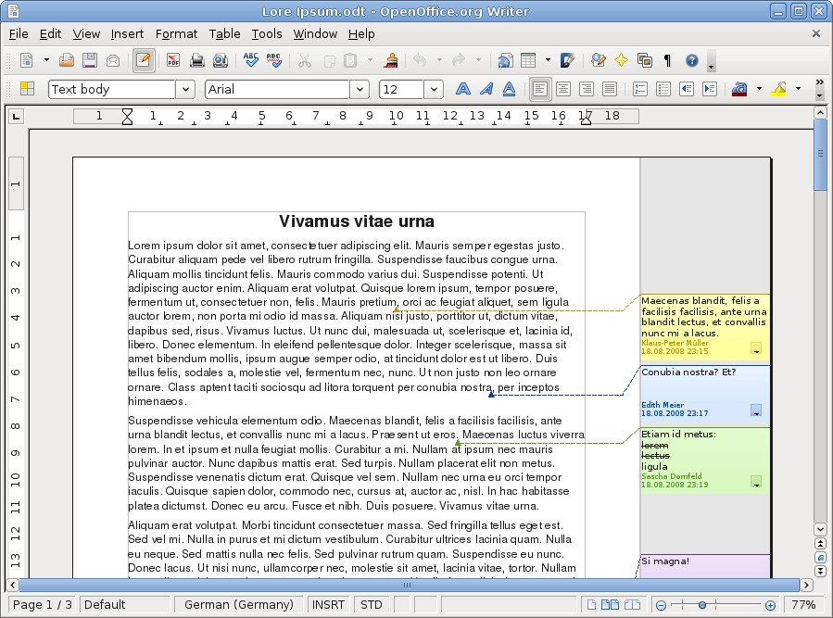
OOo 3.0 UX Improvements - Writer

Slide 7
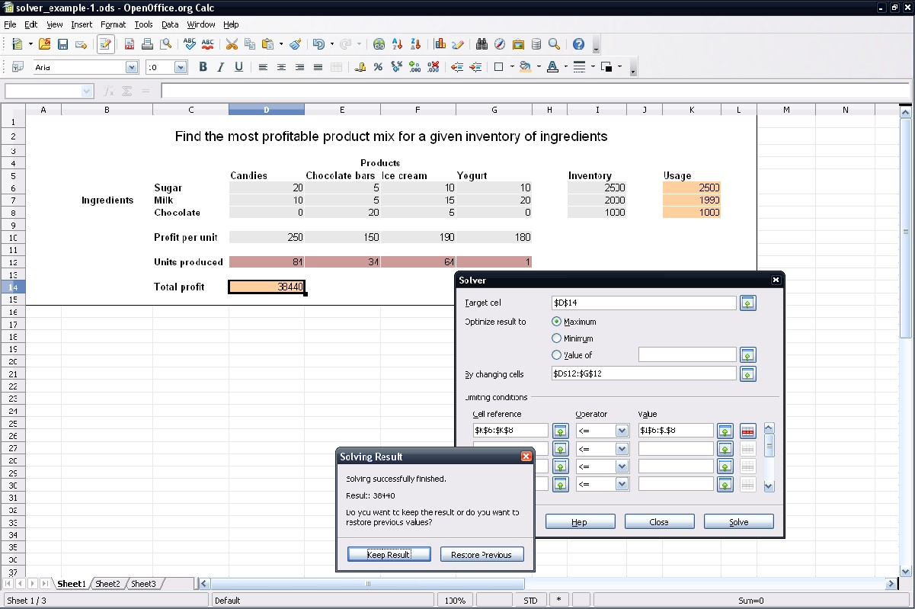
OOo 3.0 UX Improvements - Calc

Slide 8
OOo Surveys
UX team is now also responsible for surveys
Lime Survey is the new tooling for surveys
OOo User Survey has been reworked
  Shorter to increase participation (38 instead of 72 questions)
  Anonymous (registration part has been separated)
  Relaunch right before OOo Con
New Isometrics survey to build an UX index
  Detailed presentation on Friday, 14:00- 14:45:
  Numbers, Numbers, Numbers, or how data helps to improve the OOo User Interface

Slide 9
Collecting Direct User Feedback
User Feedback Extension
  OOo Extension
  Collecting real usage data
  Feedback program starts with release of OOo 3.0.1
  Extension will be bundled with OOo 3.1
Detailed presentation on Friday, 14:00- 14:45:
  Numbers, Numbers, Numbers, or how data helps to improve the OOo User Interface

Slide 10
What's Next?
Today we only patch OOo issue by issue
Without
  knowing and understanding what our customers
  really do or want to do with the software
  rethinking the currently used concepts
  a big picture of how it should be

Slide 11
What Do Our Users Complain About?
They complain about its cumbersome and outdated graphical user interface (GUI)
A great deal of functionality is hidden in many overstuffed toolbars, poorly structured menus and complex dialogs
Functions are thus difficult to access for novice users or too inefficient to use for expert users
In addition, the GUI offers an antiquated look & feel which is hardly capable to communicate innovation and to create joy of use

Slide 12
How Will the UX Team Change This?
We will run a data driven project to
  analyze our users needs and to
  understand our users
We want to innovate!
  Rethink user interaction
  Create a new appealing visual design
We do not want to
  Imitate
  Implement new features
How do we call it? Project Renaissance

Slide 13
Project Renaissance - Mission Statement
“Create a User interface so that OpenOffice.org becomes the users' choice not only out of need but also out of desire”

Slide 14
Questions & Answers

Slide 15
More UX Related Presentations
Numbers, Numbers, Numbers, or how data helps to improve the OOo User Interface
Friday, 14:00- 14:45
  Christian Jansen
  Andreas Bartel
Making the New Notes - Community, Cooperation, Concepts
Friday, 16:15- 17:00
  Max Odendahl
  Christoph Noack
  Christian Jansen

Slide 16


Thank you!
Frank Loehmann
frank.loehmann@sun.com
Christoph Noack
christophnoack@openoffice.org
<Nummer>

