Slide 1
Integrating CMS/DMS into OpenOffice
Michael E. Bohn
Consultant Office Migration
Sun Microsystems GmbH

Slide 2

Agenda
Motivation
CMS/DMS integration – current approach.
What is the Java Content Repository.
Snapshot of the current implementation.
Demo.

Slide 3
Motivation
Growing popularity of the Open Document Format.
Growing demand to manage information.
Increasing number of proprietary CMS/DMS.
Providing a common extension for all CMS/DMS.
Simplification of accessing and sharing informations.
Simplification of the administration of office installation.
Making OpenOffice.org available for more business solutions.
Making a migration much easier.

Slide 4
CMS/DMS integration – current approach

Slide 5


CMS/DMS integration
Different DMS provide propriety integration
  Alfresco
  FileNet
  OpenText
Each DMS uses his own API for communication
  Alfesco
    HTTP
  FileNet
    HTTP and Web-DAV
  OpenText
    .Net component

Slide 6
CMS/DMS integration – features provided
Common
  Browsing folders
  Checking files out and in
  Opening and saving documents
  Searching for documents
  Attaching keywords to documents
Special
  Managing work flows
  Converting documents

Slide 7
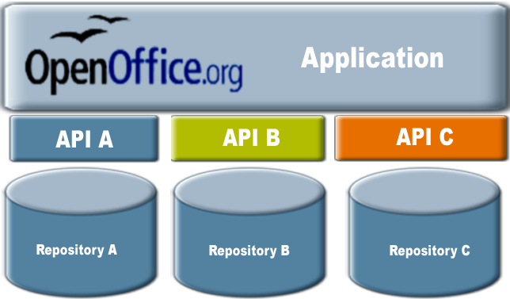
CMS/DMS integration – current approach

Slide 8
CMS/DMS integration – current approach
Many communication interfaces = Many extensions.
High learning curve for the user.
Complicated administration of the office installation.
Developer need to know each system.
User can not exchange their underlaying DMS.
Migration more complicated.

Slide 9
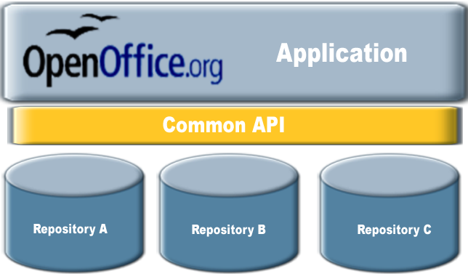
CMS/DMS integration – new approach

Slide 10
CMS/DMS integration – new approach
One communication interfaces = one extension.
User just needs to know one extension.
Simple administration of the office installation.
Developer can extend the function easily.
Customers can exchange their underlaying DMS.
Migration much easier.

Slide 11
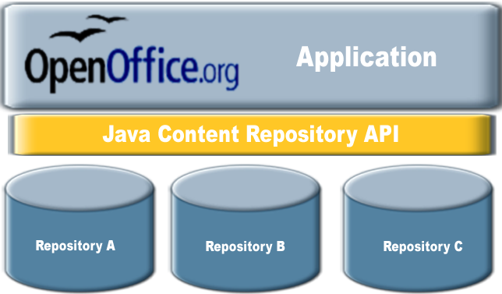
CMS/DMS integration – using JCR

Slide 12
Why using JCR as the common interface?
JCR Officially released June 17, 2005.
Two levels of compatibility with optional features.
JCR is widely adopted.
Many CM- an DM systems support an JCR API
Can be used locally and over the INTERNET

Slide 13













Systems supporting JCR
Many, many, many more……

Slide 14
What is Java Content Repository

Slide 15
What is Java Content Repository.
Consists of workspaces.
Workspace contains a tree of items.
An item can either be a node or a property.
Properties can only be a leaf
Nodes encapsulate the content structure
The actual content of the repository is stored in the values of the properties.
Level 1 – API functions to read the repository.
Level 2 – API functions to write into the repository.
XML and SQL queries supported

Slide 16
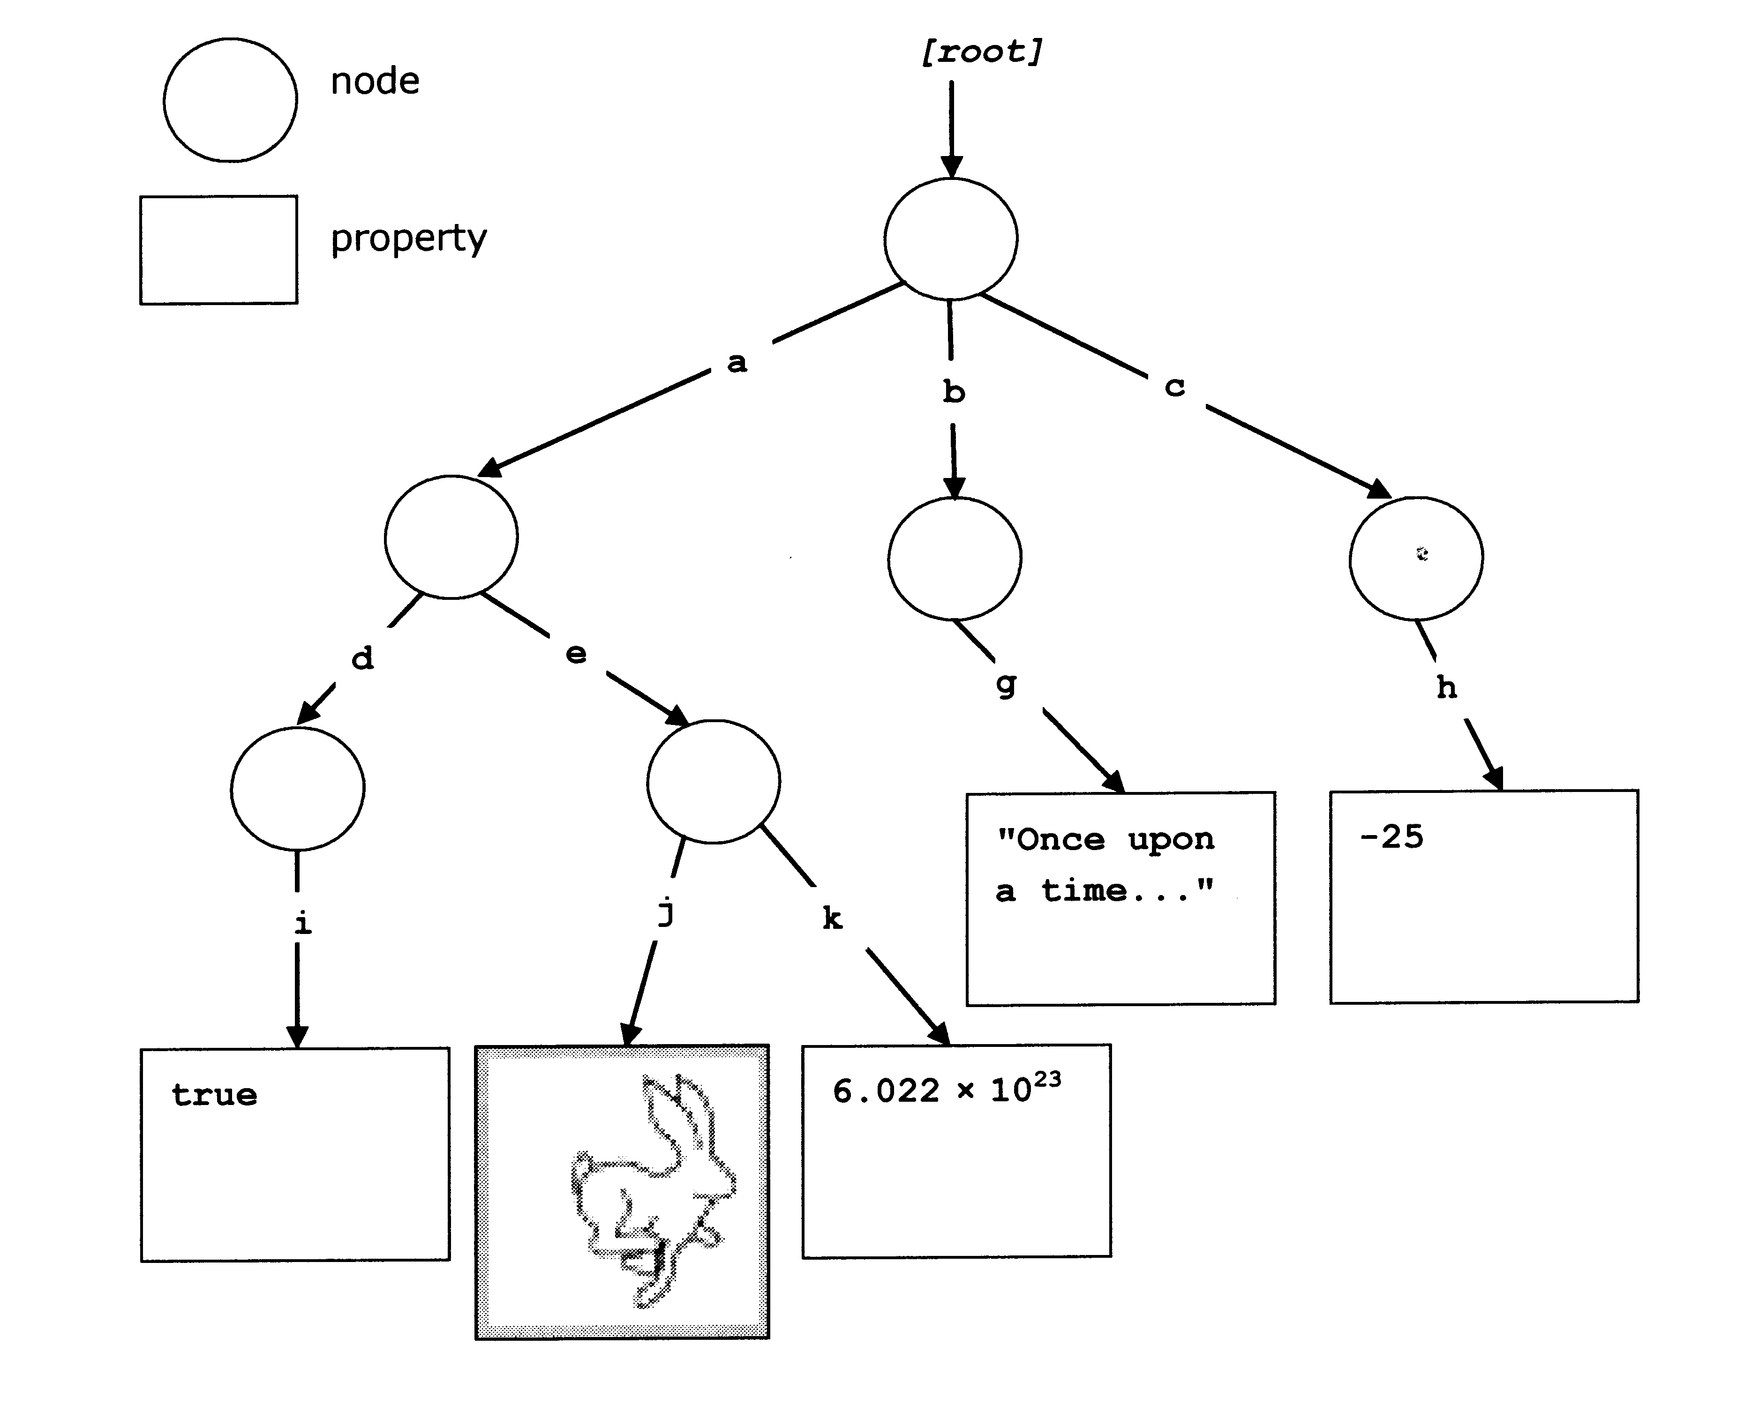
What is the Java Content Repository

Slide 17
How to use JCR with OpenOffice.org
Jackrabbit is a reference implementation for JCR.
Communication ways provided by Jackrabbit.
  Web-DAV - JCR API methods called via Web-DAV
  Remote API – functions called by using RMI
  Local API – functions called directly
Problems
  JCR with Web – DAV is not provided by all systems
  RMI is provided differently- difficult to configure on the client
  Local API is called differently on each DMS

Slide 18
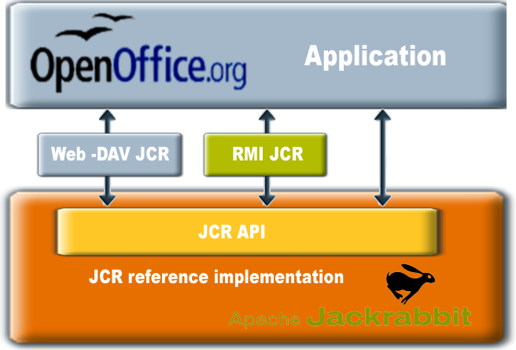
JCR - Communication ways

Slide 19
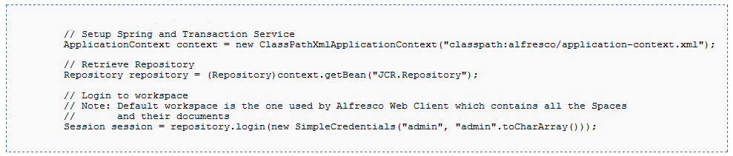
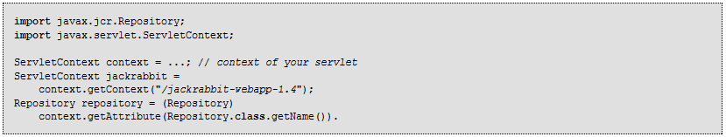
Getting JCR repository.

Slide 20
Current implementation
Supposed as prof of concept
Communication
  Set of actions has been defined
  XML is used to transport data between client and server
Serve side
  Separate Web application
  Servlet that acquires the repository object
Client side
  Java extension
  HTTP-Client used for communicating with the server
  XML – DOM used to analyze server responses

Slide 21
Current implementation
Functions
  Showing folders
  Sowing a list of documents available in a folder
  Creating folders
  Loading documents
  Saving documents
  Checking documents in and out
Servlet
  supposed to be the template for DMS vendors

Slide 22
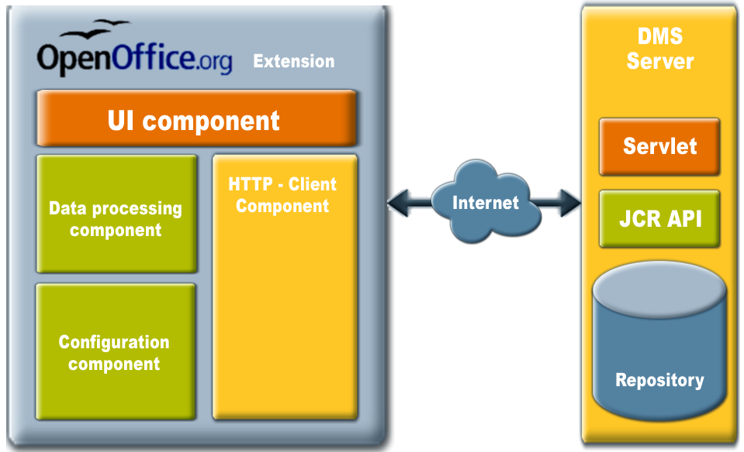
Snapshot of the current implementation

Slide 23
DEMO

Slide 24
Summary
Increasing number of proprietary DMS system
  Many extensions
  complicated
Common Interface
  Only one extension for all CMS/DMS
  Easier to maintain
  Easier to administrate
Java Content Repository is used
  Standard and widely adopted
Implementation
  Apache Jackrabbit
  Servlet

Slide 25

Q & A
Meet the Sun Experts at the Sun Booth.
24

