Slide 1


Developing Smart Tag Components for
OpenOffice.org
Frank Meies
  Co-Lead OpenOffice.org Writer
    Sun Microsystems
Frank Loehmann
  OpenOffice.org User Experience Team
    Sun Microsystems

Slide 2
Agenda
Project Background
What Are Smart Tags?
Smart Tags Demo
The Smart Tag API
Generic MOSTL Smart Tag
Example: Using the NetBeans IDE to Implement a
Smart Tag Extension
Q & A

Slide 3
Project Background
Smart tags have been introduced by Microsoft in MS Office XP, 2nd enhanced API for MS Office 2003
The OOo smart tags project was initiated by Jakob Lechner, Fabalabs, Austria in collaboration with the OOo Writer team
1st experimental smart tag API in OOo 2.2, re-designed for OOo 2.3

Slide 4
What Are Smart Tags?
Smart tags offer actions for text of a document
A smart tag component consists of two parts
  The recognizer which identifies a text part of a document by a certain criteria
  The actions offered for the recognized text
Writer only feature today
  No preinstalled smart tag component in OOo 2.3 available
  Hidden administration UI until installation of a smart tag component
  Installation of smart tag components as OOo extensions

Slide 5
Smart Tag Types, Recognizers, and Actions (1)
Smart Tag Type
mynamespace#email
Recognizer Component
email address recognizer
Action Component
email address actions
Action 1: compose email to
Action 2: new contact in address book
Action 3: ...

Slide 6
Smart Tag Types, Recognizers, and Actions (2)
An action component can also be used by more than one smart tag type
An action component could also provide more than one action
Recognizer
Component 1
Actions for Type 1
Action 1
...
Action n
Smart Tag
Type 1
Recognizer
Component 2
Action
Component 1
Smart Tag
Type 2
Actions for Type 2
Action 1
...
Action m
Action
Component 2
A recognizer component can serve more than one smart tag type
Actions for Type 2
Action 1
...
Action k

Slide 7
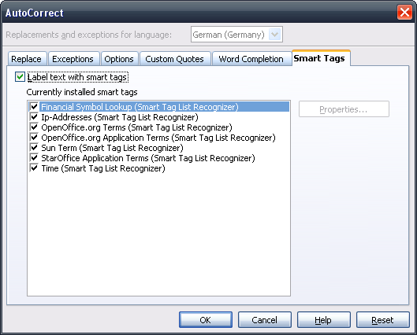
Smart Tag Administration Interface
Administration UI in Writer AutoCorrect dialog
Enable/Disable smart tag feature
Properties of a smart tag (optional)
List of currently installed smart tags
and possibility to disable single tags

Slide 8
Smart Tags Demo
Smart tags in Writer text are underlined and offer a mouse over feedback
Ctrl-click opens the action menu
Action menu could contain actions for more than one smart tag type
Demonstrational smart tag components can be found in the Links & Resources section of this presentation

Slide 9
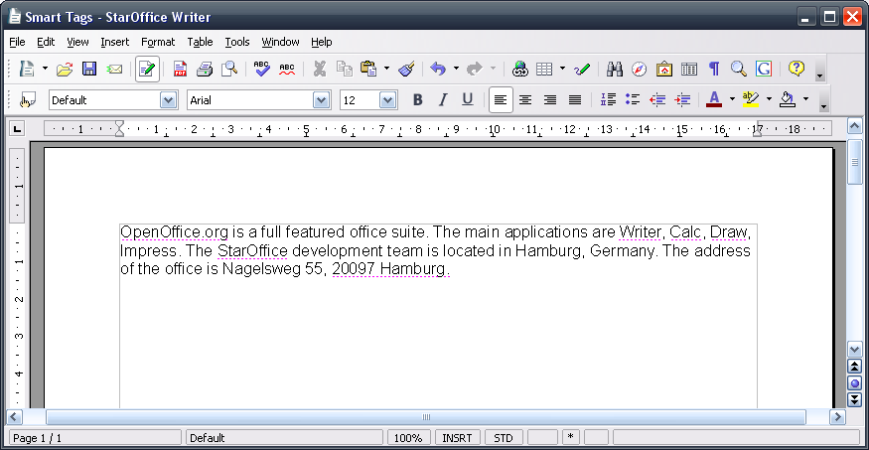
Smart Tags Demo – Step 1
Recognized text in a Writer document
Recognized text in a Writer document
Recognized text in a Writer document

Slide 10
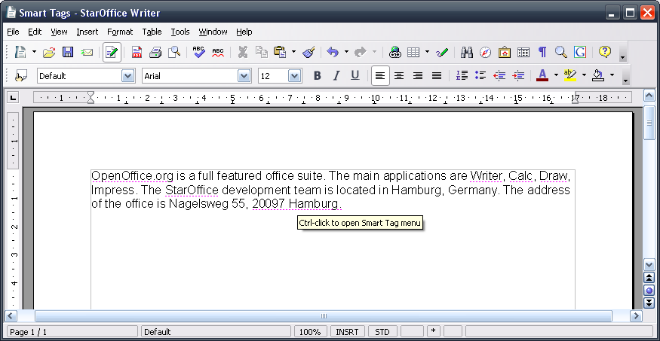
Smart Tags Demo – Step 2
Feedback on mouse over

Slide 11
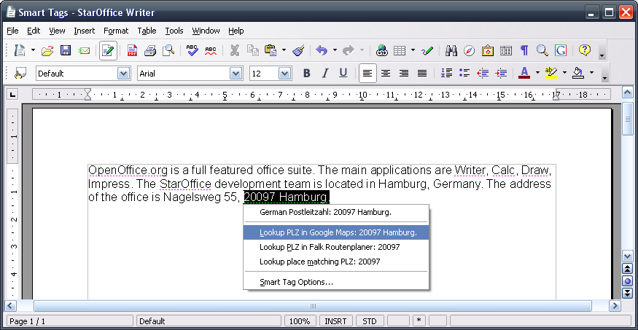
Smart Tags Demo – Step 3
Action menu shown on a ctrl-click

Slide 12
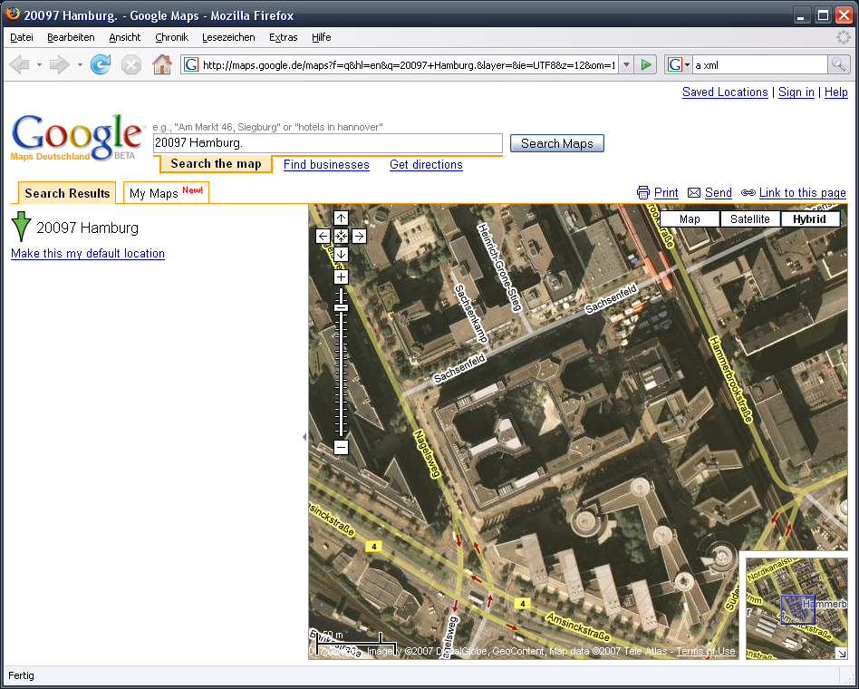
Smart Tags Demo – Step 4
Sun's office location shown in Google Maps

Slide 13
The Smart Tag API
offapi/com/sun/star/smarttags:
  service SmartTagRecognizer : XSmartTagRecognizer
  service SmartTagAction : XSmartTagAction
offapi/com/sun/star/text:
  XTextMarkup
udkapi/com/sun/star/container:
  XStringKeyMap

Slide 14
The XSmartTagRecognizer Interface
[attribute, readonly] long SmartTagCount
// 'internal' name of smart tag type: namespace#tagname
string getSmartTagName( [in] long nSmartTagIdx )
// UI name that describes this recognizer component
string getName( [in] css::lang::Locale aLocale )
bool hasPropertyPage( [in] long nSmartTagIdx )
void displayPropertyPage( [in] long nSmartTagIdx,
[in] css::lang::Locale aLocale )
void recognize( [in] string aText,
[in] css::text::XTextMarkup xTextMarkup,
[in] css::i18n::XBreakIterator xBreakIterator )

Slide 15
The XTextMarkup Interface
// pass smart tags to application
// nType = TextMarkupType::SMARTTAG
void commitTextMarkup( [in] long nType,
[in] string aIdentifier,
[in] long nStart,
[in] long nLength,
[in] css::container::XStringKeyMap xMarkupInfo );

Slide 16
Recognizer, TextMarkup and Action
Application
ST₁: type, range, [XStringKeyMap]
ST_{n}: type, range, [XStringKeyMap]
XTextMarkup
[XStringKeyMap]
invokeAction()
recognize()
type, range,
[XStringKeyMap]
commitTextMarkup()
[XStringKeyMap]
getMarkupInfoContainer()
XSmartTagRecognizer
XSmartTagAction
Recognizer Component
Action Component

Slide 17
The XSmartTagAction Interface (1)
[attribute, readonly] long SmartTagCount
// 'internal' name of smart tag type: namespace#tagname
string getSmartTagName( [in] long nSmartTagIdx )
// UI name for the smart tag type
string getSmartTagCaption( [in] long nSmartTagIdx,
[in] css::lang::Locale aLocale )
long getActionCount( [in] string aSmartTagType )
long getActionID( [in] string aSmartTagType,
[in] long nActionIndex )

Slide 18
The XSmartTagAction Interface (2)
// UI string for a single action
string getActionCaptionFromID( [in] long nActionID,
[in] css::lang::Locale aLocale )
// called by application to invoke an action
void invokeAction( [in] long nActionID,
[in] css::text::XTextRange xTarget,
[in] css::container::XStringKeyMap xProperties,
[in] string aText )

Slide 19
MOSTL Generic Smart Tag
MOSTL stands for “Microsoft Office Smart Tag List”
This generic smart tag component allows to define recognizers and actions in a simple XML file
  Recognition by
  Lists of terms
    Example: Stock Symbols (i.e. JAVA >> Sun Microsystems)
  Regular expressions
    Example: IP addresses (i.e. Whois request for IP Address)
  Action
  Execution of a predefined URL
  Recognized term can be passed in executed URL by a placeholder
Perfect to connect web services (i.e. Google) to OOo

Slide 20
MOSTL Generic Smart Tag – XML Code
<FL:smarttaglist xmlns:FL="http://schemas.microsoft.com/...">
<FL:smarttag>
<FL:caption>Financial Symbol Lookup</FL:caption>
<FL:terms>
<FL:termlist>JAVA, JAXB, JBHT,...
</FL:terms>
<FL:actions>
<FL:action id="Google">
<FL:caption>Recent News on Google Finance</FL:caption>
<FL:url>http://finance.google.com/finance?q={TEXT}
</FL:url>
</FL:actions>
</FL:smarttag>
</FL:smarttaglist>
Smart tag type name for administration UI
Term list for the recognizer “JAVA, ...”
Action menu entry
URL of web service used by action
Placeholder for recognized word (i.e. JAVA)

Slide 21
Example: Using the NetBeans IDE to Implement a Smart Tag Extension
The recognizer component recognizes OOo names
(e.g., fl, fme)
The action component offers two actions:
  Lookup issuezilla bugs of person
  Replace OOo name with real name
The list of names can be edited using the recognizer's property dialog

Slide 22
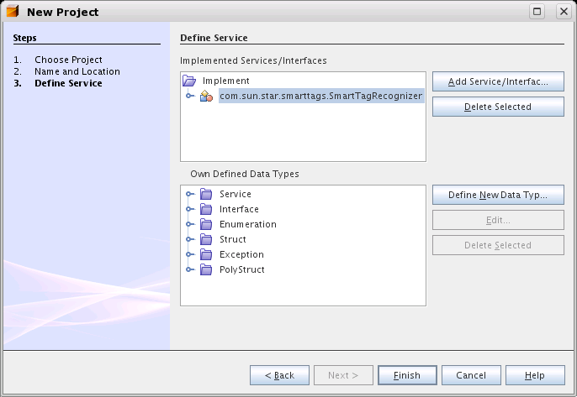
NetBeans – The OOo API Plugin (1)
Click here to add a new
service to implement
The services to implement

Slide 23
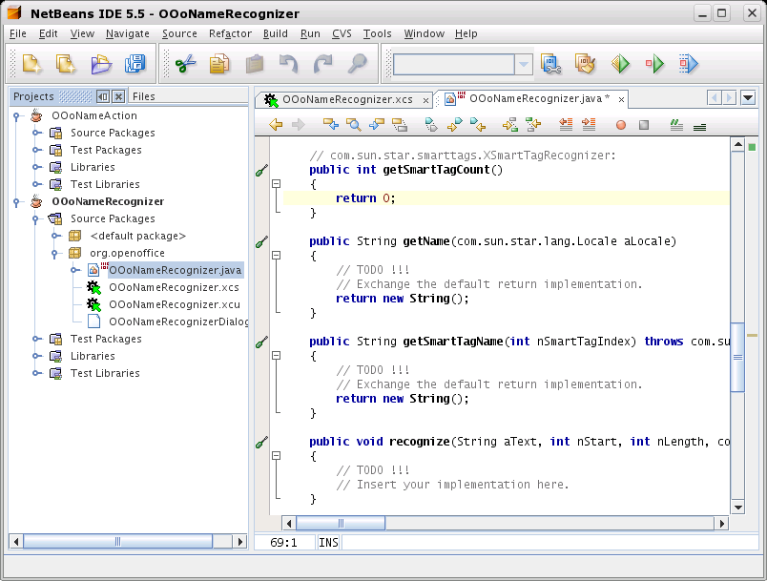
NetBeans – The OOo API Plugin (2)
Action project
Recognizer project
Configuration files
dialog definition file
Recognizer skeleton

Slide 24
Some Low Hanging Fruits
XSmartTagRecognizer:
getSmartTagCount 1
getSmartTagName “mynamespace#oooname”
getName “OOo Name Recognizer”
hasPropertyPage true
XSmartTagAction:
getSmartTagCount 1
getSmartTagName “mynamespace#oooname”
getSmartTagCaption “OOo Name”
getActionCount 2
getActionID 0, 1
getActionCaptionFromID “Lookup issuezilla bugs”
“Replace with real name”

Slide 25
The Recognizer:
Constructor:
  Create ConfigurationUpdateAccess for configuration data
  Read <OOo name, Real name> pairs from configuration
displayPropertyPage():
  Use service DialogProvider2 to create dialog from dialog definition file
  Exchange name data with dialog
  Update configuration

Slide 26
Recognizer: recognize()
public void recognize(String aText, XTextMarkup xTM, ...)
{
  Boundary aWB = xBreakIter.getWordBoundary(aText, 0);
  // iterate over words
  while (aWB.endPos <= aText.length())
  {
    String aWord = aText.substring(aWB.startPos, ...);
    if (aOOoName_RealNameMap.contains(aWord))
    {
      // new string key map, used by action component
      XStringKeyMap xProps = xTM.getMarkupInfoContainer();
      String aRealName = aOOoName_RealNameMap.get(aWord);
      xPB.insertValue(“RealName”, aRealName);
      // pass smart tag data to application
      xTM.commitTextMarkup(“mynamespace#oooname”,
      aWB.startPos, aWB.endPos - aWB.startPos, xProps);
    }
    aWB = xBreakIter.nextWord(...);
  }
}

Slide 27
Action: invokeAction()
public void invokeAction(int nActionID,
css.text.XTextRange xTarget,
css.container.XStringKeyMap xProperties,
String aText)
{
if (0 == nActionID)
{
// open issuezilla query URL
String aURL = "http://qa.oo.org[...]” + aText + ”[...]”;
XSystemShellExecute xSystemShellExecute = [...]
xSystemShellExecute.execute(aURL);
}
else if (1 == nActionID)
{
// replace OOo name with real name
String aRealName = xProperties.getValue(“RealName”)
xTarget.setString(aRealName);
}
}

Slide 28
Links & Resources
OOo names recognizer and other examples:
http://wiki.services.openoffice.org/wiki/Smart_Tags
Smart tags API reference:
http://api.openoffice.org/docs/common/ref/com/sun/
star/smarttags/module-ix.html
OOo API plugin for NetBeans:
http://wiki.services.openoffice.org/wiki/
OpenOffice_NetBeans_Integration
Mailing lists:
dev@sw.openoffice.org / discuss@ux.openoffice.org
Contact:
fme@openoffice.org / fl@openoffice.org

Slide 29

Frank Meies
  frank.meies@sun.com
Frank Loehmann
  frank.loehmann@sun.com

