Slide 1


Specification Template Workshop
Andreas Martens, Joerg Sievers,
Christian Jansen
    Sun Microsystems

Slide 2
Agenda
Why do we need specifications?
Writing a specification
A specification template - Why?
Q&A

Slide 3
Why do we Need Specifications?

Slide 4
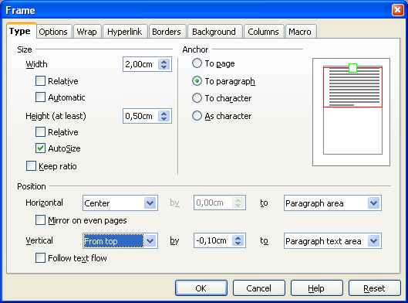
How many test
cases have to
be created after
this change?
Negative values can
now be entered here

Slide 5
... Way too many
But...

Slide 6
At least
12
test case representatives
are needed for
methodical testing

Slide 7
Examplary Test Case Design
Parameter*
Anchor
Vertical
By
To
Valid Classes
To paragraph
To character
From Top
-2.00....24.70
Margin; Paragraph Text;
Area; Page Text Area
Invalid Classes
To page;
As character
Top; Bottom;
Center
min_val...-2,00-Є;
24,70+Є....max_val
Entire page
*Preconditions: Size of frame = 5x5 cm; cm as metric; page size=A4; orientation=portrait
To reduce the count of test cases some black-box methods (here: equivalence class partitioning with boundary value analysis) are being used.
  Find for each equivalence class a representative test case.
  Combine all valid classes with one invalid class.

Slide 8
Test Case Representatives
#
Anchor
Vertical
By
To
Result
1
To paragraph
From Top
-2.0
Margin
-2.00
2
To character
From Top
-1.43
Paragraph Text
-1.43
3
To character
From Top
-0.53
Area
-0.53
4
To paragraph
From Top
-0.01
Page Text Area
-0.01
5
To page
From Top
-2.00
Margin
To=0; by=locked
6
As character
From Top
-2.00
Paragraph Text
7
To paragraph
Top
-1.01
Area
8
To paragraph
Bottom
-0.90
Page Text Area
9
To character
Center
-0.01
Margin
10
To paragraph
Top
-2.01
Margin
11
To paragraph
Top
24.71
Margin
12
To paragraph
From Top
-2.0
Entire page

Slide 9
More Impacts...

Slide 10
Errors & Costs
Analyze
Plan
Implementation
Dev. Tests
QA Tests
Customer
Relative number of issues accrued
40%
50%
10%
0%
0%
0%
Relative number of issues found
50%
25%
7%
10%
3%
5%
Costs per error correction
25.000 DM
2.000 DM
6.000 DM
500 DM
500 DM
500 DM
Ebert C., Dumke R (Hrsg.), Software-Metriken in der Praxis, Springer, Berlin/Heidelberg, 1996

Slide 11
Errors & Efforts on OOo
QA evaluates issue
Program Management sets target
Developer
  Evaluates issue
  Sets up workspace
  Fixes issue
  Builds workspaces
  Evaluates fix
QA evaluates fix in installation set
Release Engineering integrates workspace
QA
  Evaluates fix on master workspace
  Closes issue
Customer installs fixed version

Slide 12
Conclusion
Specifiying saves your time
You increase the product quality
You save others' time
You can increase test coverage systematically if needed

Slide 13
Writing a Specification

Slide 14
Todays Process
Start
i-Team
Setup
Plan
Specification
Development
Do
Specification
Approval
String Review
Development
Review / Improve
QA
Documentation
Finish

Slide 15

Tomorrows Process

Slide 16
No
Waterfall
Model

Slide 17
How to Write a Specification?
These pre-requisites are needed
  A requirement (customer need)....
  ... and an i-Team
Development starts with a
kickoff meeting...

Slide 18
Kicking off a New Feature...
Develop a common sense of the goal
  Introduce the feature
Nail down the priorities
  Prioritize the sub-feature
Notes:
TALK ABOUT THE BIG PUCTURE
Introduce the project, starting with the top-down, big picture view. Over the course of the meeting, you'll dig down to the details.
Initially, start with information like who the end user is what the customer expectations are.
Talk about the goals of this project.
PRIORITIES
This meeting is the perfect time to establish the priorities for the entire project. Ask your customer what he wants most. This is important for the customer's peace of mind as well as your own.
NAIL DOWN THE RESPONSIBILITIES
Deciside who is responsible for what.
The customer
Whether your customer is an internal stakeholder or an external client, the customer's satisfaction must take top priority

Slide 19
Kicking off a New Feature...
Nail down the responsibilities
  State clearly who is responsible for what
  Let the i-Team know who delivers what
Always keep the customer in mind
  Wether an internal stakeholder or external client, the customers satisfaction must be top priority
Notes:
TALK ABOUT THE BIG PUCTURE
Introduce the project, starting with the top-down, big picture view. Over the course of the meeting, you'll dig down to the details.
Initially, start with information like who the end user is what the customer expectations are.
Talk about the goals of this project.
PRIORITIES
This meeting is the perfect time to establish the priorities for the entire project. Ask your customer what he wants most. This is important for the customer's peace of mind as well as your own.
NAIL DOWN THE RESPONSIBILITIES
Deciside who is responsible for what.
The customer
Whether your customer is an internal stakeholder or an external client, the customer's satisfaction must take top priority

Slide 20
The Dont's in a Kickoff
Don't:
  Design the feature:
  This meeting is for planning only. If there's design to be done, schedule another meeting for that.
  Try to solve technical problems
  Don't get bogged down in details at this first meeting.
  No Agenda
  As this is a planning meeting, this meeting needs to be prepared.
  Long, unproductive meetings exhaust people.

Slide 21
Plan
I-Team Kickoff
Detailed feature / sub-feature planning
First design sessions

Slide 22
Do
Create prototypes
Write specification

Slide 23
Review
i-Team reviews specification
Based on three essential rules
  R1: Complete
  R2: Clear
  R3: Simple

Slide 24
Specification Rules
R1: Complete
First and foremost a specification has to be complete. That means all relevant aspects of a feature have to be captured.
R2: Clear
Each statement has to be unambiguously clear to Development, QA, User Experience, Documentation.
R3: Simple
Each statement shall be as short and as simple as possible.

Slide 25
Improve
Reduction of defects in specification.
Reduction of defects in implementation.

Slide 26
Finish
Specification and implementation
must be identical
Implementation
Specification
Notes:
Project Debriefing
For a team leader, a post-project debrief can be an essential tool to identify what worked well on a project, evaluate what didn't, and brainstorm ideas on how to improve.
Or, it can devolve into a finger-pointing party that exhausts and demoralizes the team.
Here's how to walk the fine line that will keep your next project debrief from turning into a bitch session.
How did the team work together?
Were they responsive and flexible?
How was morale?
Did each team member contribute positively or negatively to the effort?
How could this be improved?
Did the manager contribute positively or negatively to the effort?
How could this be improved?

Slide 27
A Specification Template - Why?

Slide 28
A Specification Template - Why?
It simplifies writing specifications,
It centralizes all information
It gives you clear guidance on:
  “What” belongs to a specification,
  “How” to write a specification, and...
...It automates common tasks like specifying user interfaces

Slide 29
A Specification Template -Why?
...and thus it saves you and others time...

Slide 30
Issues of the Old Spec. Template
Separation between specification template
and specification guide
No links to required companion documents
Unnecessary sections
  Process related aspects
  (e.g. i-Team approvals)
  A motivation section,
  an user scenarios section, etc.
Missing rules on how to write and
read a specification
Lack of examples

Slide 31
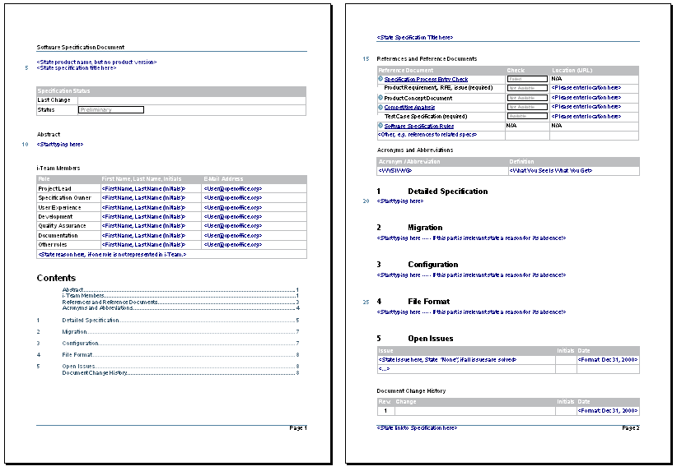
The New Specification Template
Just 2
pages

Slide 32
“Hey, this is great! That's exacly what we need.”
Jiri Kopsa
xDesign, Tools
Sun Microsystems

Slide 33
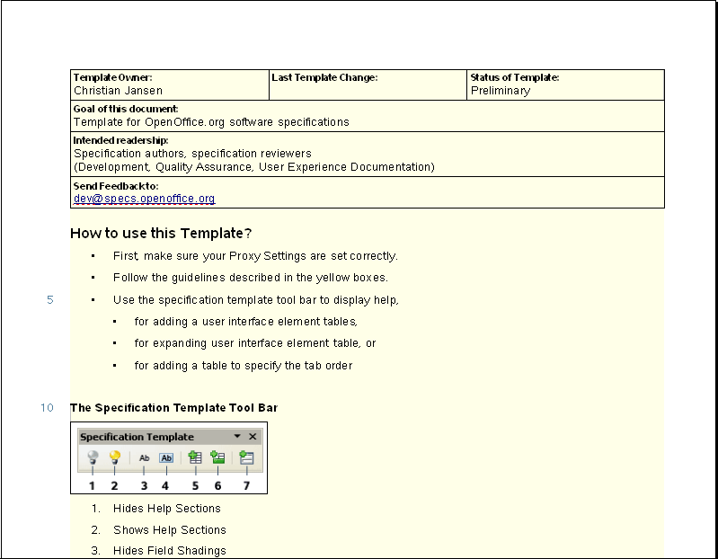
There is Lots More Stuff in it ...
A Help which
guides you through
the template

Slide 34
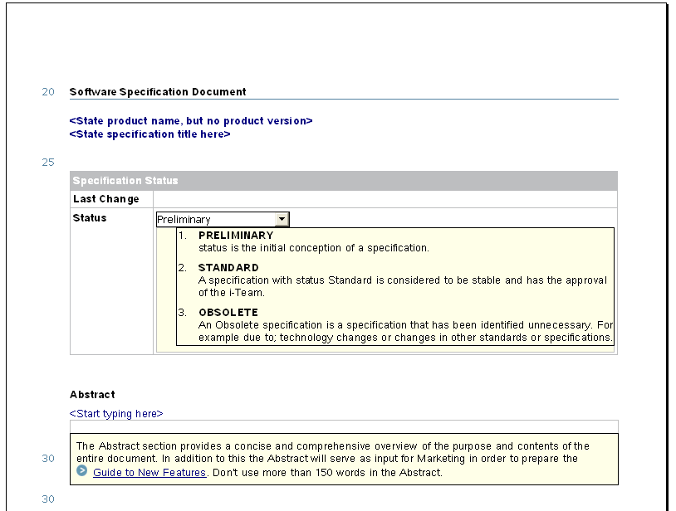
There is Lots More Stuff in it ...
Specification
Status Section
Abstract Section:
The source for the
“What's New Guide”

Slide 35
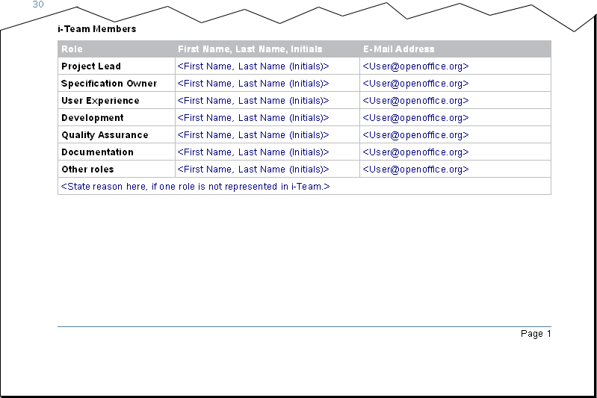
There is Lots More Stuff in it ...
The i-Team

Slide 36
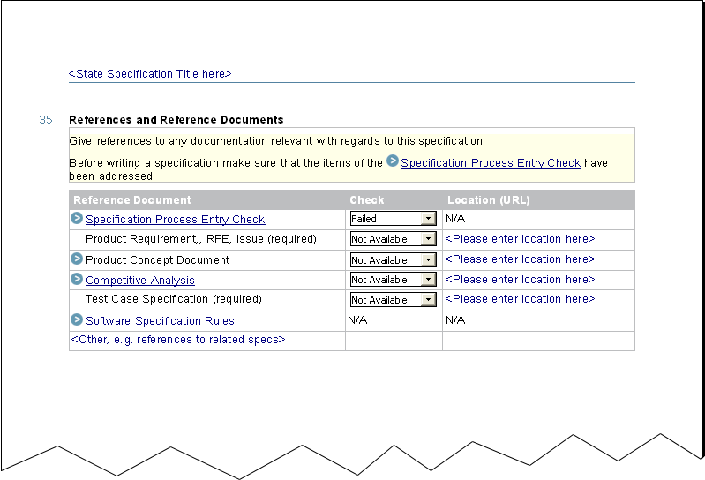
There is Lots More Stuff in it ...
Links to important
reference documents

Slide 37
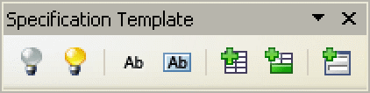
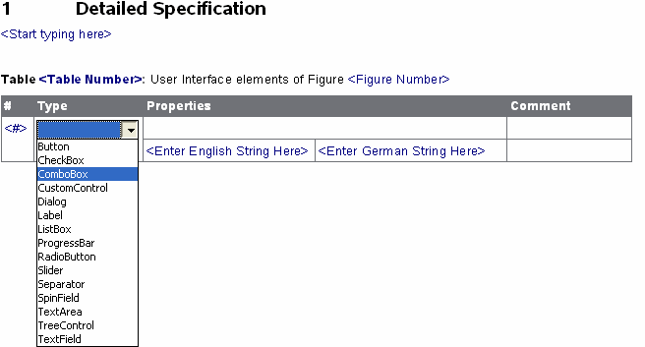
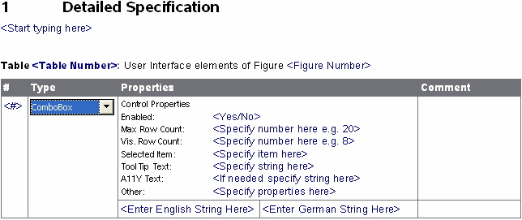
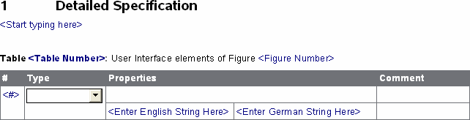
There is Lots More Stuff in it ...
Tooling for
“automatic”
User Interface
specification

Slide 38
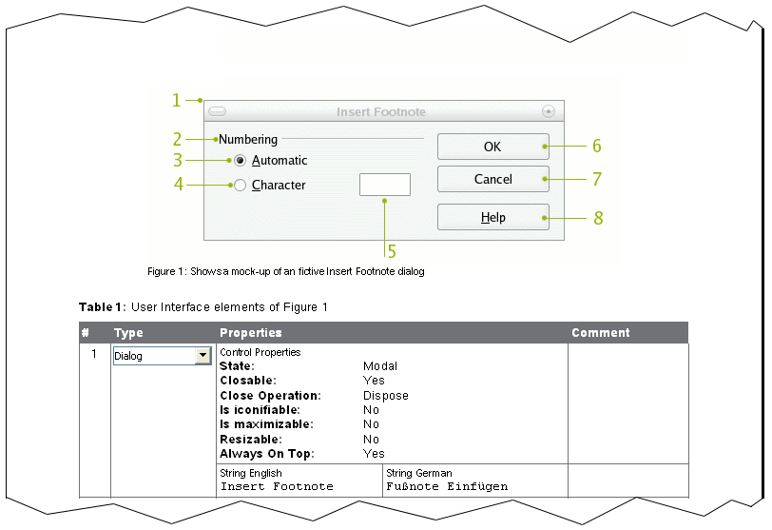
There is Lots More Stuff in it ...
Concrete examples
for junior specification
writers

Slide 39
Further Information and Feedback
Specification Project on OOo Wiki
http://wiki.services.openoffice.org/wiki/Category:Specification
Specification Project Website
http://specs.openoffice.org/
Specification Template
http://specs.openoffice.org/collaterals/template/OpenOffice-org-Specification-Template.ott
Specification Improvement Project Website
http://sunwebcollab.central.sun.com/gm/folder-1.11.771276
Feedback
so-spec-process-feedback@sunwebcollab.central.sun.com

Slide 40
Thank you!
Andreas Martens, Joerg Sievers,
Christian Jansen
    Sun Microsystems

