Slide 1


The Presenter Console
Andre Fischer
Software Engineer Impress
Sun Microsystems
19

Slide 2
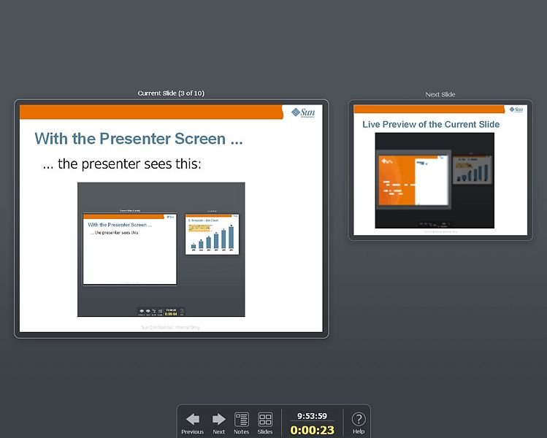
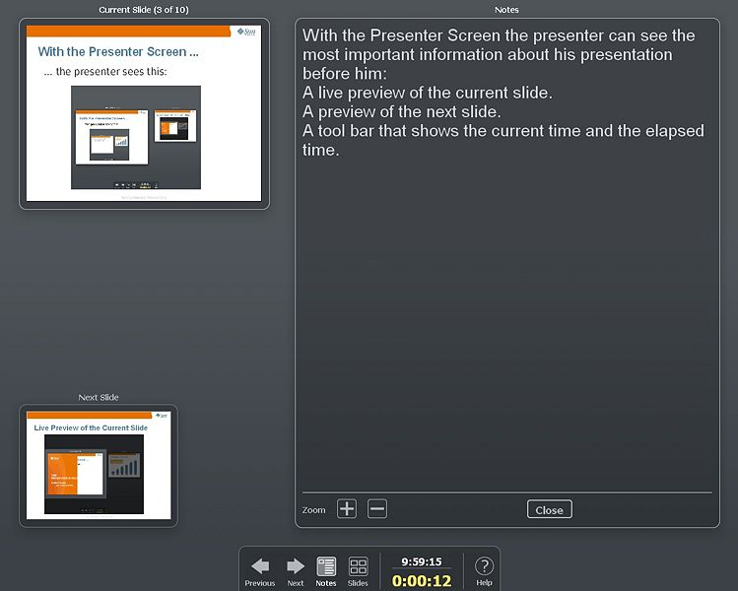
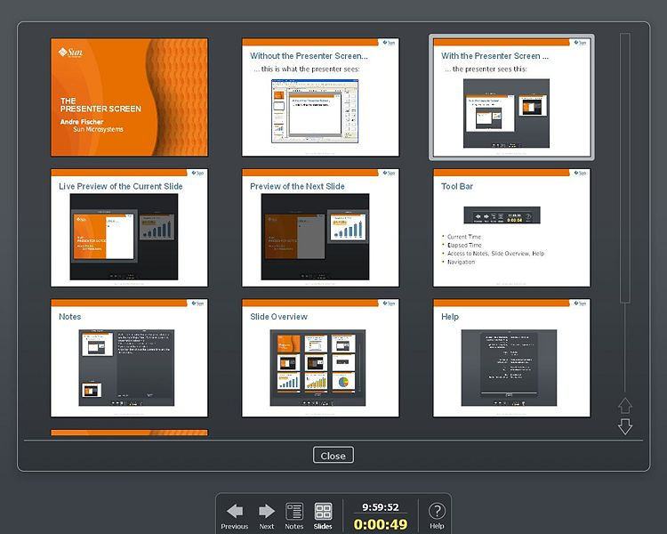
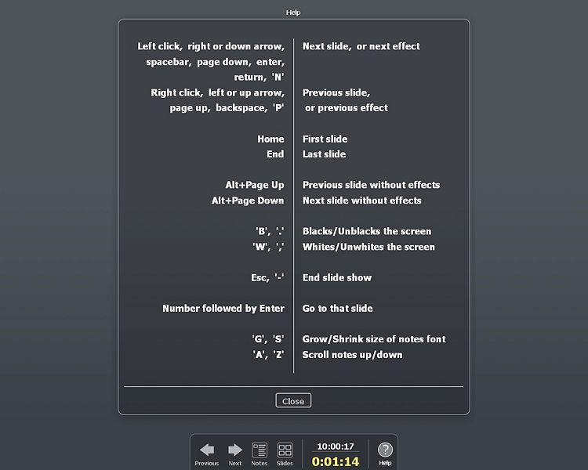
Overview
Introduction of the Presenter Console
Design Principles
Implementation
More information is available at
http://wiki.services.openoffice.org/wiki/Presenter_Console

Slide 3

Demo, Standard Screen

Slide 4

Demo, Notes Screen

Slide 5

Demo, Slide Screen

Slide 6
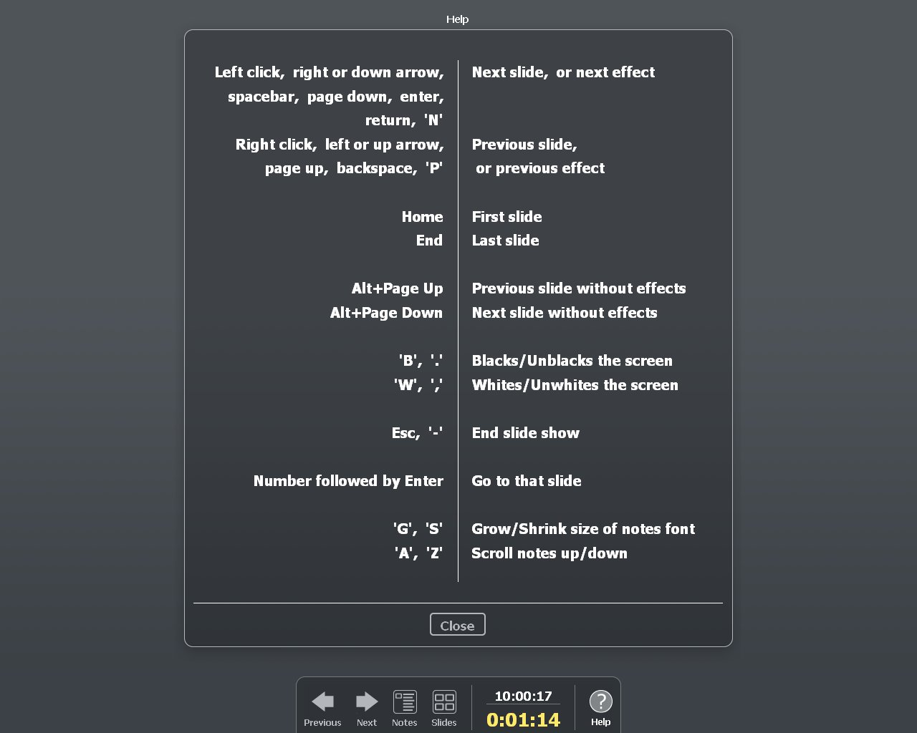
Demo, Help Screen

Slide 7
Design Principles
Presentations often take place in a stress situation
  jet lag, stage fright
Not the usual desktop workplace
  Addressing the audience with laptop before you and projection behind you
Hardware different from day-to-day use
  Different keyboard, mouse, screen resolution

Slide 8
Design Principles
The situation of giving a presentation is different from creating it – or writing a text or editing a spread sheet
Therefore the Presenter Console does have a different look and feel from the other applications

Slide 9
Design Principles
Guidelines
Simple interface
No unnecessary or even “dangerous” UI elements
No focus
Easy to read and not distractive

Slide 10
Design Principles
Simple Interface
Few and large buttons
  Easy to read and easy to hit
Windows can not be moved or resized
  Prevent misconfiguration by accidental mouse clicks
No unnecessary screen elements
  Nothing that distracts from the presentation and, more importantly, from presenting

Slide 11
Design Principles
No unnecessary or “dangerous” UI elements
Presenter Console Extension is active as soon and as long as it is installed
  Temporary deactivation no likely use case
Is shown only for more than one display
  May be changed
Is displayed on “other” display
No exit button
  Click on the background and you go to next effect
  One accidental click on an exit button and you stop the slide show? Not good!

Slide 12
Design Principles
No Focus
Windows can not be accidentally focused
  Avoid windows that “eat” key events
No modes that have no apparent exit
Keys do always the same thing
  Space always leads to next effect

Slide 13
Design Principles
Easy to read but not distractive
Standard color theme supports typical presentation environment: low lights to improve projection
  Dark background so that eyes don't have to adjust between Presenter Console and audience
  Medium to high contrast UI elements for easy readability
  Larger than normal text and buttons that can be recognized from a distance
More color themes may be necessary to support other environment types

Slide 14
Implementation
Implementation as extension
Canvas based
Drawing framework based
Layout is hard coded
Why not Java?

Slide 15
Implementation
Implementation as extension
Faster to build (less code, fewer dependencies)
Every extension helps to improve the API
Enforced separation from core code
Not everybody uses Impress or needs the Presenter Console
Independence of OpenOffice.org release cycle

Slide 16
Implementation
Implementation as extension
Most functionality can be implemented in extension
  Extension code can be found in
  /sdext/source/presenter
Some functionality can only be implemented in core
  Presenter Console specific core code can be found in
  /sd/source/ui/presenter
  Slide rendering for previews, text rendering for notes, preview cache for slide view, canvas proxy because basegfx not (yet) part of API

Slide 17
Implementation
Canvas
Canvas still has some minor drawbacks
  No (good) way to create canvas objects
  Bitmaps can not be loaded
  Suboptimal font support (API not fully implemented)
Independent from VCL window hierarchy

Slide 18
Implementation
Canvas
The canvas is accepted and actively supported technology
Without the canvas the Presenter Console could not have been implemented as extension
Every Presenter Console window has its own wrapper/proxy of the same canvas object
Use of one single canvas allows shadows and transparency over window boundaries

Slide 19
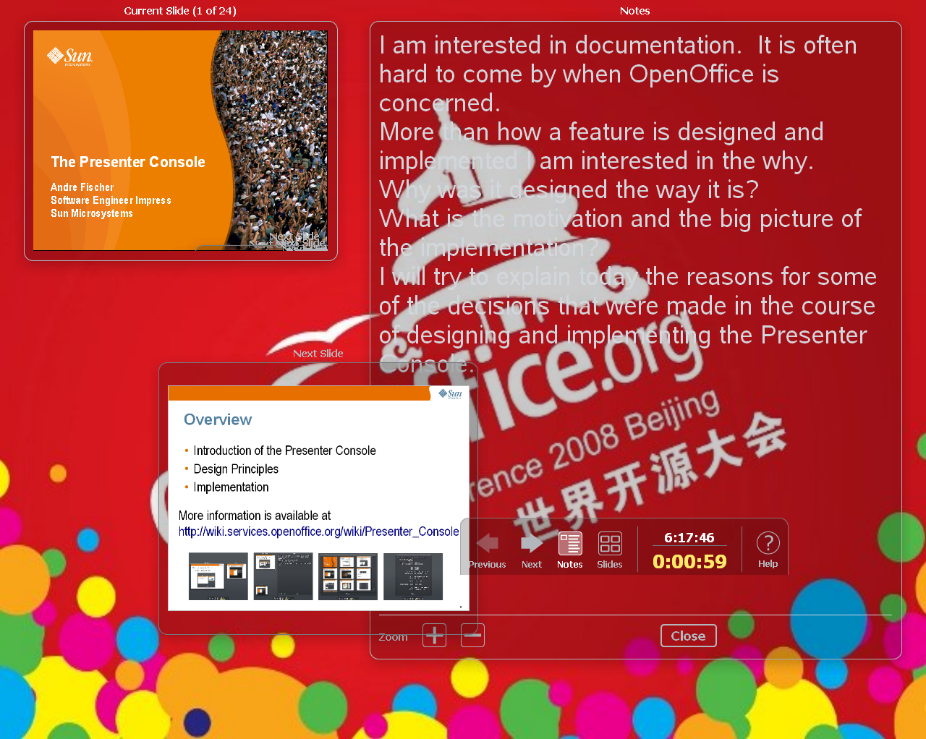
Implementation
Canvas Demo

Slide 20
Implementation
Drawing framework, overview
Focuses on activation of and relationship between resources
Resources like panes, views, and tool bars are identified by a set of URLs
The navigation tool bar of the Presenter Console is identified by
private:resource/pane/FullScreenPane
private:resource/pane/Presenter/Pane4
private:resource/view/Presenter/ToolBar

Slide 21
Implementation
Drawing framework
The drawing framework uses XML based descriptions of pane/view configurations
One framework for switching views in Impress and for switching modes in the Presenter Console
  simplifies implementation and improves robustness
Helps in making the extension extensible and configurable (themes, additional views or modes)
  Themes as extensions that override values in the Presenter Console extension
  Basically possible for providing additional views, but...

Slide 22
Implementation
Hard coded layout
Experiments with layout based on XML (.xcu) description were not successful
Now there is one simple and short hard coded layout for each of the four modes (standard, notes, slide overview, help)
General layout module is missing (not only here)

Slide 23
Implementation
Java
would have
  been platform independent
  decreased development time
  increased display quality
  improved execution speed
but
  Java canvas not (yet) finished
  no readily available means to use other canvas

Slide 24
The Future
Notes editor in Impress view.
Improve clock/timer
  reset, start, stop
  countdown, maybe with alarm, color code
Show Presenter Console on single display
Improve slide view
  make preview size modifiable
  show at least <n> slides after current slide
Add button to navigation tool bar for <your favorite feature>
Add <your favorite feature>

Slide 25

Presenter Console:
Andre Fischer
andre.w.fischer@sun.com
http://wiki.services.openoffice.org/wiki/Presenter_Console
25

