Slide 1

OpenOffice.org: Build Dictionary and Spellchecker in Your Language!
Kartik Mistry
Magnet Technologies Pvt. Ltd.
Mumbai

Slide 2
Little about me
Gujarati Language Translator
Native Language Lead! http://gu.openoffice.org
Aspell-gu Author

Slide 3
The road ahead
Basic requirements
Dictionary/Wordlist: where to get it?
Glance at Hunspell dictionary
Building procedure
When life is easy..
Demo and conclusion

Slide 4
Requirements
Linux/Windows/Mac machine
Wordlist in your language, Not there? Wait!
Courage to build OO.o (i.e. 2.3.x) on your machine. Or do you don't want that too? ;)

Slide 5
WordLists
.. is simple word collection in alphabetical dictionary order according to your language
Probably, you have it for your language! http://aspell.net
Missing is: Kannada (ka), Any takers?

Slide 6
WordLists
OpenOffice Dictionaries ready made at, http://wiki.services.openoffice.org/wiki/Dictionaries
Look for Gora Mohanti at IndLinux Project Day! You will get better idea!

Slide 7
Converting To Hunspell
Hunspell supports Unicode very well, so its OO.o's choice
Install it, http://hunspell.sourceforge.net/
Lets look at sample file,
  a. Wordlist file
  b. Affix file
Possible License Issue(s)

Slide 8
Before Building..
Make sure that you have,
  enough time/cpu power/passion
  bandwidth
OO.o build guidelines at, http://tools.openoffice.org/
We need some simple tweaks!

Slide 9
Little tweaks!
./configure with --enable-hunspell
Dictionary files into src/dictionaries/gu_IN/
makefile.mk
dictionary.lst

Slide 10
Little tweaks!!
src/dictionaries/prj/build.lst
di dictionaries\gu nmake - all di_gu di_diclst NULL
Look in other provided dictionaries when in doubt
Use sane editor!

Slide 11
Tired of compiling..
.. Life is easy!
DictOO.o wizard
Demo
Zipped dictionary

Slide 12
Little bit demo of my OO.o!

Slide 13
Resources
Lingucomponent Project: http://lingucomponent.openoffice.org/dictionary.html
Mailing List: dev@lingucomponent.openoffice.org
Hunspell Project: http://hunspell.sourceforge.net/

Slide 14
Questions
?

Slide 15
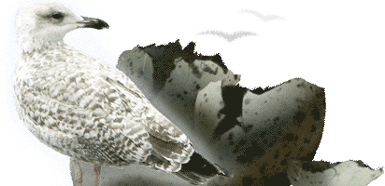
Thanks!
kartik_mistry@openoffice.org
http://gu.openoffice.org
Useless Stuffs: kartikmistry.org/blog

