Slide 1
OOoCon 2005
  Speeding OpenOffice Startup
  Profiling, Tools & Approaches
  Dhananjay Keskar
  Michael Leibowitz

Slide 2


Agenda
Introductions
  Intel & OpenOffice
  Team & Efforts
Profiling
Tools - APPR
Approaches for speed-up
Q & A

Slide 3
Intel and OpenOffice
Intel as the platform of choice for PC software
  Enable customer choices on Intel® Platforms
Channel Software Operation
  Help Intel® Channel address new market needs
Linux* on Intel platforms
  Support customer demand for Linux & OSS
  Help the channel build & sell PCs running Linux
    Intel® Quick Start Kit for Linux
  Invest & Participate in OSS Community
Robust, viable Desktop Linux
  Office automation suite is key part of PC usage
  OpenOffice is an excellent choice on Linux
Contribute to improve and optimize OpenOffice

Slide 4
About Us
Intel OpenOffice Team
  dkeskar, mikeleib, ndev, yli34, maxy, bspencer...
  Dhananjay Keskar, Michael Leibowitz, Naren Devaiah, Yin Li, Max Alt, Bob Spencer, Stan Wang, Max Yu, Gordon Jin, Weichuan Lin
Timeline:
  Jan/Feb - Gap Analysis – Features & Interoperability
  Mar/Apr - Build; read source, dev manuals
    Focused Areas: Start-up, Rendering, Threading
  May/June – Project approval, initial profiling
  July – some quick patches
  Aug/Sep – tools, startup investigations & approaches
    Expanded Team – EM64T

Slide 5
Profiling

Slide 6
Profiling
Startup & load representative document set
Initial Profiling Goals
  Get some first hand data, particularly with Intel tools
  Get better understanding of the code & modules
Expectations:
  Code hotspots, functions that could be optimized
  Call flow paths that could be tuned
Experiences:
  Code complexity – Many tools crash or confused
  Call graphs did not help as expected.
What helped:
  Using multiple tools, knowing their strengths
  Using the source, knowing UNO & interaction
  Clues & context from helpful OpenOffice developers

Slide 7
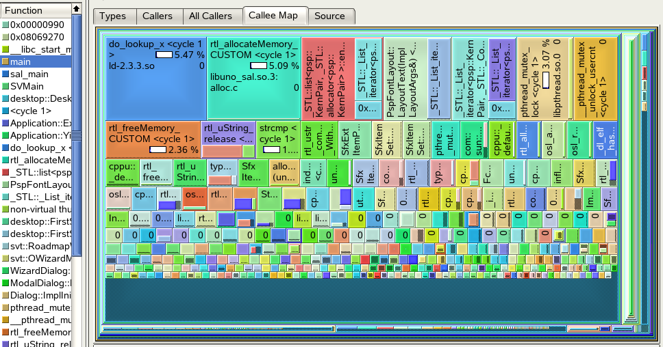
Profiling
Oft-seen Hotspot Functions for workload
SwFltControlStack::SetAttr
operator<(SprmInfo const &, SprmInfo const &)
configmgr::data::GroupNodeAccess::check
vcl::PNGReaderImpl::ImplGetFilter
vcl::PNGReaderImpl::ImplSetPixel
CreateFont(SvxFont &, SfxItemSet ..)

Slide 8
Profiling Results
Rework hot spot code
  ww8scan – quick patch, submitted.
  Locked string operations – investigation
Load/Link
  Second thoughts – Symbol visibility, library count..
  Prior & ongoing work, e.g. Michael Meeks
Better, more automated tooling for profiling
  APPR
Further investigate approaches for speed-up
  Configuration file operations & initialization
  Disk access patterns
  Smarter document load

Slide 9
Tooling

Slide 10
APPR
Automated Profiling & Performance Regression
Genesis:
  No one tool sufficient
  No one document is representative
  Manual profiling lengthy, tedious and error-prone
Goals:
  Gather & correlate measurable data of interest
  Measure & track metrics across builds
  ... and across workload variation
  Add metrics appropriate to work focus
    e.g. Startup, File Load, Responsiveness...
Implementation begun early August
  yli34 (framework), mikeleib (correlation)
  sh, StarBASIC, C, perl

Slide 11
APPR Features
Benchmark a build
  Start-up time, phase timings, other correlated data
  Empty shell/doc, load document or run workload
  Compare with previous build
Correlated Data
  RTL log, strace, link data, system monitor
  Vtune system sampling data
Visualization
  All data in one place, convenient to compare
Extensibility
  Add new metrics, new tools or change workload
Other uses, in addition to overall performance
  Feature tuning, Regression testing

Slide 12
APPR – How it works
Startup & synchronization
  Pause until all utilities loaded & ready
Monitoring & data gathering
  Trigger actions based on source markers
Correlation & visualization

Slide 13
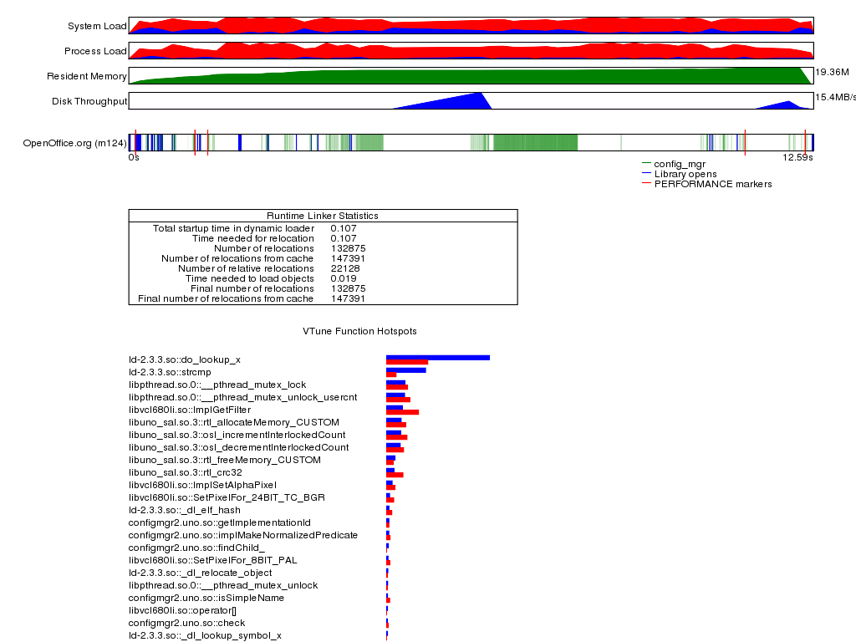
APPR – Demo
APPR Visualized Example Output

Slide 14
Approaches under Investigation

Slide 15
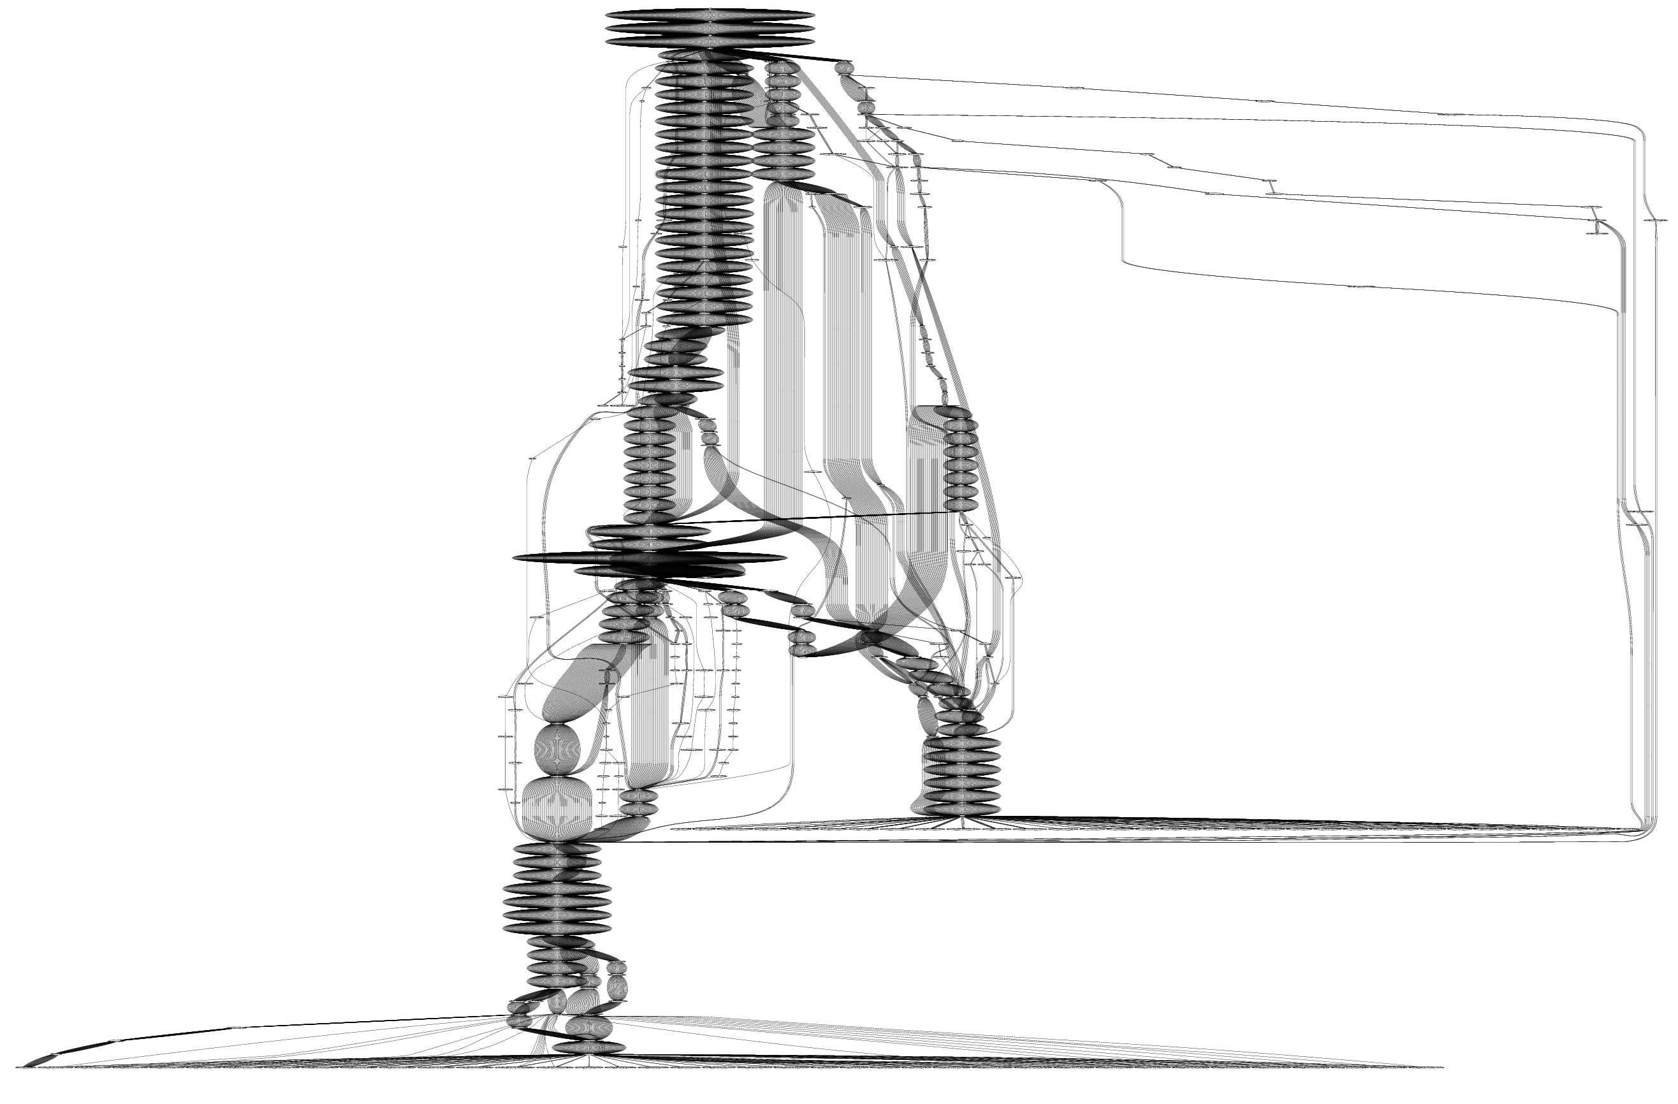
Config Manager
Profiling shows lot of config activity (green, above)
  Several hundred file reads & writes
  Scattered across disk
lstat as an indicator
  System call penalty
  487 times on startup
  Multi-paths to lstat (right)
  Apparent redundancy
Possible remedies
  Reduce or defer
  Different backend
  Initial caching
main-->sal_main-->SVMain-->desktop::Main
framework::...readConfigData
framework::...initializeConfigAccess
cppu::...createInstanceWithContext
..StartModule/foobar...
fcfg_*_types.xcu

Slide 16
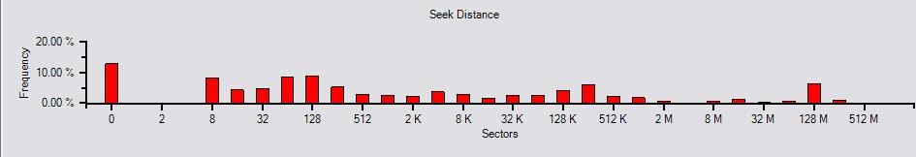
Disk Access Patterns
Scattered disk accesses – seek penalty.
  Mix of code and configuration files at startup
  “warm start” may access disk – config + page faults
  Theoretical speedup: 1.5x to 3x
Goal: Identify & exploit access patterns
  Gather and analyze traces for workload + usage
  Find deterministic sequences & map to file/offsets.
  Change high level algorithms, e.g. config manager
  Packaging changes
  Disk block reordering utility

Slide 17
Threading & Rendering
Threading can potentially improve startup.
  Real as well as perceived
Examples:
  Impress: Render 1st slide while file being read
  Calc: Render visible sheet, background others
Goal:
  Start discussion on problems
  Understand bottlenecks & work involved
  Prototype specific threading based improvements

Slide 18
Conclusions
Startup is one of the oft-heard user complaints
  OpenOffice 2.0 is faster than 1.1
  But, still considered to be slow by many
  Especially with document – empty or loaded
Potential for speedup, promising approaches
  Pre-linking, symbol visibility has helped
Call to Action:
  Discussion on ideas & gotchas
  Give us your feedback & suggestions
  Use APPR on code areas you care or know about
  Better collaboration

