Slide 1
Why OpenOffice.org
  OpenOffice.org
  Annual User Conference
  Lyon, France
  September 11-13th 2006
  John McCreesh
  Marketing Project
  jpmcc@openoffice.org
  http://www.mealldubh.org
  Copyright (c)John McCreesh 2006. This work is licenced under the Creative Commons Attribution-NonCommercial-ShareAlike 2.5 License.
  To view a copy of this licence, visit http://creativecommons.org/licenses/by-nc-sa/2.5/scotland/ or send a letter to
  Creative Commons, 559 Nathan Abbott Way, Stanford, California 94305, USA.
Notes:
Good afternoon. My name is John McCreesh. I live in Edinburgh in Scotland and that’s my email address and blog on the screen.
I’ve spent most of my working life in IT. I became interested in open-source during the dot-com era. I started the phpMyEdit project on SF in 2000 and it’s still active today. I started working in the OOo Marketing Project over four years ago. I was elected co-Lead of the Marketing Project for two years before becoming Lead in May 2006.
The topic of my talk is “Why OpenOffice.org”, which is the MP theme for this year. We are here to promote OpenOffice.org the product, and also OpenOffice the community.
So, we have two Why questions to answer, and here they are:

Slide 2
Why OpenOffice.org
Why contribute to the community?
  individual volunteers
  corporate sponsors
Why use the software?
  OOo = Oh! Oh! Oh!
  trigger points
  native-language
  counter marketing
  two visions of the future
Notes:
Why should anyone devote their time and effort to working for OpenOffice.org rather than walking the dog, playing football, getting drunk, or saving whales?
Why should governments and companies spend taxpayers’ or shareholders’ money on something they don’t own?
<click>
And then the killer question - your boss, your kids, the guy you play golf with, says to you “why should I use OpenOffice.org”? It’s a casual question - you have ten seconds to answer before their eyes glaze over. Can you do it? I’ll come back to this question later on. However, the MP says there are definitely some right answers, and some wrong ones.
But let’s start with the first question, first part. Most of us spend considerable amounts of time, effort, energy, money, on OpenOffice.org. Why do we do it? How do you explain to your partner that you are going to spend another evening on that damn computer? or that you’re going off for three days to some damn conference leaving him/her to look after the kids?
Simon Phipps - Sun’s open-source guru - gave a theoretical answer in his blog. Why do we do it?

Slide 3
Individuals
Each member is responsible for covering their own costs, and
because of that there's a level playing field for all participants, and
use without contribution is also OK
Blog, Simon Phipps
Notes:
Simon says we do it for what we get out of it.
He goes on to say that if everyone who has contributed has already been fully rewarded for doing so, then there’s no reason for anyone using the software to feel guilty that they’re using without contributing.
That may be true from an academic economics viewpoint, but from a marketing perspective I’d rather keep it quiet - guilt is good :-) From a conversation with Simon yesterday, I think he may have repented of this position too.
I’d like to know why we all do what we do for OpenOffice.org. We need more volunteers - one of the best ways to encourage people is to show them what people do and why. If you’re really enthusiastic about the software and can show them what you use it for, they’re more likely to try it.
Similarly, if we can share your stories, we can get more people involved.
I’d like you to fill out a questionnaire and out it in the Why box you’ll find at reception...

Slide 4
Your ‘why’
What do you do for a living (optional)?
What do you do for OpenOffice.org?
On average, how much time do you spend on OpenOffice.org per week?
What do you get out of it? Why do you do it?
Notes:
If you want to leave them anonymous, that’s fine. If you don’t want what you write to end up in marketing material, that’s fine too.
And as a taster, here’s mine. I’d like to answer in a roundabout way. This is the kind of email that I like receiving:

Slide 5
My “why”
“Our website is an animal welfare site which provides information and resources for animal welfare issues. I use OpenOffice.org software to produce our educational leaflets, etc. I have recommended it to regional animal welfare groups as well.
“Thank you for your dedication to open-source technology and improving our world. You enable people like me and groups like ours to function effectively on a shoestring budget. We are a 501(c)3 and all donated funds go towards animal welfare.”
Notes:
This email wasn’t sent to me. I read it, but it was sent to all you in this audience.
OK, I have a dog, but I’m not particularly an animal rights person. But there are millions of people out there who are trying to make the world a better place. Usually for little or no financial reward. We give them software that is just as good as the software used by the biggest corporations in the world.
Politicians talks about digital exclusion - people can’t afford PCs, access to the internet, desktop software. If you can’t word process documents, if you can’t produce a presentation, you don’t exist. For me, OpenOffice.org drives desktop digital inclusion - and I think that’s great.
Another typical excerpt:
Awesome job, I really appreciate what each and every person involved had accomplished; I also applaud Sun for giving us this opportunity.

Slide 6
My “why”
Information
Technology
Cultural
Creatives
Notes:
OpenOffice.org is where the world of ‘geeks’ meets the world of ‘cultural creatives’.
Paul Ray and Sherry Anderson, "Cultural Creatives: How 50 Million People are Changing the World" 50 million out of 300 million in the USA. They wouldn’t be seen dead with McDonald’s in their cars, yet they have Microsoft on their desktops.
Cultural creatives: Buy food at farmers’ markets, definitely no GM, drinks and chocolate all fair trade. Likely to be involved in voluntary activist groups, make poverty history. Want access to nature, very concerned about global warming, green tourism, no package holidays. Hate junk TV, advertising, rampant consumerism, junk foods.
Peter Brown of the FSF is kicking off a campaign to spread the FSF message outwith the ghetto this month - these are the people he should be talking to.
Let’s go on to corporate bodies - governments, public administrations, companies. Why OpenOffice.org? this one’s easy...

Slide 7
Corporates
A resource becomes a commodity ... when it is readily available to all competitors and therefore provides no lasting distinction to any one company.
Think of Microsoft Office. No company gains an edge by buying a license to use Office —it’s a commodity input shared by most companies.
Does IT Matter, Nicholas G Carr
Notes:
...it’s economics, stupid.
Does IT Matter?: Information Technology and the Corrosion of Competitive Advantage by Nicholas G. Carr, published by Harvard Business School Publishing. Nicholas Carr stirred up a fury in the world of IT by suggesting that corporations were wasting a fortune on IT systems. Software salesmen are selling them competitive advantage from commodity products. You will gain new customers if you have a better word processor. Your share price will rise if you buy our spreadsheet. I don’t think so.
Much software today is a commodity. Like electricity. You’re stuck if you haven’t got it; but having it doesn’t get you any competitive advantage. You need to get it as cheaply as possible. And the cheapest way to get software is through co-operation, through open-source.
There is nothing new in this. There is a mythology that this open-source stuff started with long haired hippy communist types in California in the 1990’s. Nonsense. The earliest example of open-source was firmly in corporate IT, and its birth was facilitated by the epitome of corporate IT, big blue IBM...

Slide 8
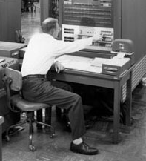
Corporations then...
In August 1955 the 17 organisations running IBM 704s formed a user group called SHARE.
By the first anniver-sary, they had 700 open-source programs.
They saved “of the order of 1.5 million US Dollars”.
Notes:
In the 1950’s a typewriter company called IBM had a business selling mainframes. Basically you got the hardware and that was it. Nothing. No system software, no utilities, none of the commodity stuff you need to get going. So IBM got a group of users together and encouraged them to share the load of writing these utilities.
I don’t know what 1.5 million dollars in 1955 is worth now. in 1955 the IT profession recognised open-source was the way forward. So why did it all go wrong?
Not because there was anything wrong with the business model, it just wasn’t scaleable. OK for a small group in the US to swap punched cards, but it just didn’t scale.
In the 1950s, the economics were right for open-source, but they didn’t have the technology

Slide 9
“We have the Technology”
Internet / Personal Computers
  software development
  software distribution
“SourceForge toolkit”
  mailing lists, version controlled source repositories, issue trackers...
It works
  CPAN: ten thousand reusable components in millions of lines of code, written by several thousand contributors over ten years.
Notes:
Clearly, that has now all changed. We have PCs, we have the internet, we can distribute software at zero-cost. We have all the tools that you find in places like SourceForge - listman, bugzilla, cvs, wikis...
And we have examples that show it can work - the Comprehensive Perl Archive Network.
So, in the 50s, we had the economics - 1.5 million US dollars - but the technology wasn’t scaleable.
Now, we have the scaleable technology. But do we still have the economics?

Slide 10
Economics
UK FTSE-100 Companies
  employ 3.5 million people
  spend £500m-£1,000m pa on commodity software from an effective monopoly supplier
The alternative
  funding 10 open-source developers each would cost in the order of £75m pa in total
  no need to pay for commodity licences again
Notes:
You bet we do. here’s a back of an envelope example from the UK. That’s one heck of an economic force. So why aren’t corporates falling over themselves to get into open-source?
Well, in some areas they are. Let’s look at the linux kernel. The holy of holies, the ark of the covenant for open-source people. Two years ago Andrew Morton gave some very interesting figures:

Slide 11
One example
Linux Kernel
  1,000 contributors
  100 corporate sponsored employees contribute 97% of changes
  20 of those contribute about half
  Andrew Morton, 2004
Notes:
This is the Linux kernel. This is the finest achievement of open-source. It’s now almost wholly corporate sponsored.
As a diversion, OpenOffice.org gets a terrible press among open-source extremists because of Sun’s involvement. I don’t know how many Sun employees work on OpenOffice.org, but I would guess it’s not a million miles away from this.
I digress. The bottom line is:

Slide 12
Why for Corporates?
Companies mining the open source vein aren't taking the high road but rather ruthlessly applying a competitive advantage
There is no open-source community,
John Mark Walker
Notes:
John Mark Walker got a lot of flack for this article on O’Reilly. He argued that a lot of the Free Software Foundation philosophy was actually a hindrance to open-source adoption by corporates.
IDC report published in July 2006 “open source-software is being used by 71 percent of the developers in the world and is in production at 54 percent of their organizations.”
Let’s summarise the “Why Contribute” piece of this talk:

Slide 13
Why contribute?
Individuals
  because they want to
Corporates
  because they must

Slide 14
Why OpenOffice.org
Why contribute to the community?
  individuals
  corporates
Why use the software?
  OOo = Oh! Oh! Oh!
  trigger points
  native-language
  counter marketing
  two visions of the future
Notes:
Let’s turn to the second why question - why use the software? Remember the friend on the golf course question - “Why should I use this OpenOffice.org thing”. You have ten seconds before he gets that sleepy look ...

Slide 15
No! No! No!
OpenOffice.org uses an open XML file format adopted as ISO/IEC 96300
OpenOffice.org is licenced under the LGPL
OpenOffice.org is multi-platform including 64 bit
OpenOffice.org is open-source
OpenOffice.org is produced and supported by a virtual community
Notes:
These are all very true, but they are also all very uninteresting to your friend on the golf course.
Marketing people would say these are features of the software or of the community. What people are interested in is the benefits they receive from using the product or joining the community.
These will vary from person to person. The average home user doesn’t know what an operating system is, so telling them OpenOffice.org is available on multiple operating system is no help.
So, back to your five minutes on the golf course. The MP has a visual aid to help you explain “why OpenOffice.org?” All you have to do is remember the mnemonic - OOo - OpenOffice.org

Slide 16




Oh!
Oh!
Oh!
Great software...easy to use...and it's free!

Slide 17
Oh!
Great software!
Oh!
Easy to use!
Oh!
and it's free!
Notes:
Each “Oh” in OOo represents one of the key benefits
Each “Oh” is how surprised people are when they hear about them
Maybe we could have a song...

Slide 18
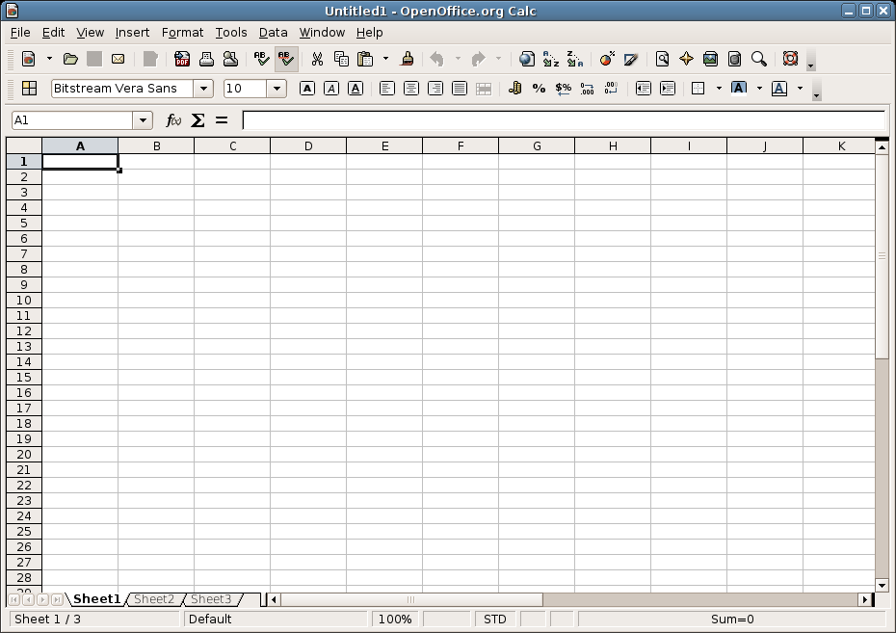
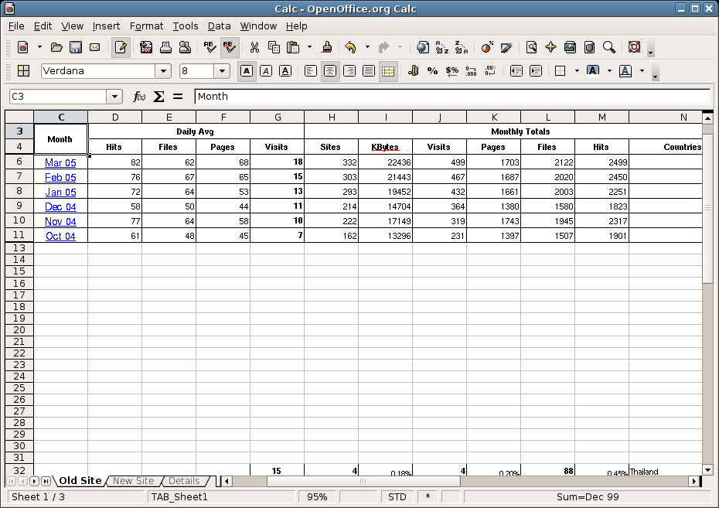
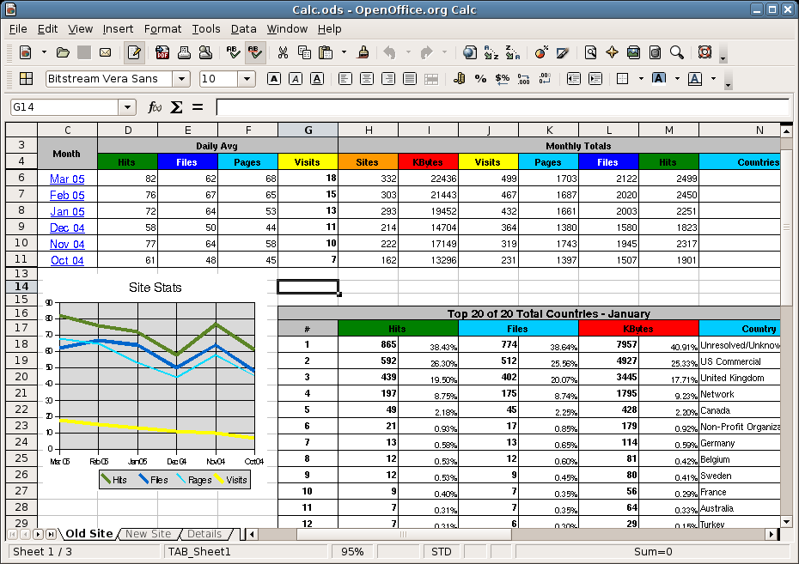
Oh!
Oh!
Oh!
Calc - great numbers
Notes:
The main benefit is that OOo is great software. It does everything that people need. This sequence shows:
Oh - that looks like Excel
Oh - that’s a basic spreadheet - I know what that is
Oh - that looks pretty complicated - this is great software

Slide 19
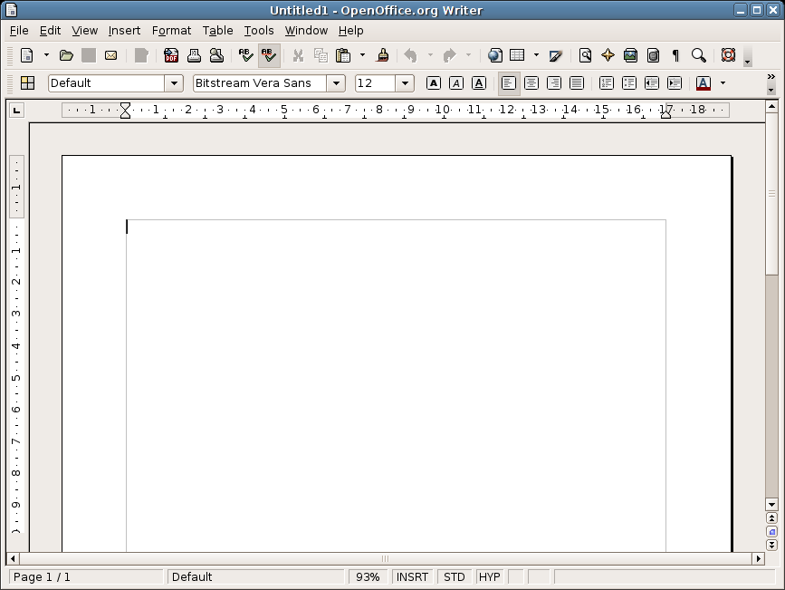
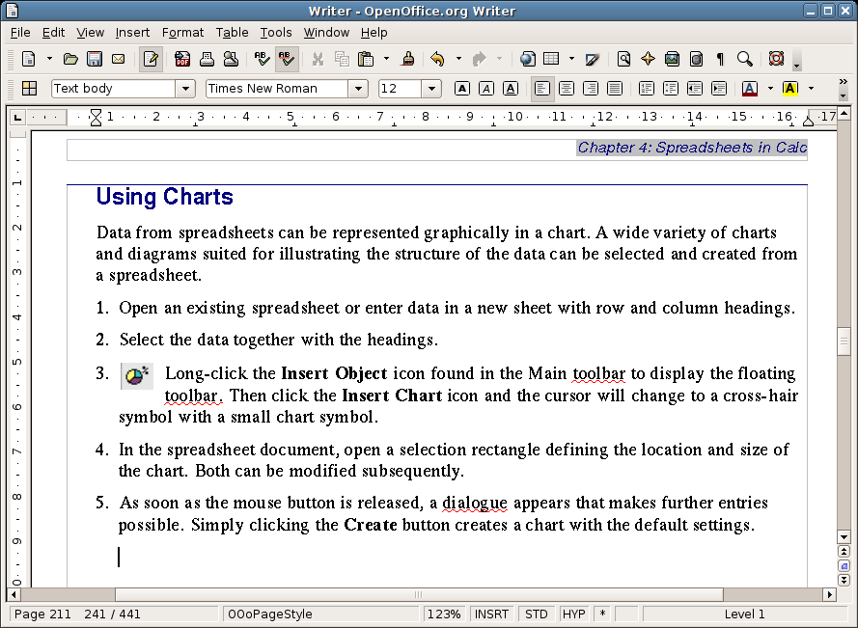
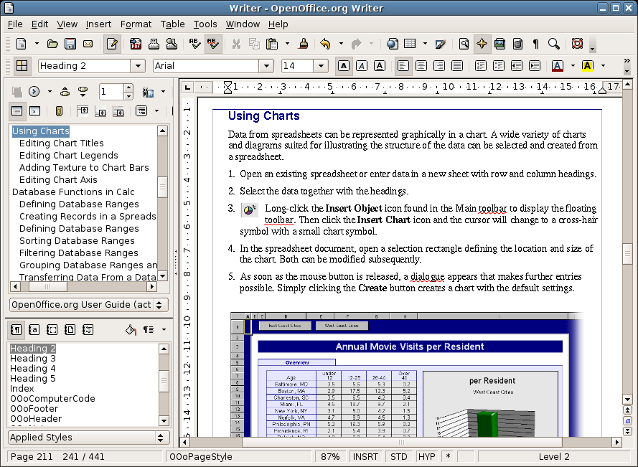
Oh!
Oh!
Oh!
Writer - great words
Notes:
And again for Writer:
Oh - that looks like Word
Oh - that’s a basic document - I know what that is
Oh - that looks pretty complicated - this is great software

Slide 20
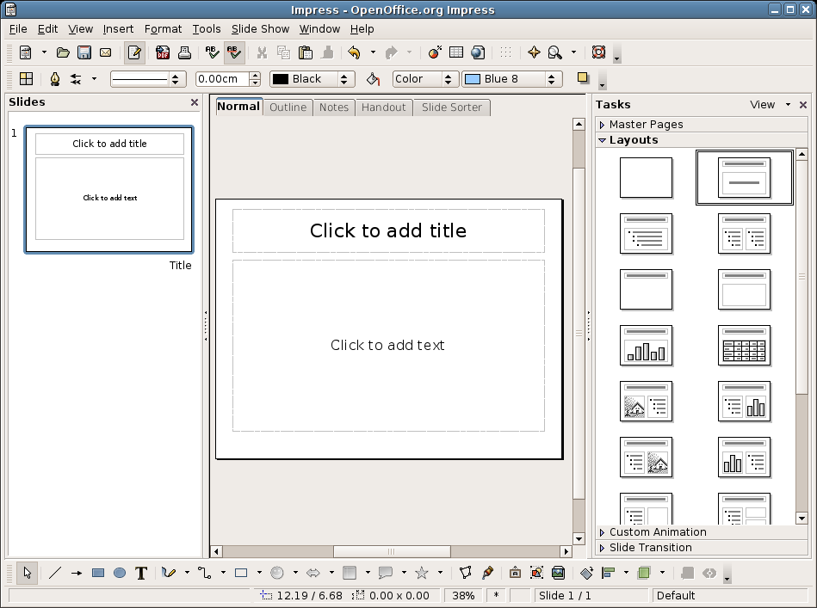
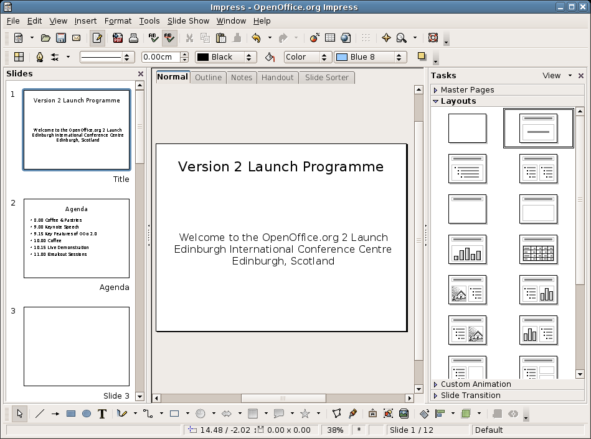
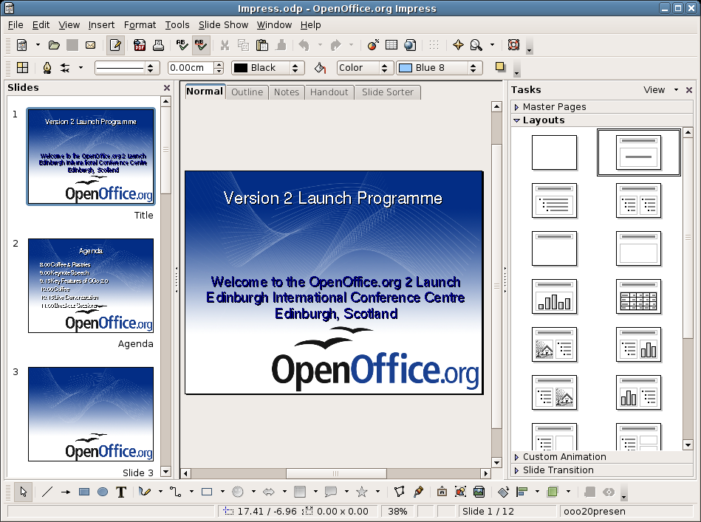
Oh!
Oh!
Oh!
Impress - great slides
Notes:
And as we’re doing everyhthing in threes, here’s Impress
Oh - that looks like Powerpoint
Oh - that’s a basic presentation - I know what that is
Oh - that looks pretty complicated - this is great software

Slide 21
OpenOffice.org uses all my old files without any retyping!
Oh!
It works in my native language!
Within minutes I was using it like an expert!
Oh!
Oh!
Easy to use!

Slide 22
I can use it at home, at work, at school, anywhere!
Oh!
I can't believe that it's really free of charge!
I've given copies to all my friends!
Oh!
Oh!
and it's free!

Slide 23
Oh!
Oh!
Oh!
Great software...easy to use...and it's free!
Notes:
Oh - it’s great software -people are suspicious of free stuff. You get what you pay for. You have to hit them first of all with the quality of the product
Oh - it’s easy to use - most people are terrified of change, terrified of computers - ask them to change something on their computer and they are terrified squared. Those who aren’t terrified are lazy. You have to convince them it’s easy
Oh - and it’s free. Yes, we do mean free. You don’t have to pay for it. You can give it away. So why not try it?
OK, so that was a little amusement. I’ll post it on the conference site if anyone wants to play with it.
However, the thinking behind it is going to go on show on...

Slide 24
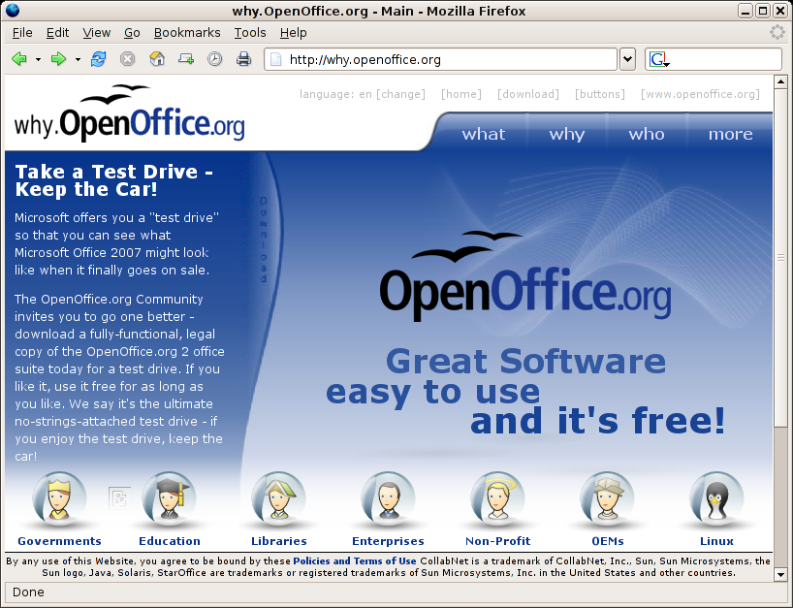
Notes:
why.openoffice.org. We have had complaints for years that out website does not sell the product. It doesn’t even tell you what OOo is unless you dig for it.
why is an attempt to change that - this is a shot of a concept put together by André Wyrwa and the Art project.
However, although OOo is great, Oh its easy to use, oh and it’s free - this is not enough to make your friend on the golf course use it. Why?

Slide 25
The commodity trap
Existing office software users
  Microsoft Office
  Mature Product
  80% only use 20% of the functionality
  Probably got it ‘for free’ (OEM bundle, pirate - 35%)
  Good Enough
Notes:
Chances are he’s got MS-Office on his PC, and it does the job. What we need is a trigger point

Slide 26
Trigger points
New office software users
  buying a new PC
  first-time office software buyer
  first-time PC user
Current users
  ‘pirates’
  ‘end-of-life’ upgraders
Notes:
...something that forces them to make a decision. I’d like to look at the first group of these:

Slide 27
Importance of Languages
Most of the estimated 1,000 million PCs which will be in use in 2010 have not been made yet
Most of these will be used by people for whom English is not their Mother Language
There are 6,000 languages in the world
Most of the world’s languages are not yet supported by office software
Notes:
and talk a bit about languages. At OOoConf two years ago we announced a target of being on 40% of the world’s desktops by 2010.
Let’s do a little diversion into the importance of language, particularly for desktop applications...

Slide 28

Two Barriers to IT
Why should I have to learn a foreign language before I use a computer?
Foreign Language
Computer Skills
Notes:
This is a good question ...but it’s not just software - it’s all the other stuff around it - the training materials, the local language support. It’s the whole Native Language Project piece which we in OpenOffice.org do so well. There’s one date that should be in everyone’s diary...

Slide 29
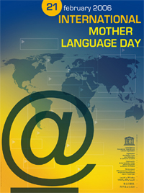
21 February
UNESCO’s International Mother Language Day 2006 was devoted to the topic of languages and cyberspace
Notes:
This is the year of the translators, the Native Language community. We often focus on adding features. And we do add them. 2.0.3 you can now put names against more objects. There are not many people who were prevented using OOo because of that, but ...

Slide 30
Top Ten Languages
1. Mandarin Chinese - 1,000 million
2. Hindi/Urdu - 600 million
3. English - 500 million
4. Spanish - 350-400 million
5. Russian - 275 million
6. Arabic - 260 million
7. Bangla/Bengali - 210 million
8. Portugese - 175 million
9. Malay/Indonesian - 170 million
10. French - 130 million
Notes:
There are 210 million potential users waiting for a Bangla translation.
Mother Language support - Native Language Projects - are absolutely key to us being on 400 million desktops by 2010. In UNESCO’s Year of Mother Languages in Cyberspace, let’s celebrate the work of the Native Language Confederation.
OK, back to the script

Slide 31
Trigger points
New office software users
  buying a new PC
  first-time office software buyer
  first-time PC user
Current users
  Piracy
  Enforced upgrades
Notes:
Back to our friend on the golf course, who of course has a copy of MS-Office on his PC. What will persuade them to change? Well, Microsoft’s advertising budget is enormous - let’s see how we can use some of it to sell OOo

Slide 32
Piracy
‘Blind-eye’ Microsoft policy (China in 1998)
Complex licencing mechanisms
Rampant piracy
Payback time
  World Trade Organisation
  Rewards for Informers
  Publicity
  Technology
Notes:
Although about three million computers get sold every year in China, people don't pay for the software. Someday they will, though. And as long as they're going to steal it, we want them to steal ours. They'll get sort of addicted, and then we'll somehow figure out how to collect sometime in the next decade.
Bill Gates, May 1998.
We are now in the next decade.
As a proponent of open-source software, I am 100 percent and more in favour of commercial software vendors clamping down on software pirates with the full rigour of the law. Why should honest open-source developers face cut-price competition because Microsoft is too lazy to pursue pirates? I am delighted that they are spending a fortune telling people to stop being pirates - we can use that to propose an alternative:

Slide 33
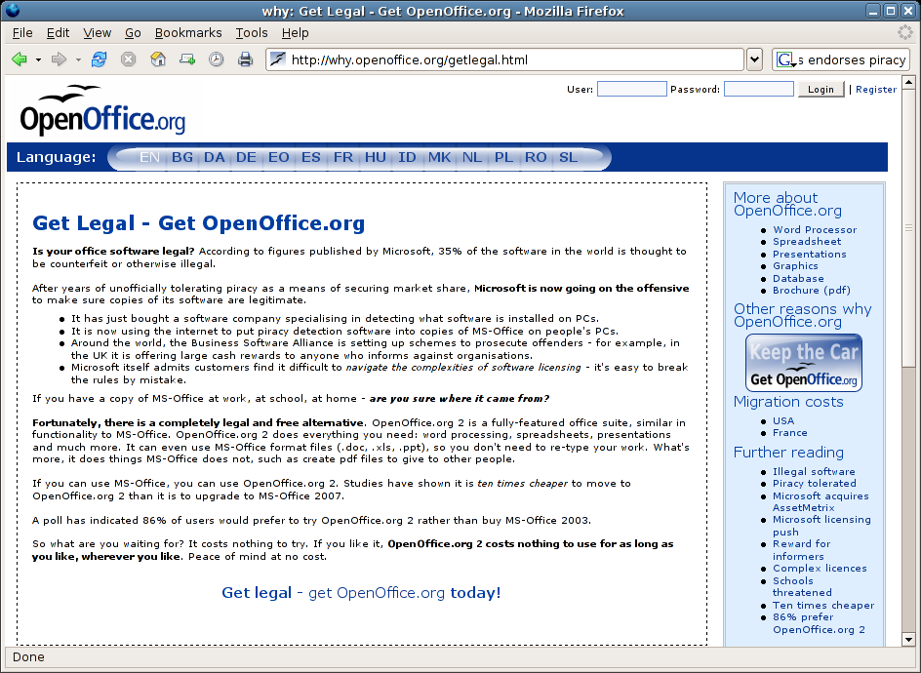
Notes:
This is counter-marketing - piggy-backing on other people’s advertising campaigns to sell a rival product. It’s really annoying. So, ask your friend on the golf course is he worried about ending up in court.
Another group of people reaching a trigger point are

Slide 34
Enforced Upgraders
OpenOffice.org 2 closed the gap on MS-Office
  Same functionality (80:20)
  Use legacy file formats
  Close enough look and feel
Product convergence
  let’s upgrade
Notes:
I’d like to talk a bit about MS-Office. No, I’d like to talk a lot about MS-Office. This was a change in tack for the MP this year.
OOo 2 reached convergence. So, we need to put clear blue water between ourselves. In fact, both OOo and MS-O reached the same conclusion. How we went about it was fascinating.

Slide 35
OpenOffice.org vision
OpenOffice.org 2
  OpenDocument Format
    OASIS Standard
    ISO/IEC 26300
  Technical feature - IT professionals
  Governments, Public Administrations, Corporates
Prime mover advantage
  open standard, but
  OpenOffice.org is the reference implementation

Slide 36
Microsoft vision
MS-Office
  MS-Office 12 -> MS-Office 2007
  “new and quite engaging user interface”
  Consumer feature
  End users
Secure control of the desktop
  reinforces “10 years behind” claims
  OpenOffice.org into catch-up
  Are Sun Microsystems in this for the long haul?
Notes:
...
This was a big gamble for MS. It delayed their launch by at least 18 months.

Slide 37
Microsoft’s gamble
Change is dangerous:
  “Wordstar 2000 had an entirely new interface ... because the new interface required so much relearning, users switched to other products...”
Microsoft’s marketing is fallible:
  “Microsoft’s three attempts to produce Windows were mirrored by an equal number of attempts to produce application software”
From Airline Reservations to Sonic the Hedgehog
Martin Campbell-Kelly
Notes:
In 1984 MicroPro was the biggest player in the wordprocessor market, with WordStar having about a quarter of the market. With one ‘look and feel’ upgrade, they lost it to WordPerfect 4.0 and never recovered.
WordPerfect went on to get 80% of the market in 1990 before Microsoft used their control of Windows 3.0 to kill them off over the next five years.
Microsoft can make marketing mistakes ... and analyst reaction to MS-Office 2007 was not good...

Slide 38
A step too far?
"When you introduce something new, it disrupts, and this increases things like help desk costs and employee downtime. So, to get to the benefits that come with this, they have to get past whatever retraining will be needed around the new user interface and any hardships around the new file format, which are always disruptive. These are two big hurdles Microsoft has to get around."
Joe Wilcox, Jupiter Research
Notes:
...
even better, there’s independent evidence that migration to OOo is now actually a cheaper option:

Slide 39
The wrong upgrade
“Migrating to OpenOffice.org 90 per cent cheaper than to Microsoft Office 12”
Computerworld Vol. 11 Issue 23
“The French tax agency claims that upgrading its 80,000 desktops to Office XP would cost €29.5m, but switching to OpenOffice.org only €200,000”
ZDNet UK November 09, 2005
Notes:
You will be hearing a lot more about this. The more Microsoft tell people to upgrade, the more we will tell them it’s the wrong upgrade. Counter-marketing again.
For example, when Microsoft announced a test drive, so did we:

Slide 40
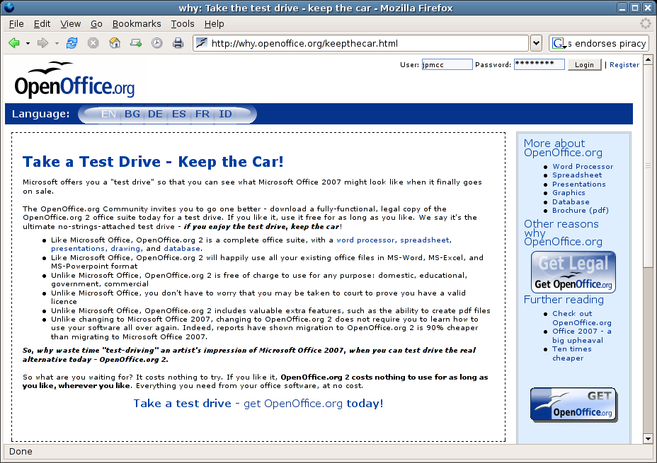
Notes:
Let’s make no mistake...

Slide 41
The stakes are high
Microsoft wins
  OpenOffice.org 3 will be forced into permanent catch-up mode
  Sun Microsystems will withdraw from the contest
OpenOffice.org wins
  OpenDocument Format becomes the de-facto desktop standard
  Trojan Horse for other open-source software
Notes:
I’ve only two slides left, so with this picture of the marketplace, let’s return to the original question - why get involved in this OpenOffice.org stuff anyway?

Slide 42
Why OpenOffice.org?
Next few years critical to the software industry
  return commodity software development to its roots as a co-operative venture
  users own their data, not application vendors
  bring essential software tools to every language group that wants it
  challenge the most successful monopoly since the British East India Company

Slide 43
Why OpenOffice.org?
  OpenOffice.org is changing the world
  Anyone can help
Notes:
OpenOffice.org is changing the world. It’s changing the world of IT; it’s also ending the digital desktop divide. When Campbell-Kelly writes his next edition of the history of the software industry, we’ll have several chapters all to ourselves.
Enjoy it.
Thank you and any questions?

