Slide 1
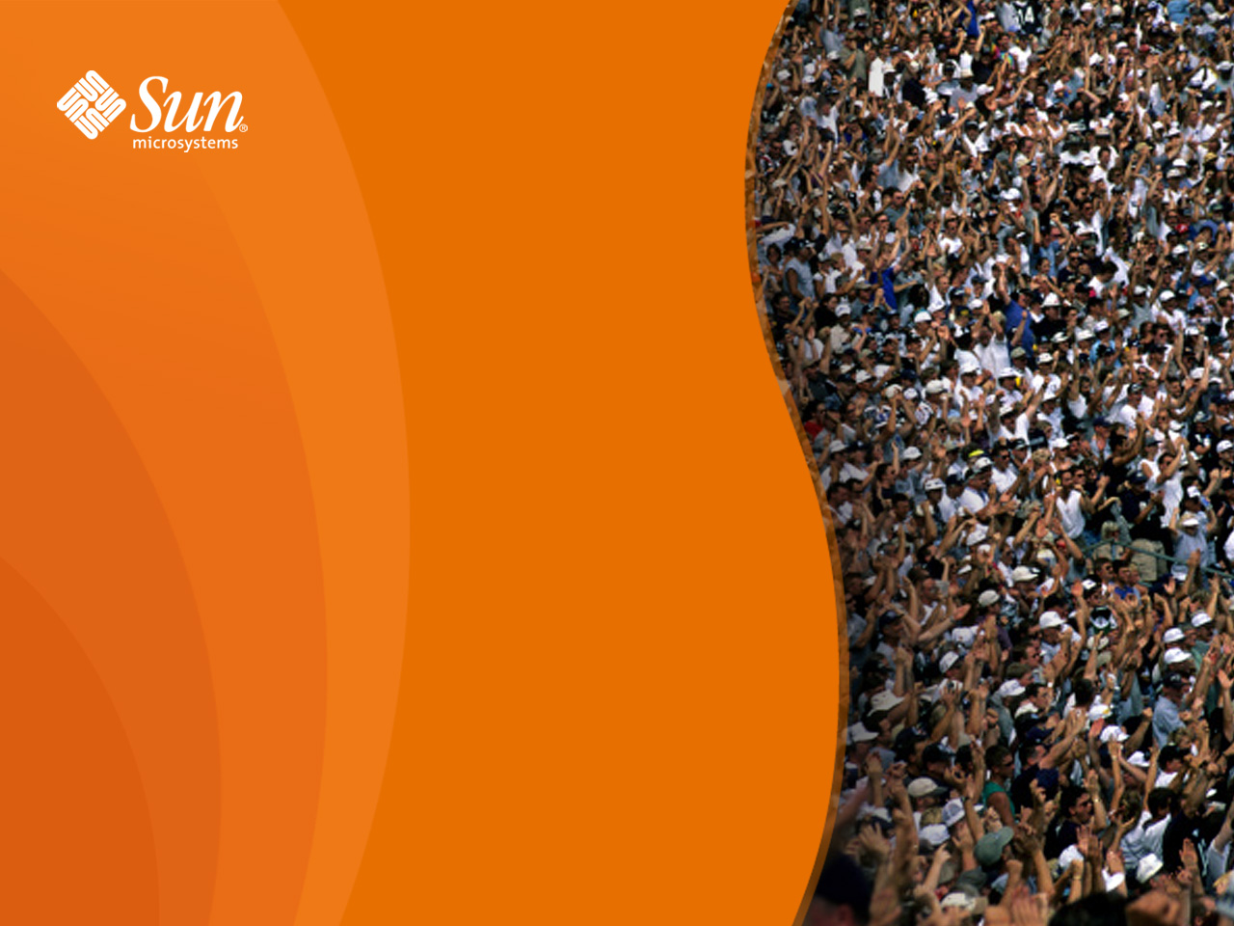
CLEANING UP OOo MULTI-THREADING
Kay Ramme
  Senior Technical Architect
  StarOffice/OpenOffice.org UDK Project Lead
    Sun Microsystems

Slide 2
Agenda
Current Use of Multi-Threading ...
Opportunities for Improvement ...
In an Ideal World ...
Proposed Solution ...
Current Implementations ...
The Plan ...
Q&A ...
May be some Deep Diving ...

Slide 3
Current Use of Multi-Threading
Basically single threaded, some dedicated threads:
  Windows clipboard
  Windows drag&drop
  VOS timer
  UCB-helper background loader
  Acceptor thread(s)
  Configuration flasher
  ICE thread
  ...
Uno request threads.
Everything implemented thread-safe.

Slide 4
Opportunities for Improvement
(see http://wiki.services.openoffice.org/wiki/Analysis/Multi-Threading for details)
Does not scale with multiple clients, CPUs, ...
No documentation regarding threading-model or -architecture.
It is not (really) thread-safe.
Fragile / no systematic approach to thread-safeness.
Every developer has to take care of multi-threading.
Hard to implement OLE/COM based components:
  Thread-affinity has to be encapsulated.
  All OSL threads are OLE/COM MTA.

Slide 5
Opportunities for Improvement (continued)
(see http://wiki.services.openoffice.org/wiki/Analysis/Multi-Threading for details)
Subtle dependencies against the “main-thread“,
  because VCL being thread-affine.
Performance penalties because of much locking etc. (e.g. Interlock counters).
Increased code size and complexity because of multi-thread constraints (locking).
Long lasting (slow) operations blocking the GUI (partly addressed with polling).
Competing threading models, Uno <-> VCL .

Slide 6
In an Ideal World
(see http://wiki.services.openoffice.org/wiki/Architecture/Goals_for_OOo_Threading-Model%26-Architecture for details)
Always Responsive GUI ...
Scales with multiple clients, CPUs, ...
Systematic approach to concurrency ...
Simple to implement and use ...
Exactly one threading-model
Good Documentation ...

Slide 7
Always Responsive GUI
GUI is soft real time.
Long lasting (slow) operations, e.g.
  loading,
  printing,
  saving, respectively
  I/O in general
need to be offloaded.
Want to use dedicated threads for this.
Need to ensure scalable I/O (UCB).

Slide 8
Scales with Multiple Clients, CPUs
Scalability basically is about parallelism.
OOo could scale on a ...
  application level – documents of different applications can be manipulated in parallel,
  document level – multiple documents can be manipulated in parallel,
  window level – every window can process events in parallel,
  ...
Need to identify scaling sensitive code.

Slide 9
Systematic Approach to Concurrency
(See http://wiki.services.openoffice.org/wiki/Uno/Binary/Spec/Threading-Architecture for details)
Automatic External locking.
Only few thread-aware code.
Only well tested thread-aware code.
Support for encapsulating thread-affinity.
Defined scalability.

Slide 10
Simple to Implement and Use
In clients and services code.
Be conservative, only require thread related programming where actually necessary.
No surprise (thread-transparent):
  No call back by another thread.
  No asynchronous call backs.
  Every activity is triggered by the client.
Code can just marked to be either
  thread-safe,
  thread-unsafe, or
  thread-affine.

Slide 11
Documentation
Have specifications.
Have implementation Descriptions.
Have Tutorials / Best Practices.
Publicly provide implementation status.
Document everything in the wiki.

Slide 12
Proposed Solution
(See http://wiki.services.openoffice.org/wiki/Uno/Binary/Spec/Threading-Architecture for details)
Drop VCL threading-model.
Extend Unos threading-model .
Switch all code to be thread-unsafe, except scaling sensitive parts (UCB, Config Manager).
Fix thread-affinity.
Introduce I/O threads.
Enhance scalability step-wise, as needed only.

Slide 13
Current State
Proof of Concept in CWS UTF2.
Asynchronous Dialogs ~80% (Intel, CH2000, Sun).
Uno threading-model extension nearly ready - 90%.
Thread-Affinity fix is on the way – about 80%.
Switch to thread-unsafe is ongoing - about 85%.
Introducing I/O threads – open.
Enhance scalability – open.
Document in the wiki – about 85%.

Slide 14
The Plan
Finish&Integrate new threading-model / -architecture.
Remove outdated thread related constructs.
Introduce I/O threads.
And finally, switch to an event driven architecture ...

Slide 15
Questions & Answers

Slide 16
Deep Diving
Outlook ...
How Uno is going to support thread related code ...
Making VCL Thread-Transparent ...
Switching OOo to thread-unsafe ...
History ...

Slide 17
Outlook
Use a running office process not only for GUI, but also for other services (3rd party integrations).
This would be a push for more scalability / parallelism.

Slide 18
Unos Extended Threading-Model
(See http://wiki.services.openoffice.org/wiki/Uno/Effort/Binary/Extend_Threading-Model for details)
Background
  Environments – to manage objects of same OBI (and purposes)
  Mappings – to map from one environment to another
  Objects – the actual functionality
Concrete
  Map thread-unsafe objects to become thread-safe
  Map thread-affine objects to become thread-safe
Tutorials
  Working with Environments, Mappings & Objects
  http://wiki.services.openoffice.org/wiki/Uno/Article/Multi-Thread_Programming
  Multi-Thread Programming
  http://wiki.services.openoffice.org/wiki/Uno/Article/Working_with_Environments%2C_Mappings_%26_Objects

Slide 19
Unos Extended Threading-Model
(See http://wiki.services.openoffice.org/wiki/Uno/Effort/Binary/Extend_Threading-Model for details)
Purpose Environments: “<OBI>[:purpose]*”
Environment Stacking
Cascaded Mappings
  “<OBI>[:purpose]*” <-> “<OBI>[:purpose]*”
Two new, thread related purposes:
  “:unsafe”
  “:affine”
Bootstrapping support

Slide 20
Make VCL Thread-Transparent
(see http://wiki.services.openoffice.org/wiki/Effort/Make_VCL_Thread-Transparent for details)
Problem:
  VCL inherits Windows thread-affinity.
  VCL provides the Solar-Mutex.
  The solar mutex becomes released wrongly, in some situations. Fixing this introduces regressions because of “Dialog::execute”.
  DDE depends on the “main” thread ...
Tasks:
  Encapsulate thread-affinity by using a dedicated thread.
  Remove the Solar-Mutex.
  Replace “Dialog::execute” where necessary (Intel - D.Keskar).

Slide 21
Switching OOo to Thread-Unsafe
Find Uno components a mark them as thread-unsafe.
Find threads, make them use Unos extending threading-model.
Take a look at the libraries / private APIs, mark them as thread-unsafe.
FIND all EXCEPTIONS.

Slide 22
History
~1997: “Horst” introduced multi-threading.
~1998: “Horst” and Markus introduced the beloved Solar-Mutex.
2000: Markus asked me briefly, to spend some thoughts on this and to (just) solve it.
2002: I heard the same from Jörg (Heilig).
2002: Kai (Sommerfeld) and I started our journey to finally solve this.
2005: Intel / Dhananjay (Keskar) jumped on.
2006: Still on my way ... but seem to be close.

Slide 23
Some Links
http://wiki.services.openoffice.org/wiki/Architecture
.../wiki/Uno
.../wiki/Effort/Revise_OOo_Multi-Threading
.../wiki/Effort/Make_VCL_Thread-Transparent
.../wiki/Effort/Make_Dialogs_Asynchronous
.../wiki/Effort/Encapsulate_the_Win32_thread_affinity
.../wiki/Spec/Threading-Model
.../wiki/Spec/Threading-Architecture

Slide 24

CLEANING UP OOo MULTI-THREADING
Kay Ramme
  Kay.Ramme@sun.com

