Slide 1
Comparing ODF and OOXML
  Treating the extensibility, modularization, expressivity, packaging, performance, reuse of standards, programmability, ease of use, application/OS neutrality of the formats, along with other whims of the author
Rob Weir
IBM
robert_weir@us.ibm.com
http://www.robweir.com/blog
OpenOffice.org Conference
Lugdunum, Gaul
Ides of September, 2006
Notes:
I don't want to give the impression that one standard is evil while the other is destined for sainthood. Neither format was created by idiots. Both sides know what they are doing, and for the most part they are accomplishing what they set out to do.
The question to ask yourself is, What are the goals of the format, stated and unstated, and do those goals align with yours.

Slide 2
The age of proprietary formats
Created by a single vendor
Controlled a single vendor
Evolved by a single vendor
Notes:
Before we jump into the comparisons between the two formats, I'd like to review a little history, to show where we've been, and how we got to where we are today.

Slide 3
Rich Text Format
  “The RTF standard provides a format for text and graphics interchange that can be used with different output devices, operating environments, and operating systems. RTF uses the ANSI, PC-8, Macintosh, or IBM PC character set to control the representation and formatting of a document, both on the screen and in print. With the RTF standard, you can transfer documents created under different operating systems and with different software applications among those operating systems and applications”
From RTF 1.0 specification (1987)
Notes:
Better than exchanging unformatted ASCII text, but it never did represent the full feature set of the DOC format. So vendor lock-in was still perpetuated.
Spreadsheets never developed an interchange format beyond Comma Separated Value (CSV) format.
Presentation didn't even have this.

Slide 4
We once had documentation
Microsoft Excel Developers Handbook, Microsoft Press, 1997
MSDN CD's had the Office binary file format documentation
MSDN web site had the Office binary file format documentation
Visual C++ came with the Office binary file format documentation
But at some point, the updates stopped coming,
and the documentation was pulled.
What happened ???
Notes:
In the mid 1990's Microsoft made the binary file format available in printed and electronic form.
However, the documentation lagged the product, and eventually documentation updates stopped occuring.

Slide 5
The door is shut...
  “...you may use documentation identified in the MSDN Library portion of the SOFTWARE PRODUCT as the file format specification for Microsoft Word, Microsoft Excel, Microsoft Access, and/or Microsoft PowerPoint ("File Format Documentation") solely in connection with your development of software product(s) that operate in conjunction with Windows or Windows NT that are not general purpose word processing, spreadsheet, or database management software products or an integrated work or product suite whose components include one or more general purpose word processing, spreadsheet, or database management software products.”
MSDN Licence, 1998
Notes:
In other words, you can use this documentation only if you are not competing with Windows or Office.

Slide 6
...and locked...
  By 1999 the format documentation is no
  longer available for download.
  Alternative is to license from Microsoft
  under these terms;
  “ISV License Program
  This program entitles qualified
  software developers to license the
  Microsoft .doc, .xls, or .ppt file format
  documentation for use in the development
  of commercial software products and
  solutions that support the .doc, .xls, or .ppt
  file formats from Microsoft and to
  complement Microsoft Office.”
Notes:
Then the format specification is pulled
from MSDN, and is only made available
under special license. Commercial use
requires that your product “complement
Microsoft Office”.
The term “complement” is not defined in
the license, but it probably does not
include creating a multi-platform
competitor to Office and giving it away
for free.

Slide 7
..and a guard posted at the door
  Since Office 2003, Digital Rights Management is being pushed into Office.
  The Digital Millennium Copyright Act and the EU Copyright Directive have provisions which make it illegal to circumvent DRM
  So although progress at interop to date has been heroic, proponents of closed formats have the technological and legal means to prevent document exchange if they wish. This is true in XML word as well as in the binary world.
Notes:
Pre-DMCA copyright analysis would attempt to determine what was protected as expression versus what can be derived from fair use reverse-engineering to interoperability.
But the DMCA has provisions which can strip away some of the fair use provisions.
If you want to prevent fair use reverse-engineering, add some token DRM.
For example, Lexmark v. Static Control Components

Slide 8
Standardization Process
ODF
  Based on OO.org XML formats
  12 Dec 2002 -- submitted to OASIS
  1 May 2005 – OASIS ODF standard released
  16 Nov 2006 – Submitted to ISO/IEC JTC1 under Publicly Available Specification (PAS) rules.
  3 May 2006 – ISO/IEC IS 26300 approved
  706 page specification in 867 days
OOXML
  Based on Office 2003 XML formats
  15 Dec 2005 -- submitted to Ecma
  est. by 31 Dec 2006 – Ecma standard approved at Ecma General Assembly
  est. by 31 January 2007 – Submitted to ISO/IEC JTC1 under FastTrack rules.
  est. Q1/2008 – ISO/IEC JTC1 approval of OOXML???
    Gartner forecasts low likelihood of approval *
  5,419 page specification (draft 1.4) in 254 days
* http://www.gartner.com/resources/140100/140101/iso_approval_of_oasis_opendo_140101.pdf

Slide 9
Know the SDO's
OASIS
  DocBook
  DITA
  RELAX NG
  ebXML
  LegalXML
  Emphasis on e-business standards
Ecma
  C#
  CLI
  EcmaScript
  Eiffel Programing Language
  As well as various hardware and media standards

Slide 10

How open is open?

Slide 11
Reuse of standards
“If I have seen a little further it is by standing on the shoulders of Giants.”
Isaac Newton, letter to Robert Hooke, 1676
Choose reuse because:
Reduced time to write specification
Higher quality specifications
Can leverage existing community expertise
Can leverage existing education materials
Better interop, especially in a word of promiscuous mashups, not monolithic silos
Network effects – synergy is good

Slide 12
Reuse: Head to Head
ODF reuses:
  Dublin Core
  XLS:FO
  SVG
  MathML
  XLink
  SMIL
  XForms
OOXML reuses:
  Dublin Core

Slide 13
Packaging
Both formats use a ZIP-format container file
  Good balance of compression and runtime efficiency, allows easy access to subdocuments and works with existing tools
  Notable that Microsoft did not go with their proprietary CAB format.
  A loose end to clean up? The ZIP format is 18 years old, but was never formally submitted for standardization.

Slide 14
Some comparative metrics
176 Word documents from Ecma TC45's document library
Convert all to OOXML and ODF format
Record:
  Number of pages
  ZIP size
  Numbered of contained files
  Numbered of contained XML files
  Total uncompressed size of contained files
  Total uncompressed size of contained XML files.

Slide 15
Mean = 34 pages
Median = 8 pages
* All charts and calculations done with the excellent open source “R” environment; http://www.r-project.org/
Notes:
Some statistics based on 176 Word documents taken from Ecma TC45's document library.
All documents were converted into ODF and OOXML format, and measured.

Slide 16
Mean = 0.38

Slide 17
Mean = 0.50

Slide 19
Observed compression ratios
ODF size / DOC size = 0.38
OOXML size / DOC size = 0.50
Net is ODF documents were smaller, on average 72% of the size of the OOXML document
Double check with empty files
  ODF size = 6,888 bytes
  OOXML size = 10,001 bytes
  ODF/OOXML = 0.69

Slide 20
Platform/Application Neutrality
ODF's status is clear from the multiple implementations in the market today, from multiple vendors on multiple platforms
The situation with OOXML is not so clear

Slide 21
Things to look for in the spec
Windows
blob
Base64Binary
bit
Implementation-defined
Undefined
Legacy
Backwards compatibility
Reserved

Slide 22
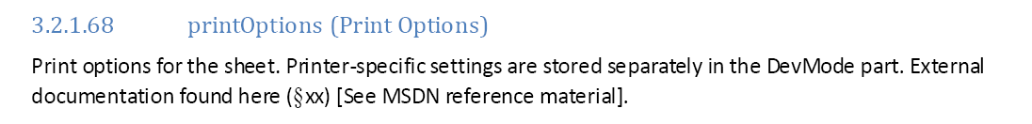
3.2.1.68 – DEVMODE
This binary blob stores printer settings in a format that can only be understood
on Windows.

Slide 23

7.4.1.5 – Clipboard formats
The OOXML specification does not say what any of these values mean, but
merely restricts them to seemingly arbitrary numbers.
So, not only is the data stored in binary format, it is in a an unspecified
format identified merely by number.

Slide 24
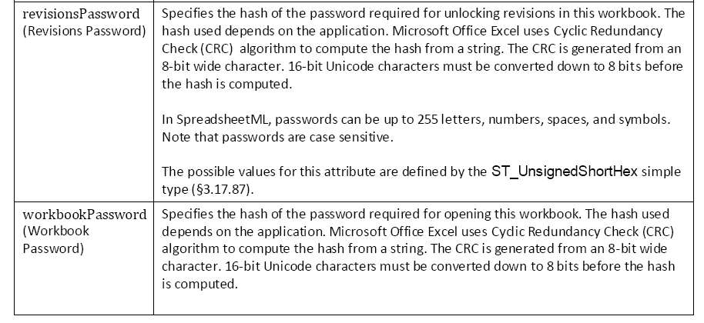
3.1.29 – Sheet-level passwords
Problem is a CRC is not defined unless you give the polynomial as well as the bit length.
We would also need to know exactly how Unicode characters are to be turned into 8 bit ones.
Hex encode? Throw out the high bits? Two bytes for each character?
Insufficient information is disclosed to allow interop.

Slide 25
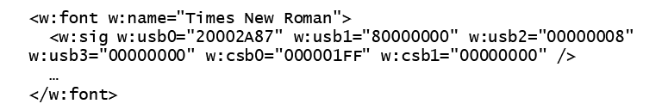
2.7.2.17 – Locale Signature
C:
typedef struct tagLOCALESIGNATURE {
DWORD lsUsb[4];
DWORD lsCsbDefault[2];
DWORD lsCsbSupported[2];
} LOCALESIGNATURE, *PLOCALESIGNATURE;
XML:
Can you tell the difference?

Slide 26
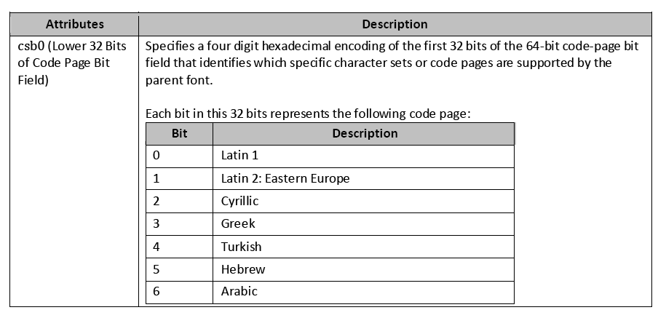
2.7.2.17 – Locale Signature
Bitmasks in XML ?!

Slide 27
Conformance according to ODF
Documents may contain elements in foreign namespaces
Document Consumers must be able to read any document which would have been valid if all foreign markup were removed.
Document Consumers may preserve such foreign markup

Slide 28
Implied validation pipeline
Load XML
Remove elements and attributes that are not in an ODF namespace
Validate the resulting document according to ODF schema

Slide 29
OOXML's approach
Part 5 of recently posted 1.4 draft OOXML
Much more complex, 37 pages describing a sophisticated validation pipeline
A new XML ML for Markup Compatibility

Slide 30
Markup Compatibility
Ignorable
MustUnderstand
  List of namespaces which either can be safely ignored, or must not be ignored
PreserveElements
PreserveAttributes
  List of elements or namespaces which should be preserved in editing, even if the namespace is ignorable
ProcessContent
  Content is processed even if element is ignored

Slide 31
AlternateContent/Choice/Fallback
Similar to a “switch/case/default” construct
See example compliance.xml

Slide 32
Implied validation pipeline
Verify validity of Markup Compatibility markup
Process MustUnderstand's and generate errors if needed
Remove Choice/Fallback markup for cases that were not used
Namespace subsumption – remove markup in obsolete namespaces and replace with new namespaces
Process the Ignorable's removing the ones you don't understand
Process the ProcessContent content

Slide 33
My take on it
Intriguing idea, but not fully baked (still draft).
Gives a lot of (too much?) flexibility in negotiating fidelity of representation based on capabilities of the consumer.
Danger – it essentially lets a producer rewrite the standard and the schema outside of a standards setting. Could enable Office to maintain a two-tier file format, with the high-fidelity version not documented, and the low-fidelity version available only in <Fallback>. Remember RTF?

Slide 34
Performance
How to measure the performance of a format versus the performance of an application?
Some factors:
  Number of XML files in the Zip which must be parsed
  Size of the XML files
  Preprocessing required to resolve Ignorable, MustUnderstand, etc.
  Can't give an absolute answer, since not all consumers of a the document are attempting the same thing.

Slide 35
Licensing Problem
The only implementation of OOXML is the Office 2007 beta, and the End User License Agreement (EULA) has this restriction:
“7. SCOPE OF LICENSE. ...You may not disclose the results of any benchmark tests of the software to any third party without Microsoft’s prior written approval”

Slide 36
Solution: test the XML
Take 176 working documents from Ecma TC45's document library, in Word format
Convert to ODF and OOXML formats
Collect static and runtime metrics for these document pairs, including:
  Size, compressed and uncompressed
  Size of just the XML
  Number of pages
  Number of files in the Zip
  Time to parse the XML – this is the core of any tool which will consume these documents so large differences here will directly map into large differences in applications

Slide 37
Number of files in the Zip
OOXML files = 5.7 +
ODF files
R^2 = 0.9958

Slide 38
Total Size of the XML's
OOXML size = 82,000 bytes +
1.5 * ODF size
R^2 = 0.92

Slide 39
Net effect on parse time
OOXML time = 3.5 * ODF time
R^2 = 0.9596
Time is time to parse all XML
files in the Zip archive with
Python's minidom

Slide 40
Bimodal behavior?

Slide 41
Performance Conclusions
Choice of an XML parser is key
  ODF files have larger, but fewer XML files
  OOXML have many small XML files
  Many (most?) parsers are not well optimized for the 2nd case.
Be a wise consumer of benchmark data
  Beware of tests which confuse application performance for file format performance
  Look to see if the documents used in the test are typical.
  Consider the performance of all types of applications, not just heavy-weight desktop editor

Slide 42
The End
Thank you

