Slide 1


Slide 2

Mass deployments by big companies and local governments
Can we support them?
Kazunari Hirano
OOo Japanese Native Language Project

Slide 3
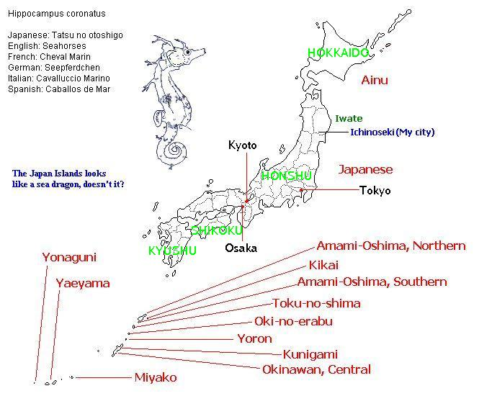
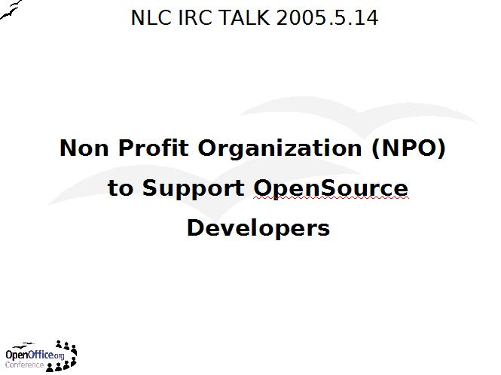
Japan
http://native-lang.openoffice.org/conference/slides/14-May-2005-Non-Profit.sxi

Slide 4
NTT Group
Nippon Telegraph and Telephone Corporation
http://www.ntt.co.jp/index_c.html
http://www.ntt.co.jp/index_e.html
In line with the global spread of ICT(Information and Communications Technology), NTT Group is providing international communications services and mobile multimedia services globally.
from http://www.ntt.co.jp/about_e/global.html

Slide 5
NTT COMWARE
NTT COMWARE provide system support services for Japan's telecommunications infrastructure, the biggest one of which is NTT.
http://www.nttcom.co.jp/english/
NTT Group
System Support Service
NTT COMWARE

Slide 6

Good Day Inc.
http://www.good-day.co.jp/en/index_html
OpenOffice.org support service
OpenOffice.org guide book
FTP Server to host OOo Builds
Foster OOo developers
NTT COMWARE
OpenOffice.org Community
OOo support service
Host Mac OSX Builds
Good Day Inc.

Slide 7
NTT COMWARE, Facts
From January 2008, all 5,000 members of NTT COMWARE use OpenOffice.org
The company obliges its members to create Inhouse Documents with OpenOffice.org

Slide 8
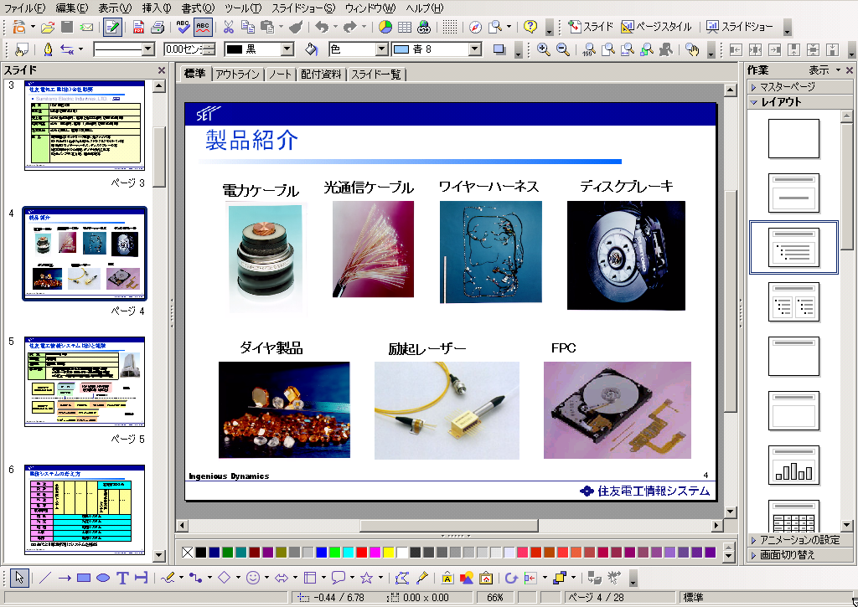
Sumitomo Electric Industries
http://www.sei.co.jp/sei_info_e/movie/01.html

Slide 9
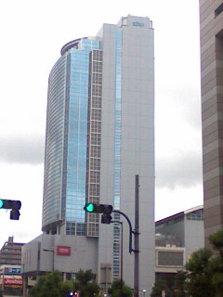
Sumitomo Electric Information Systems
http://www.sei-info.co.jp/
Sumitomo Electric
Industries Group
System support Service
Sumitomo Electric
Information Systems

Slide 10
Sumitomo Electric, Facts
On May 12 Sumitomo Electric Industries, Ltd. (SEI) announced they will use OpenOffice.org company-wide.
They started in April to use OpenOffice.org as recommended software, alternative to Microsoft Office.
Recommended PCs, which they will newly purchase, preinstall OpenOffice.org.
One of SEI group businesses, Sumitomo Electric Information Co., Ltd., maintains 15,000 PCs within SEI.
These PCs will be replaced with OpenOffice.org preinstalled PCs at the pace of 500 PCs per year.

Slide 11
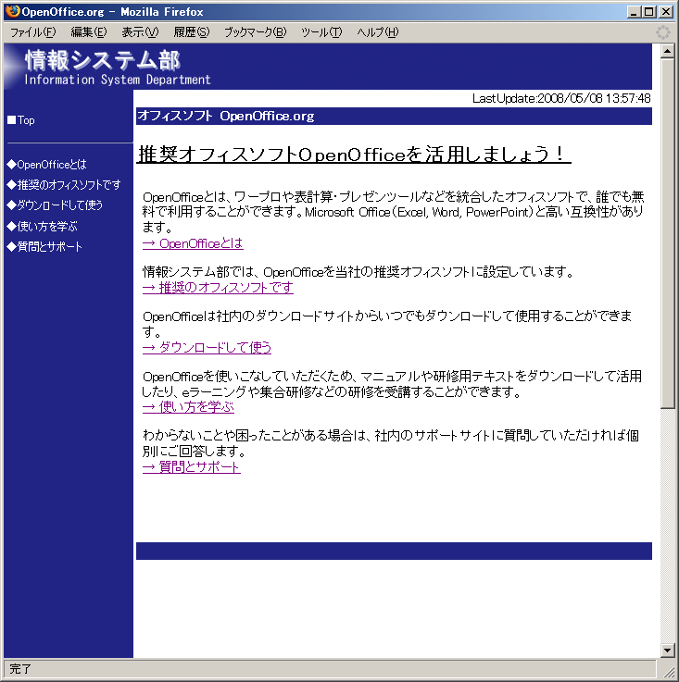
Information System Dept. Support Site

Slide 12
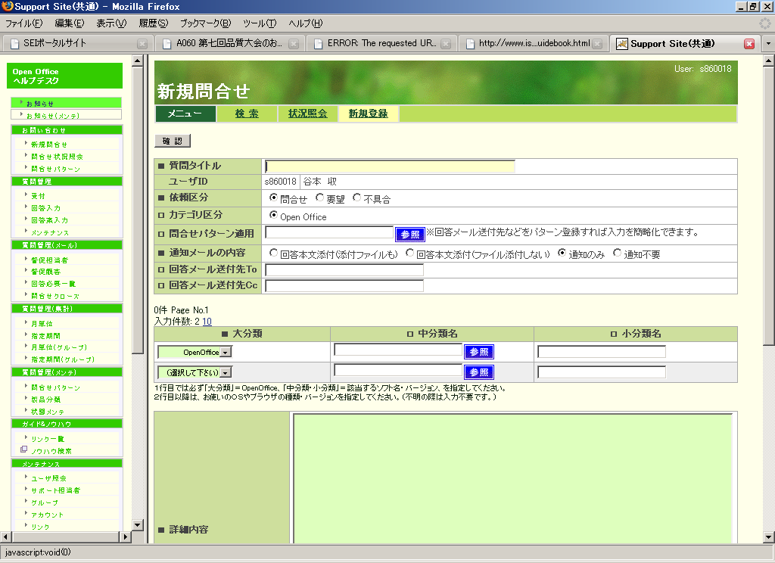
Questions & Answers

Slide 13
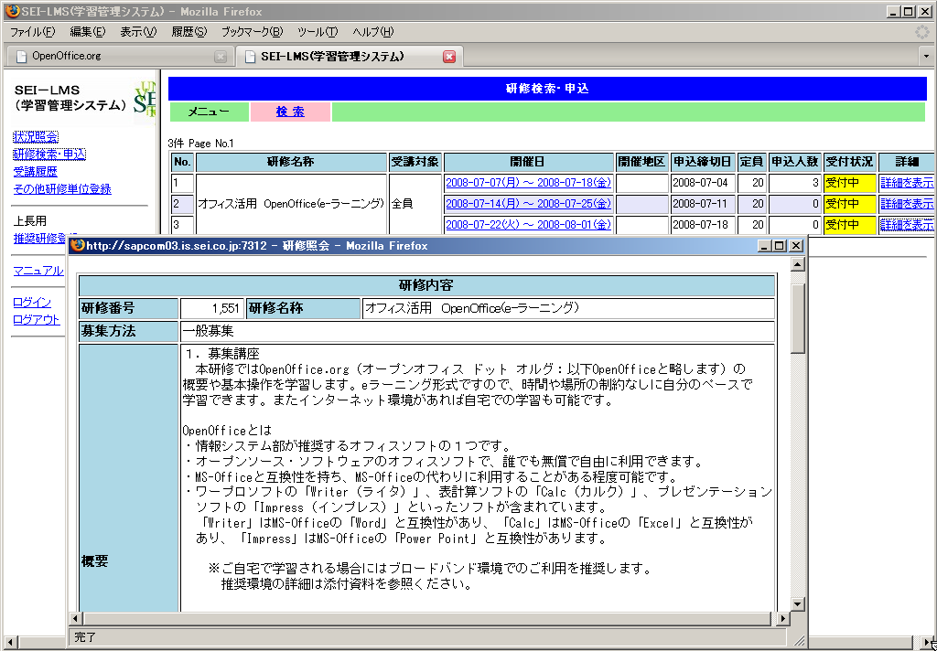
E-Learning system

Slide 14
Aizuwakamatsu City
http://jp.youtube.com/watch?v=iYg3EYEv9gI
On May 28th, Mayor Ichiro Kanke announced the city government will introduce OpenOffice.org into all its offices.
http://jp.youtube.com/watch?v=2n1sdd2Qrbg
"ODF, which can be used from the free software, OpenOffice.org, will help reduce the burden on our citizens"

Slide 15
Aizuwakamatsu, Facts
Estimates cutting the cost about 15,000,000 yen ($150,000) over 5 years.
From May 2008 they stopped newly purchasing of Microsoft Office.
OpenOffice.org is going to be installed on 850 PCs.
Information disclosure
Contribution to OpenOffice.org community

Slide 16
Can we support them?
Why did they make public their OpenOffice.org deployment?
They want OOo Community to be alive and continue.
They want professinal support.

Slide 17
What is Professional Support?
Understand their industries
Understand their business
Understand administrative services, tax services
Professional support service providers works in cooperation with, in collaboration with OpenOffice.org Community
Foster developers to create Quality Localized Builds

Slide 18

Quality Localized Builds
http://marketing.openoffice.org/ooocon2004/presentations/thursday/BOF_LocalizedBuilds.pdf

Slide 19


