Slide 1


Slide 2

The OpenOffice.org Scripting Framework: Adding a Scripting Language
Prof. Dr. Rony G. Flatscher
WU (Wirtschaftsuniversität Wien)
Austria, Europe

Slide 3
Agenda
OOo scripting framework
  Overview
  Dispatching scripts/macros
  Example
    Intermixing OOo Basic with ooRexx and vice versa
Apache Software Foundation's BSF
  Overview
Adding a scripting language to OOo
Outlook

Slide 4
OOo Scripting Framework, 1
Module "scripting"
  Since OOo 2.0
  Implemented in Java
    BeanShell
    JavaScript (Mozilla "Rhino")
    Java
  Allows to
    Maintain scripts
      Create, edit, remove scripts
      Supports the OOo locations: user, share, application

Slide 5
OOo Scripting Framework, 2
  Allows to (continued)
    Dispatch scripts
      Arguments (IN, OUT, IN/OUT)
      Returns script's return value, if any
    Extend OOo with new scripting engines
      Need for interfacing with Java
        Scripting languages implemented in Java
          Extremely easy to interface
        Scripting languages implemented e.g. in C++
          Need to use JNI (Sun's Java Native Interface)
          To ease coding use ASF's BSF 2.4

Slide 6
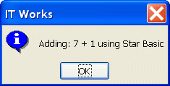
Example, 1
Simple OOo Basic script, adds two arguments
Function in an OOo Basic library ("application")
Code (cf. Frysak)
Function addition(arg1, arg2 as Integer) as Integer
' view that we are currently using Star Basic
MsgBox("Adding: " & arg1 & " + " & arg2 & " using Star Basic", 64, "IT Works")
' return calculation
' to calculate make sure the parameters are Integers
addition = CInt(arg1) + CInt(arg2)
End Function

Slide 7
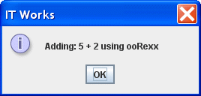
Example, 2
Simple ooRexx script, adds two arguments
Stand-alone program, located in "user"
Code (cf. Frysak)
-- a small test macro to test the x_RunMacro.rex macro
parse arg arg1, arg2
info = "Adding:" arg1 "+" arg2 "using ooRexx"
.bsf.dialog~messageBox(info, "IT Works", "information")
return arg1+arg2
::requires BSF.CLS

Slide 8
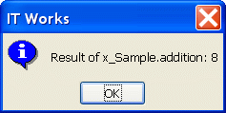
Example, 3
Invoking OOo Basic and ooRexx scripts (Basic)
Sub RunMacro
' create the Dispatcher service
oDisp = createUnoService("com.sun.star.frame.DispatchHelper")
' prepare parameters as array
Dim a(1) As New com.sun.star.beans.PropertyValue
a(0).Name = "arg1" : a(0).Value = 7
a(1).Name = "arg2" : a(1).Value = 1
' macro URL to addition function above
sMacroURL = "vnd.sun.star.script:BakkMacros_Basic.x_Sample.addition?" & _
"language=Basic&location=application"
' call addition function
r = oDisp.executeDispatch(StarDesktop, sMacroURL, "", 0, a())
' view result
MsgBox("Result of x_Sample.addition: " & r.result, 64, "IT Works")
' ... continued on next page ...

Slide 9
Example, 4
Invoking OOo Basic and ooRexx scripts (Basic)
'... continued from previous page ...
' macro URL to x_Sample.rex
sMacroURL = "vnd.sun.star.script:BakkMacros.x_Sample.rex?" & _
"language=ooRexx&location=user:uno_packages/BakkMacros.oxt"
' call x_Sample.rex and use the same parameters again
r = oDisp.executeDispatch(StarDesktop, sMacroURL, "", 0, a())
' show result
MsgBox("Result of x_Sample.addition: " & r.result, 64, "IT Works")
End Sub

Slide 10

Example, 5
Invoking OOo Basic and ooRexx scripts (ooRexx)
x_ScriptContext = uno.getScriptContext() -- get the script's context
x_Context = x_ScriptContext~getComponentContext -- get component context
x_Desktop = x_ScriptContext~getDesktop -- get desktop (an XDesktop)
-- create DispatchHelper service and query its interface
x_MSF = x_Context~getServiceManager~XMultiServiceFactory
x_DispHlp = x_MSF~createInstance("com.sun.star.frame.DispH")~XDispatchHelper
x_DispatchProvider = x_Desktop~XDispatchProvider -- get dispatch provider interface
-- prepare parameters
parameters = uno.CreateArray(.UNO~PropertyValue, 2)
parameters[1] = uno.createProperty("arg1", 5)
parameters[2] = uno.createProperty("arg2", 2)
-- define ooRexx dispatch target
MacroURL = "vnd.sun.star.script:BakkMacros.x_Sample.rex?" || -
"language=ooRexx&location=user"
-- make dispatch call
r = x_DispHlp~executeDispatch(x_DispatchProvider, MacroURL, "", 0, parameters)
msg = "Result of x_Sample.rex:" r~result
.bsf.dialog~messageBox(msg, "IT Works", "information")
-- ... continued on next page ...

Slide 11
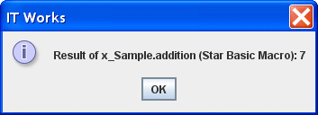
Example, 6
Invoking OOo Basic and ooRexx scripts (ooRexx)
-- ... continued from previous page ...
-- define Star Basic dispatch target
MacroURL = "vnd.sun.star.script:BakkMacros.x_Sample.addition?" || -
"language=Basic&location=application"
-- make dispatch call
r = x_DispHlp~executeDispatch(x_DispatchProvider, MacroURL, "", 0, parameters)
msg = "Result of x_Sample.addition (Star Basic Macro):" r~result
.bsf.dialog~messageBox(msg, "IT Works", "information")
::requires UNO.CLS

Slide 12
Bean Scripting Framework
Developed at IBM as an opensource project
  Purpose: deploying scripting languages in JSPs
Donated to the Apache Software Foundation
  Part of ASF's Jakarta project
    http://jakarta.apache.org/bsf
  Used in many other projects within ASF
    e.g. ant, xerces, etc.
A Java framework
  Eases access to scripting languages from Java
  Eases (reflective) interaction with Java from scripts

Slide 13
Bean Scripting Framework
Quite a few BSF scripting engines available
  Usually implemented in Java, e.g.
    Groovy, Groovy Monkey
    Jacl (TcL)
    JavaScript (Rhino)
    JLog (PROLOG)
    JRuby (Ruby)
    Jython (Python)
    ObjectScript
    …
  Can be easily added to OOo via BSF!

Slide 14
BSF Architecture
exec(...)
eval(...)
apply(...)
call(...)
Java Program
BSF (Java)
BSF Registry
BSFEngine

Slide 15
BSF, Executing a Script, 1
Executing a JavaScript script
import org.apache.bsf.*; // import BSF support
public class TestSimpleExecJavaScript {
public static void main (String[] args) throws java.io.IOException
{
try
{
BSFManager mgr = new BSFManager ();
BSFEngine engine = mgr.loadScriptingEngine("javascript");
String code = "java.lang.System.out.println(\"JavaScript was here!\")";
// invoke the JavaScript script
engine.exec ("javascript", 0, 0, code);
}
catch (BSFException e)
{
e.printStackTrace();
}
}
}

Slide 16
BSF, Executing a Script, 2
Executing an ooRexx script
import org.apache.bsf.*; // import BSF support
public class TestSimpleExecRexx {
public static void main (String[] args) throws java.io.IOException
{
try
{
BSFManager mgr = new BSFManager ();
BSFEngine engine = mgr.loadScriptingEngine("rexx");
String code = "SAY 'Rexx was here!'";
// invoke the Rexx script
engine.exec ("rexx", 0, 0, code);
}
catch (BSFException e)
{
e.printStackTrace();
}
}
}

Slide 17
BSF4Rexx, 1
Example: ooRexx (Open Object Rexx)
  A free, dynamic and opensource scripting language, perfect for EUD (end-user development)
    http://www.ooRexx.org
  Implemented in C++, not Java!
  Creating a BSF engine for ooRexx
    JNI (Sun's Java Native Interface)
    Add (reflective) support on the Java side, e.g.
      Loading Java classes, creating instances, dispatching messages
      Creating event adapters on the fly (Java bytecode) ...
    If usable via BSF, it becomes easy to deploy it
      ooRexx (a non-Java language) can use all of Java!

Slide 18
BSF4Rexx, 2
Architecture of "BSF4Rexx" (ooRexx BSF engine)
http://wi.wu-wien.ac.at/rgf/rexx/bsf4rexx/current
BSF()
BsfDropFuncs()
BsfInvokedBy()
BsfLoadFuncs()
BsfLoadJava()
BsfQueryAllFunctions()
BsfQueryRegisteredFunctions()
BsfShowErrorMessage()
BsfUnloadJava()
BsfVersion()
exec(...)
eval(...)
apply(...)
call(...)
Java Program
BSF (Java)
JNI
BSF Registry
BSF4Rexx
(C++)
RexxEngine
BSF.CLS
ooRexx
scripts
RexxAndJava

Slide 19
BSF4Rexx, 3
"RexxAndJava"
  Support for non-Java programs to
    Load Java classes, create Java instances, dispatch messages, marshall arguments and return values, etc.
  Can be used by any other BSF engine!
    Hence not restricted to ooRexx!
  If you have a non-Java language that you wish to add to OOo, use this existing infrastructure for interfacing with Java (to ease your life considerably ☺) !
    If you have any questions, please approach me or use the mailing list "dev@api.openoffice.org" or the newsgroup "news:comp.lang.rexx"

Slide 20
Adding a New Engine, 1
Outlining the process to add a new engine
  OOo scripting framework (Java)
  Using BSF 2.4 (alternatively: BSF 3.0 / JSR-223)
Reference implementation using BSF
  "BSF4Rexx"
    http://wi.wu-wien.ac.at/rgf/rexx/bsf4rexx/current/
    BSF4Rexx-apache-bsf-source.jar
  Used OOo's BeanShell implementation as a template, cf.
    com/sun/star/script/framework/provider/beanshell/

Slide 21
Adding a New Engine, 2
Module "scripting"
  http://framework.openoffice.org/scripting/
    Homepage of the OOo scripting framework
    Specifications
  svn co svn://svn.services.openoffice.org/ooo/trunk/scripting scripting
    Checking out the entire OOo scripting module
  scripting/java/com/sun/star/script/framework/provider
    Root for OOo script engines
    Utility/helper programs for script engines
    "beanshell", "java", "javascript" script engines

Slide 22
Adding a New Engine, 3
Module "scripting"
  Java 1.5 or higher (since OOo 3.0, October 2008)
  Define a name for your engine, e.g. "ABC"
    Create a directory of "abc" (lowercase!) in "provider"
    Define an extension for your language, e.g. "A"
  Use "beanshell" implementation as a blueprint
    Copy all "beanshell/*" files to "abc/"
    Rename "template.bsh" to "template.A"
      Change template script code to your language

Slide 23
Adding a New Engine, 4
Module "scripting" (continued)
    Rename "ScriptEditorForBeanShell.java" to "ScriptEditorForABC.java"
      Adapt all occurrences of "BeanShell" and "bsh" in this program to match your engine's names (i.e. "ABC", "A") and functionality
    Rename "ScriptProviderForBeanShell.java" to "ScriptProviderForABC.java"
      Adapt all occurrences of "BeanShell" and "bsh" in this program to match your engine's names (i.e. "ABC", "A") and functionality

Slide 24
Adding a New Engine, 5
Module "scripting" (continued)
  Define a name for your engine, e.g. "ABC"
    Create a directory of "abc" (lowercase!) in "provider"
    Define an extension for your language, e.g. "A"
  Use "beanshell" implementation as a blueprint
    Copy all "beanshell" files to "abc"
    Rename "template.bsh" to "template.A"
      Change template script code to your language
    Rename "ScriptEditorForBeanShell.java" to "ScriptEditorForABC.java"
    Rename "ScriptProviderForBeanShell.java" to "ScriptProviderForABC.java"

Slide 25
Adding a New Engine, 6
Module "scripting" (continued)
  Create a manifest file, e.g.
Manifest-Version: 1.0
RegistrationClassName: com.sun.star.script.framework.provider.abc.Scri
ptProviderForABC
Created-By: YourName
Specification-Title: ABC to/from UNO Bridge
Specification-Version: 0.999
Specification-Vendor: YourName
Implementation-Title: org.abc.uno
Implementation-Version: 0.999
Implementation-Vendor: YourName

Slide 26
Adding a New Engine, 7
Create a Java archive
  Name: "ScriptProviderForABC.jar"
  Entries
    META-INF/MANIFEST.MF
    com/sun/star/script/framework/provider/abc/*
  Add additional resources as needed
    If using additional Java archives add them to the manifest
    Cf. OOo documentation on packaging and deploying
Use the OOo package/extensions manager to deploy

Slide 27
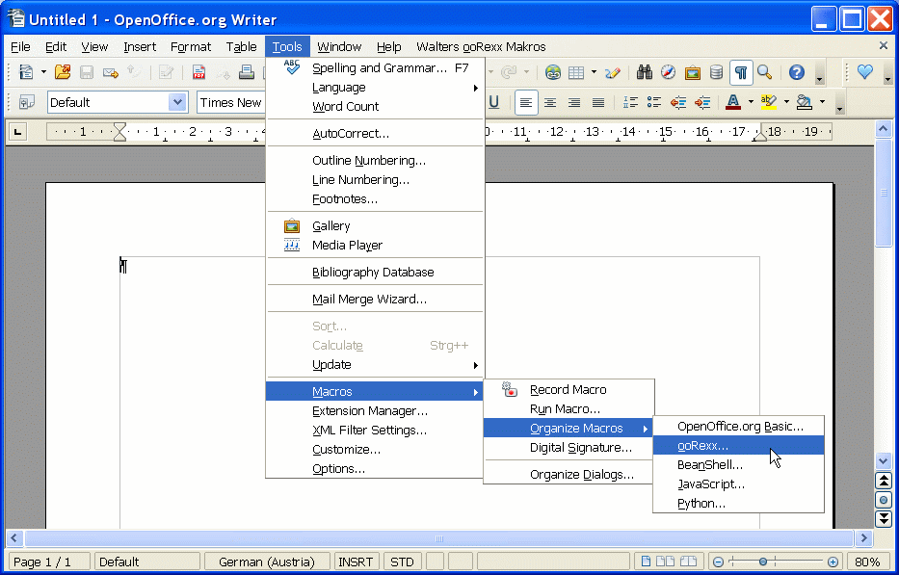
OOo with an Added Scripting Language

Slide 28
BSF 3.0/JSR-223, 1
JSR-223
  Defined the Java scripting framework
    Package "javax.script"
  Introduced with Sun's Java 6
  Only available for Java 6 or higher!
Apache's BSF 3.0
  Opensource Implementation of JSR-223
    Implements the package "javax.script"
    Available for Java 1.4 or higher!
  Part of ASF's Harmony ("Apache's Java")

Slide 29
BSF 3.0/JSR-223, 2
OOo Scripting engine using JSR-223
  Supply BSF 3.0 with your OOo engine
    OOo engine can run on pre Java 6 installations!
  On Java 6 or higher, the Java 6 scripting framework will be used instead of BSF 3.0
    As "javax.script" is part of the Java runtime environment, it will get picked up before any other package!
  OOo engine may in addition use BSF 2.4
    Taking advantage of BSF 2.4 support
    E.g. taking advantage of "RexxAndJava" for non-Java languages

Slide 30
Roundup & Outlook, 1
Adding a new scripting language to OpenOffice.org is easy!
OOo scripting framework is implemented in Java
  Use Java frameworks/infrastructures to ease implementation
  ASF's BSF 2.4 a good choice
    Reference implementation available ("BSF4Rexx")
    Take advantage of "RexxAndJava", if necessary
  ASF's BSF 3.0 / JSR-223 a good choice
    Deploy with the BSF 3.0 package for pre Java 6

Slide 31
Roundup & Outlook, 2
Now that you have added a new scripting language
  Make it easy to use UNO using it !
    Add support modules to reduce the coding needs, e.g.
      Ease querying interfaces
      Ease interacting with properties
      Ease reflection of UNO objects
      …
  This evening's presentation "Creating/Devising Specific OpenOffice.org Support for Dynamic Scripting Languages" concentrates on this issue

Slide 32


