Slide 1


Mozilla Calendar Project
Daniel Bölzle, Christian Jansen
    Sun Microsystems
13

Slide 2
Lightning Highlights
Open Source Calendaring Project
Seamless integration into Mozilla Thunderbird
  well accepted platform
  support for e-mail features (eg, invitations)
Extensible Architecture
Project Lead and core team provided by Sun

Slide 3
Mozilla Calendar Project
OpenSource
Sun stellt etwa die Hälfte der Entwicklungsresourcen und den Project Lead
Sunbird
  Standalone Application
Lightning
  Extension for Mozilla Thunderbird
Framework for pluggable calendar providers
Support for 23 locales

Slide 4
Platform Support
Windows
Solaris (x86 & SPARC)
Linux
Mac (PPC & Intel)

Slide 5
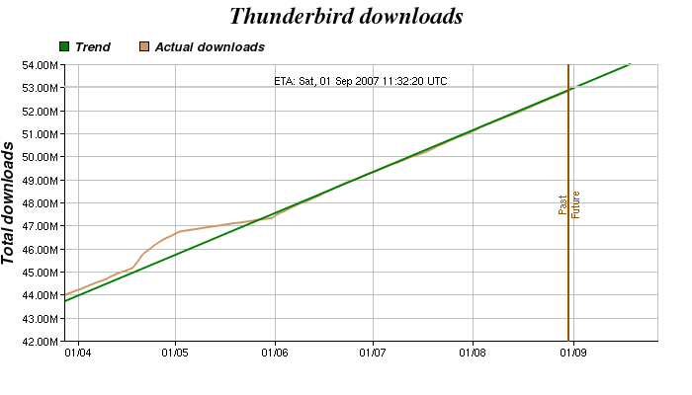
Thunderbird Downloads
Source: Thunderbird Statistics, http://tb.asbjorn.it/pages/dlgraph.php

Slide 6
Mozilla Platform
Component framework (XPCOM)
  huge API, rapid development, few 'stable' interfaces
Active community
Lots of extensions
  addons.mozilla.org
XUL+JavaScript
  Document rendering similar to dialog rendering
    Gecko, Shared DOM-API
  XUL-Overlays for flexible UI implementations
  Scripting: trendy but limited functionality
    (threading, performance, debugging)

Slide 7
Mozilla Plattform
Feingranulare Komponentisierung (XPCOM), viel API
  Nur wenig API ist als „stabil“ gekennzeichnet,
  agile Weiterentwicklung
  engagierte Community

Slide 8
Release 0.7 Features
Supports local and server based calendars
  iCal/ICS, WCAP, WebDAV, CalDAV, Google Calendar
Events/Tasks with recurrences, time zones, etc.
Month, Week, Day view, Agenda (Today Pane)
Multiple calendars support
Invitation handling
  Free/Busy management
  Address Book integration / LDAP
  Server based and iTIP/iMIP

Slide 9
Demo

Slide 10
Release 1.0 Features
Offline-mode and synchronisation
Searching for calendars
  Subscriptions
Search in calendars
Enable free/busy functionality to more providers
Invitations: Email reply, Inbox with status
Transition: Email <-> Event/Task
Task View

Slide 11
Mock-ups

Slide 12
Post 1.0
OpenOffice.org integration
Small device sync
Better CalDav Support
Exchange Support

Slide 13
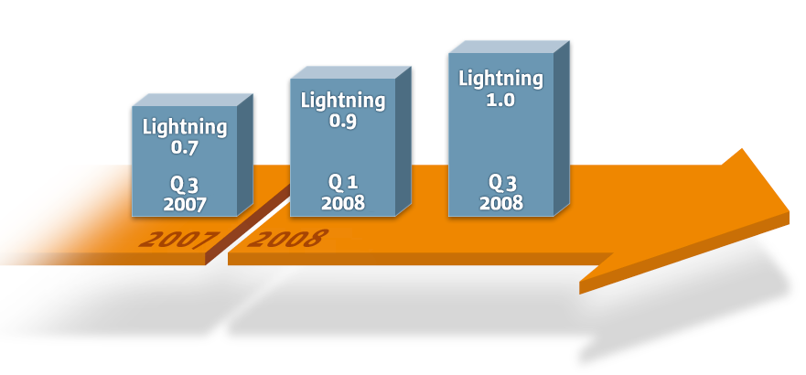
Lightning Release Dates

Slide 14
Participate
....

Slide 15
Links
Mozilla Calendar Projekt
  http://www.mozilla.org/projects/calendar
Projekt Roadmap
  http://wiki.mozilla.org/Calendar:Roadmap
Aktuelle nightly builds
  ftp://ftp.mozilla.org/pub/mozilla.org/calendar/lightning/nightly/latest-mozilla1.8/

Slide 16
Q&A

Slide 17
Thank You
Daniel Bölzle, Christian Jansen
    Sun Microsystems
13

