Slide 1
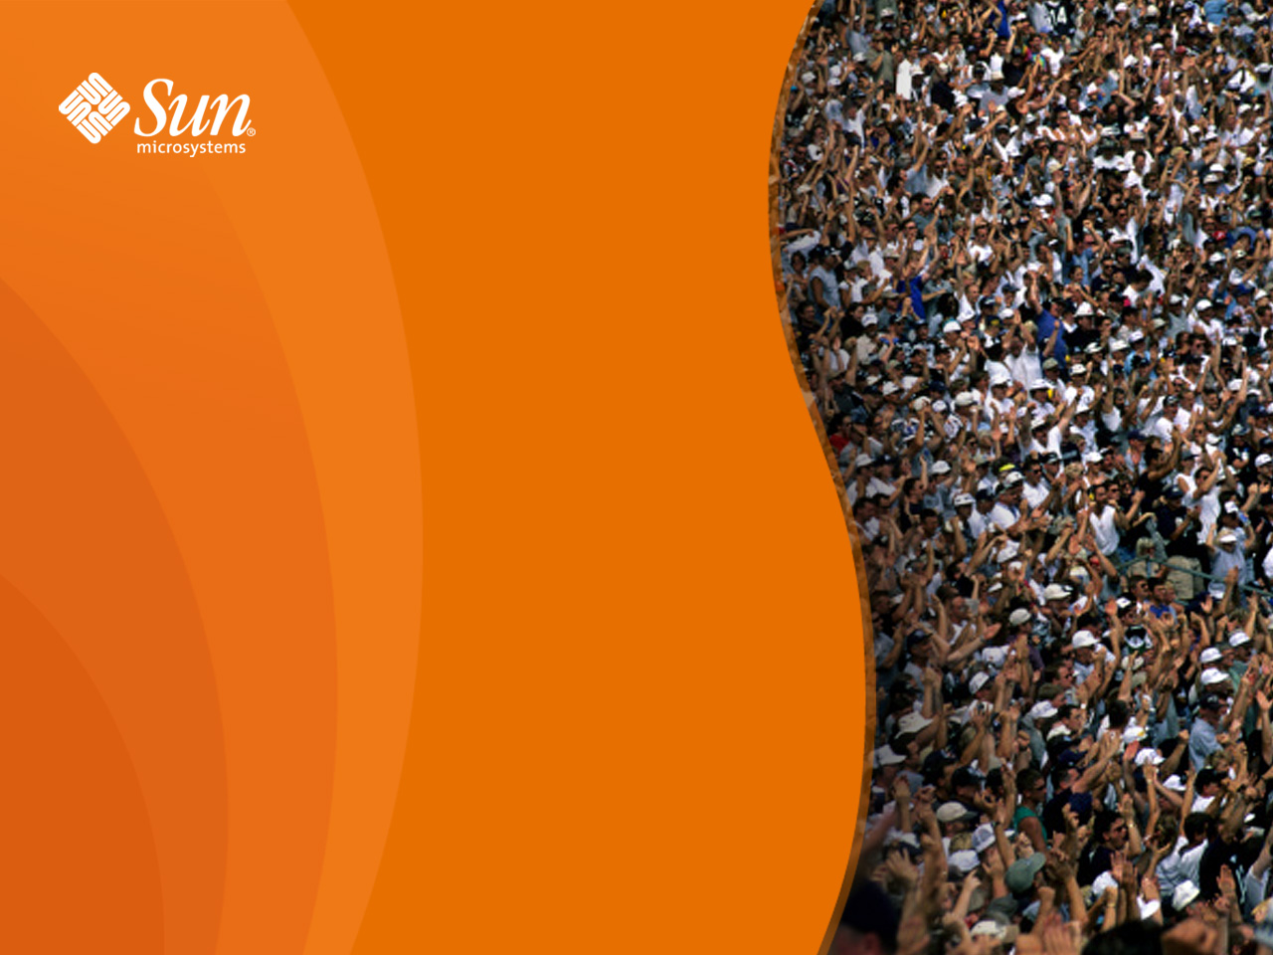
Moving OOo to XCanvas, Step 2 –
Draw and Impress
Thorsten Behrens
  StarOffice/OpenOffice.org
    Sun Microsystems

Slide 2
Outline
The What and the Where of the DrawingLayer
What are the problems?
How does the architecture look now?
Migration plan
XCanvas: recap
How was XCanvas integrated?
Demo

Slide 3
DrawingLayer: Where and What For?
Top Layer
GUI
CUI
ODF
UNO
Part of module svx
Used from all apps, to view & control Draw shapes
Writer
Math
Wizards
Calc
Base
XML
Impress
IDE
Mid Layer
GUI
CUI
UNO
FWK
i18n
Common GUI
Drawing Layer
BASIC
System Integration
Help
Utilities
Framework
UNO
VCL

Slide 4
Problems With Current DrawingLayer
Model and view basically in one object
deep inheritance and usage of concrete instances, with app framework, control layer, and VCL
(almost) no points of customization:
  impossible to exchange render backend
  extremely hard to add new shape types
rendering is a crosscutting concern

Slide 5
DrawingLayer Rework
Split up into two CWS:
  Overlay/Interaction/BaseGfx stuff: aw024. Will hit HEAD soon
  DrawingLayer primitives: aw033
    Needs the changes from aw024 merged in, and then at least ½ year additional effort

Slide 6
Reworked DrawingLayer: Overview
Model
1..*
View
SdrObject
ViewContact
1..*
ViewContact
getChild()
getVOC()
getViewIndependentPrimitiveList()
ViewObjectContact
ViewObjectContact
getPrimitiveList()
getRecPrimitiveList()
Object(s)Contact
SdrView
generates:
basePrimitive
getRange()
getDecomposition()

Slide 7
Reworked DrawingLayer: Details
Separates model & view (controller: later)
  SdrObject (model)
  ObjectContact & ViewObjectContact: view + “content” of the view
Bins ad hoc output/geometry generation, instead employs factored-out graphics tooling (basegfx)
Provides scene-graph like hierarchy of view content, makes it easy to “plug in” different renderers

Slide 8
Migration Plan
Design XCanvas API, provide set of working implementations
Base newly implemented UNO slideshow component on XCanvas
Port Draw/Impress to XCanvas
  Utilize overlays from aw024
Make XCanvas accessible from remaining UNO API
Port Calc to XCanvas
Port Writer to XCanvas

Slide 9
XCanvas, What Was That Again?
'X' because it's a UNO interface
new UNO-API based rendering subsystem for OOo
slated to replace VCL's OutputDevice for rendering application content:
  Impress slideshow (OOo 2.0)
  Draw/Impress edit view

Slide 10
Reasons for XCanvas
  UNO API for rendering
  Significantly better portability
    low impedance towards modern graphics APIs
    easy to start with, for contributors
  Separation of concerns
    XCanvas: rendering
    toolkit: controls & windowing
  Speed
    low impedance towards contemporary graphics hardware
  Quality
    ubiquituous alpha compositing
    anti-aliasing
    color management

Slide 11
Key XCanvas Features
Contemporary set of render primitives
Multitude of backends feasible
Stateless, concurrency-friendly design
Flexible caching concept

Slide 12
How's XCanvas Plugged In?
It's Model/View: you just need to reimplement the view part
Tacid assumption: XCanvas output and VCL OutputDevice output must mix on the same area (until all of OOo has been migrated)!

Slide 13
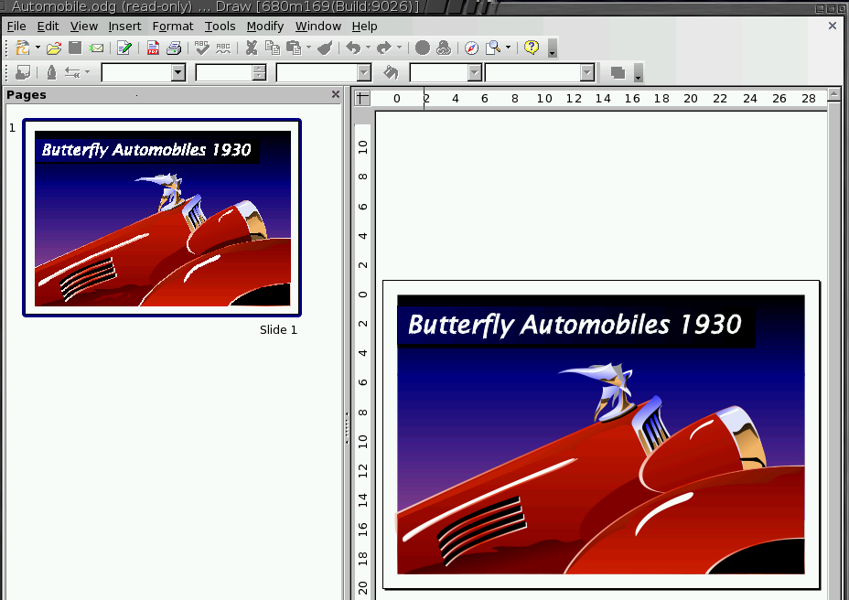
Demo

Slide 14
Further Info
OOo Wiki's DrawingLayer rework page

Slide 15
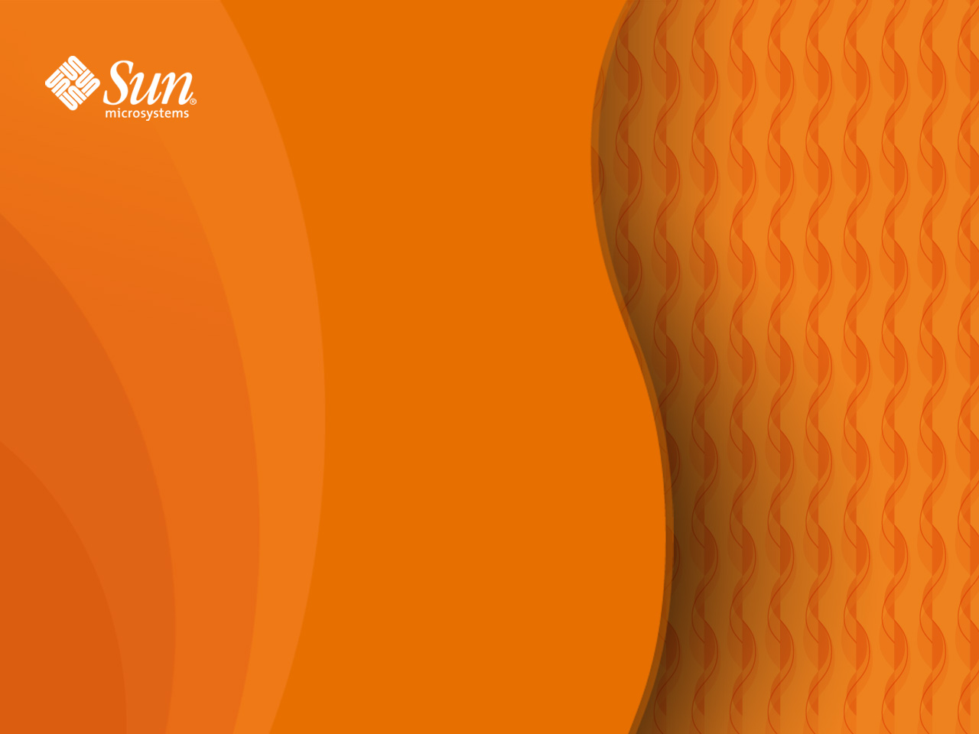
Q&A
Thorsten Behrens
  thorsten.behrens@sun.com

