Slide 1


ooo.doc 2008
Present and Future of the Documentation Project
Clayton Cornell
Sun Microsystems Hamburg
Documentation Project Lead
Frank Peters
Sun Microsystems Hamburg

Slide 2
ooo.doc Objectives
Create easy user access
Allow easy contribution
Ensure targeted content
Ensure documentation is up-to-date and technically accurate
Be efficient, minimize duplication of efforts
Implement transparent processes
Include all locales

Slide 3
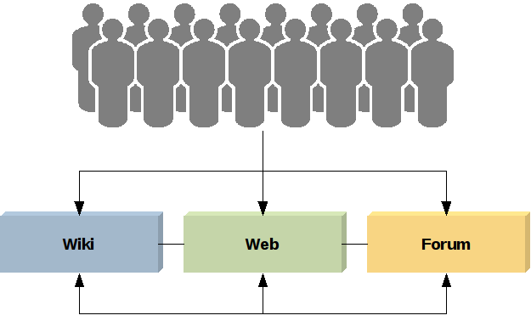
User Access
Wiki (Doc)
  300,000
  monthly page views
Forum
  4,500
  monthly postings
Website (Doc)
  200,000
  monthly page views
Cross-links between the access channels

Slide 4
DocWiki:Where Are We?
New Additions since OOoCon 2007
  411 new HowTos and References (many of them by DrKing)
  All OOoAuthors docs for OOo2.x
  New OOoAuthors docs for OOo3.0
New localized manuals are available on the Wiki:
  Chinese Developer's Guide
  French, Chinese and Japanese Administration guide (in progress)
  French, Chinese and Japanese BASIC Guide (in progress)
New functionality since OOoCon 2007
  Language InterWiki links
  Update to MW 1.11
  New extensions: Collections, WikiMath, Language Selector,
  IDL tags, Displaytitle

Slide 5
DocWiki:What's Missing?
A Concise Editing Policy
  To support consistent look, feel, and style
  Martina is working on that (mwaller@openoffice.org)
A Set of Templates
  To support consistent structure and easier localization
  Martina is working on that (mwaller@openoffice.org)
Localization Policy and Templates
  To support consistent experience across languages
  Needs to be worked at with NLC
What else?
  Wiki Access Rights, Wiki Areas for NLC or Projects with rights to delete, functionality?

Slide 6
Forum:Facts
The OpenOffice.org User forum is managed entirely by members of the OpenOffice.org User community.
Localized forums:
  French, Hungarian, Japanese, and more languages coming soon
Get involved as contributor, volunteer, administrator or help start a localized forum

Slide 7
Forum:Statistics
Status of Forum
  User Forum went live on 17 November 2007
  53,000 posts in 11,000 topics by more than 12,000 members

Slide 8
DocWebsite:Facts
Nowadays, the collaboration platform is the DocWiki
DocWebsite as repository for static content and snapshots
OpenOffice.org 3.0 Conceptual Guide
  Contributed by Gabriel Gurley
  Provides educational guides and training materials
  Awarded with Sun award
OOoAuthors
  New OOo3.0 guides

Slide 9
Targeted Content
User Documents
  Application Help
  Getting Started Guide*
  Migration Guide*
  Writer, Draw, Impress, Calc Guide*
  Tutorials
Developer Documents
  Developer's Guide
  BASIC Programming Guide
Administration Docs
  Administration Guide
What's missing?
  Programming Extensions
  More documentation on Base
  Macro Cookbook
  YOUR SUGGESTION HERE
You can help to
reduce this list!
* provided by the OOoAuthors group

Slide 10
Transparent Processes
We need them!
  Where do I start?
  How do I add comments?
  How do I add a HowTo/guide/FAQ?
  How do we localize content?
  How do we cross-link?
Martina Waller is working on a style guide and some editing policies for the DocWiki

Slide 11
Include all Locales
Working on it
InterWiki links
Need consistent subpage structure
Sun sponsors localization of Admin G and BASIC G inside the DocWiki

Slide 12
Ease of Contribution
Type of Wiki Contributions
  Comment on an existing page
  Edit an existing page (modify, add content)
  Categorize an existing page
  Create external content and link to it through the Wiki
The only requirement to edit or comment on Wiki pages:
  Get registered with the Wiki
What could be made easier?

Slide 13
DocWiki:Statistics

Slide 14
DocWiki:Contributors
2,700
+
1,300
4,000 contributions since January
a contribution is a wiki page added or modified

Slide 15
Wiki:Outlook
PediaPress extension
  Creating ODF and PDF from aggregated Wiki pages
  Allow print-on-demand from Wiki documents
InterWiki links
  Link content from different languages easily and transparently
Localization progress and process (eg using ISO language codes)
MediaWiki Engine Upgrade
Other New Functionality
  Flagged Revisions to improve reliability and accuracy
  WYSIWYG Wiki editor

Slide 16
Next Steps:Your Turn
Wiki Editing Guidelines
  Go help Martina: mwaller@openoffice.org
Agree on Localization/NLC Process
  Join the discussion on dev@native-lang.openoffice.org
Identify Documentation Gaps
  Add your suggestions to the wishlist
  http://wiki.services.openoffice.org/wiki/Documentation/Dashboard/Wishlist
Fill Documentation Gaps
  Add FAQs, HowTos, add chapters to guides, add tutorials
Help Improve Documents
  Update, clean-up, verify FAQs, HowTos, guides

Slide 17
Challenges
Wiki structure
  Updates and versioning
  Monitoring input
  Connecting English and NLC content
  Presentation of content
Localization
  Community efforts
  Formal localization process
  Relation between localized content pages
Editorial process
  Validation of content
  Consistency of style and look

Slide 18

Questions?
http://documentation.openoffice.org
http://wiki.services.openoffice.org/wiki/Documentation

