Slide 1

OpenOffice.org &
ODF eco system
Dieter Loeschky
Sr. Manager Software Engineering
OpenOffice.org / StarOffice Development
Sun Microsystems

Slide 2
Agenda
ODF Roadmap
Sun ODF Plugin for MS Office
ODF Document Converter
ODF Toolkit
Growing OOo and ODF eco system

Slide 3
ODF Roadmap

Slide 4
Why ODF?
Globalization Requires Standardization
“Modern information technology has turned the world into a village with amazing speed. It links people and builds bridges in a way which even quite recently we would have believed impossible.
An open, unhindered exchange of information in all areas of life is of fundamental importance for today's knowledge-based society. It is an important foundation for our shared objective: a peaceful, democratic, pluralistic society. The Open Document Format, as a completely open and ISO-standardized format, is an excellent vehicle for the free exchange of knowledge and information in the globalized age.”
Dr. Frank-Walter Steinmeier
Federal Foreign Minister, Germany

Slide 5

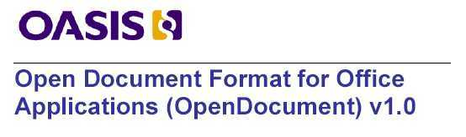
ODF is Maturing Quickly
ODF 1.0
  OASIS approval in May 2005
  ISO approval in May 2006
ODF 1.1
  Minor update
  Focus on accessibility
  OASIS approval in February 2007
ODF 1.2
  Solid draft available
  Focus on formulas and metadata
  Rough estimate:
    approved as OASIS standard – Q1 2009
    approved as an ISO standard - Q4 2009
ISO/IEC 26300

Slide 6
What is new in ODF 1.2?
Spreadsheet Formulas
Extended Metadata (Semantic/Intelligent Documents)
Digital Signatures
Accessibility Enhancements
Database Frond-End Format
Miscellaneous Features

Slide 7
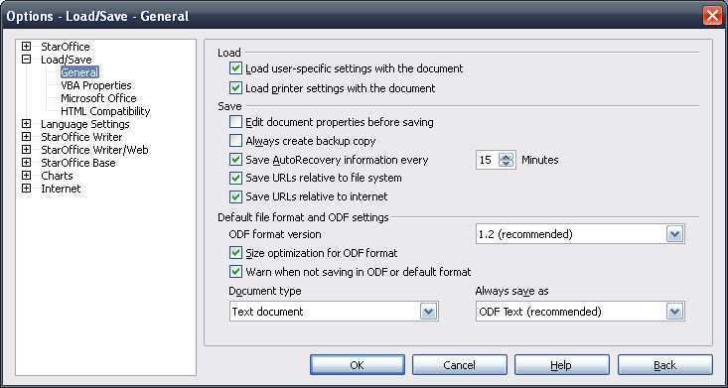
ODF 1.2 in OpenOffice.org (1)
Option to save in ODF 1.2 or ODF 1.0/1.1

Slide 8
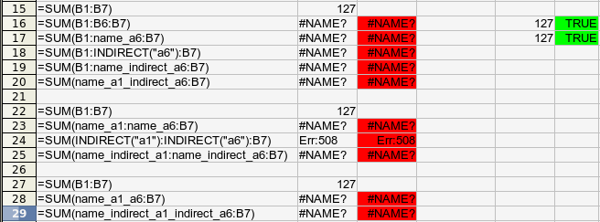
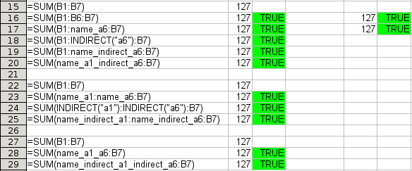
ODF 1.2 in OpenOffice.org (2)
ODF 1.2 Formulas in Calc
OOo 2.x
OOo 3.0

Slide 9
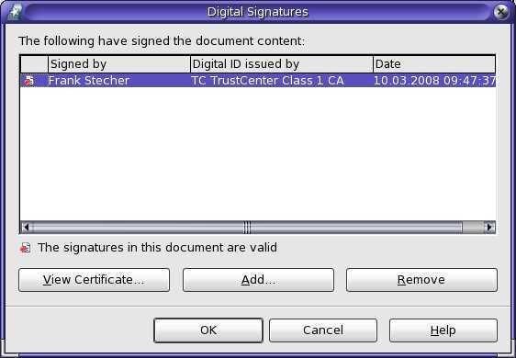
ODF 1.2 in OpenOffice.org (3)
Digital Signatures as defined in ODF 1.2

Slide 10
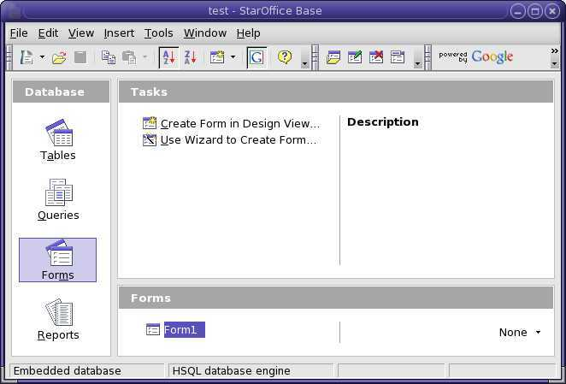
ODF 1.2 in OpenOffice.org (4)
Base uses new ODF 1.2 database front end file format

Slide 11
Who Designed ODF 1.2?
OASIS OpenDocument
Technical Committee
Chairs:
Michael Brauer, Sun Microsystems
Rob Weir, IBM
Editor:
Patrick Durusau
Voting Membership:
˜13 members from
˜7 organizations, including IBM, Sun
and Microsoft
Total Membership:
˜60 members from
˜24 organizations
Metadata Sub Committee
Chair:
Patrick Durusau
Formula Sub Committee
Chair:
David Wheeler
Accessibility Sub Committee
Chairs:
Peter Korn, Sun Microsystems
Rich Schwerdtfeger, IBM

Slide 12
How ODF moves forward within OASIS
OASIS OpenDocument
Technical Committee
OASIS ODF Adoption
Technical Committee
OASIS ODF
Interoperability
and Conformance
Technical Committee
Metadata Sub
Committee
Formula Sub
Committee
New Technical Committee:
  Reviews current state
  of conformance and interoperability
  among ODF implementations
  Creates conformity
  assessment methodology
  Creates test documents
  Creates ODF Profiles
  (Subsets, Combinations of ODF
  and other Standards)
New Sub Committee:
Collects Requirements
for the next
(post 1.2) ODF version
Accessibility Sub
Committee
Requirements Sub
Committee

Slide 13
Sun ODF Plugin for MS Office

Slide 14
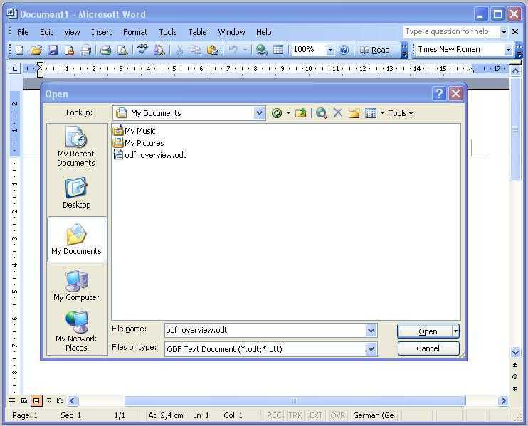
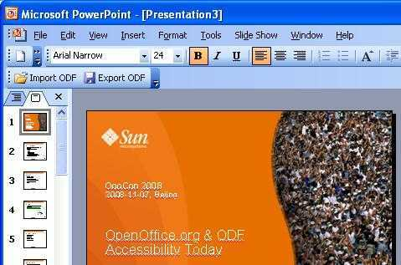
Sun ODF Plugin for MS Office
Enables MS Office 2000/2003/XP/2007
users to read and write ODF
Based on OOo
Best quality due to
OOo filters

Slide 15
StarOffice Server
ODF Document Converter

Slide 16
StarOffice Server
ODF Document Converter
Use the „StarOffice 9 Server – Development Kit“
to build your own Document Converter
Use StarOffice Server Java API for integrating
OOo UNO services into own applications
More Use Cases
  Document Format Conversion
    Example: all OOo import/export formats
  Server-side automated Document Creation
    Example: Create docs from templates and database content
  Document Distribution
    Example: Print, fax, email generated documents

Slide 17
ODF Toolkit

Slide 18
ODF Toolkit Project at OOo
Purpose: To provide a home for components that:
  Are ODF related, and
  Complement the ODF Toolkit, or
  Are clients of the ODF Toolkit
Sub projects launched:
  AODL (.NET Module)
  ODFDOM (Java ODF Extension to W3C DOM)
Modularization/Re-Packaging:
  Restructuring of OOo packages
    Separation URE (UNO Runtime Environment), OpenOffice.org core, branding

Slide 19
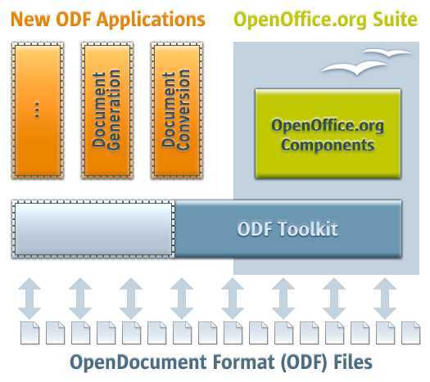
ODF Toolkit at OOo

Slide 20
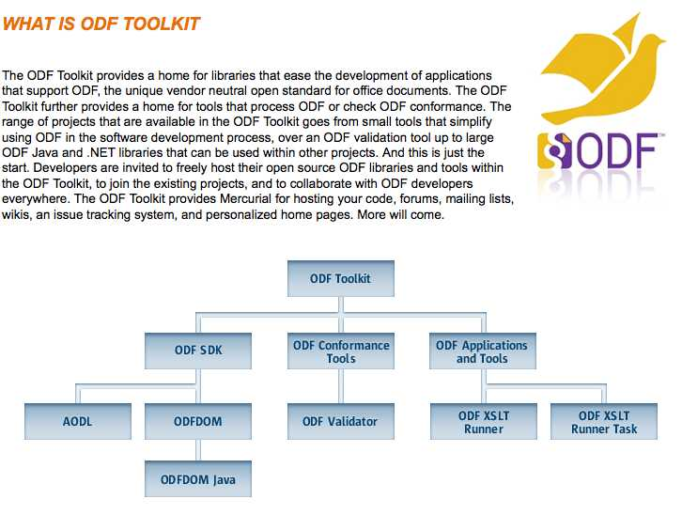
brand new: ODF Toolkit at odftoolkit.org
Sun and IBM co-founded the project odftoolkit.org
Goal is to give the ODF Toolkit a broader scope

Slide 21
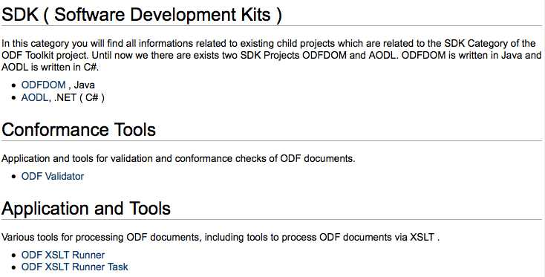
ODF Toolkit at odftoolkit.org

Slide 22
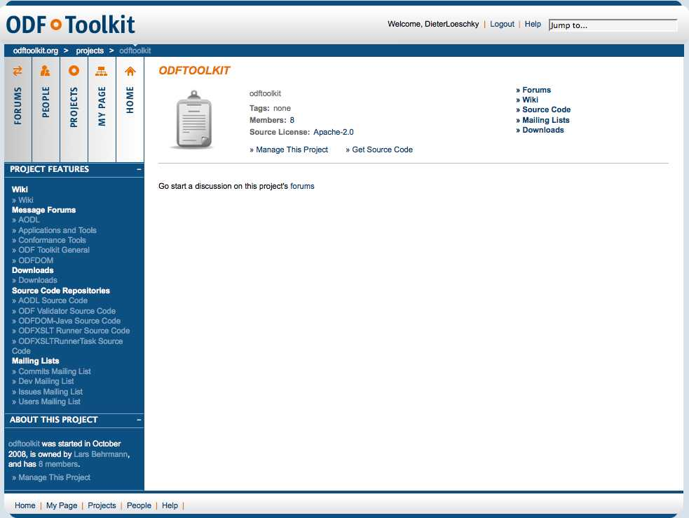
ODF Toolkit at odftoolkit.org
Give it a try!

Slide 23
Growing OOo and ODF eco system

Slide 24
Growing OOo and ODF eco system
ODF adoption in
  OpenOffice.org
  StarOffice
  IBM Symphony
  Microsoft Office (via Sun ODF plug in)
  KOffice
  Google Docs & Spreadsheet
  AbiWord
  ZOHO Writer
  Textmaker 2006
  Apple Mac OS X Leopard
  ...

Slide 25
Growing OOo and ODF eco system
OpenOffice.org integration in
  MS SharePoint
  Alfresco
  SAP
  O3Spaces
  OpenText LiveLink
  FileNet
  Fabasoft Folio
  SugarCRM
  Drupal
  Collanos
  Drupal

Slide 26
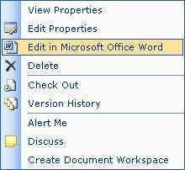
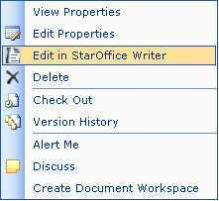
In detail: integration in MS SharePoint
Seamless integration into MS SharePoint Web UI
  Create/Open/Edit/Save documents with OOo
  Searching in ODF Documents using SharePoint Search
MS SharePoint functionality in OOo
  Open and save documents on SharePoint's document libraries
  Document management (check-in, check-out, versioning)

Slide 27
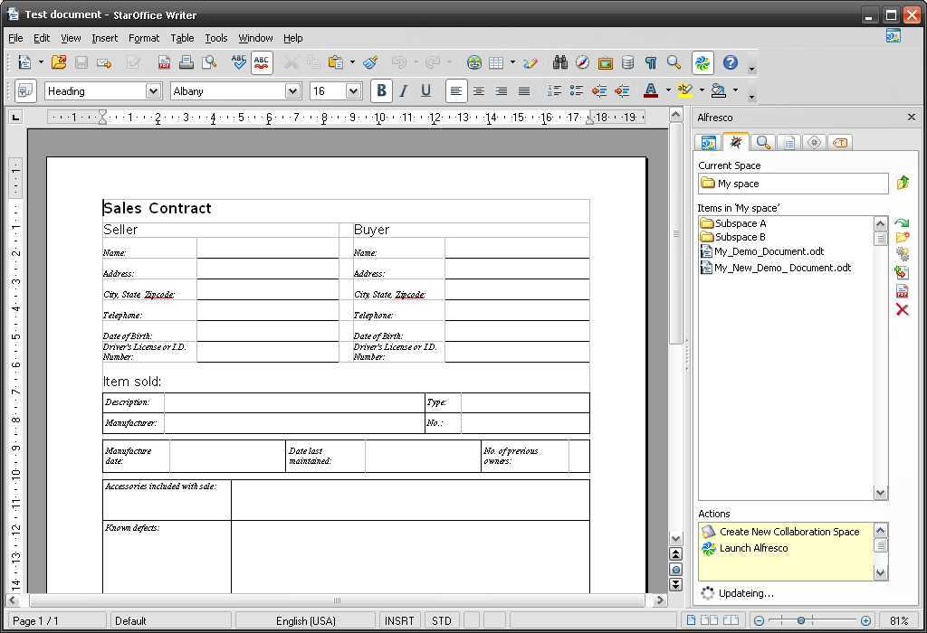
In detail: integration in Alfresco
Load/save/create
Checkin/checkout
Workflows
Spaces management
PDF creation
Document details
ODF search

Slide 28
In detail: integration in SAP
ALV Grid Export
  Export of any SAP ALV table to OOo
  Better solution as MS Excel integration due to picture export
DIO, SAP ABAP based integration
  Available but in maintenance mode
WebDynpro
SAP GUI based integration or HTML frontend
  OOo runs in web browser (Java Plugin)
Guided Procedures
  ODF based data entry forms workflow

Slide 29
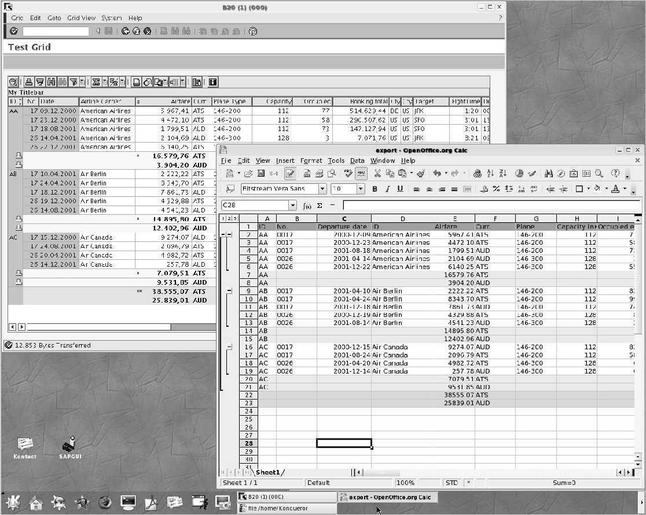
In detail: integration in SAP

Slide 30
Microsoft stated that
“ODF has clearly won”
(Stuart McKee, National Technology Officer at Microsoft)
That's nice but not the end of the game
Let's stay innovative and keep on track!

Slide 31

Your
Questions

Slide 32
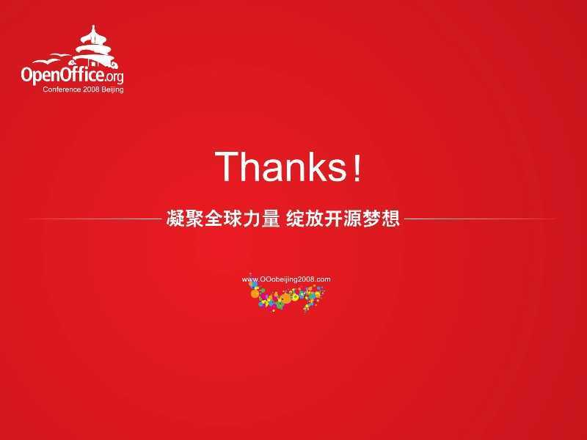

Slide 33

OpenOffice.org &
ODF eco system
Dieter Loeschky
Dieter.Loeschky@sun.com

