Slide 1

Progress Indicators in OOo – Status Quo
Matthias Müller-Prove
  User Experience Engineer / Interaction Designer
    Sun Microsystems GmbH
    Aug 2006, Oct 2007
Notes:
This document:
http://specs.openoffice.org/ui_in_general/progress/ProgressIndicators.odp
Author: http://so-doc.germany.sun.com/Teams/User_Experience/Team/mmp/welcome.html

Slide 2
determinate

Slide 3

Splash

Slide 4
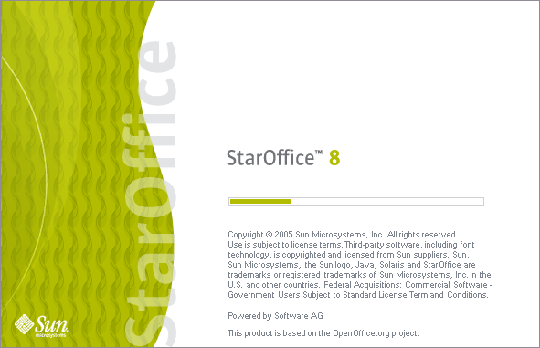
Splash

Slide 5
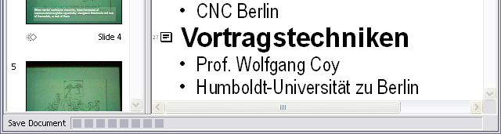
Document Progress

Slide 6

Web Page Wizard

Slide 7
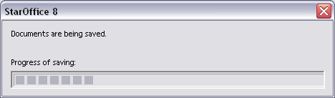
StarOffice Document Recovery

Slide 8
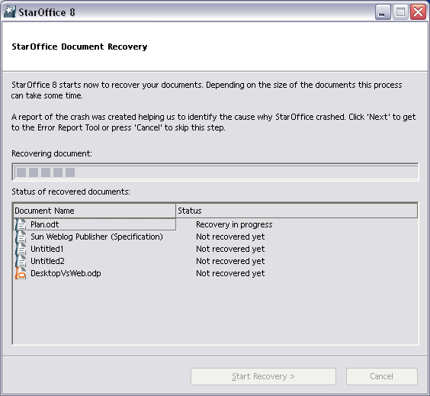
StarOffice Document Recovery

Slide 9
determinate with cancel

Slide 10
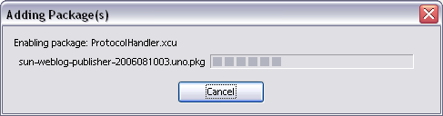
Extension Manager

Slide 11
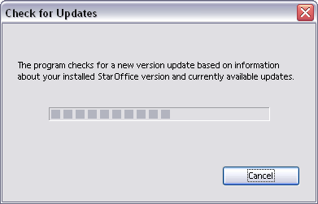
Check for Updates

Slide 12
asynchronous

Slide 13

Sun Weblog Publisher 1.0

Slide 14
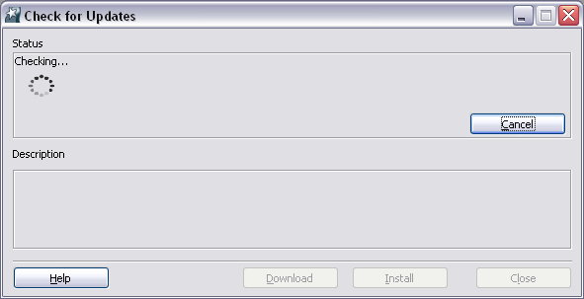
Update Manager
http://specs.openoffice.org/installation/online_update/Online_Update_Download_Installation.odt

Slide 15
Sun Guidelines

Slide 16
Sun Web Application Guidelines
Chapter 15: Progress Indicators
  http://developers.sun.com/docs/web-app-guidelines/uispec4_0/15-progress.html

Slide 17
Progress Indicators in OOo – Status Quo
Matthias Müller-Prove
  User Experience Engineer / Interaction Designer
    Sun Microsystems GmbH
Notes:
This document:
http://specs.openoffice.org/ui_in_general/progress/ProgressIndicators.odp
Author: http://so-doc.germany.sun.com/Teams/User_Experience/Team/mmp/welcome.html

