Slide 1
OOoCon 2005
  Localizing OOo
  The Italian Experience

Slide 2

Agenda
Speaker Introductions
Damien Donlon – Software Engineer Sun G11N
Monica Badia
Alessandro Cattalan
Q & A

Slide 3

A Pilot Project
  October 2004: pilot project
    Translation of the Basic module
  Among the involved communities:
    French
    Italian
    Spanish
    Braz. Portuguese
    Japanese
    Simplified Chinese
    Korean...

Slide 4

Aims
Investigate the possibility of extending the collaboration between the OOo communities and Sun
Finding out to which extent this co-operation was possible
Investigate the possibility of localizing OOo open-source

Slide 5
TOOL offered by Sun
SunTrans Editor for the translation
SunGloss for the terminology
Language Leads for the support

Slide 6
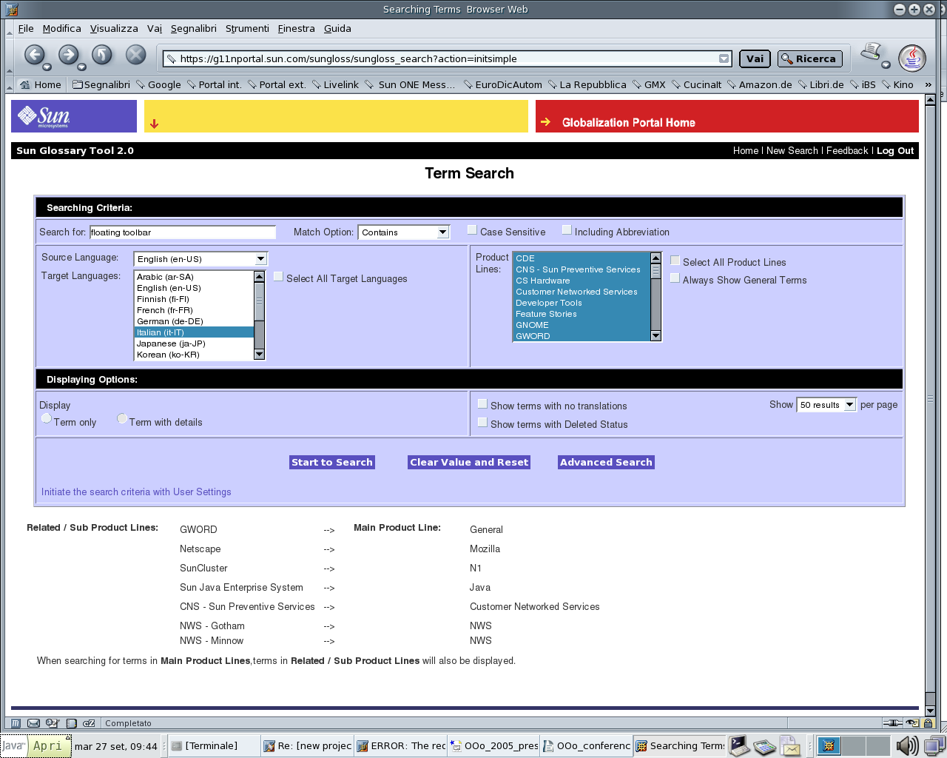
SunGloss
Freeware starting from November 2005

Slide 7
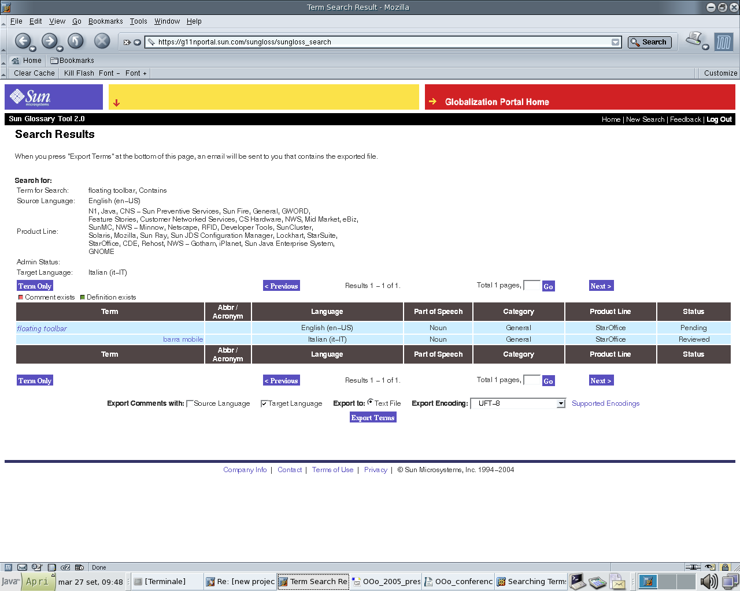
SunGloss

Slide 8
Language Leads
French, Italian, German, Spanish, Swedish, Braz. Portuguese
Japanese, Trad. Chinese
Create and maintain the terminology in the SunGloss
Review work
Facilitate the communication between the OOo and Sun
Advisor “on request”

Slide 9
Review Work
Criteria for the correction
= professional translation vendor
1. Correct translation
2.Correct and consistent terminology
3. Readability of the text

Slide 10
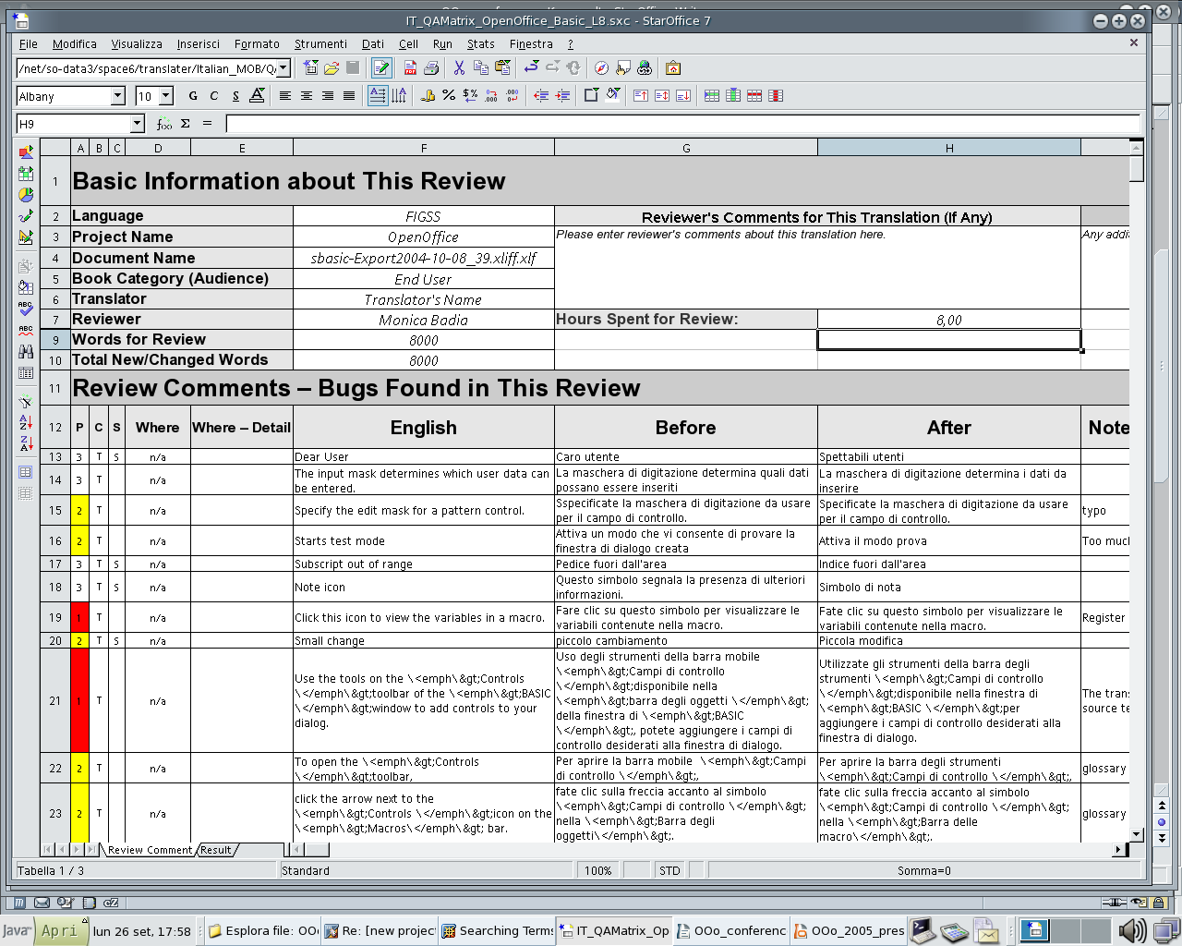
A Tool for the Review – QA form

Slide 11
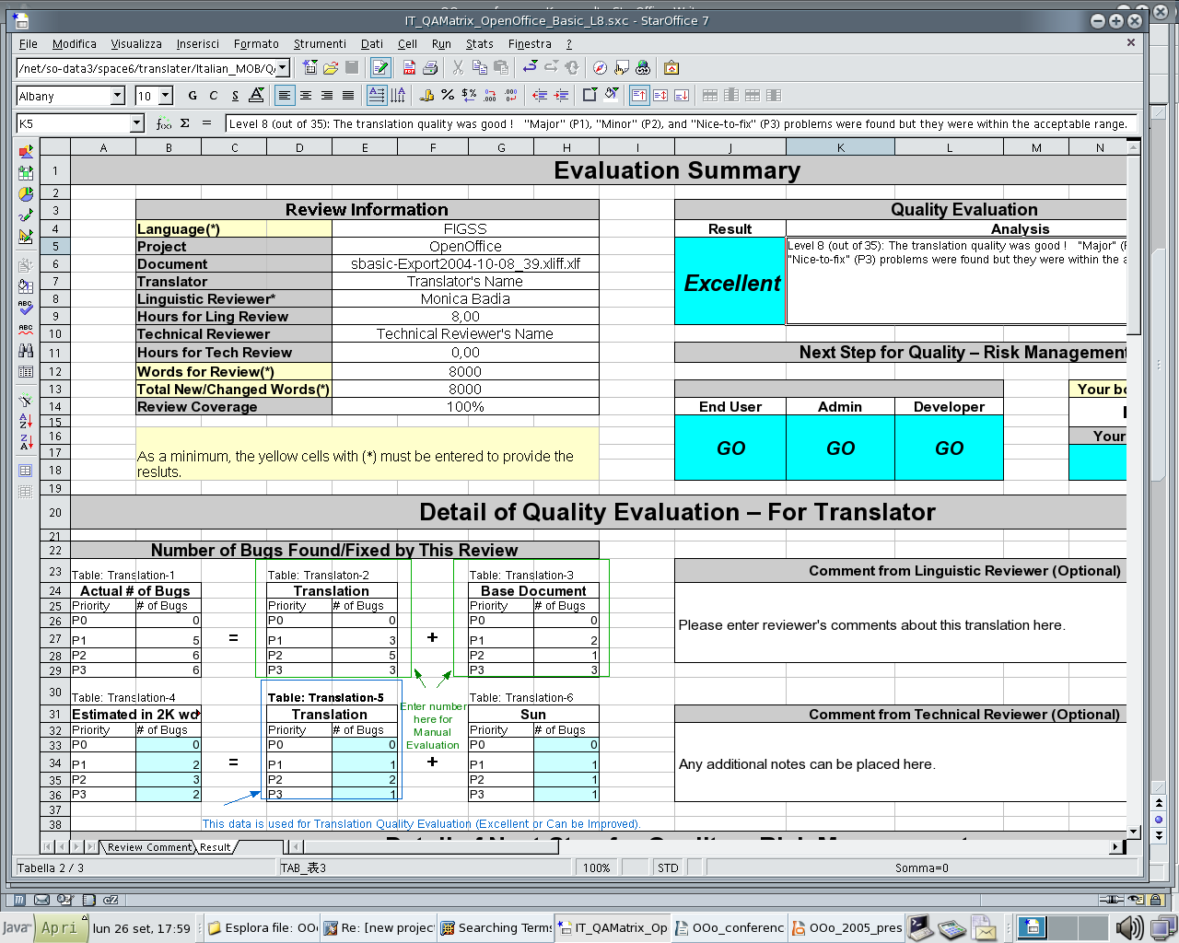
QA Matrix Results

Slide 12
Conclusions
Huge volume – everyone is more than welcome to join the community
Structure your group – assign tasks according to personal skills and experiences (Linguists for translation; engineers for review work)
Stay tuned for a new Web page with suggestions for all those who wants to approach the translation work

