Slide 1

Run Through The Jungle
Mathias Bauer
  StarOffice/OpenOffice.org
  Sun Microsystems Inc.

Slide 2

Agenda
Some words about the speaker
Introduction
Rumours and facts about modularity
OOo code architecture
Framework Environment
Applications in the framework
Integration of features into the UI
OOo Writer architecture
Q & A

Slide 3
Notes about the speaker
At Sun Microsystems:
  Working on StarOffice/OpenOffice.org since 1995
  Application Framework, 3rd party integration
  Manager Software Engineering
    Application Framework Team
    Writer, Math, Text Engine
For OpenOffice.org:
  Working on the project since its foundation
  Application Framework Project Lead
  In the past also worked on “Programmability”

Slide 4
Introduction
Interesting places (work in progress)
  http://wiki.services.openoffice.org/wiki/Architecture
  http://wiki.services.openoffice.org/wiki/Framework
  http://framework.openoffice.org/servlets/ProjectDocumentList
What you should know already
  Some basic ideas what OOo can do
  Some basic knowledge about which parts OOo has
  Basic UNO concepts (interfaces, services)

Slide 5
Possible meanings of “modularity”
Split up code into libraries, perhaps load on demand
  Loading on demand can hurt code quality
  Too many libraries can have negative impact on disk space, memory footprint and performance
Make many parts of the program removable
  Questionable if applicable to parts of applications
  Removable parts must be loadable on demand
Reduce build dependencies and narrow interfaces
  Can be quite some work if done after the fact
  Improves code maintainability and stability
  Bad or unclear modularity makes code look like a jungle

Slide 6
Concrete example: OOo on Windows
http://wiki.services.openoffice.org/wiki/Architecture/Libraries
Full installation contains 309 libs, 100 MB
Startup without application uses 68 libs, 28 MB
Adding writer loads 21 libs more, 17 MB
Many libraries are loaded on demand (most of them being UNO services)
Some big libraries are loaded though the loading code uses only a few symbols
Biggest problem is huge svx library

Slide 7
First Impression of an OOo developer noob
“Better run through the jungle,
Woa, dont look back to see.”
John Fogerty
Creedence Clearwater Revival
“Run Through The Jungle”, 1970

Slide 8
Elements of the OOo architecture
GUI class library (StarView, VCL)
Application Framework
Support libraries
  Adaptors, helpers
  C++ service class libraries
  GUI classes (dialogs etc.)
Libraries containing UNO services
UNO Language binding and runtime
System integration
Application libraries

Slide 9
“Template” based framework
Characteristics
  Control over all aspects of the program
  Base classes for Application, Document, View etc.
  Derived classes only add specific aspects
Advantages
  High code reuse
  Fast addition of new features if they fit into the picture
Possible drawbacks
  Tight coupling of modules and classes
  Large build dependencies
  “High level hacking”

Slide 10
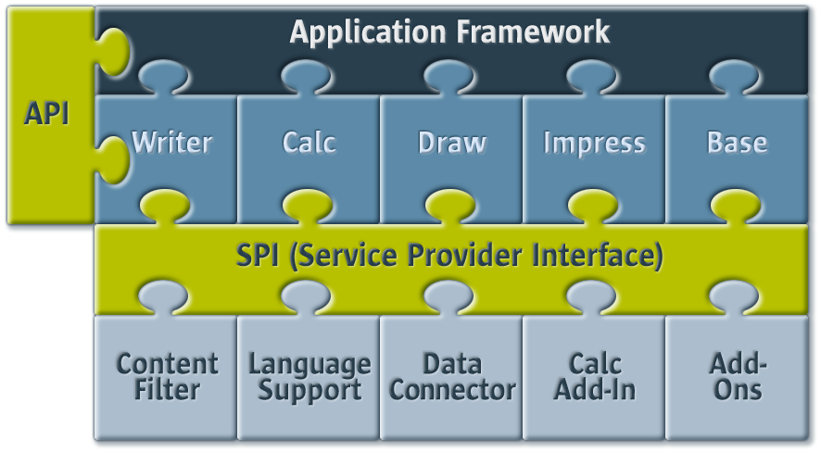
Coarse-grained architecture of OOo

Slide 11
Framework Architecture
CUI
GUI
UNO
C++
Load Environment
Filter Mgmnt.
Type
Detection
Storage Mgmnt.
AutoSave/Recovery
Embedding
Generic UI
Document
Mgmnt.
Window
Mgmnt.
UCB
VCL
Config
UNO

Slide 12
General purpose services
(Module names in paranthesis)
Embedding objects (embeddedobj)
Embed OOo through OLE2 (embedserv)
Storage and package management (package, sot)
Configuration (configmgr)
Document filter management (filter)
Templates management (sfx2)
Dispatch Provider for global functionality (sfx2)

Slide 13
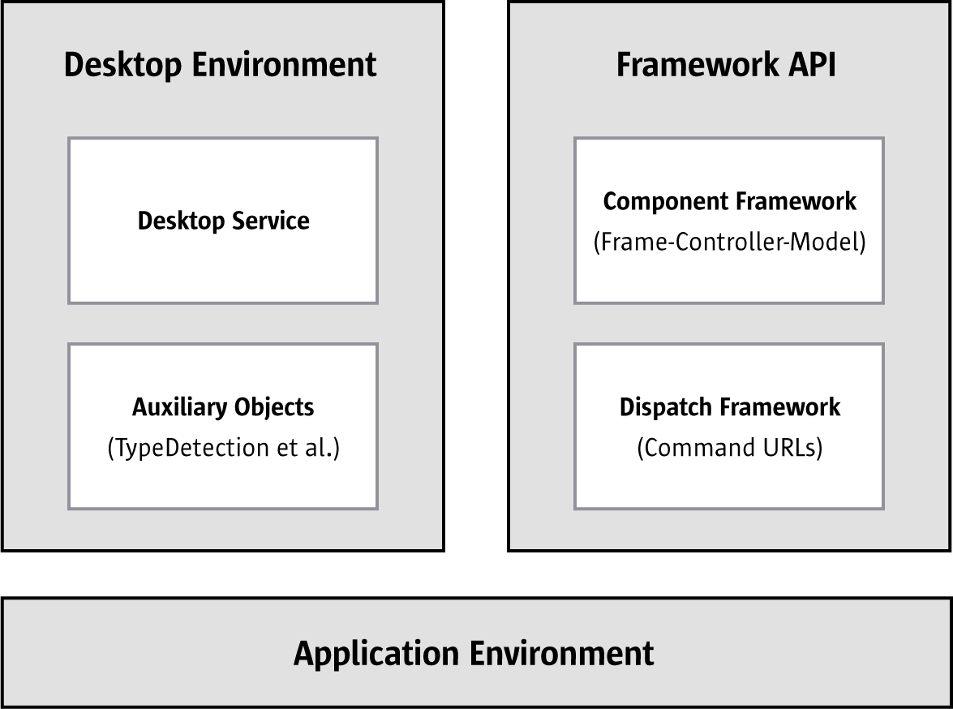
Application Environment

Slide 14
Starting OOo: the desktop module
UNO bootstrapping (creation of service manager)
Creation and initialisation of some general services
  Configuration
  UCB
  Desktop
  GlobalEventBroadcaster
Instantiate handler for command line / pipe
React according to command line arguments
Exact description at http://wiki.services.openoffice.org/wiki/Architecture/Process_Flow

Slide 15
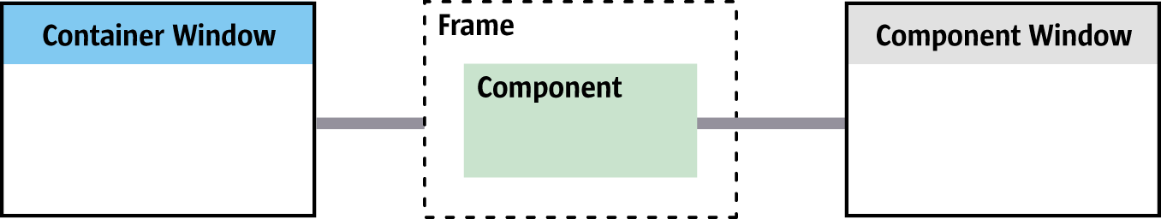
Framework API
Frame
  Owns component
  Controls task window
  Anchor for dispatching
Component
  Controller, model is optional (MVC paradigm)
  Has component window
  Participates in dispatching

Slide 16
Creating/loading a document
Framework creates Frame and its window
Framework loads document into Frame
  Does type and filter detection
  Hands over Frame to FrameLoader
  FrameLoader creates document service (model) according to filter
  Hands over medium to document for loading
  Creates a view/controller pair for the model
  Plugs Controller/Model/Frame together
  Controller requests UI elements, provides configuration
  Frame creates UI elements according to configuration

Slide 17
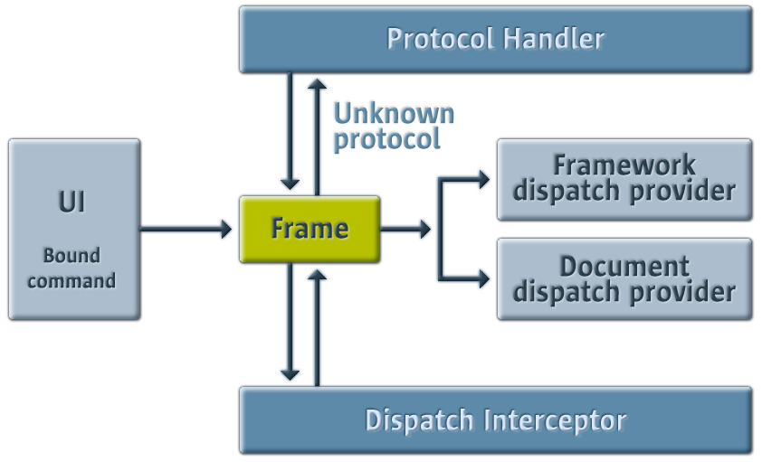
Command Dispatching

Slide 18
Overall architecture
Top Layer
Mid Layer
GUI
CUI
ODF
UNO
L10N
Bottom Layer
Writer
Calc
Impress
Draw
Base
IDE
Math
Chart
Bib
Wizards
XML
GUI
CUI
UNO
FWK
L10N
i18n
Common GUI
System Integration
Drawing Layer
BASIC
Help
Utilities
Framework
UNO
VCL
L10N
UCB
Config Manager
UNO
GSL
Platform

Slide 19
Basic Application Architecture
App
GUI
ODF
UNO
Model
View / Controler
GUI
GUI
Filters (.ods,.xls)
Config
VCL
FWK

Slide 20
Writer Architecture
Writer
View
GUI
UNO
Model
S
root
T
page
page
page
E
ODF
Filters
paragraph
S
paragraph
E
GUI
DOC
...
ODT
HTML
SXW
Drawing Layer
Config
VCL
FWK

Slide 21
Run Through The Jungle - finished
Mathias Bauer
  Mathias.Bauer@sun.com

