Slide 1
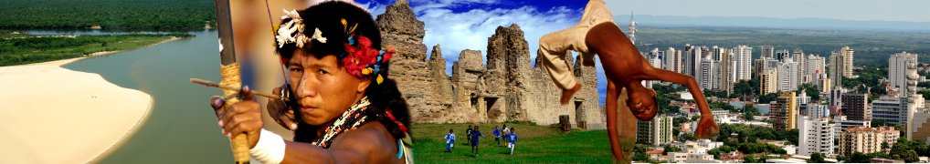

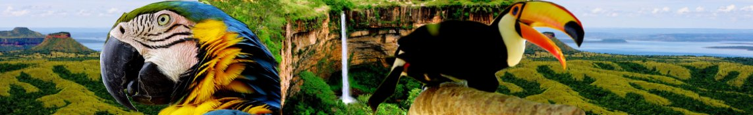
Brazil
a strange success case

Slide 2

The beginning
Find a coordinator for pt-BR;
Start a glossary for pt-BR;
Justify and create the pt-BR project;
Start working.
  7 people, each in a different state,
  On-line support straight from China.
2001
2002
2003
2004
2005
2006

Slide 3

The discovery
Participation in the 2° International Free Software Forum – FISL;
  Presentation of the OpenOffice.org product.
Creation of the pt-BR NPL;
First Brazilian compilation;
Support from Procergs' presidency;
Creation of the Brazilian community
2001
2002
2003
2004
2005
2006

Slide 4

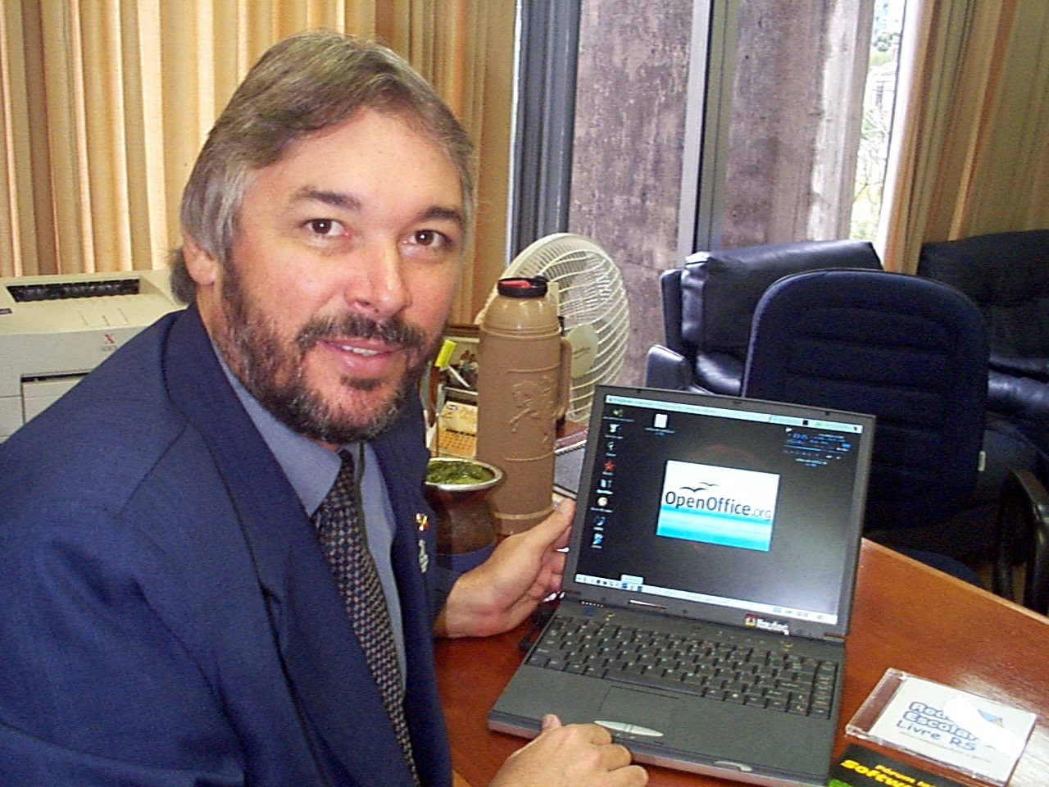
“An open solution, with excellent quality, is being presented to society at large and will aid in the battle against digital exclusion.”
Marcos Vinícius Mazoni
PROCERGS' President
2001
2002
2003
2004
2005
2006

Slide 5

The work
Projects
  Spell checker;
  Translation of the interface and help;
  Sun overwrites community's work.
Marketing
  Mirrors;
  Statistics;
  Publicity.
End user support;
  Mailing lists;
  Rau-Tu system;
  Docs and Manual.
Support
  Metrô – São Paulo;
  Celepar - Paraná.
2001
2002
2003
2004
2005
2006

Slide 6
2001
2002
2003
2004
2005
2006

Slide 7


Recognition
The OpenOffice.org.br project is consolidated and is recognized by the IT media;
Abundance of materials in the form of manuals, translated documents and how-tos;
Creation of sub-projects:
  Brazilian Cliparts;
2001
2002
2003
2004
2005
2006

Slide 8
2001
2002
2003
2004
2005
2006

Slide 9
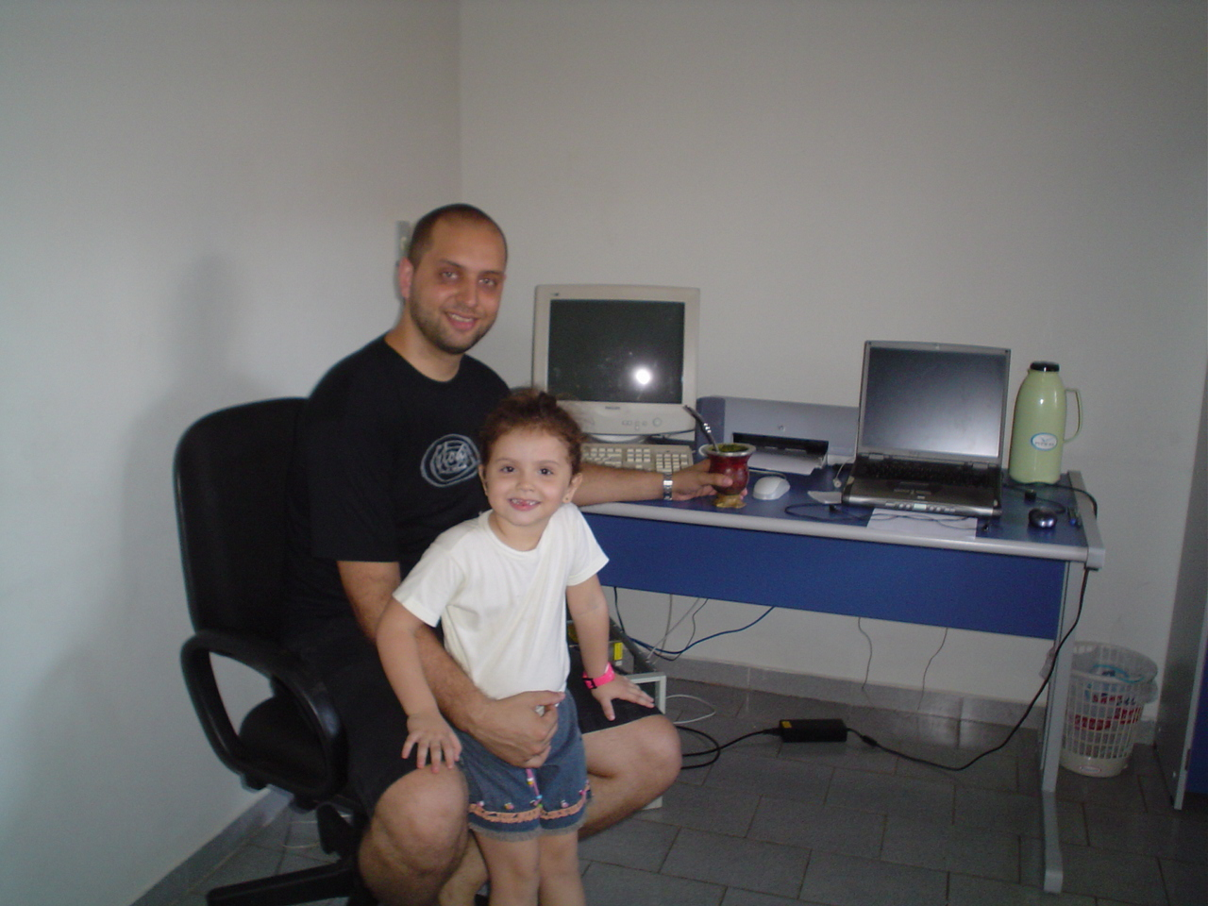
Work Area

Slide 10
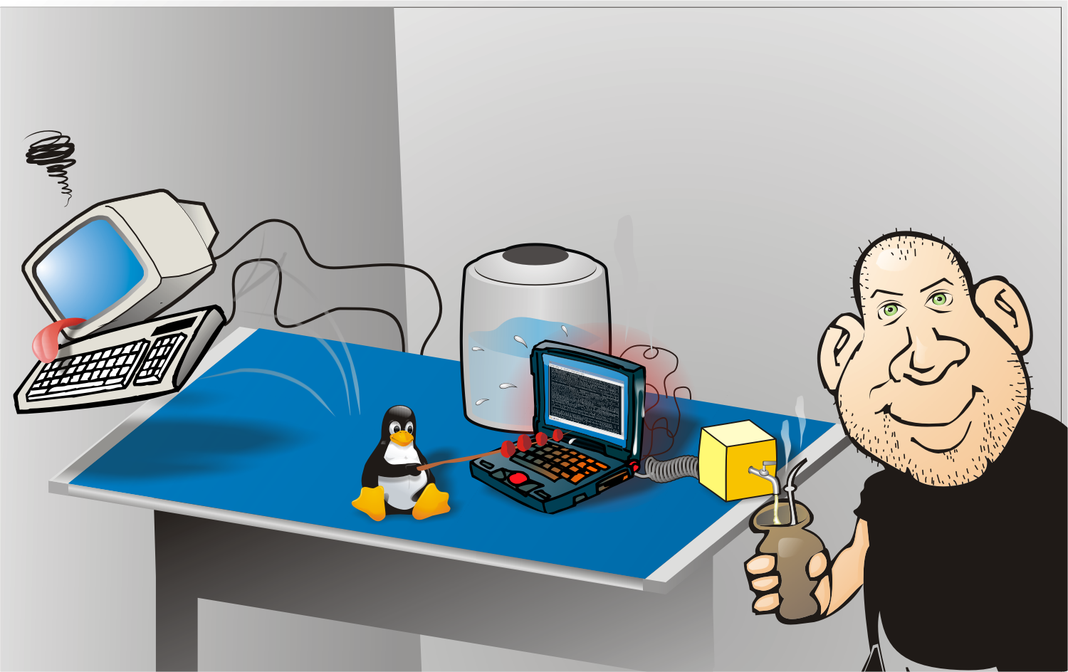
Compiling....

Slide 11

The problem
Trademark infringement
by local company;
  Private companies;
  Government;
Difficulties in following the Central Project;
  Lack of equipment and resources;
  Countries economic difficulties;
  Threat to users and developers.
2001
2002
2003
2004
2005
2006

Slide 12
Projects in 2005
Localization;
Thesaurus;
Brazilian Cliparts;
Clipping;
Statistics;
Escritório Aberto;
Extras;
CoGrOo – Grammar Checker;
Mirrors;
Server security.
2001
2002
2003
2004
2005
2006

Slide 13

The conquest
– Projeto Brasil is born;
  New visual identity;
  Portal aggregating efforts and news;
1° National Meeting of BrOffice.org
  Developers' meeting;
  Excellent cases of success;
  Louis Suarez-Potts participated.
2001
2002
2003
2004
2005
2006

Slide 14
Noticeable events
Three news in OpenOffice.org;
e-PING – Government recomends ODF;
House of Representatives – Standards and Free Software;
Banco do Brasil - 38.000 desktops;
Brazilian Army – ALL desktops with Broo;
Digital Inclusion Project;
CDTC – Federal Gvt. e-learning;
2001
2002
2003
2004
2005
2006

Slide 15
Noticeable events
Ekaaty e Famelix – include BrOffice.org.
Spell Check – 2.5 millions of words;
Info Magazine, main magazine of (proprietary) IT talk about OOo and Linux;
BrOffice.org participates of LinuxWorld – Brasil;
BrOffice.org adheres to ODFAlliance.
2001
2002
2003
2004
2005
2006

Slide 16





Thanks
To our wifes, companions and girlfriends. Without their HUGE patience, there would be no free softtware!
To the Brazilian Community that, despite all adversities, has always been faithful to the project, collaborating whenever possible.

Slide 17

Questions ???
Contacts:
filhocf@openoffice.org
Website:
http://www.broffice.org

