Slide 1


Slide 2

Redesign of accelerators to support extensions
Wu Yan <wuyan@RedOffice.com>
Zhang Xiaofei <zhangxiaofei@RedOffice.com>
Framework Developers
RedFlag2000 SOFTWARE,CO.,LTD

Slide 3

Content
About the Speakers
Current XML based accelerators configuration
Designing the new configuration
The practice
Summary

Slide 4
About the Speakers
Wu Yan: Started working in RedFlag2000 framework team since 2006, focusing on OOo configuration.
Zhang Xiaofei: Started working in RedFlag2000 framework team since 2007.
A special thanks to Andreas Schluens, who mentored us over this work.

Slide 5
Current XML based accelerators configuration
Accelerators in OOo:
  In OpenOffice.org2.0, over 1,000 accelerators are assigned by default to access OOo core functionalities.
  They make operations much simpler and improve the work efficiencies.
  ... and they can be easily customized from GUI:

Slide 6
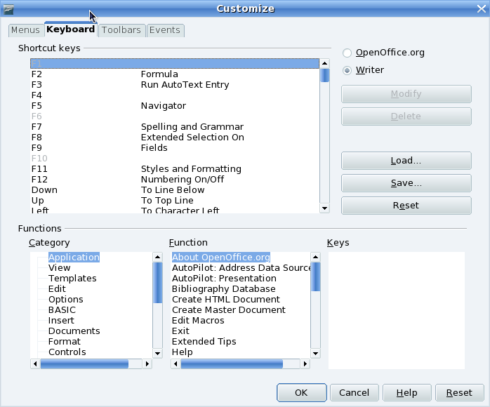
OOo customization GUI

Slide 7
Current XML based accelerators configuration(cont'd)
What can the current do
  Provide accelerators defined for all OOo modules
  Provide module depending accelerators
  Provide user defined accelerators placed inside the ZIP storage of ODF format

Slide 8

Current XML based accelerators configuration(cont'd)
Then why improve it
  The strength of the current OOo accelerators is limited within the core functionalities.
  No means for extension developers to assign accelerators of their own.

Slide 9
Current XML based accelerators configuration(cont'd)
What causes the tragedy
  The configuration is structured by the physical organization of files and folders
  XML files do not contain information about the structure of configuration

Slide 10
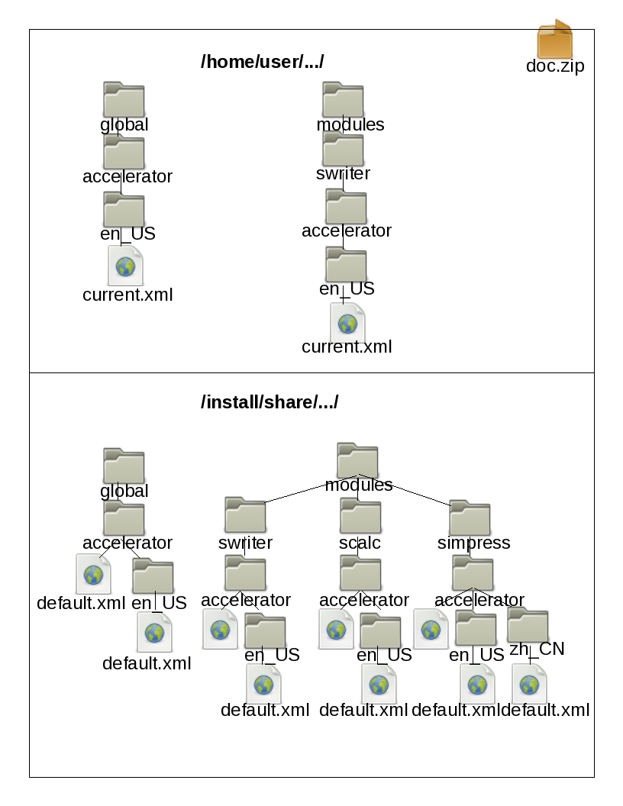
Organization of XML files and folders

Slide 11
<accel:acceleratorlist>
<accel:item accel:code="KEY_Q" accel:mod1="true" xlink:href=".uno:Quit"/>
<accel:item accel:code="KEY_P" accel:mod1="true" xlink:href=".uno:Print"/>
<accel:item accel:code="KEY_S" accel:mod1="true" xlink:href=".uno:Save"/>
<accel:item accel:code="KEY_N" accel:mod1="true" xlink:href=".uno:AddDirect"/>
<accel:item accel:code="KEY_W" accel:mod1="true" xlink:href=".uno:CloseWin"/>
<accel:item accel:code="KEY_F4" accel:mod1="true" xlink:href=".uno:CloseWin"/>
<accel:item accel:code="KEY_X" accel:mod1="true" xlink:href=".uno:Cut"/>
</accel:acceleratorlist>
Example: default.xml

Slide 12
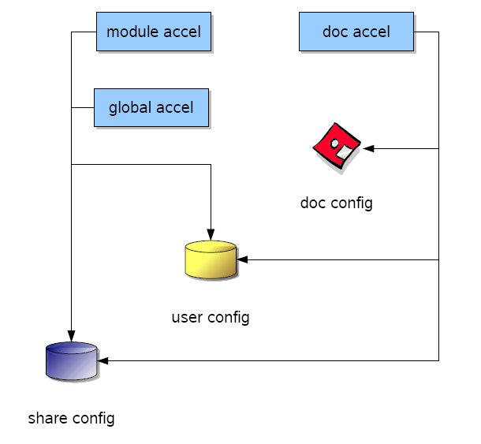
Current XML based accelerators configuration,
illustrated by Andreas Schluens

Slide 13
Current XML based accelerators configuration(cont'd)
3 fix, non-configurable layer
  Shared
  User defined
  Document based accelerators are optional
Know
  which files must be loaded from disk
  how these files should be merged together
Accelerators can't be extended

Slide 14
Designing the new config.
Bring OOo configuration management components into this
  Provides a unified interface to get and set OOo configuration data
  Organizes the configuration data in a hierarchical structure
  Configuration can be merged together at runtime

Slide 15
Designing the new config.(cont'd)
what the new configuration will be like
  XCS(for the schema)/XCU(for data files) based
  Use the UNO API to access the configurations
  Note: legacy doc configs are still XML based

Slide 16
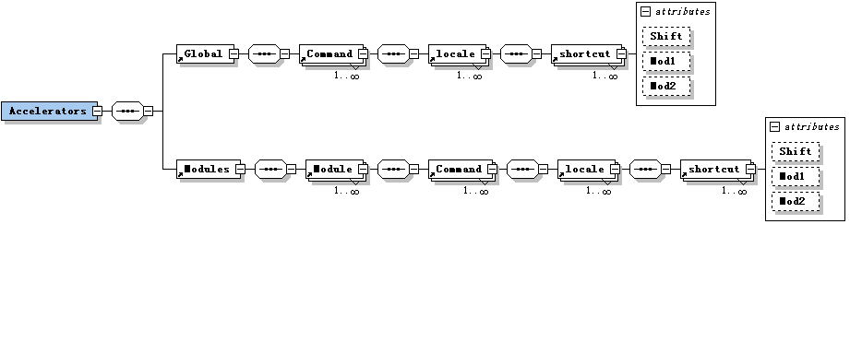
Designing the new config.(cont'd)
Define the configuration schema: An initial design

Slide 17
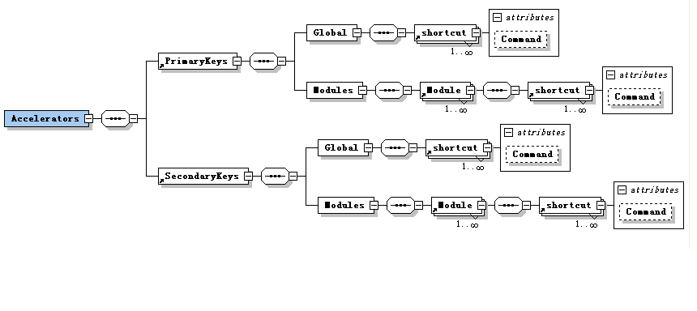
Designing the new config.(cont'd)
Define the configuration schema: the final version

Slide 18
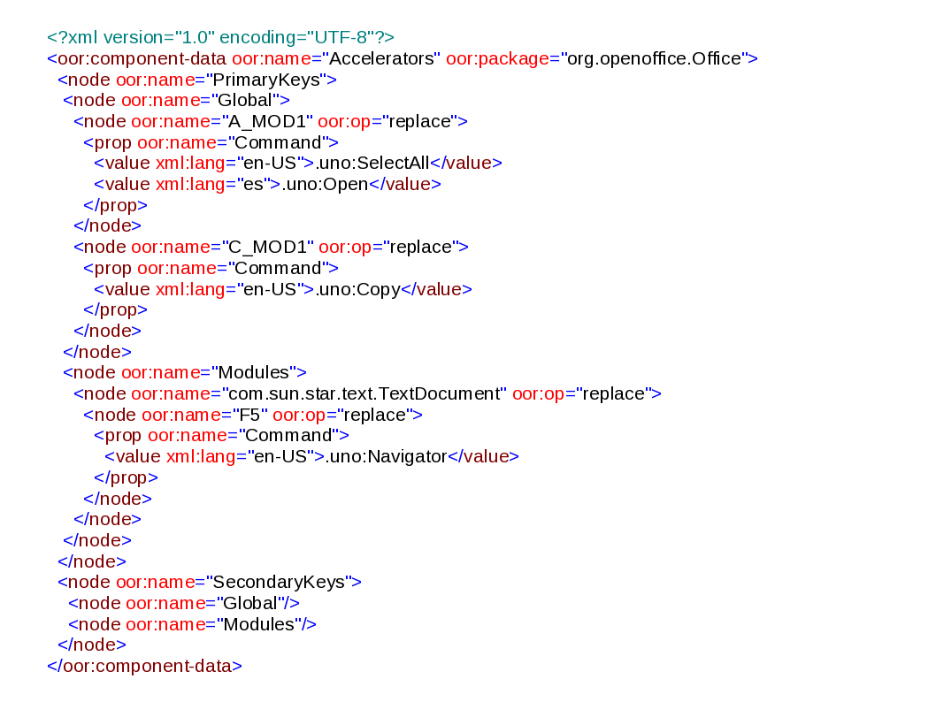
Designing the new config.(cont'd)
What an XCU configuration looks like

Slide 19
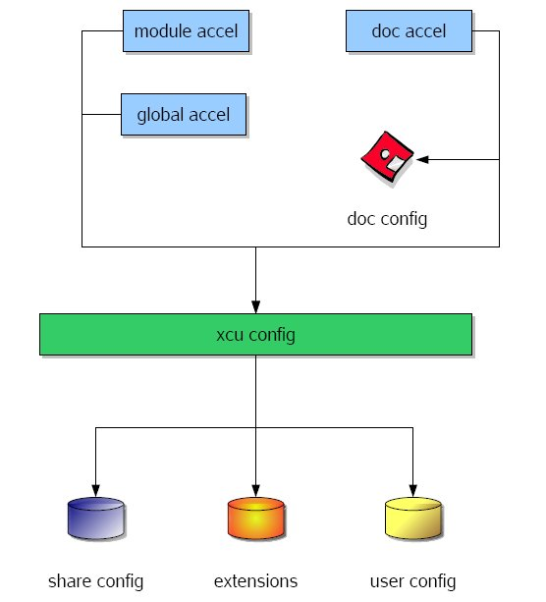
Designing the new config.(cont'd)
The new design of accelerators configuration,illustrated by Andreas Schluens

Slide 20
Designing the new config.(cont'd)
Extension developers could extend accelerator configuration for his/her extension with XCU

Slide 21
The practice
What I worked on before this
  Fixed some UI(Menubar,toolbar,accelerator) Bugs
  Refactored configuration Items: HistoryOptions, UserOptions...
    Use Configuration API to read/write config.
    Wrote UNO API tests for configItems

Slide 22
The practice(cont'd)
Step1: Rework the core code to enable reading/writing XML/XCU files
  Load configuration data to accelerator cache
  Save the changes of accelerator cache to configuration
  Support reading/writing accelerators inside document using XML parser

Slide 23
The practice(cont'd)
Step2: Migrate old XML conifg. data to XCU
  ~50 XML files, >1000 accelerators
  Write OOo basic script to accomplish this, using
    Storage API
    Accelerators API
    Configuration API

Slide 24
The practice(cont'd)
Step3: Testing the new config.
  Write UNO API test

Slide 25
The practice(cont'd)
Step4: Documentation
  Plan to add a new chapter to the Developer's Guide
  If extension developers don't know how to use, all the works are in vain!

Slide 26
The practice(cont'd)
Example
  Give the Writer's Tools some acceleration!
    Writer's Tools: help users perform a wide range of tasks as an extension
    Define a Accelerators.xcu
    Insert the xcu file into the package
    Now we can call 'Lookup Tool' with Shift+Ctrl+L, and call the 'Google Search' with Shift+Ctrl+G

Slide 27
<?xml version="1.0" encoding="UTF-8"?>
<oor:component-data oor:name="Accelerators" oor:package="org.openoffice.Office">
<node oor:name="PrimaryKeys">
<node oor:name="Global">
</node>
<node oor:name="Modules">
<node oor:name="com.sun.star.text.TextDocument">
<node oor:name="L_SHIFT_CTRL" oor:op="replace">
<prop oor:name="Command">
<value xml:lang="en-US">macro:///WriterTools.Tools.LookupTool</value>
</prop>
</node>
<node oor:name="G_SHIFT_CTRL" oor:op="replace">
<prop oor:name="Command">
<value xml:lang="en-US">macro:///WriterTools.Tools.GoogleTranslate</value>
</prop>
</node>
</node>
</node>
</node>
</oor:component-data>

Slide 28
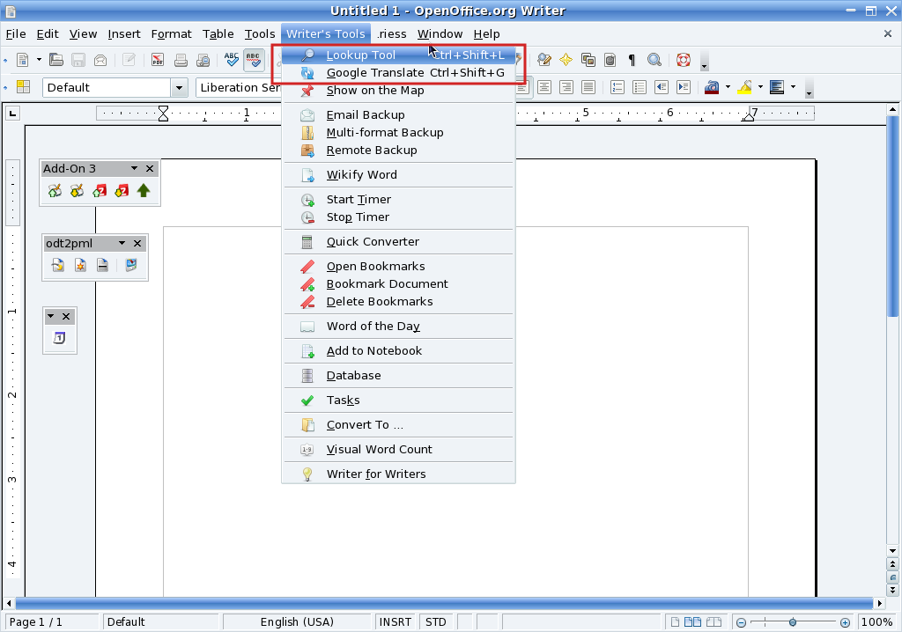
Accelerators are extended by Writer's Tools

Slide 29
Summary
XML based accelerators configuration
XCS/XCU based accelerators configuration
Joys from OOo community
  Contribution
  Harvest
Working in OpenOffice.org is fun.

Slide 30

www.OOoBeijing2008.com
http://marketing.openoffice.org/ooocon2008/

