Slide 1

OOo Websites Designs
A Collection
Matthias Müller-Prove
Sun Microsystems
Nov-26, 2007

Slide 2
www.openoffice.org
September 2007
Notes:
by MMP, based on whiteboard at kickoff, 26-Jul-2007
with ideas from Per Eriksson

Slide 3
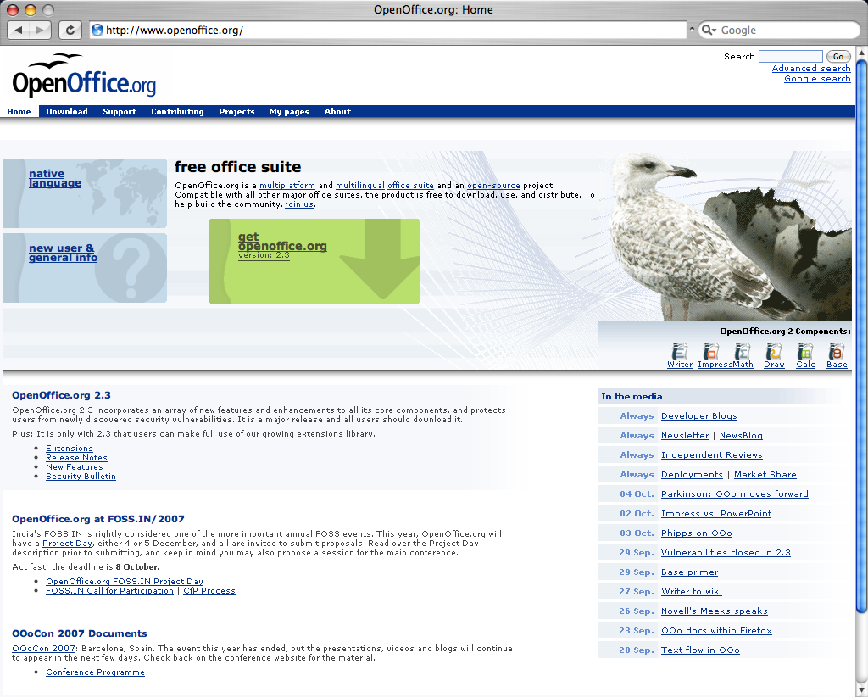
Notes:
Per Erikson18-Aug-2007:
If you analyze the first page as it is today, by looking at the place that the different content on the first page take, it would mean that the following is important to us:
Latest news (~ 20%)
In the media (~ 20%)
An egg and a seagull (~ 20%) :-)
White space (~ 15%)
Support (< 1%)
Contributing (< 1%)
Projects (< 1%)
About (< 1%)
I think that support is widely requested by the user. So why does it cover about less than 1% of the area?
Same thing with contribution. I think it's important, but according to the current first page, the white space is far more important than information on contributing.
The user needs alternatives, and a good first page can work as an important portal for contributors as well, powering the contributor with the tools needed for the every day tasks.

Slide 4
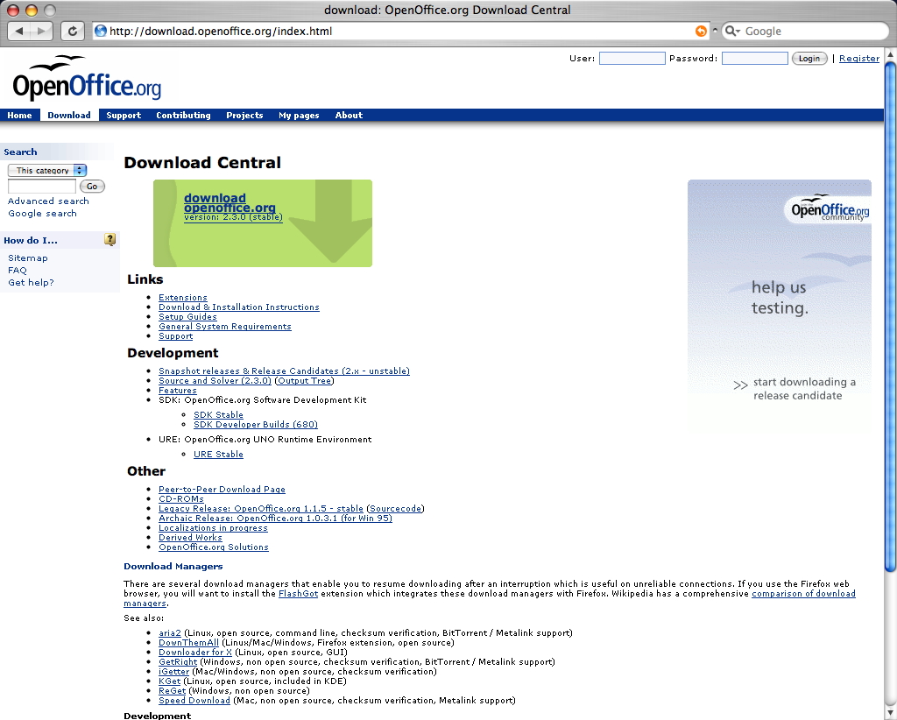

Slide 5
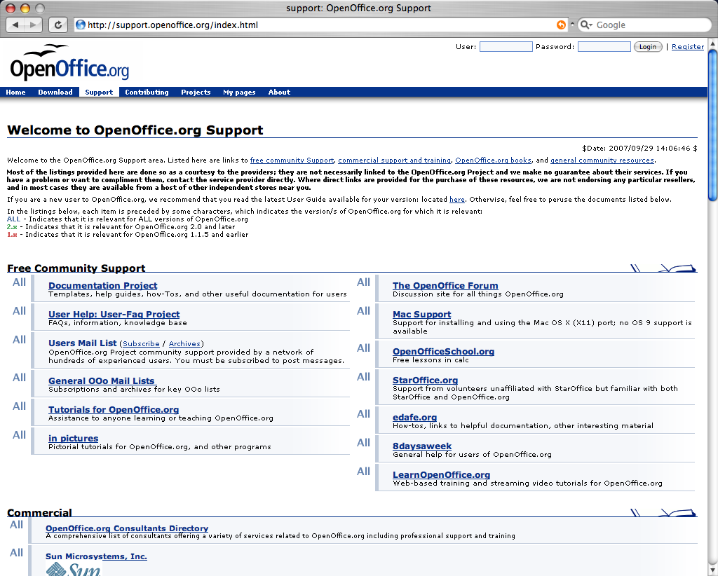

Slide 6
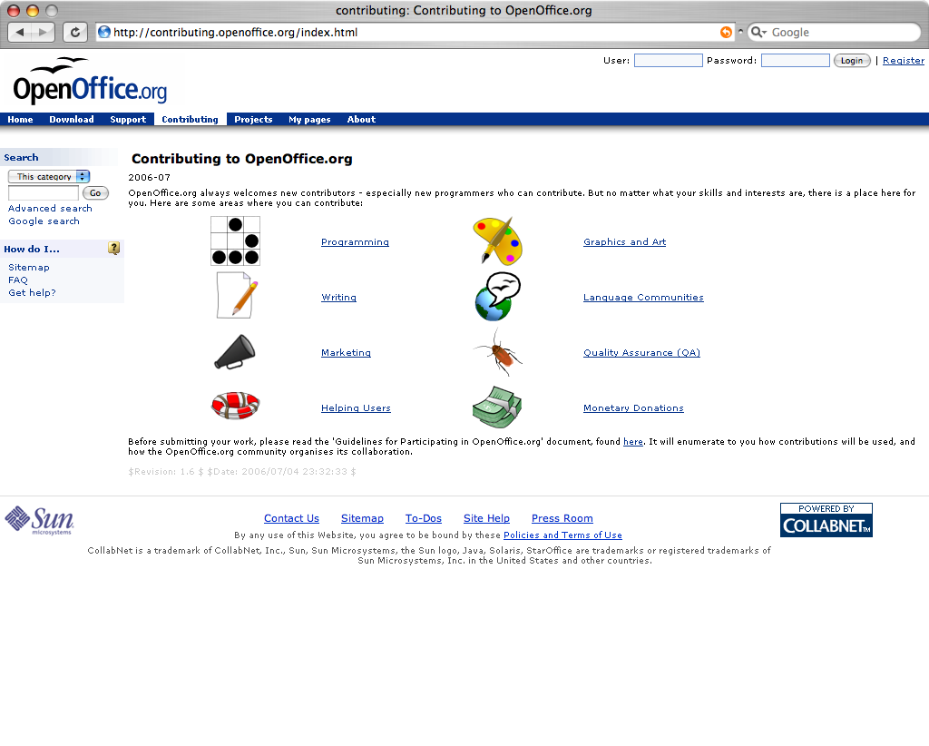

Slide 7
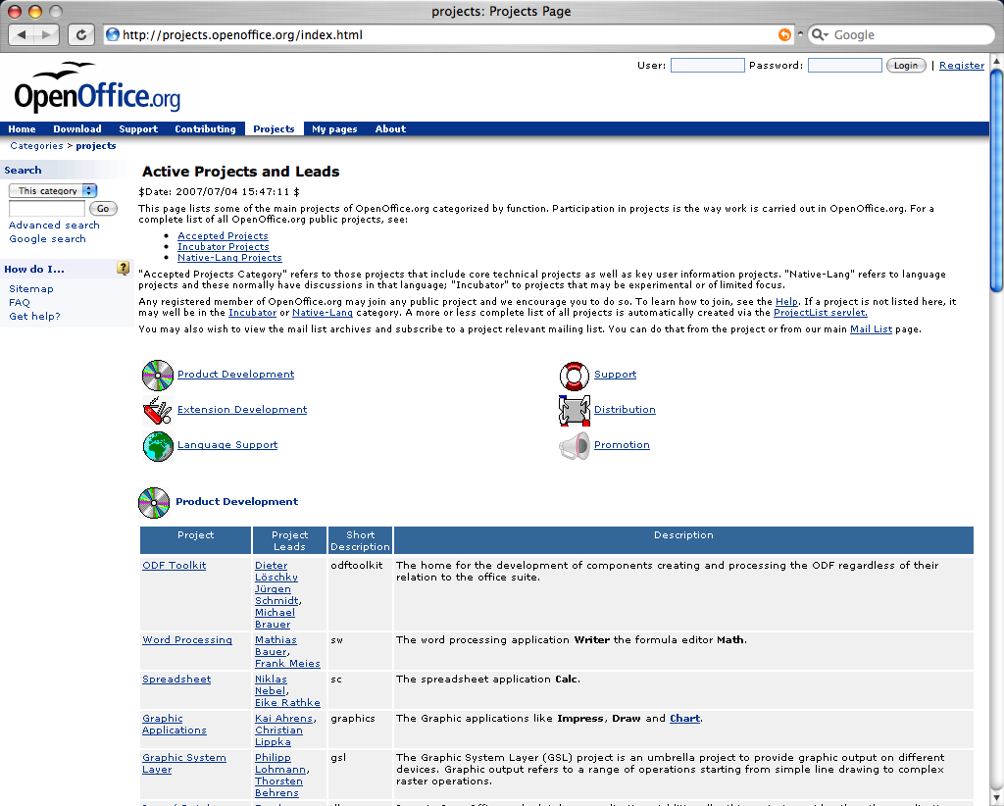

Slide 8
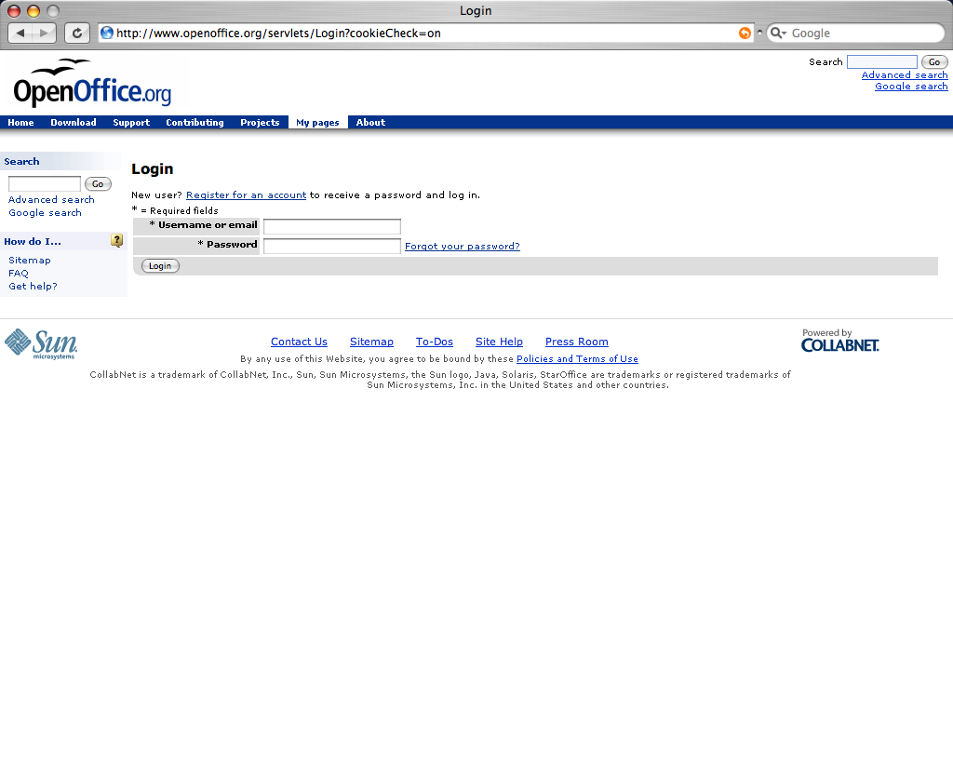

Slide 9
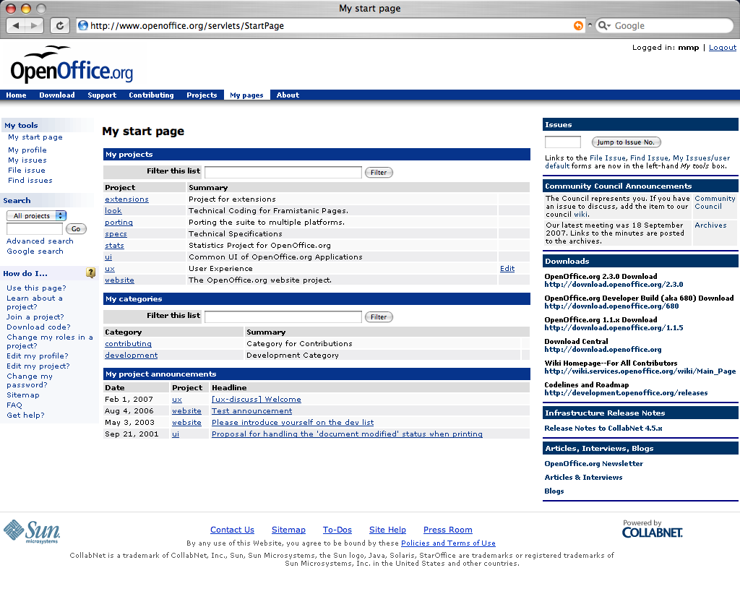

Slide 10
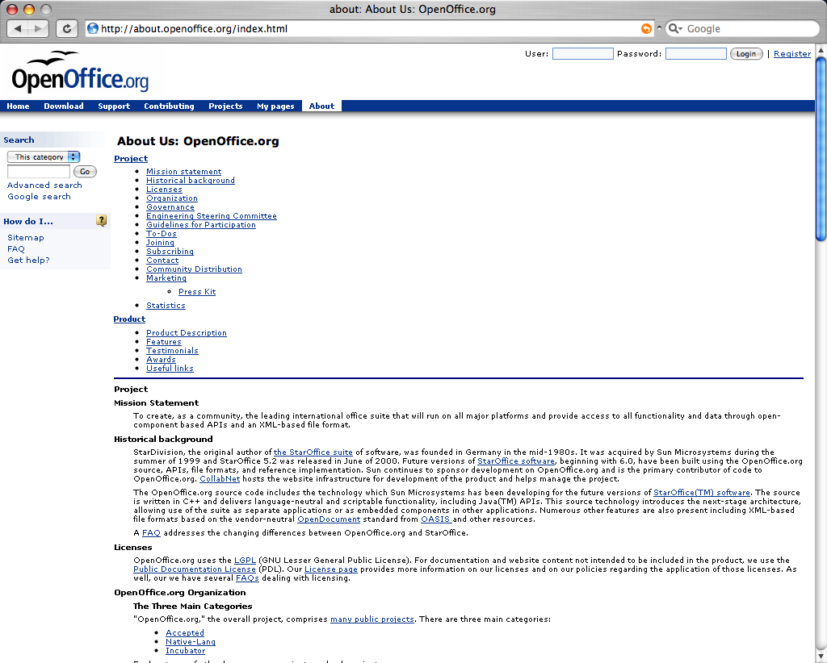

Slide 11
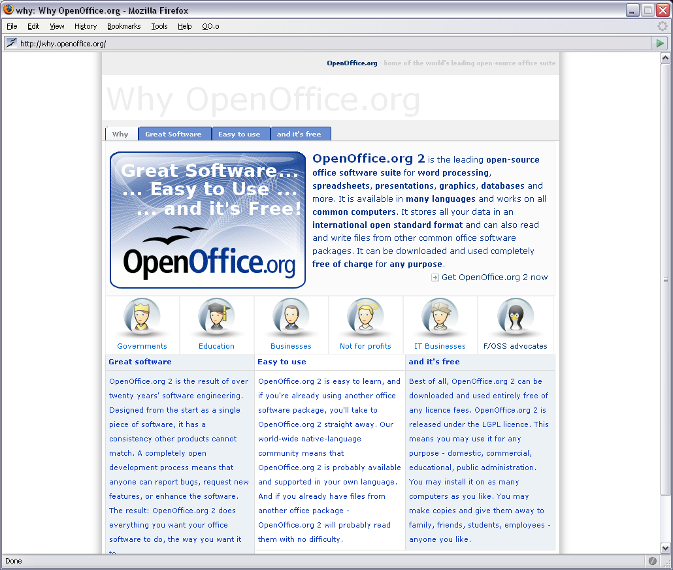

Slide 12
Design Proposals

Slide 13
Andre Wyrwa
http://marketing.openoffice.org/tryouts/Why.OpenOffice.org/en/index.html

Slide 14
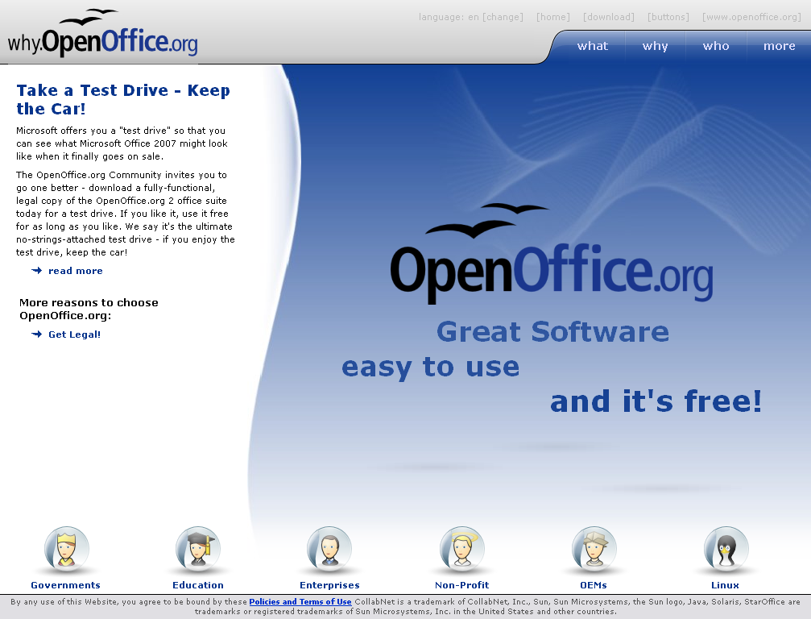

Slide 15
Filip Molčan
22-Oct-2007
http://www.molcan.cz/download/ooo-mockup2.jpg
http://oooportal.com/

Slide 16
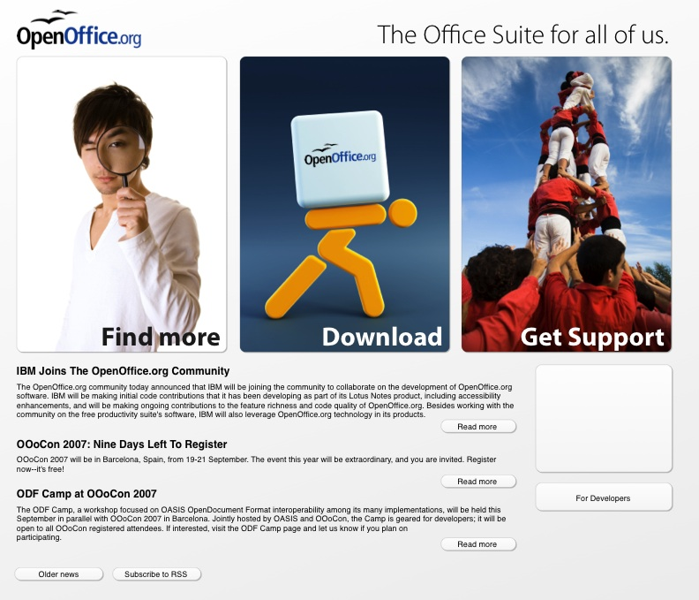

Slide 17
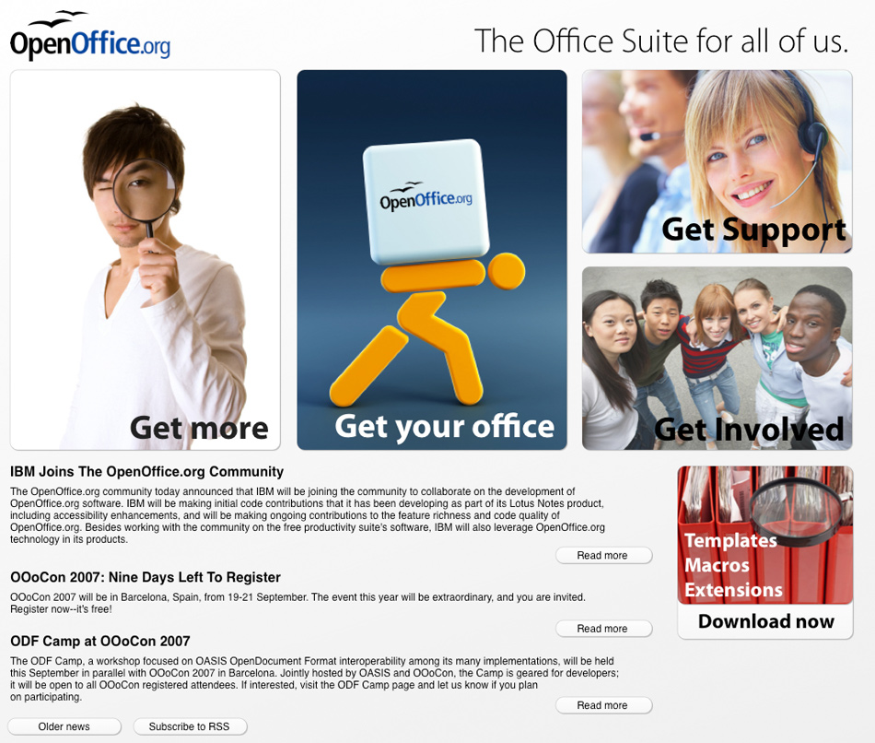
Notes:
http://www.molcan.cz/download/ooo-mockup2.jpg
Hi Molčan,
some comments on your proposal
http://www.molcan.cz/download/ooo-mockup2.jpg
positives
+ use of large images/areas
+ round and beveled corners
+ spacing between the elements
+ white to gray gradient on the background
+ the large font on the images
+ ffi ligatures demonstrated a professional attitude with our office suite
+ the news ticker. nice font & size. We "just" have to make sure how this is filled with content...
constructive feedback
- the page layout is too heavy on the right because of the white image to the left and 2 1/2 dark images to the right. Is it possible to do it this way:
A C D
B C E
2 medium sized areas to the left, symmetric to the right side
and one large in the middle (like it is now)
and no one stiched bottom right.
- "Get Involved"
-- legibility of could be improved.
-- what is the intended content? Is it http://contributing.openoffice.org/ , my current baby, to attract folks to join the community?
- "Get Support"
-- to me this looks too much like stock photo.
- "Get more" and "Download extensions and stuff"
-- one looking glass should be enough for the page.
-- the distinction of "Get more" and "Download now" is not clear (to me).
- "Get your office"
-- I liked the yellow guy in the first place. But then, the OOo box seems to be a big burdon to him.
After all: good work. Go on!

Slide 18

Notes:
With curve by Graham Lauder, 23.Oct-2007

Slide 19
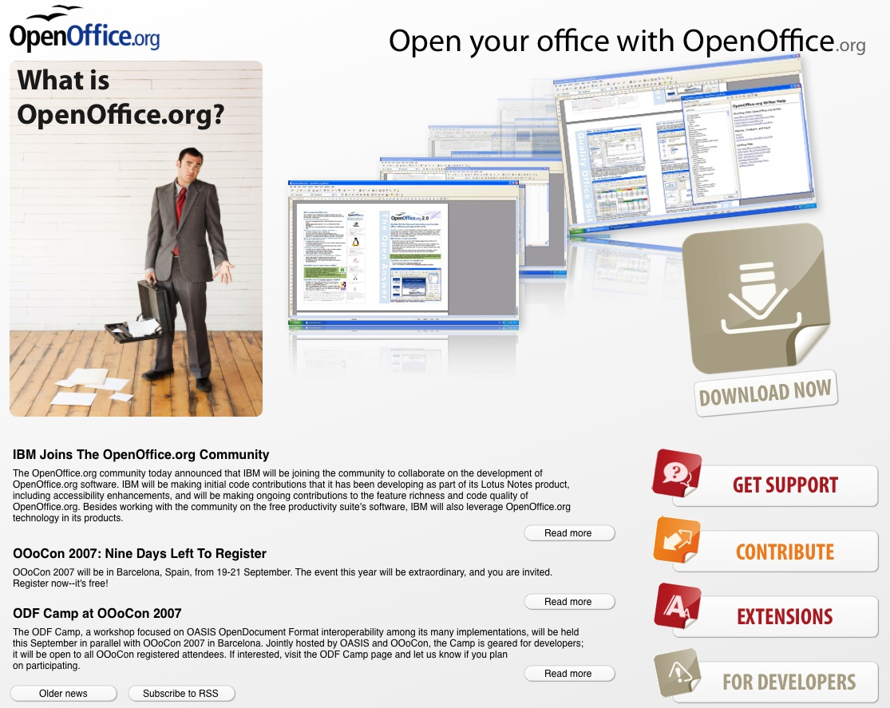

Slide 20


Slide 21
James Herrington
26-Oct-2007
http://first4quality.co.uk/OpenOffice/

Slide 22
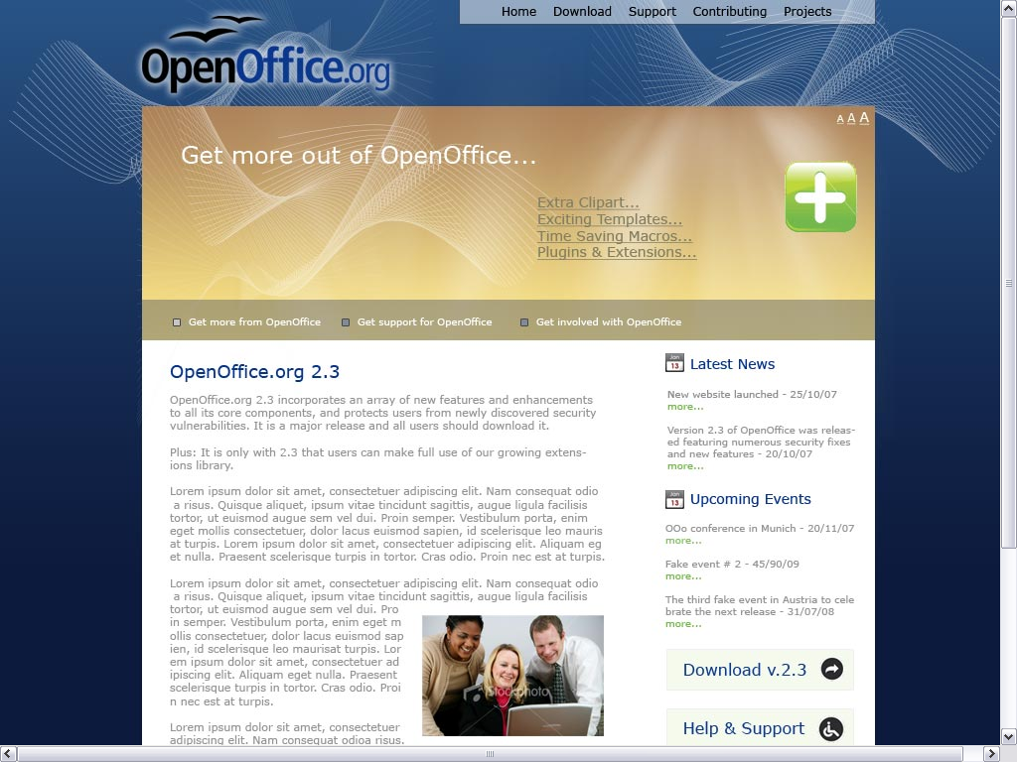

Slide 23
RJ Gilson
22-Nov-2007
http://fission1.free-web-hosting.biz/OOo_Web/simple/OOo_New_Simplified.html

Slide 24
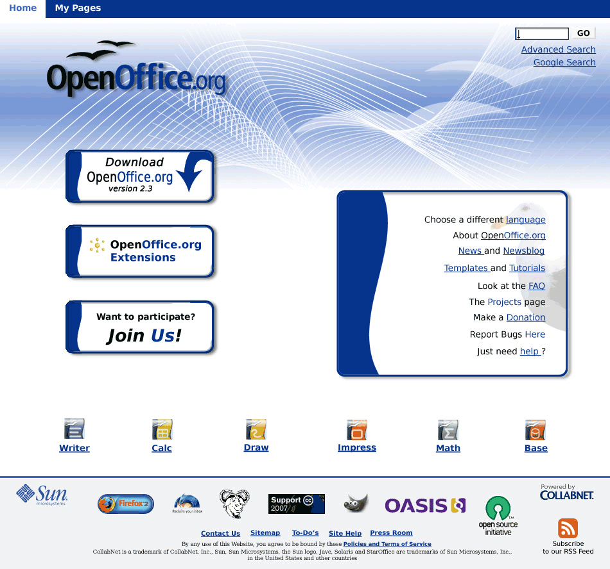

Slide 25
Nikash V. Sing
24-Nov-2007
http://overkill.hyperphp.com/site.php

Slide 26
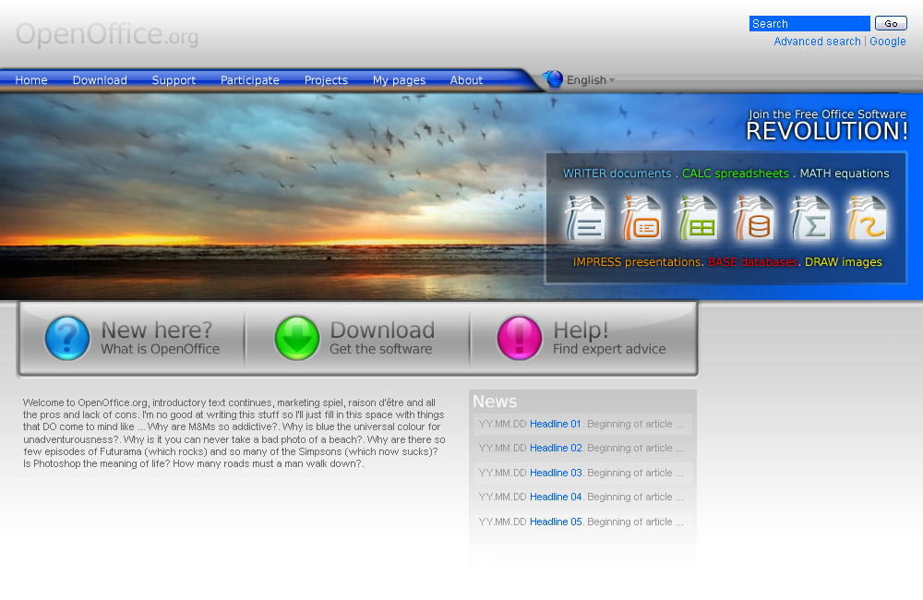

Slide 27
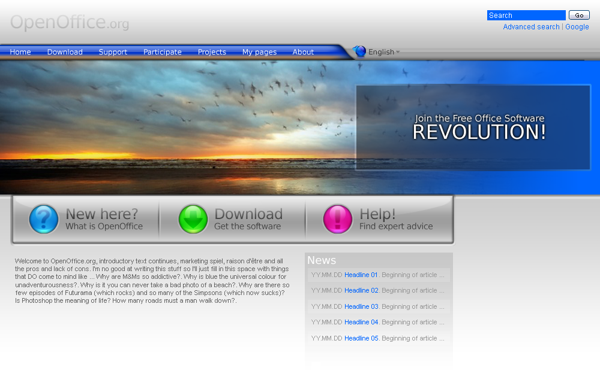

Slide 28
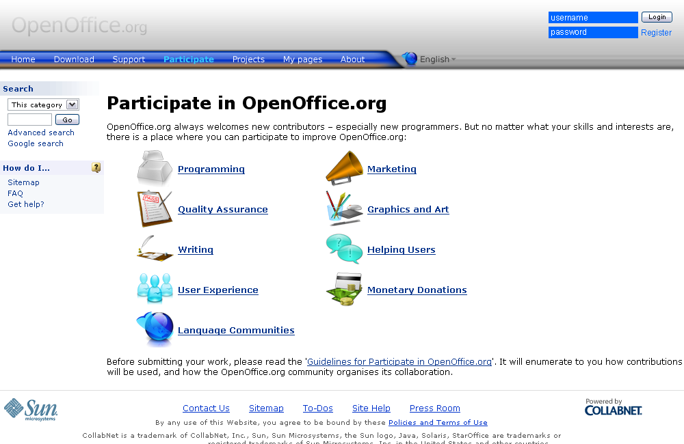

Slide 29
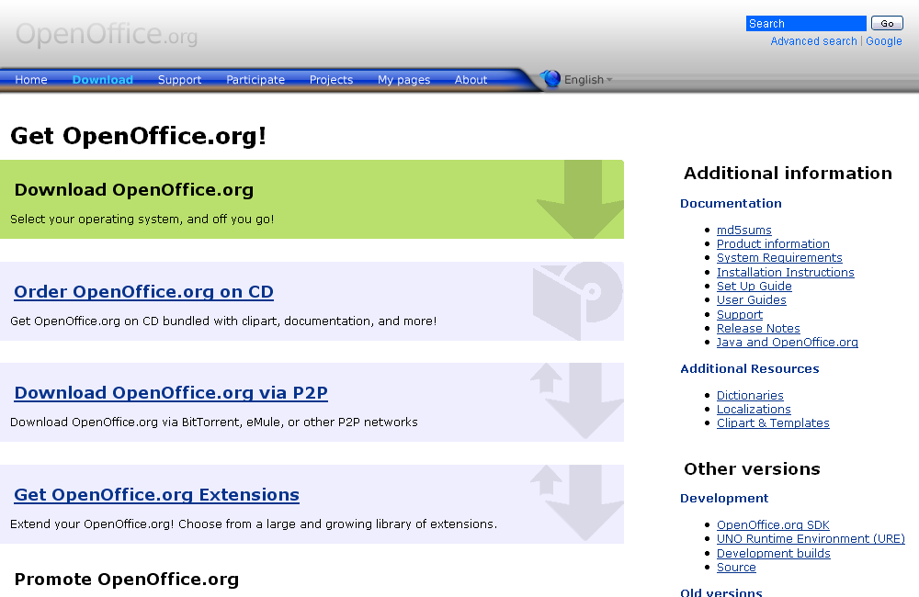

Slide 30
Ivan M
29-Nov-2007
http://www.patentpending.co.nz/images/openoffice/siteconcept1.png

Slide 31
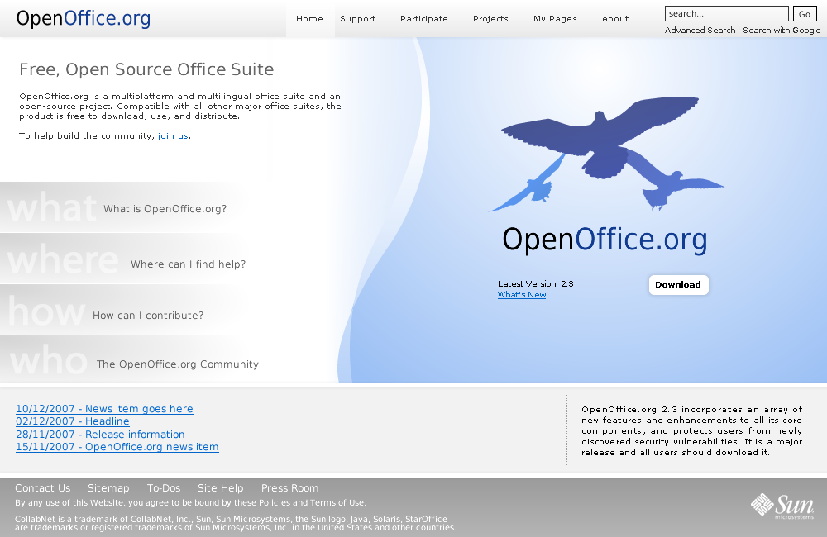

Slide 32
OOo Websites Designs
A Collection
Matthias Müller-Prove
  mprove@sun.com

