Slide 1
OOoCon 2005 - Koper
  Developing for OpenOffice.org (aka How to Contribute)

Slide 2

Agenda
Speaker Introduction
Contributions to the OOo project
The JCA and other stuff
A new/different development process
Child workspaces in practice
Challenges
Q & A

Slide 3
Who I am
Joined the StarWriter 2.0 Team in 1994
Program Manager OpenOffice.org / StarOffice
Project Lead Tools
Project Lead Porting
Project Lead External
Member of Community Council
“Ratte”: Release Mgr of SRC680 code line

Slide 4

Contributions to OOo
  Use the product
    Download, install and use OOo
      http://download.openoffice.org
    Give feedback via Survey
      http://www.openoffice.org/welcome/regitsratrion-site.html
    Donate money or other resources
      http://www.openoffice.org/contributing/donate.html
  Participate
    Subscribe to mailing lists
    Ask questions and give answers
      Wiki on ooo.services.openoffice.org /go-ooo.org
  Join a project
    Review work, give feedback via mail, IssueTracker
    Request for enhancements, input for specifications

Slide 5
Contributions to OOo
  Become a QA expert
    Use the the latest snapshots (biweekly snapshots)
    Review and file new issues
    Work on test plans
  Localize
    New localizations
  Develop
    Use the API
    Components
    Compile and review the code
  Core Development
    Add new functionality
    Porting

Slide 6
The JCA and other stuff
  Code contributions
    Sign the JCA for changes or additions to the code basis or localization
  External components
    Code: LGPL, BSD style
      Get documented within external project
    Other artifacts
      Licenses compliance

Slide 7
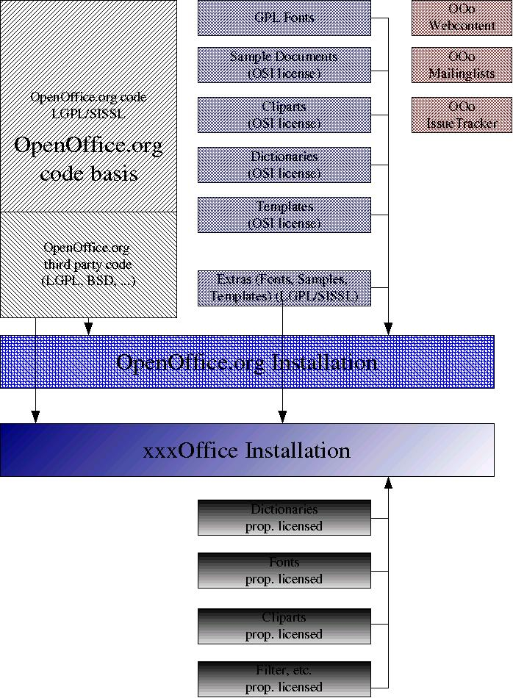
External Components

Slide 8
Software Development
  Preparation
    Writing a Specification
    Planning a change
  Implementation
    Coding
    Hacking
  Verification
    QA with a testplan
    Does the beast compile
    Regression/automated tests

Slide 9
OOo complexity
  The Platforms
    Unix (Linux, Solaris, MacOSX, FreeBSD and other)
      Different baselines
    Windows
  The Code size
    The beast need hours to build (interface changes)
    It's a moving target (several hundred code changes per day)
    Architectural dependencies (layered arch.)
  Localization
    UI-Freeze
    Layout

Slide 10
The traditional model
  Continuous integration and build
    Developer has to stay until their changes has been build and smoke tested (tinderbox builds)
    The build has to be fixed immediately
  Release early and often
    Early and often releases ensures quick bug findings
  Make a Release stable
    Until it is ready/bug free

Slide 11
The problems with the traditional model
  Continuous integration and build
    Too many changes within a build cycle
    The problem of not having atomic commits
  Release early and often
    A developer wants user to test code
    A user wants already tested code and not extra burden writing bugs
  Make a Release stable
    Can be an unpredictable process

Slide 12
The OOo 2.0 numbers
  >100 developers committed to the repository
  Committed > 100,000 times
    450 files per day
  Fixing > 4000 issues
    Reported by > 500 people

Slide 13
The new process
Old
New
Continuous commits
QA after integration
Having known problems in the master build
Features which are not finished get into the tree
Scheduled commits
QA before integration into the code line
Have less problems on the master build
A new feature only get integrated when it is ready
Possibility to reschedule target milestone of a feature

Slide 14
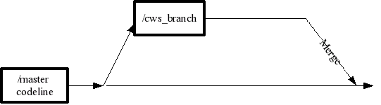
Child workspace
A child workspace is implemented as a CVS branch

Slide 15
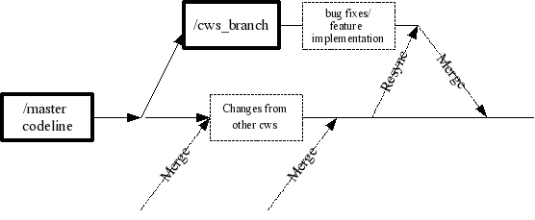
Cws resync
A cvs branch can be merged backed without conflicts only if now conflicted changes has been done in the meantime
“Long” living cws will need a resync first before joined back

Slide 16
Tools for cws
Create a new child workspace – cwscreate
Add a new module – cwsadd
Update a child workspace – cwsresync
Analyze a child workspace - cwsanalyze
Register a new task – cwsaddtask
Environment Information System (EIS)
http://tools.openoffice.org/dev_docs/ooo-cws-tools-doc.sxw
http://eis.services.openoffice.org

Slide 17
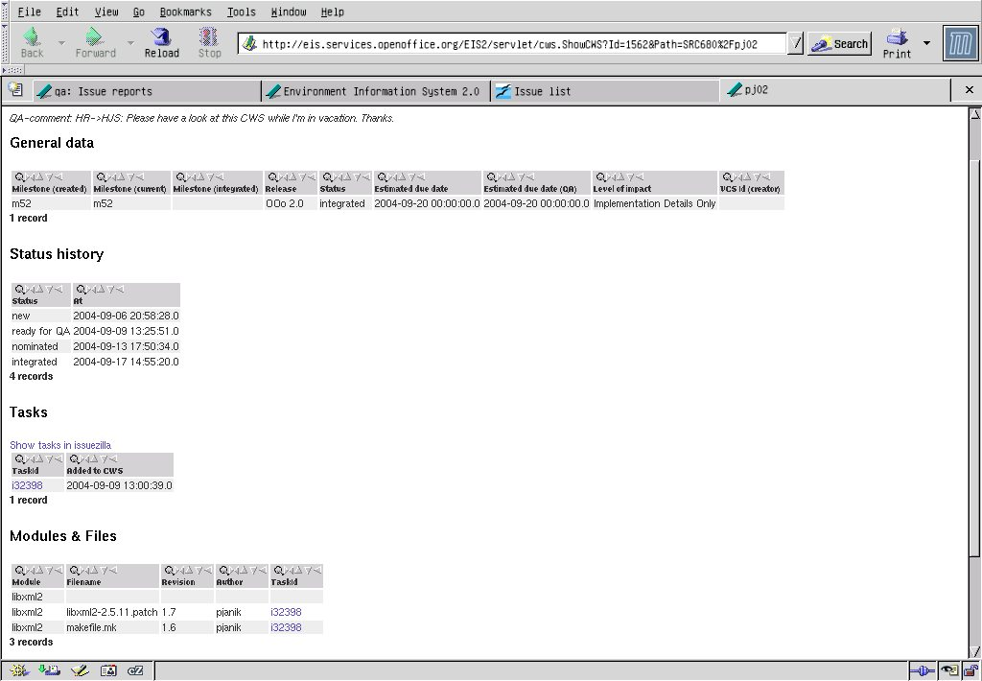
EIS – cws data

Slide 18
Child workspace creation
Create a new child workspace
  Register in database in EIS
  What's the purpose ?
    Provide a description
    What level of QA is needed
    UI relevant
    Help relevant
      -> Specification needed ?!
    Timeframe
  What are the impacts
    Regarding the user experience ?
    To other developers ?

Slide 19
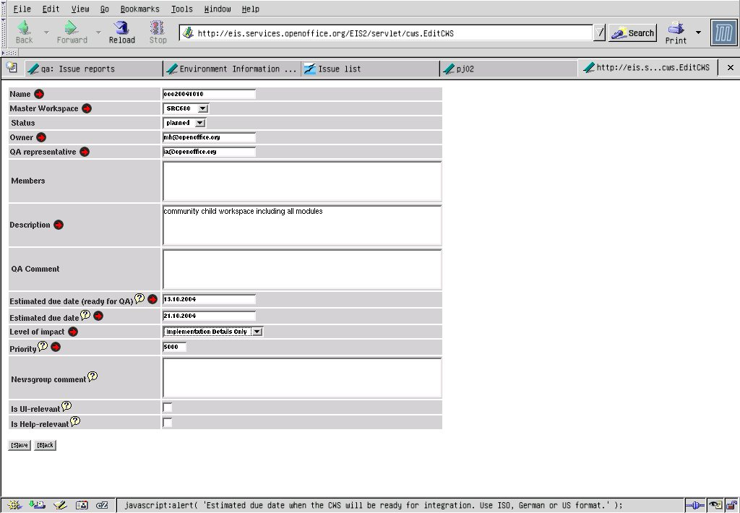
cwscreate

Slide 20
Cws lifetime
The quick thing (less than one day, some days)
  There's no impact, it just fix the damn thing
    Trivial bug fixes
    Build problems
The big thing (months or years)
  New functionality
    Leads to new UI, translation is needed
    Needs documented in Help, Documentation
    Specification is needed
  New architecture
    Other developer need to know about these changes

Slide 21
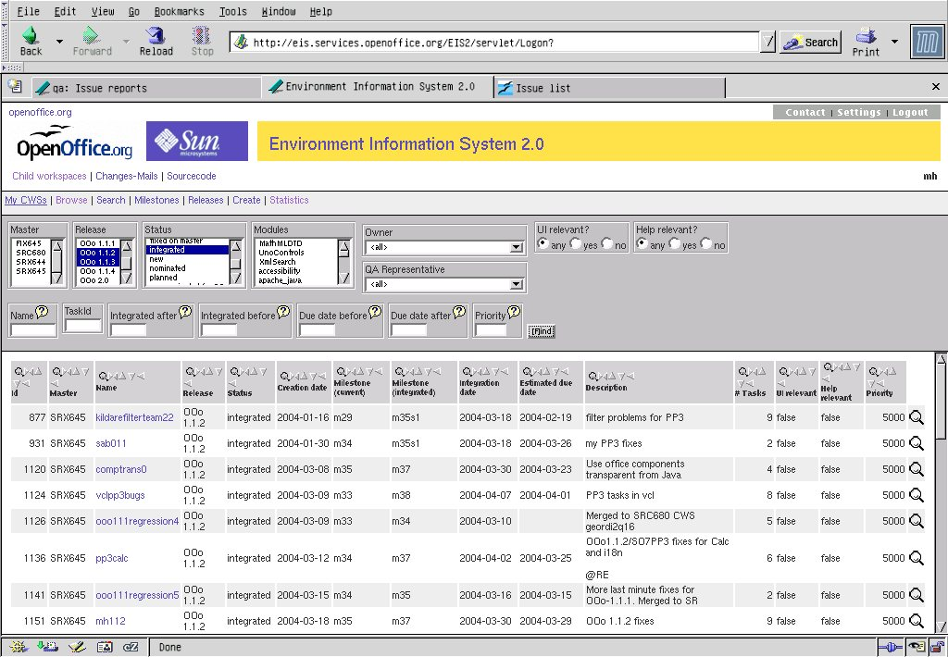
Environment Information System

Slide 22
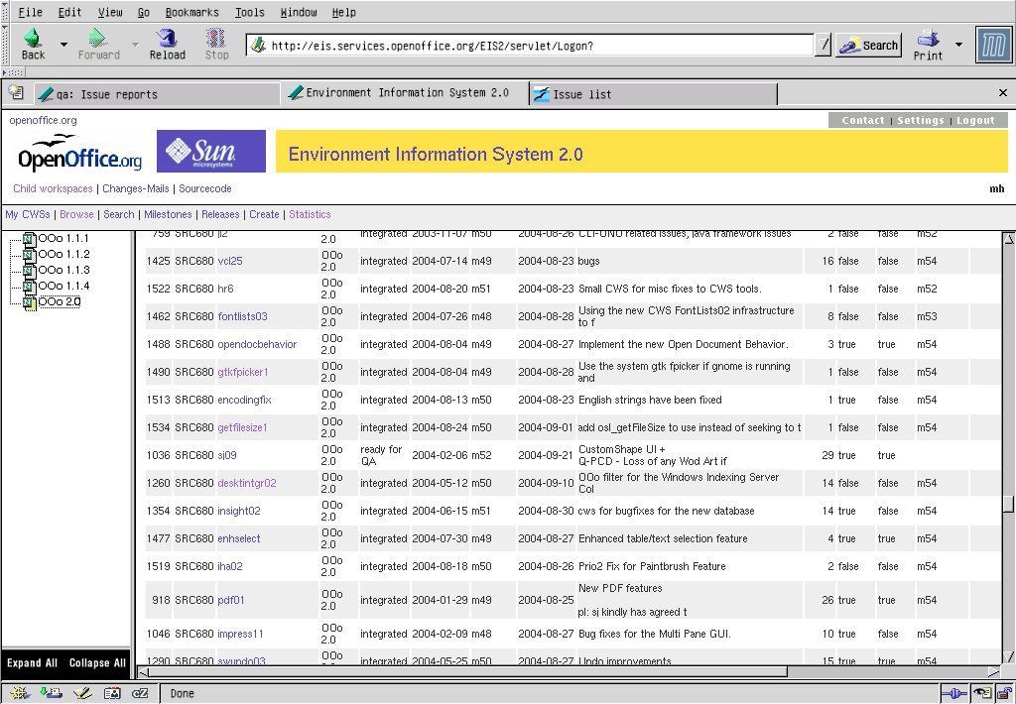
EIS - releases

Slide 23
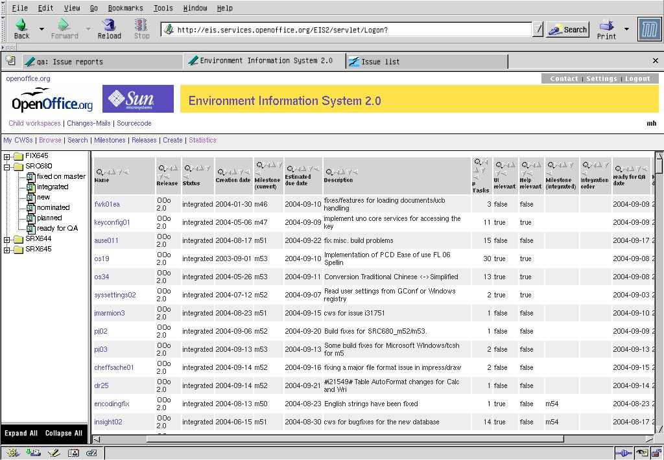
EIS - integrated

Slide 24
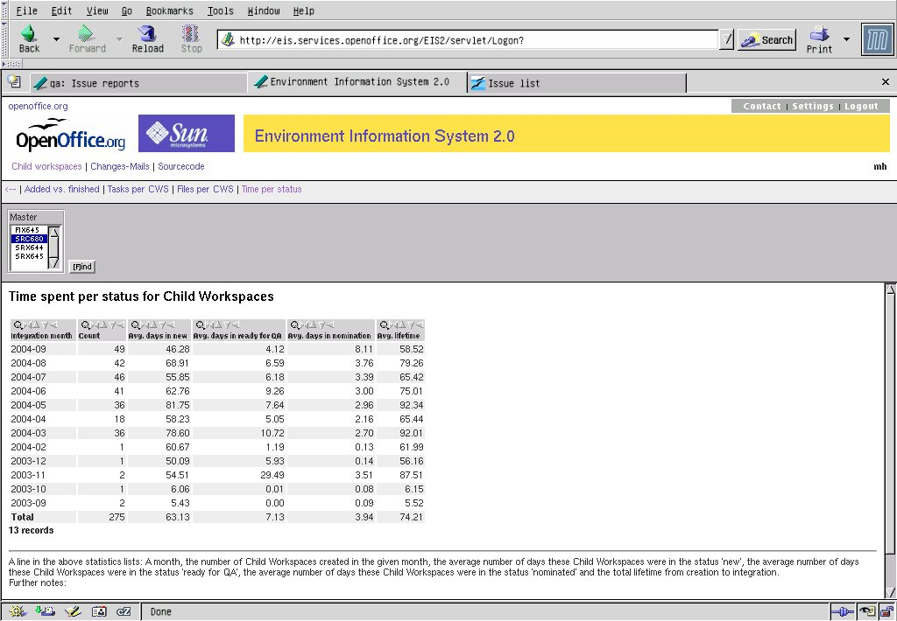
Cws stats

Slide 25
A better solution
  Continuous integration and build
    Simulate atomic commits of file sets
    Group issues to logical entities
  Release early and often
    Release often already tested code
    It does not matter if a features gets in weeks earlier or later
  stable Release
    Minimize the time needed to make the product stable
    Be able to release a stable code base at any time

Slide 26
Challenges
  Experimental code lines
    Developers requires to have experimental code tested broadly
    More than one build is required
  Specification process
    Which Criteria make a specification necessary
    In which cases a test plan, documentation or just comment in the source code are sufficient
  Communication
    http://www.go-ooo.org/ooo-build.html
    Be honest, speak about pro's and con's
    Talk with each other, make sure that you get understood by your partner

Slide 27
Experimental code line
Work with #ifdef for experimental code
  High maintenance costs
  Gets horrible if you get staggered ifdef cascades
Cascading parent/child concept
  scales
Dependent Master
  Resync after every new milestone
  Exit criteria must be clear
Open Question: Single or multiple cws integration ?

Slide 28
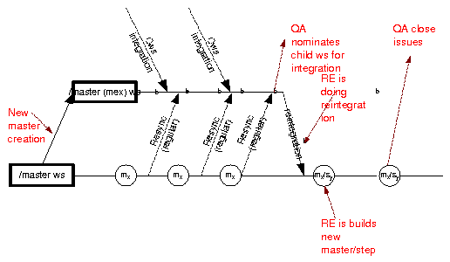
Experimental Code line

Slide 29
Source Control System
Is CVS perfect for OpenOffice.org ?
Which problems we do have with CVS ?
CVS vs Subversion ?
Are there other alternatives (distributed Source Control) ?

Slide 30
Team Work
Common understanding of Users, Developers and QA how a feature is intended to work
Documentation of why decisions have been made about controversial issues
http://specs.openoffice.org/collaterals/Specification_template.stw
http://specs.openoffice.org/collaterals/OpenOffice_org_Specification_guide.sxw
Different levels of specifications:
  Specification
  Test plan
  Comments in Source Code

Slide 31
ToDo's and the vision
Experimental / QA code line
Interaction with community
  Tweaking the Specification Process
  Requests of Enhancements
Planning Releases
Get quick cws round trips for “need to have” things
Speed up the patch process
  Patch Gatekeeper wanted
Get automated tinderbox builds for cws
QA wanted to test before integration
  Enhance smoketest and automated test and integrate them into the build system

Slide 32
Summary
Be every time in a state to release
QA before integration
Grant liberal commit access to the cvs repository
Think twice before nomination for integration !
Get assistance !

