Slide 1
  WordForge
  Localisation infrastructure for everyone
  Dwayne Bailey
  Co-Director
Notes:
South Africa has 11 official languages. These are enshrined in South Africa’s constitution. Legally citizens are allowed to demand that the government supply services in their language. Government must also translate all laws into all of the official languages

Slide 2
  Izixhobo kufeneke zisebenzele abantu, hayi abantu izixhobo. Isoftware sisixhobo ngoko ke kumele sisebenzele abantu ngolwimi lwabo lwasemzini.
  Dwayne Bailey, badly pronounced, OpenOffice.org launch South Africa 2004, OOoConf 2006
Notes:
South Africa has 11 official languages. These are enshrined in South Africa’s constitution. Legally citizens are allowed to demand that the government supply services in their language. Government must also translate all laws into all of the official languages

Slide 3
African language reality
  Over 200 languages with more then 1 million mother tongue speakers

Slide 4
Africa and the digital divide
Connectivity (currently horrible)
Low cost computers (refurbs, OLPC, PDAs, cellphones)
Low cost software (Linux of course)
Localised software (done ;) )

Slide 5
WordForge
Imagine a Hippo...
empowering digitally endangered languages

Slide 6
What is a DEL?
Small languages
Unsophisticated languages communities
Languages that will get swallowed through globalisation and other forces.
Localise or be localised

Slide 7
DEL realities
Unskilled in computers
One or two volunteers
Bad connectivity
No formal standardisation of language
DEL has the worst of everything

Slide 8
!DEL realities
Poorly standardised terminology
Labour intensive management process
Geek driven solutions
But at least they have cheap connectivity :)

Slide 9
Current localisation realities
Won't scale
Silos of knowledge
Not strategic but product focused
Communication/Information overload

Slide 10
What is WordForge developing?
  Process driven and standards based tools for localisation. With a focus on DEL but of benefit to everyone.

Slide 11
Why standards?
Standard formats:
  XLIFF (Localisation Interchange)
  TMX (Translation Memory)
  TBX (Terminology)
Allows us to share information
Create tools to focus on the standards, not the anomalies if each new piece of localisation
Put more information into offline
files: TM, glossaries, etc

Slide 12
Why is good process important?
Good process leads to better translations
Good process focuses the right work on the right applications
Good process allows small teams to deliver strategic results
Good process makes the job of everyone easier, allowing us to scale

Slide 13
Glossaries are important because...
They guide translations
  Influence new translators
  Remind old translators
  Disambiguate confusing terms
They prevent the lookup delay, but then must be integrated
Help to standardise the terminology of DELs

Slide 14
Translation Memory
Can act as a good guide and influencer
Encourages the reuse of good translations
With good matching it is very useful

Slide 15
WordForge tools
Translation Toolkit – OOo to PO, Mozilla to PO, checkers, filters, etc
Pootle – translation management system (TMS), goals, glossary, translations memory, standards based
Pootle editor – online translation editor
Editor – offline XLIFF editor

Slide 16
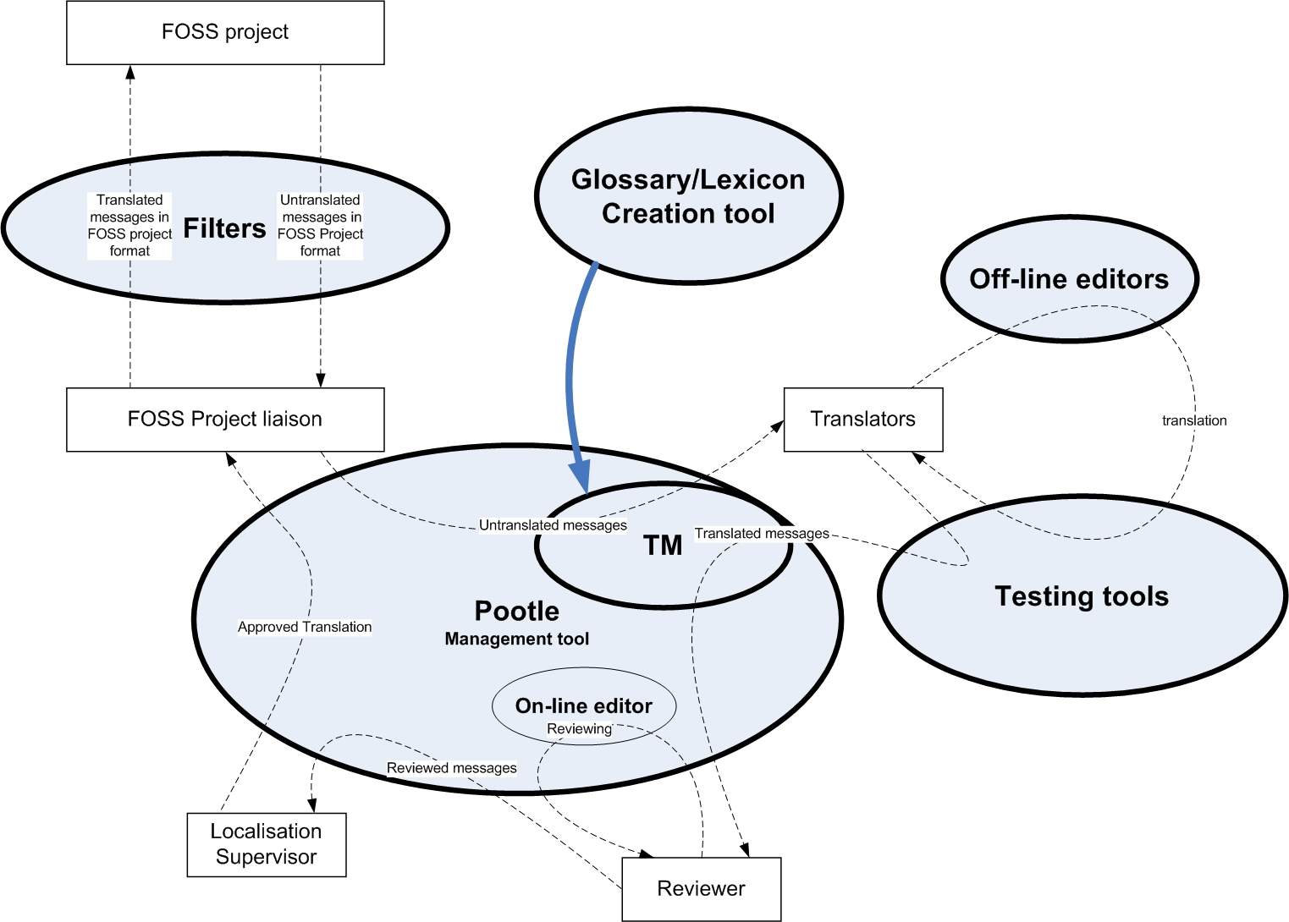
A vision of WordForge tools at work

Slide 17
The ultimate vision...
Pootle fits the needs of teams
  Zulu Pootle
  OpenOffice.org Pootle
Pootle shares
  Shared terminology development
  Shared translation memory
Pootle is adaptable
  It matches the process needs of the project or team

Slide 18
Status of WordForge
Toolkit is mature and in production
Pootle is now very usable: glossaries, TM, goals
Toolkit has all the functionality for XLIFF, TMX and TBX

Slide 19
Status of WordForge: Pootle
Pootle is now our major focus area
  Migrating to XLIFF
  Refactoring
  Integrating Debian SoC DB backend
  Improving user experience
  Creating the hooks for process management

Slide 20
Relationships
WordForge is OSS
Who is using it?
  Knowingly or unknowingly all OOo community localisers
  Almost all new languages in Mozilla
  Rosetta use oo2po for OOo localisations
Which communities use it
  Arabic, Brazilian Portuguese, Georgian, etc
  Translate.org.za, KhmerOS
  Creative Commons

Slide 21
Code Contributors
Debian through SoC
  DB backend and integration of the same into Pootle
Community driven glossary
Arabic team RTL language fixes

Slide 22
Support
Open Society Institute (OSI)
IDRC

Slide 23
WordForge and you
Coders
  Localisers who can code are very hard to find
    So if you can code join us
  If you can't code help but know someone who can
    Bribe them
    Convince them
    Bundle them into cars late at night
    Tickle them
Non coders

Slide 24
Questions comments?
No Xhosa demo's :) Well maybe one!

