Slide 1


Slide 2

Get OOXML Done Within One Week
  Alex Wang
  Chair/OASIS UOML-X TC
  Chairman / Sursen Co.

Slide 3
Open Office Must Face OOXML Compatibility
Fact 1: MS Office still occupy most market share
Fact 2: Most office document use MS format
Fact 3: New versions of MS Office use OOXML
Fact 4: OOXML has become ISO standard
Conclusion 1: More and more OOXML document in future
Conclusion 2: After handling doc/xls/ppt, Open Office has to handle OOXML
OOXML has become a matter that Open Office must face

Slide 4
OOXML Compatibility is a Great Challenge
OOXML specification has 10,000 pages, while ODF has 700+ pages
OOXML will be much more difficult to handle than doc/xls/ppt
Open Office community has cost many years for doc/xls/ppt compatibility
How many years we will wait for OOXML compatibility?

Slide 5
Traditional Way for Compatibility
Edit the existing contents in the original way
Parse the entire format
Implement ALL functions and ALL features defined by the format
Unsolvable problem
  The format maybe unstable
  Impossible to reach 100%
  Different implementation cause different layout
  Not reliable

Slide 6
Paper Fidelity Way for Compatibility
Don’t modify the existing contents, append new contents upon it
Retrieve visual appearance of the original document, needn’t handle the file format
Simplify the problem to be solvable
Very reliable
Behaves the same way as paper, which can be accepted by normal users

Slide 7
Three Steps of Paper Fidelity Way
  Use MS Office to open OOXML document
  Get rid of handling file format
Retrieve visual appearance and save to a layout-based document by virtual printer
  The same technology as Acrobat Writer, mature and reliable
Open the layout-based document in Open Office, edit new content, append new contents on existing ones

Slide 8
Existing Standard and Tools
UOML(Unstructured Operation Markup Language) Standard, an OASIS standard that defines instructions to access layout-based document
SEP DCMS(DoCbase Management System), a free software that implements all functions defined by UOML
UOML Writer, a free and open source virtual printer that conforms to UOML
UOML plug-in for Open Office, an Open Office plug-in that is able to open a UOML document and append new edited content upon it

Slide 9
MS Office
Open
Office
UOML
Writer
UOML
Plug-in
UOML
SEP DoCbase Management System
OOXML Document
UOML Document

Slide 10
Get Done OOXML Within One Week
Retrieve visual appearance information of OOXML document and save to a UOML document by UOML writer
  It is ready now
Open UOML document, edit new content upon it, save new edited document to UOML document, by UOML plug-in
  Need Open Office release provider to do little modification, the modification can be done within one week

Slide 11
Step 1: Use MS Office to open its document

Slide 12
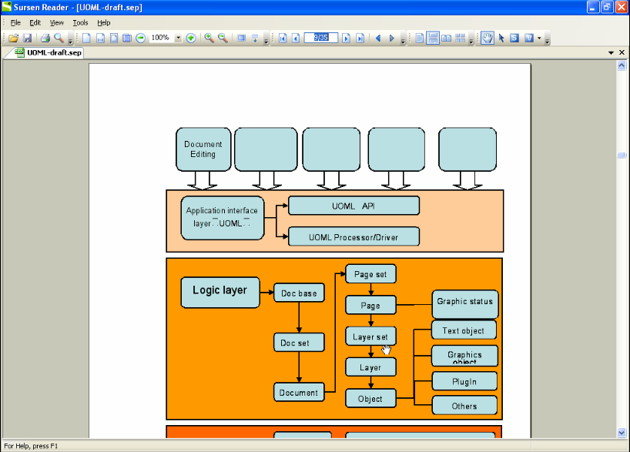
  Step 2: Generate a UOML document
  by UOML Writer

Slide 13
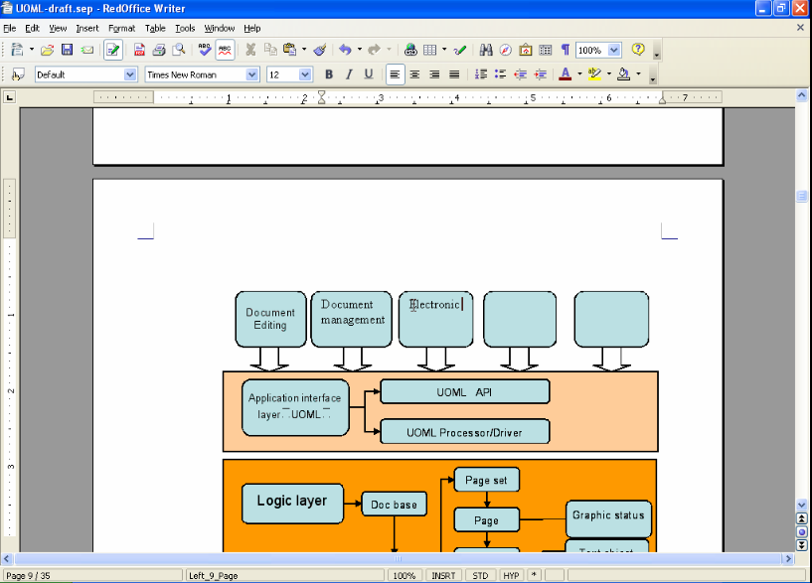
  Step 3: Append new contents on existing onesin RedOffice by UOML plug-in

Slide 14
Benefits and shortcomings
  Reliable
  The layout is 100% retained
  Can't modify the existing contents in the original way
  Can be accepted by most users

Slide 15
Value of UOML Solution
  Government, Enterprise can install one MS Office in entry, convert all input documents to UOML documents
  The other hundreds of computers are only required to have OpenOffice installed, thus get rid of format compatibility problems
  It works the same way as the tradition paper work, can be accepted by users
  OpenOffice can be promoted without format compatible problems

Slide 16
Value of UOML Solution
  OpenOffice
  OpenOffice
  OpenOffice
  OpenOffice
  MS Office
  OpenOffice
  OpenOffice

Slide 17
About UOML
UOML - Unstructured Operation Markup Language, is an OASIS standard, approved in 2008-10-10
UOML is NOT a document storage format
UOML defines instructions to access layout-based document
  Based on XML, cross-platform, programming language independent, specific application independent
UOML document is short for UOML-accessible document
OASIS UOML-X TC:
http://www.oasis-open.org/committees/tc_home.php?wg_abbrev=uoml-x

Slide 18
  Q & A

Slide 19


