Slide 1


ODF API - ODFDOM
Svante Schubert
Software Engineer
Sun Microsystems, Hamburg
20

Slide 2
Do you know ODF?
The OASIS / ISO standard for office documents (2005/06)
The document format of many office applications
A zipped package of XML and related files
(image, sound, user files)
Origin from OpenOffice.org's default format

Slide 3

What to do with ODF documents?
Usually store your Texts / Spreadsheets / Presentation
Edited and viewing by an Office application

Slide 4

What to do with ODF documents?
But how do I process 1.000.000 ODF documents?

Slide 5

We need an ODF API!
API to automate ODF processing
  Creating, manipulating ODF documents
  Lightweight API
  API close related to ODF
  Opensource

Slide 6
Where to find an ODF API?
Use StarOffice / OpenOffice.org API?
  Office API not ODF centric
  StarOffice funded 1984, ODF standardized 2005 / 06
  Office viewing & editing functionality undesired,
  Lightweight editing functionality not easy extractable

Slide 7
The Idea of a new ODF API!
We need a new lightweight ODF API!!
  New API will focus on ODF
  Taking over ideas from previous ODF APIs (OOo API, AODL, ODF4J, etc.)
Notes:
The Idea is to create a new library and the merging of both after some time..

Slide 8

New ODF API - ODFDOM
Sun opensourced ODFDOM
  Lightweight API
  OpenDocument centric
  Opensource (Apache 2)
  Multi-layered
  Java 5 reference implementation

Slide 9

ODF Basics - Package & Files
ISO standardized default content
(as shown, but NOT Picture folder)

Slide 10
ODF Basics - Package & Files
Manifest as an Inventory /
'table of content'
Any user content..

Slide 11
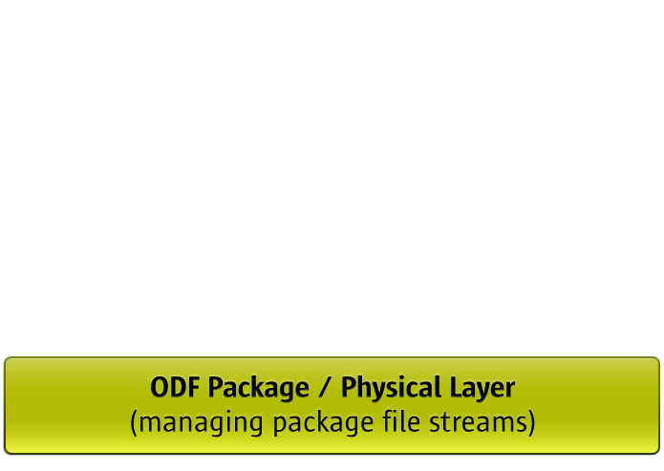
ODFDOM - Layered Model
ODFDOM featuring:
  Adding / removing file streams from the ODF package (ZIP)
Notes:
Generated from the ODF RelaxNG Schema (typed W3C XML DOM, similar to HTML DOM part of Apache Xerces parser)

Slide 12
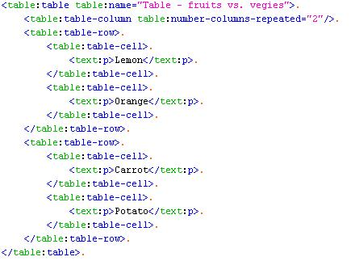
ODF Basics – XML Table Example

Slide 13
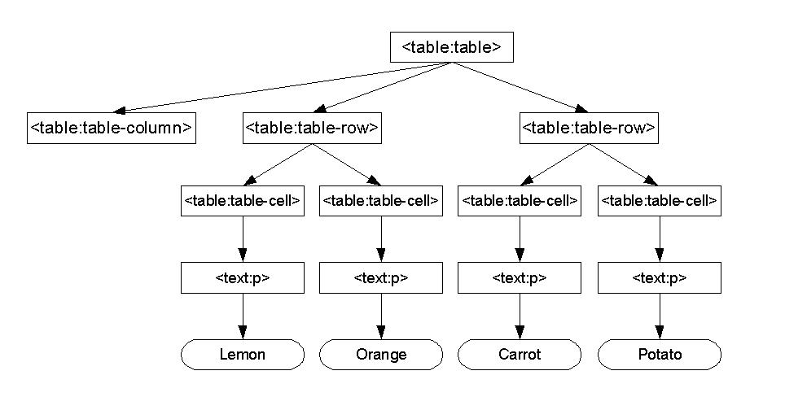
Design Idea - DOM API for ODF

Slide 14
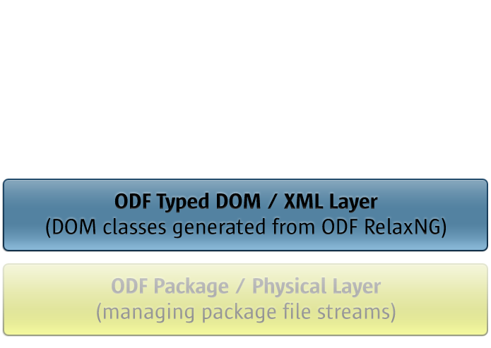
ODFDOM - Layered Model
ODFDOM featuring:
  Processing ODF documents on ODF XML element level
Notes:
Generated from the ODF RelaxNG Schema (typed W3C XML DOM, similar to HTML DOM part of Apache Xerces parser)

Slide 15
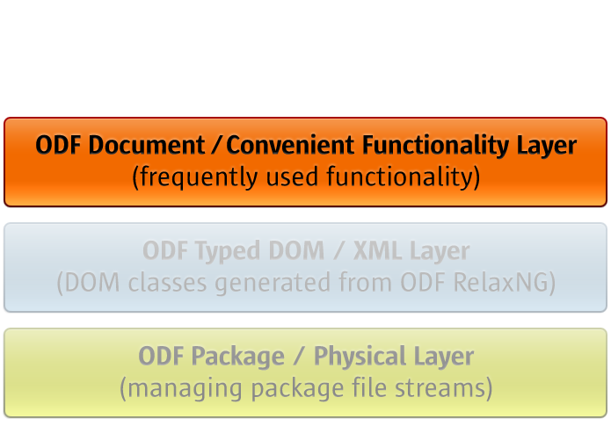
ODFDOM - Layered Model
ODFDOM featuring:
  Common high-level convenience functionality (e.g. add table, add table row, etc.)
Notes:
Generated (at least skeleton at the first time) from the ODF RelaxNG Schema (typed W3C XML DOM, similar to HTML DOM part of Apache Xerces parser)

Slide 16
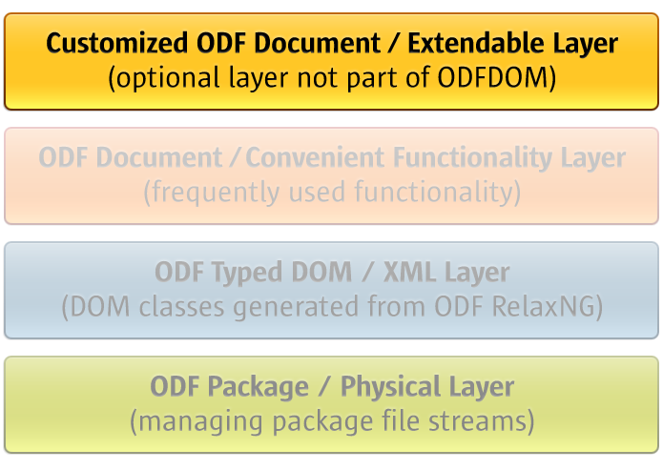
ODFDOM - Layered Model

Slide 17
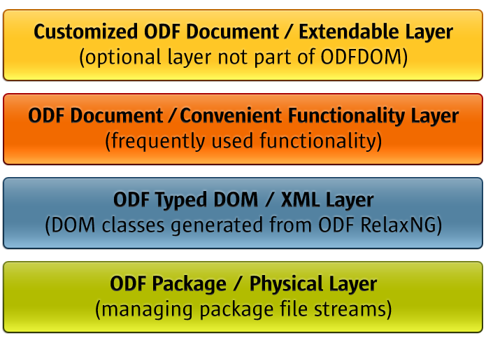
ODFDOM - Layered Model

Slide 18
ODFDOM - Resources
Quick Look
  Project of ODF Toolkit - http://odftoolkit.org
  Wiki - http://odftoolkit.org/projects/odftoolkit/pages/ODFDOM
Deep Look (Packages)
  The zipped JavaDoc API
  The JAR of the reference Java 5 implementation
  The zipped NetBeans package containing the sources of ODFDOM

Slide 19
Why an ODF TOOLKIT Project?
Round up ODF developer story
Provide a site to share programs & ideas on ODF
  ODF SDK
  ODF Conformance Tools
  ODF Applications and Tools
ODF SDK - ODFDOM
Provide a layered model for ODF reusable for different programming languages (ODFDOM)
To discuss common ODF application problems...

Slide 20
Shared Problems of ODF Application
How to support multiple ODF versions?
  ODFDOM supports by default latest ODF version
  Provides downgrade functionality to older ODF versions
  Problem: Not yet specified when a feature was added to ODF
How test ODF application for conformance?
  Why not sharing ODF conformance tests and documents with other ODF applications?
Notes:
Possible ways to support multiple ODF versions:
Only support the latest ODF version?
Every ODF version gets its own ODFDOM version?
Every ODF version can be accessed by latest ODFDOM?
Possible solution: annotate element and attribute accessors with an annotation of ODF version of their introduction

Slide 21
Shared Problems of ODF Application
ODF RelaxNG schema not sufficient for Code Generation
  Misses relation between stylable element and style:family
  (e.g. text:p is related to the value 'Paragraph')
  Creation of attribute default values from ODF 1.2 schema possible, missing example for default of mandatory attributes
  (As in OOo - create an image just by an image source)

Slide 22

Questions & Answers
Svante Schubert
Svante.Schubert@sun.com
20

