Slide 1

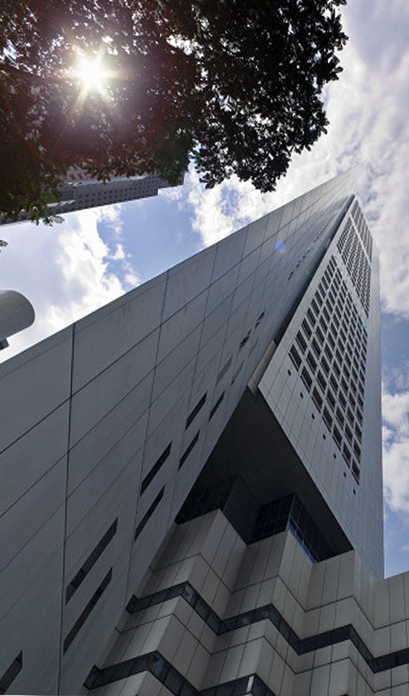
Workshop - ODFDOM
Lars Behrmann
Frank Meies
Svante Schubert
Sun Microsystems, Hamburg
20

Slide 2

Do you know ODF?
The OASIS / ISO standard for office documents (2005/06)
The document format of many office applications
A zipped package of XML and related files
(image, sound, user files)
Origin from OpenOffice.org's default format

Slide 3
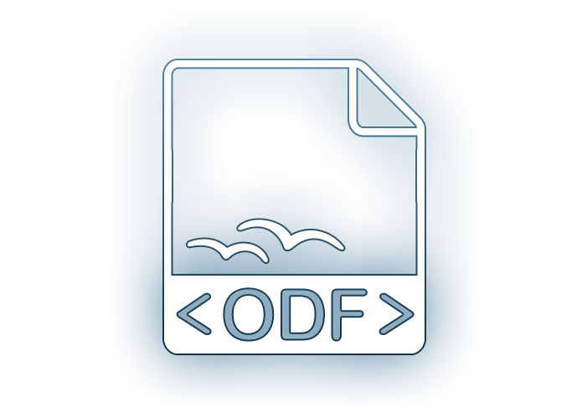
What to do with ODF documents?
Usually store your Texts / Spreadsheets / Presentation
Edited and viewing by an Office application

Slide 4

What to do with ODF documents?
But how do I process 1.000.000 ODF documents?

Slide 5

We need an ODF API!
API to automate ODF processing
  Creating, manipulating ODF documents
  Lightweight API
  API close related to ODF
  Opensource

Slide 6
The Idea of a new ODF API!
We need a new lightweight ODF API!!
  New API will focus on ODF
  Taking over ideas from previous ODF APIs (OOo API, AODL, ODF4J, etc.)
Notes:
The Idea is to create a new library and the merging of both after some time..

Slide 7

New ODF API - ODFDOM
Sun opensourced ODFDOM
  Lightweight API
  OpenDocument centric
  Opensource (Apache 2)
  Multi-layered
  Java 5 reference implementation

Slide 8

ODF Basics - Package & Files
ISO standardized default content
(as shown, but NOT Picture folder)
Manifest as an Inventory /
'table of content'
Any user content..

Slide 9
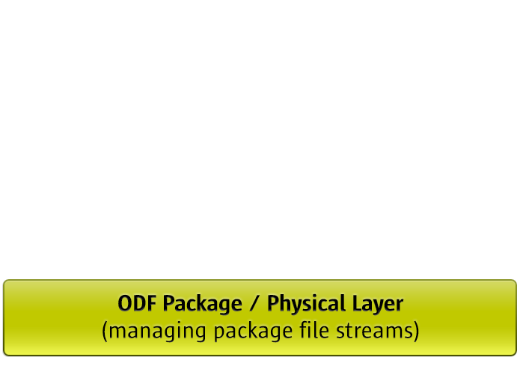
ODFDOM - Layered Model
ODFDOM featuring:
  Adding / removing file streams from the ODF package (ZIP)
Notes:
Generated from the ODF RelaxNG Schema (typed W3C XML DOM, similar to HTML DOM part of Apache Xerces parser)

Slide 10
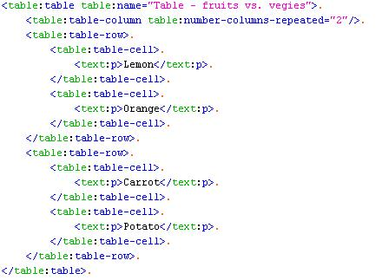
ODF Basics – XML Table Example

Slide 11
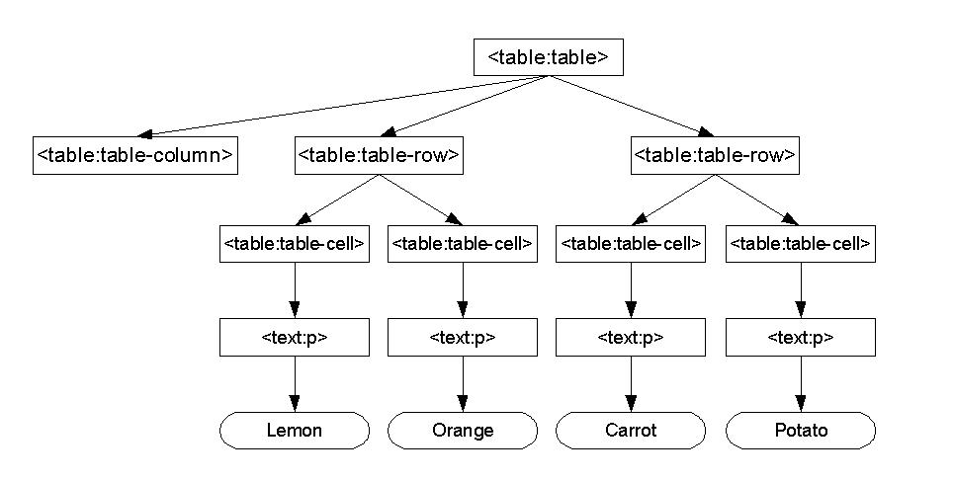
Design Idea - DOM API for ODF

Slide 12
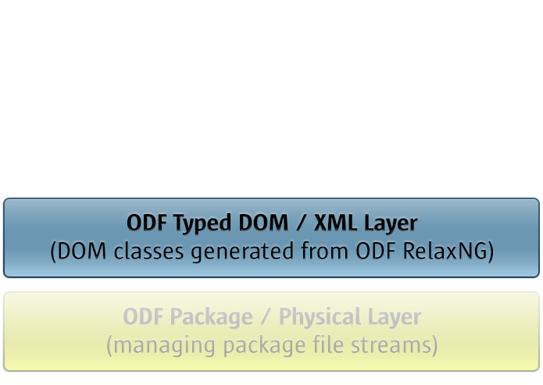
ODFDOM - Layered Model
ODFDOM featuring:
  Processing ODF documents on ODF XML element level
Notes:
Generated from the ODF RelaxNG Schema (typed W3C XML DOM, similar to HTML DOM part of Apache Xerces parser)

Slide 13
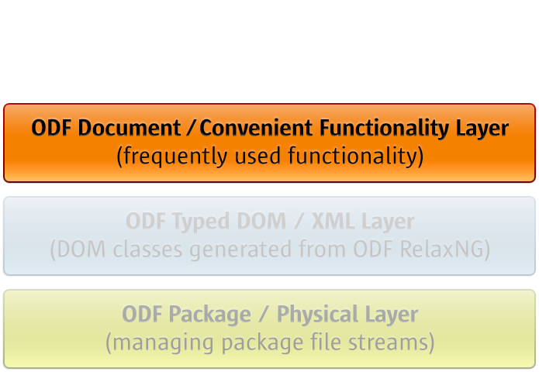
ODFDOM - Layered Model
ODFDOM featuring:
  Common high-level convenience functionality (e.g. add table, add table row, etc.)
Notes:
Generated (at least the sceleton at the first time) from the ODF RelaxNG Schema (typed W3C XML DOM, similar to HTML DOM part of Apache Xerces parser)

Slide 14
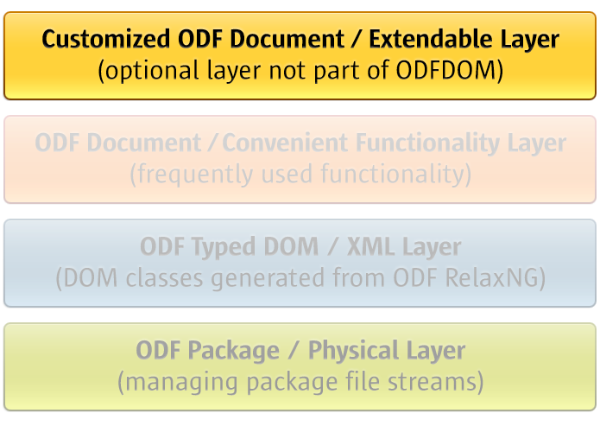
ODFDOM - Layered Model

Slide 15
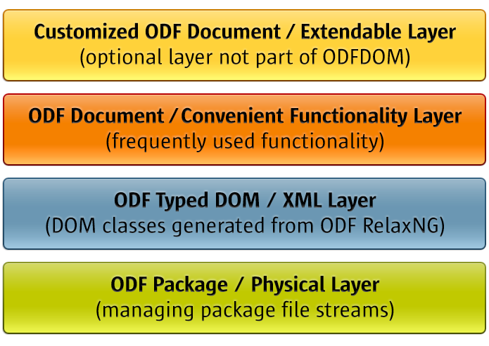
ODFDOM - Layered Model

Slide 16
ODFDOM - Resources
Quick Look
  Project of ODF Toolkit - http://odftoolkit.org
  Wiki - http://odftoolkit.org/projects/odftoolkit/pages/ODFDOM
Deep Look (Packages)
  The zipped JavaDoc API
  The JAR of the reference Java 5 implementation
  The zipped NetBeans package containing the sources of ODFDOM

Slide 17
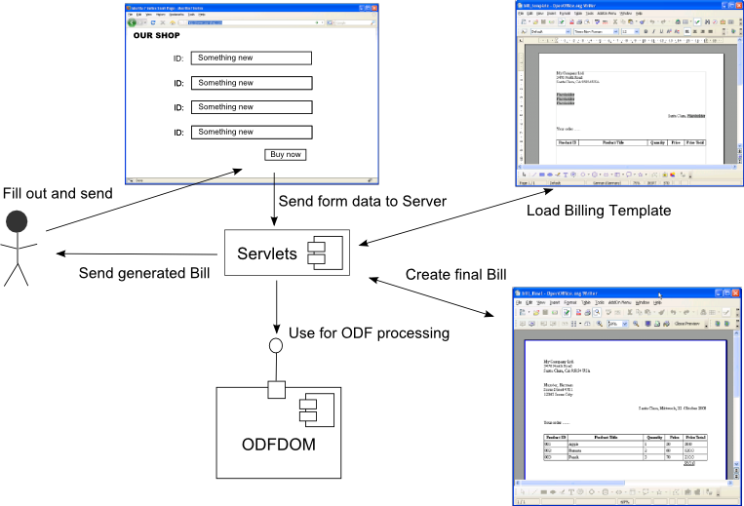
Exercise: Text Document (1)
Goal: Use ODFDOM API to create Company Bills in
ODF from HTML Forms based on Templates.

Slide 18
Exercise: Text Document (2)
Required steps:
Set up a Web Application Netbeans Project
Add a JSP File with a HTML Form
Add required libraries to projects and imports to JSP file
Add a JSP File which receives the HTML Form Data
Add Java code that
  Receives the HTML Form Data and calculate the bought items
  Load the Billing Template
  Finds the required place holder
  Applies the calculated data to the place holder
  Finally saves the generated Bill

Slide 19
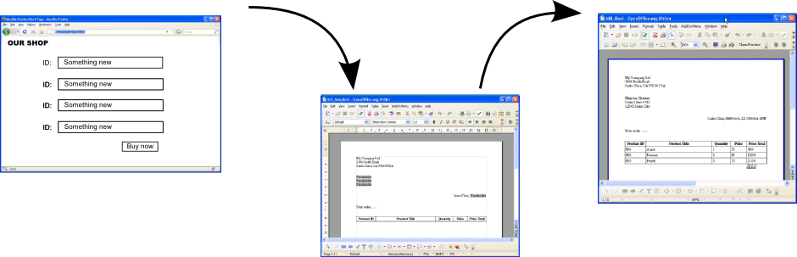
Exercise: Text Document (3)
After all steps are finished we have our generated Bill:

Slide 20
Exercise: Spreadsheet Document (1)
Goal: Use ODFDOM API to read data from a
spreadsheet document and present the
data as HTML page:
Web Application
HTTP Request
HTML Code
Servlet
Collect Data using ODFDOM
ODS Document

Slide 21
Exercise: Spreadsheet Document (2)
Required steps:
Set up a Web Application Netbeans Project
Add required libraries to projects
Add required imports to JSP file
Add Java code that
  Finds the table rows in the ODS document
  Finds the table cells for each table row
  Gets the text content of each table cell
  Writes the respective HTML tags for the rows/cells/text content

Slide 22
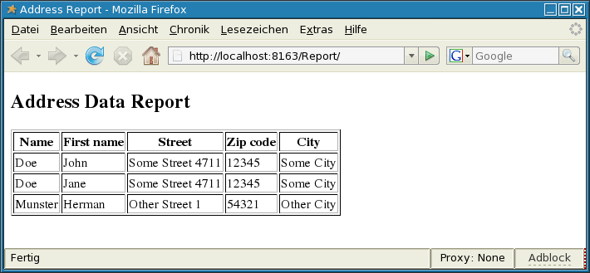
Exercise: Spreadsheet Document (3)
The final result should look like this:

