Slide 1


Thunderbird/Lightning
Managing Time...
Berend Cornelius
Software Engineer
Sun Microsystems
6

Slide 2
Motivation and Considerations
Customers' Demand
Platform Independency
Open Source Product

Slide 3
The Mozilla Platform
A very vivid Community
Broad Acceptance all over the World
Stable mature and consistent Technology based on
  Java Script
  Cascading Stylesheets (css)
  XUL
  XPCOM

Slide 4
The Mozilla Calendar Project
Shipped in 31 locales on all major platforms
  Windows
  Solaris (x86 & SPARC)
  Linux
  Mac (PPC & Intel)
Sunbird
  Standalone Application
Lightning
  Extension for Mozilla Thunderbird
  (well accepted e-Mail client)

Slide 5
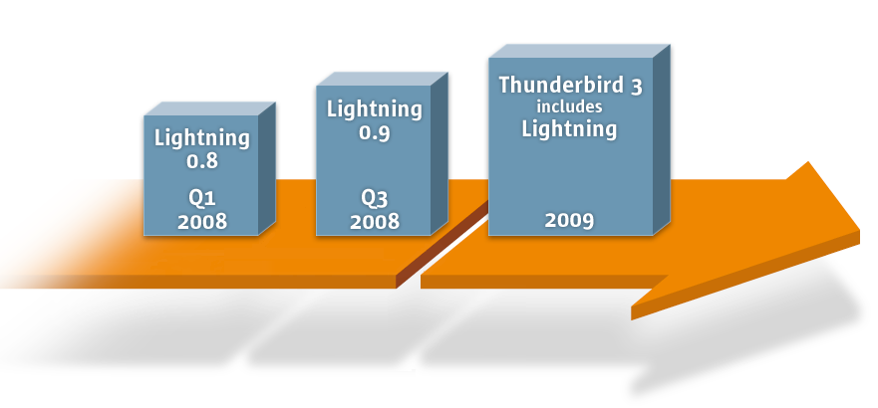
Lightning Roadmap
20%
8%
57%
15%

Slide 6
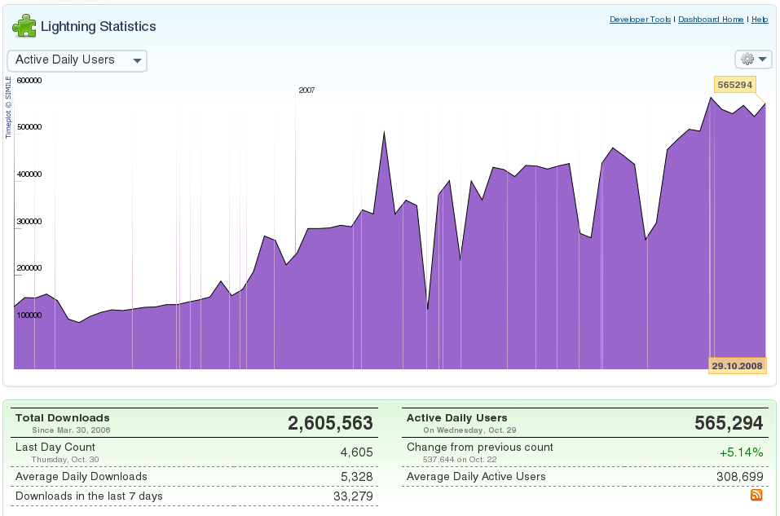
Lightning Statistics
20%
8%
57%
15%

Slide 7
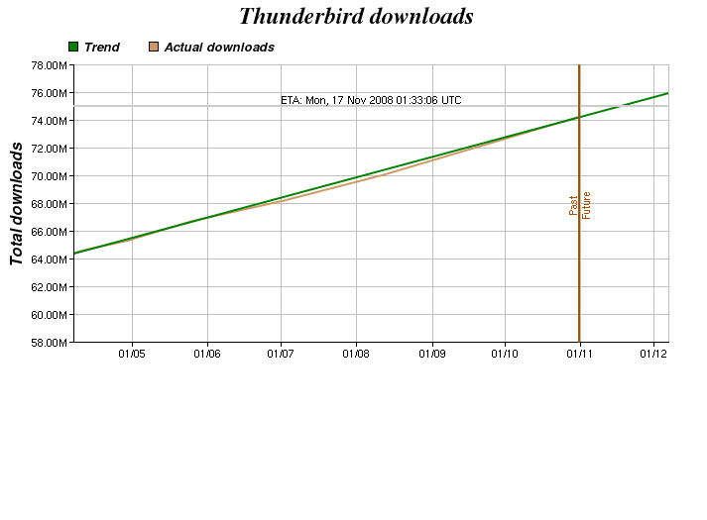
Thunderbird Statistics

Slide 8
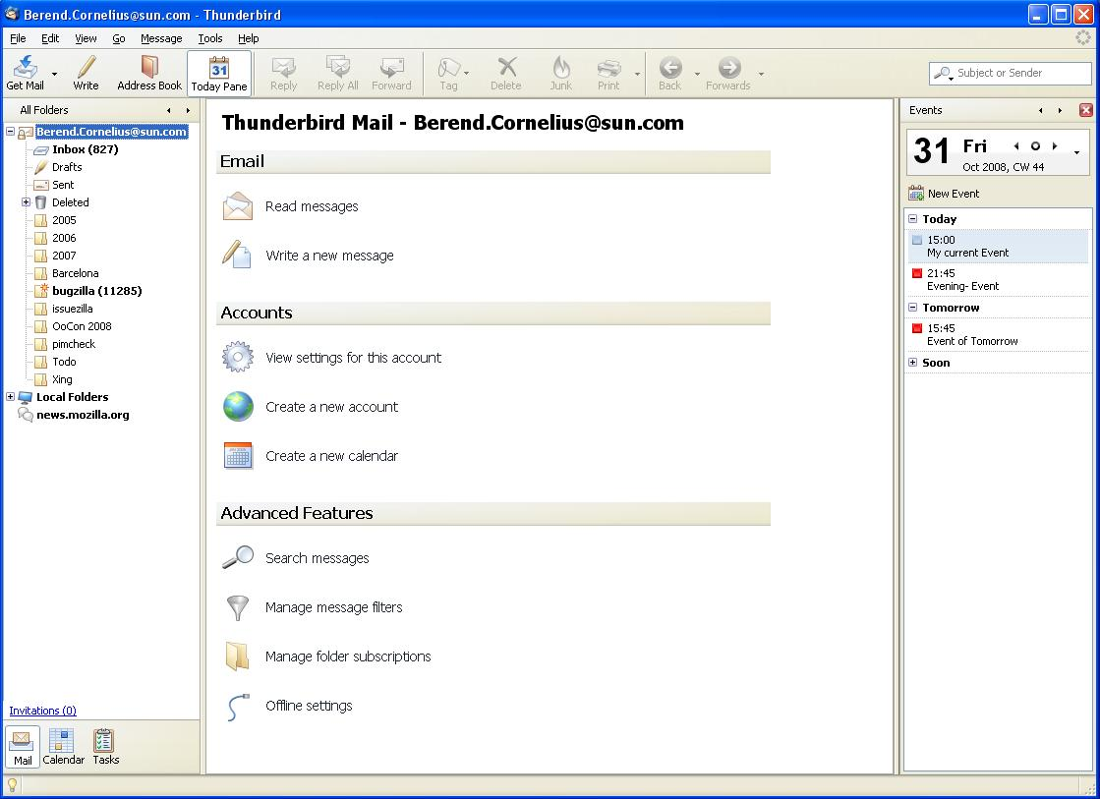
Lightning 0.9 Mail Mode

Slide 9
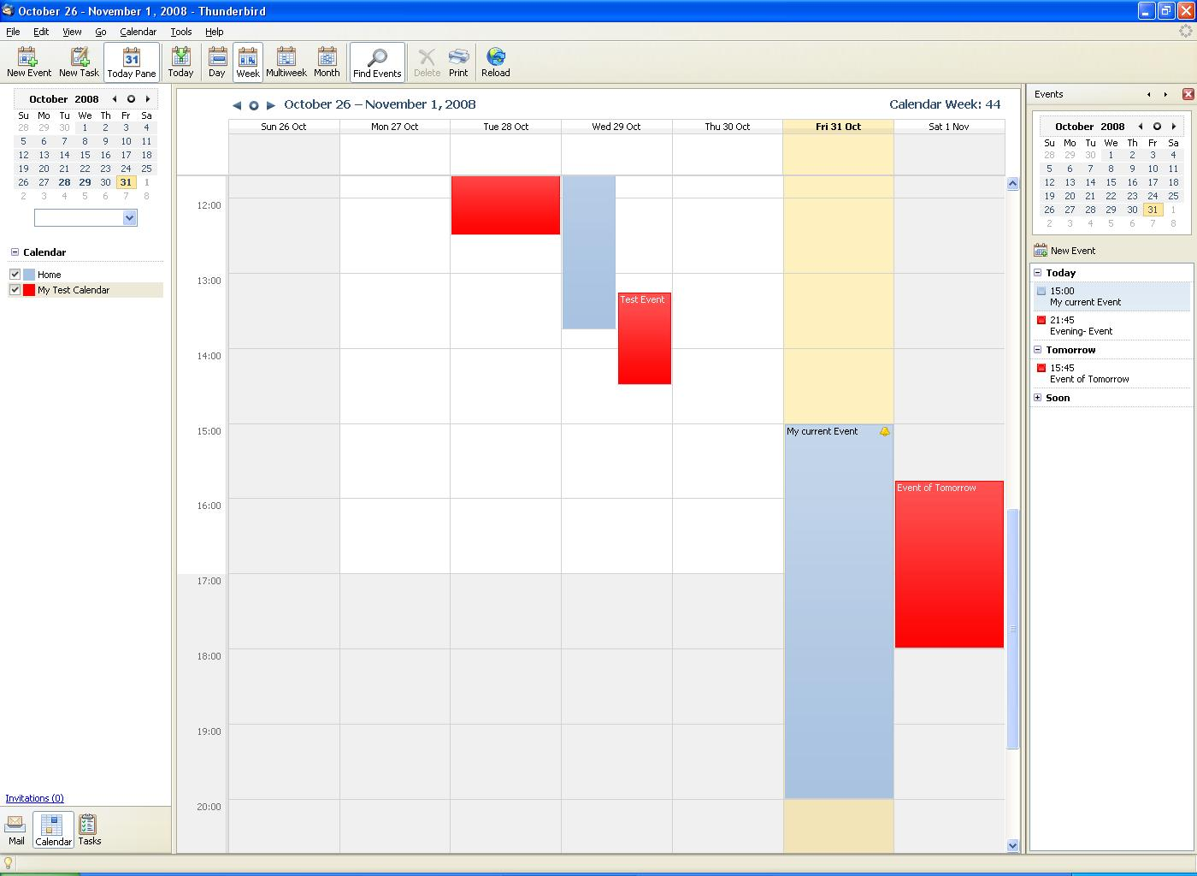
Lightning 0.9 Calendar Mode

Slide 10
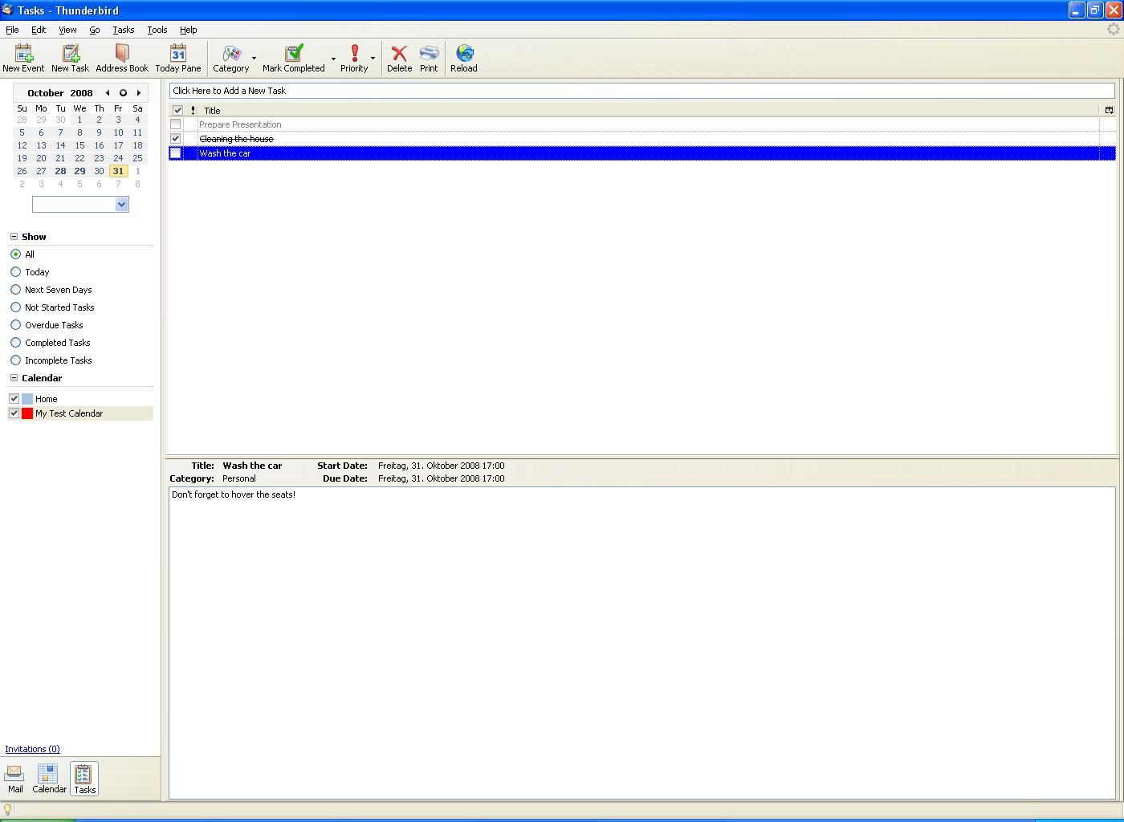
Lightning 0.9 Task Mode

Slide 11
Major Standards
ICalendar (RFC 2445)
ITIP/IMIP (RFC 2446 and RFC 2447)
CalDAV (RFC 4791)
WCAP

Slide 12
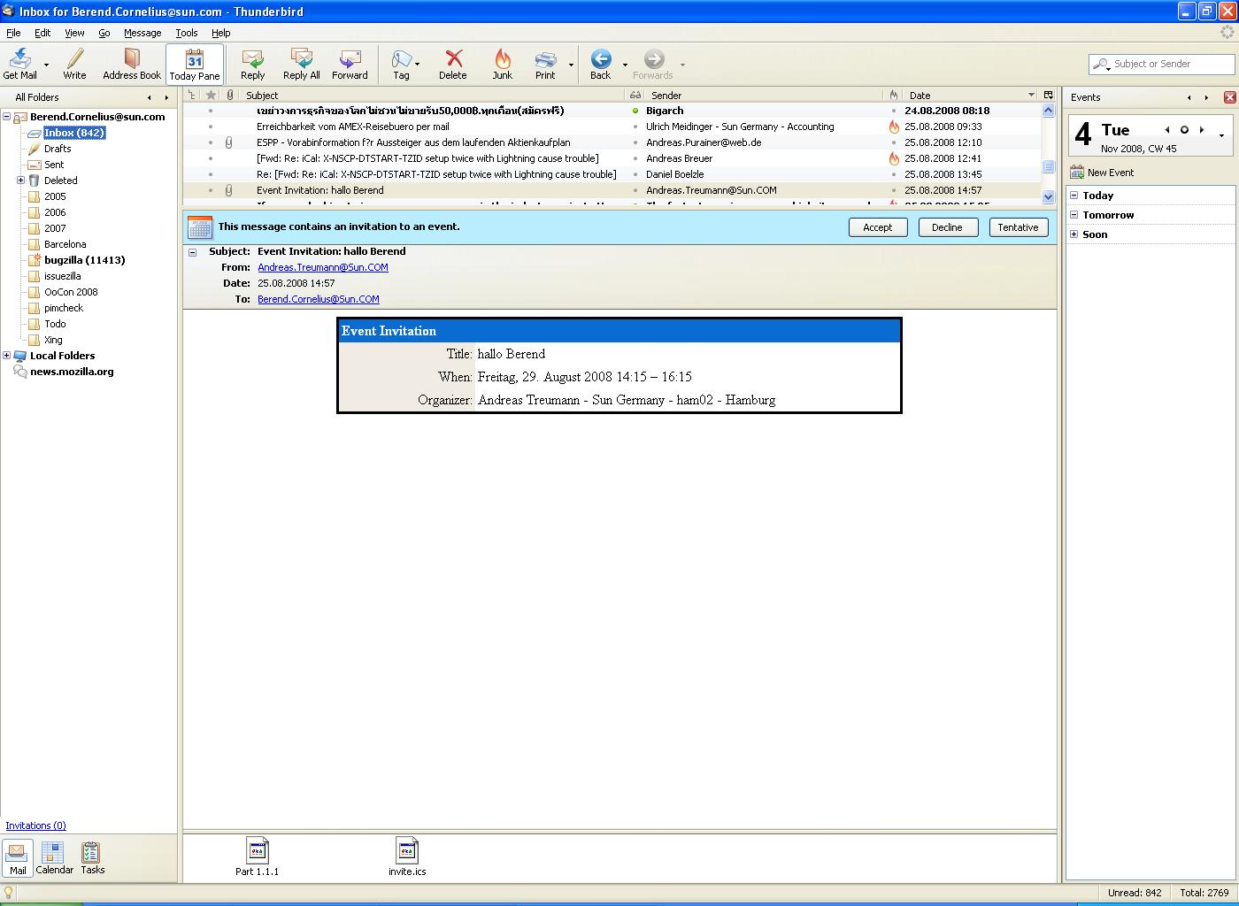
Receiving an Invitation

Slide 13
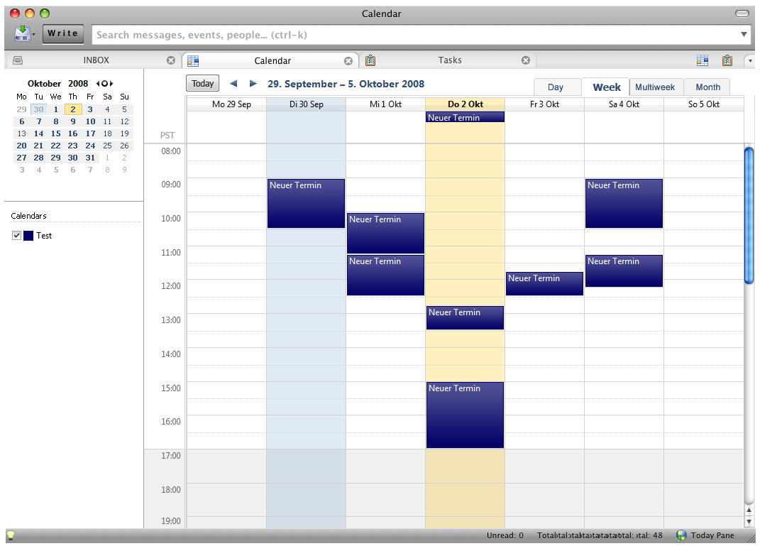
Lightning Integration in Thunderbird

Slide 14
Links
Mozilla Calendar Project
http://www.mozilla.org/projects/calendar
Calendar Weblog
http://weblogs.mozillazine.org/calendar/
Mailing Lists
news://news.mozilla.org/mozilla.dev.apps.calendar
news://news.mozilla.org/mozilla.support.calendar
Nightly builds
ftp://ftp.mozilla.org/pub/mozilla.org/calendar/lightning/nightly/latest-comm-central

Slide 15

Enjoy your Time!
Berend Cornelius
Berend.Cornelius@sun.com
6

