Slide 1


Slide 2

OpenOffice.org Portable -
The Office in your pocket
Andreas Mantke
Content Developer - OpenOffice.org

Slide 3
Who am I
Andreas Mantke
Working for a social insurance organisation
Member of OpenOffice.org since autumn 2002
Project status: Content Developer
From 2003 to 2006 contact for documentation in the de-project
Currently working with the projects de, documentation, extension-website, OpenOffice.org Portable

Slide 4
Agenda
What is OOo Portable?
Usage
OpenOffice.org Portable Plus
Technical overview
(Structure, Modifications, Compression)
Installer / Upgrading
Known Issues
Benefits

Slide 5
What is OOo Portable?
A special version of OpenOffice.org:
    To carry around on a portable device
    To use on any Windows computer
    (or with wine on Unix / Linux)
    On plugged-in
      USB flash drive,
      portable hard disk
      iPod,
      other portable device,
    access to your software and personal data just as on your own PC
    none of your personal data is left behind on guest PC

Slide 6
Usage
Start: double-click OpenOfficePortable.exe file
Then, like local copy of OpenOffice.org
Stay Safe
  Virus scanning
  Safely removing of the device
  Backup your device

Slide 7
Usage
Java (and all depending functions) portable usable
Launcher for every programme module
(Writer Portable etc.)
Preseted dynamic standard path for temp and documents to enhance the safety of the portable data
Extensions installable / executable
(Java / Python)

Slide 8
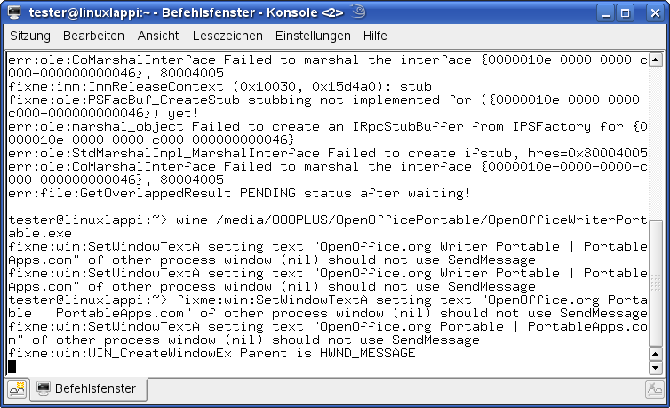
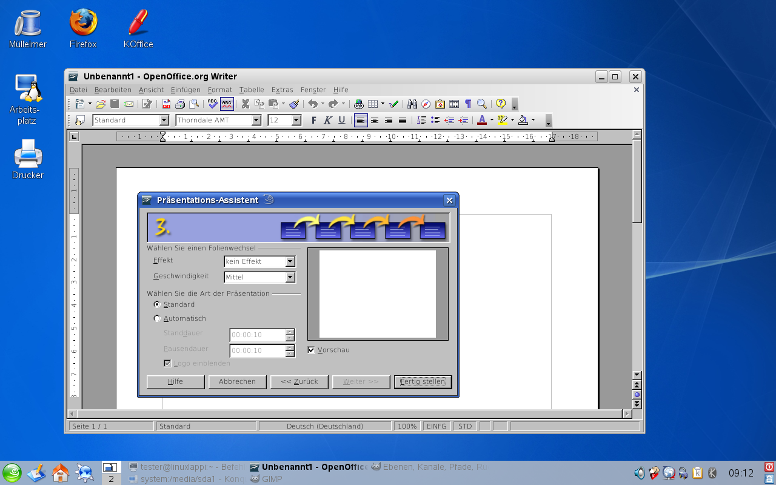
Usage with wine
Possible:
Launch from
command line
with wine

Slide 9
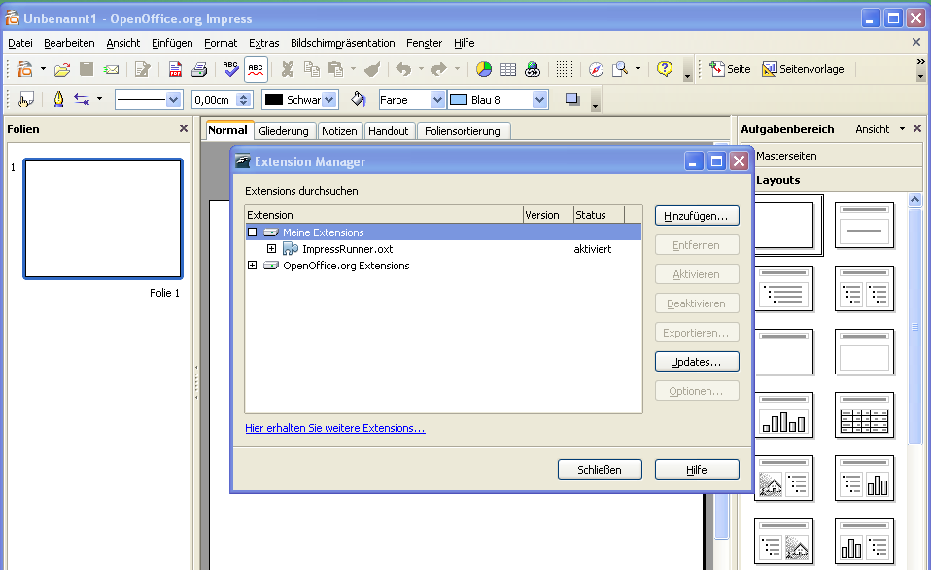
Usage: Extensions
Extensions installable and executable (Java / Python)

Slide 10
Usage: From CD
OpenOffice.org Portable Live
Copy of a local installed OOoP
  With config files
  Needed Extensions
OpenOfficePortable.ini

Slide 11
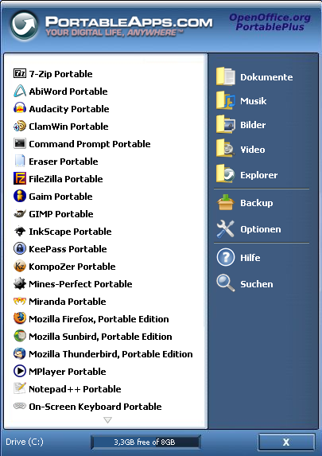
OOo Portable Plus
Addition to OOo Portable
All necessary office applications in a suite
Directory documents fixed integrated

Slide 12
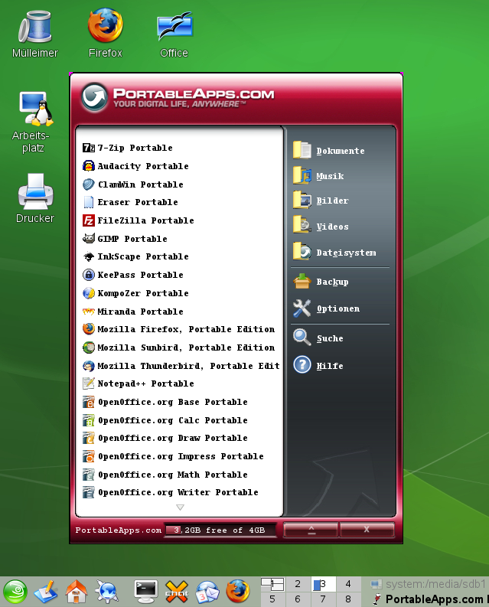
PortableApps-Suite with wine
OOoP Plus /
PortableAps menue
with wine

Slide 13
Selection of portable apps
OpenOffice.org Portable
7-ZipPortable
ClamWinPortable
FileZillaPortable
FirefoxPortable
GIMPPortable
InkscapePortable
MirandaPortable
NVUPortable
SudokuPortable
SunbirdPortable
ThunderbirdPortable
VLCPortable

Slide 14
Technical Overview: Structure
OpenOffice.org
OpenOffice.org
/App
/Data
/Others

Slide 15
Technical Overview: Structure
OpenOffice.org
OpenOffice.org
/App
Special Launcher:
OpenOffice.orgPortable.exe,
OpenOffice.orgWriterPortable.exe,
OpenOffice.orgCalcPortable.exe,
(...)
/Data
/Others

Slide 16
Technical Overview: Structure
OpenOffice.org
/App
/openoffice (OpenOffice.org core)
/AppInfo (ini-file and app-icons)
/Default Data (settings)
/Java (place for java runtime)
/Data
/Others

Slide 17
Technical Overview: Structure
OpenOffice.org
/settings (User)
/Temp
/App
/Data
/Others

Slide 18
Technical Overview: Structure
OpenOffice.org
/App
PortableApps Images (/help)
Installer Source files (/source)
/Data
/Others

Slide 19
Technical Overview: Modifications
Friendly Launcher (created with NSIS)
  OpenOfficePortable.exe
Mini Launcher for every Application
  OpenOfficeWriterPortable.exe etc.
Customized OpenOffice.org Installation
complete without:
  Explorer extension,
  ActiveX control,
  Online update

Slide 20
Technical Overview: Modifications
Compression of all exe- and dll-files with UPX:
  --best --compress-icons=0 –nrv2e
  --crp-ms=999999 -k
Compression of all png-files with 7zip to the maximum level
Recompression of all zip-files with 7zip to the maximum level

Slide 21
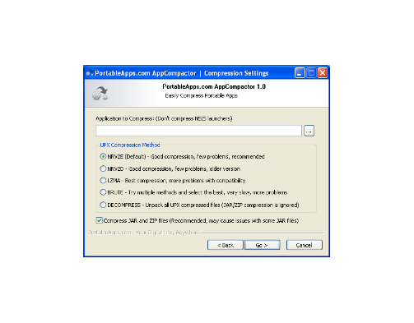
Technical Overview: Modifications
All done with
PortableApps.com App Compactor

Slide 22
Technical Overview: Compression
- 28,59 %
350
306
300
250
218,5
200
150
100
50
0

Slide 23
Installer
Modular constructed
At the moment: Compilation for every language
  Planed: multi-language-installer
Option: with and without Python-Support
NSIS-Script

Slide 24
Installer
We need:
OpenOffice.org-en-US without language files (core-OOo) and python
Language files for every language (i.e. en-US, de-DE)
Python-Files (Option in the installer)
Image packs

Slide 25
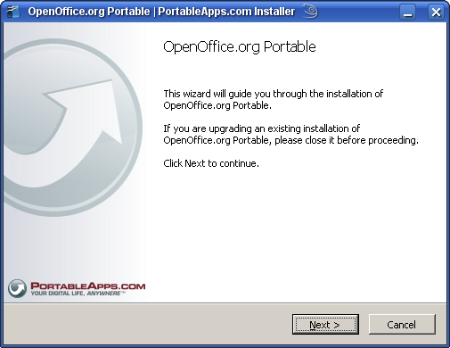
Installer
Selfextracting archiv
Guides in
3 steps
through the installation

Slide 26
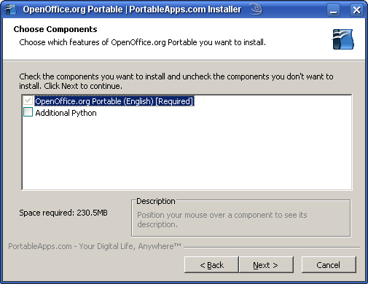
Installer
Select components:
  Python Support
Location to save

Slide 27
Upgrading
No On-line Update
Just Download a new OooPortable
Save the directory \Data\settings
Unzip on your portable device
Copy the saved directory \Data\settings into the new OpenOffice.org Portable

Slide 28
Know Issues
Trojan/Virus detected
(some antivirus applications)
Long Paths and Odd Characters (OpenOffice.orgPortable)
In the past also: Java / JavaVM

Slide 29
Know Issues
Performance of the portable Apps depending on:
  The performance of the host system (especially the USB device and the CPU speed)
  Quality of the storage medium

Slide 30
Benefits
Your Office in your pocket
Only Necessary: MS Windows ™
(from 3.0 on minimum MS WindowsXP)
and an open USB-Port
Option: with wine on Unix / Linux
None of your personal data left behind
on guest PC

Slide 31
Benefits
Your configuration data in your pocket
Extensions installed
Reduced disc space
Marketing: Show Features on customer PC without installation etc.
Marketing: give a (product-)presentation with no issue about the software environment on the guest PC

Slide 32
Benefits
Migration without risk
(first step: OpenOffice.org)
Nearly every main OpenSource office application is now available in a portable version (i.e. Mozilla Firefox, Thunderbird)

Slide 33
Questions?

Slide 34
Further Information:
http://portableapps.com/apps/office/openoffice_portable
in german language:
http://portableapps.com/de/apps/office/openoffice_portable
and
http://www.oooportable.org/

Slide 35


