Slide 1



IBM Lotus Symphony :
Worldwide IBM internal deployment
Best Practices
  John Walicki - walicki@us.ibm.com
  STSM, Open Client Architect
  IBM CIO Total Workplace Experience
© 2008 IBM Corporation
Notes:
To replace the title / subtitle with your own:
Click on the title block -> select all the text by pressing Ctrl+A -> press Delete key -> type your own text

Slide 2
The fine print... :-)
© IBM Corporation 2008. All Rights Reserved.
The information contained in this publication is provided for informational purposes only. While efforts were made to verify the completeness and accuracy of the information contained in this publication, it is provided AS IS without warranty of any kind, express or implied. In addition, this information is based on IBM’s current product plans and strategy, which are subject to change by IBM without notice. IBM shall not be responsible for any damages arising out of the use of, or otherwise related to, this publication or any other materials. Nothing contained in this publication is intended to, nor shall have the effect of, creating any warranties or representations from IBM or its suppliers or licensors, or altering the terms and conditions of the applicable license agreement governing the use of IBM software.
References in this publication to IBM products, programs, or services do not imply that they will be available in all countries in which IBM operates. Product release dates and/or capabilities referenced in this presentation may change at any time at IBM’s sole discretion based on market opportunities or other factors, and are not intended to be a commitment to future product or feature availability in any way. Nothing contained in these materials is intended to, nor shall have the effect of, stating or implying that any activities undertaken by you will result in any specific sales, revenue growth or other results.
IBM, Lotus, Lotus Notes, LotusScript, Notes, Passport Advantage, Quickr, Sametime, SmartSuite, Symphony and WebSphere are trademarks of International Business Machines Corporation in the United States, other countries, or both. Unyte is a trademark of WebDialogs, Inc., in the United States, other countries, or both.
Adobe is a registered trademarks of Adobe Systems Incorporated in the United States, and/or other countries.
Java and all Java-based trademarks are trademarks of Sun Microsystems, Inc. in the United States, other countries, or both.
Microsoft and Windows are trademarks of Microsoft Corporation in the United States, other countries, or both.
Linux is a registered trademark of Linus Torvalds in the United States, other countries, or both.
Other company, product, or service names may be trademarks or service marks of others.

Slide 3
IBM® Lotus® Symphony™ : Worldwide IBM internal deployment Best Practices
Abstract :
Learn how IBM IT designed and initiated its worldwide deployment of Lotus Symphony. IBM's document interchange policy is based on ODF, with Lotus Symphony becoming the preferred personal productivity suite for most employees. This talk will detail the methodology and deployment experiences of IBM's large scale deployment of Lotus Symphony. Open Document Format extends our Open Computing strategy which is centred on the value of open standards, open source software and open architectures.
John Walicki - Open Client Architect, IBM
Biography: John Walicki is part of the IBM Senior Technical Staff and architect for the Open Client Initiative. He leads the open standards based Browser Independence deployment of Firefox within IBM and the Document Interchange strategy to switch IBM to Open Document Format based productivity editors. John is a member of the IBM CIO Office Total Workplace Experience organization. His global development and integration teams are working to lower the costs of deployment of an enterprise enabled Linux Client. John is an active leader in the Linux desktop community where he represents IBM on The Linux Foundation's Desktop Linux Workgroup and as a member of the Gnome Advisory Board. John previously was a manager in the Watson Information Services department at the IBM T.J. Watson Research Center where he spent 16 years supporting the IBM Research user community.

Slide 4
Agenda
IBM Lotus Symphony: Worldwide IBM internal deployment Best Practices
IBM IT Transformation
IBM IT Document Interchange strategy
IBM internal deployment of Symphony 2008 - 2010
  Enablement
  User Segmentation
  Education / Support
  Adoption
  Business Application Reengineering
1

Slide 5
Realization of IBM Vision for Open Computing
Evolution of the IBM I/T Client Strategy
Vision: Employees get right tool at the right time for the right cost. To realize this…
  Higher productivity through collaboration
  Drive to Web through lightweight platforms
  Roles based dynamic delivery of IT resources
2008 - 2012
2006
2001
Flexible Offerings
Light / Thin Client
Open Computing
Employee Subsidized Devices
Roles Based Policies For Personalization / Customizations
Applications As Hosted Services
Platform Shifting To Network
Globalized End User Services
2 PC Images: Windows, Linux
Shift To Self-Help Model With Translated Content
Global Workstation Asset Management
Single Image Delivery Solution Supporting Multiple Sourced Media (network, CD/DVD)
1999
Consolidation of Standard End User Services At Geography/Country Level
Web Based Software Delivery
Linux Desktop
Cross-geography Alignment
1988
Standardization Program
Standardized Image Build & Delivery, Support, Mail and Calendar, Asset Management, Software Delivery
Each Division Had Own IT Shop Supporting Separate Host VM/MVS Systems
User Support Based On Specialist Down The Hall
Site Location Focused
1
Notes:
IBM has come from having well over 300 local IT “cowboy” shops in the 80’s to the introduction of a global end-to-end standard set of processes and solutions for end user computing and PC asset cradle-to-grave processing.
We are now beginning to transform to a more flexible model based on job roles and services rather than software.
1

Slide 6
IBM’s roadmap to “open computing”
Increased interoperability and flexibility
Web 2.0 open technologies
Open Collaborations
Notes 8 & Productivity Tools
High
ODF Strategic standard for document interchange
Adoption of Open Document Format
Eclipse-based Expeditor / Sametime IM 7.5
Notes 701: Linux/Mac
Open standards, open source, open architecture
IBM Productivity Tools
Open Client (Linux, Win, OS X)
Strategic Open Standards
IBM Workplace Managed Client
Closed solutions
Microsoft Office
Deliver increased value through strategic open standards
Provide better choices
Increase interoperability
Optimize document interchange
Windows 2000 / XP
Lotus SmartSuite
First Linux desktop introduced
Low
OS/2
Windows 95/98
1998
2002
Time
2006
2008
1
Notes:
Open Computing is about strategic open standards, approved open source, and open architectures.
IBM has moved from a generation of proprietary based solutions to those which are more open, and which provide increased business value by:
…giving employees more choice
…increasing interoperability of technologies as enablers for more seamless application integration
…enabling document interchange today and into the future without regard to file format
1

Slide 7
What does it mean to be Open ?
Goals of Openness
  Flexibility
  Resiliency
  Maximize freedom of action
  Avoid vendor lock-in
Open Standards
  Improving information sharing by simplifying integration of disparate technologies
  Promoting interoperability by using open published specifications
Open Architecture
  Increasing collaboration by easily extending business processes – eg SOA
  Innovating on top of common hardware specifications
Open Source
  Promoting innovation by leveraging community development
  Accelerating open standards adoption
Open Computing
Open standards
Community
Innovation
Open architecture
Open
source
Notes:
Open source is part of this wider Open Computing vision – alongside Open Standards and Open Architecture.
Open Computing is based around collaboration and innovation, and breaks down walls between technologies, processes, and people to support information flow, process automation, collaboration, and innovation.
Open standards, open architectures and open-source software can all move a company’s systems to exploit the opportunities of globalization by providing greater degrees of participation, flexibility and resilience.
Open standards promote interoperability and information integration by using open, published specifications for APIs, protocols and data and file formats, so you can simplify data sharing among disparate internal and external business systems. This is a critical first step to optimizing location- and company-independent processes. Information integration includes management of unstructured information and also information in context (Master Information Services)
Open architecture enables the building of loosely coupled and reconfigurable solutions, so you have the independence to isolate and distribute work to the most effective teams within and outside the organization. And, it also makes it easier to integrate activities into common workflows that increase collaboration within and among all teams involved in the extended the business process.
Open source software promotes standards and leverages community development and collaborative innovation
Adopting open technologies is, of course, not the only way to address business needs. However, there is little doubt that software technology will continue to move from closed, proprietary base infrastructures to open, standardized platforms, allowing software innovation to take place higher up the software stack.

Slide 8






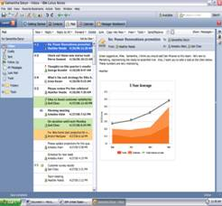
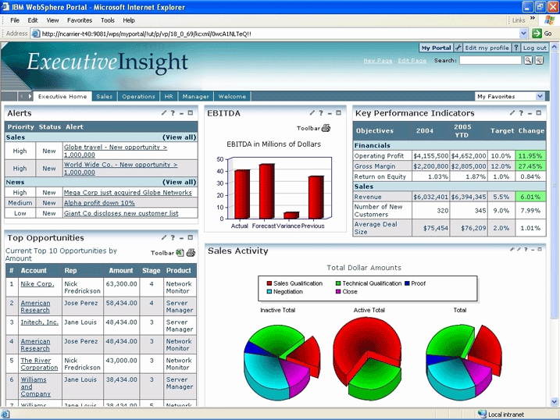





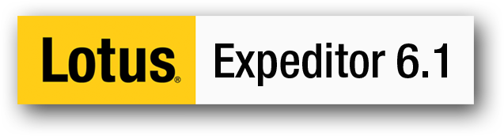
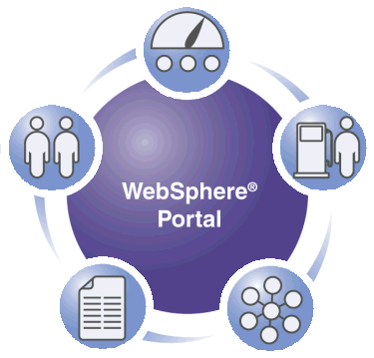


IBM’s Open Client Strategy
Heterogenous Desktop Environment
Client strategy is to provide IBM’s workforce with the right client platform based on job role
  Flexibility and choice of client platform and operating system
  Reduced total cost of ownership, especially through server-managed clients
  Cross-platform client application development through Lotus Expeditor Rich Client Platform
  Leverage web browser for business applications
  Linux plays a key role in the wider IBM Client strategy
  Document Interchange via ODF
Client Access
Rich
Thin / Virtual
Collaboration & Application services
LOB Apps
Symphony
Notes
Sametime
Connections
Quickr
Platform Framework
Portal
Windows
Mac
Operating Systems

Slide 9

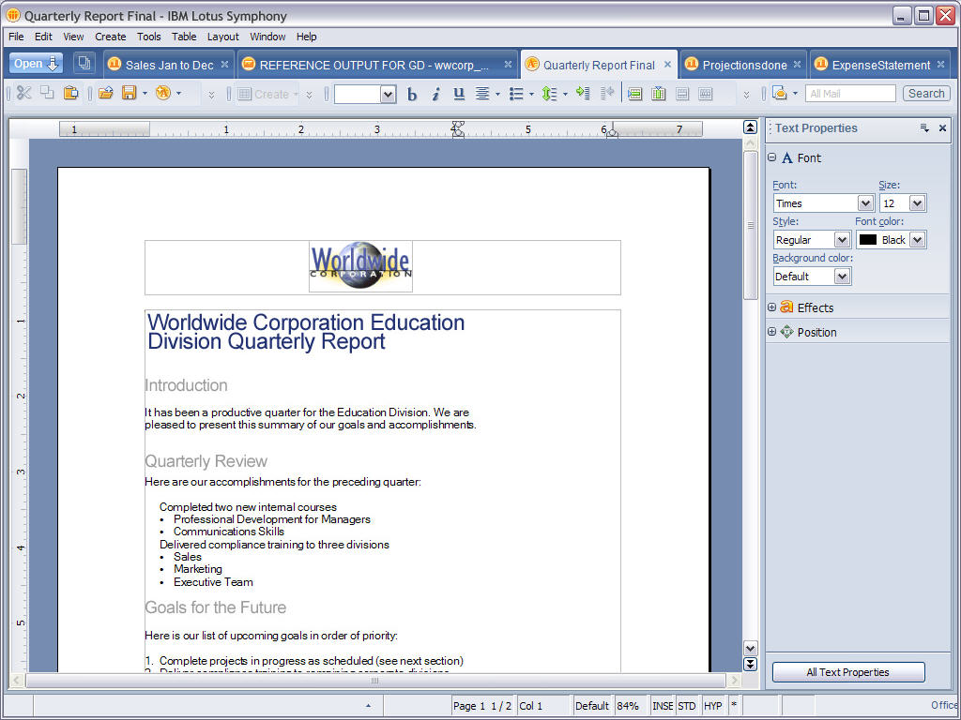

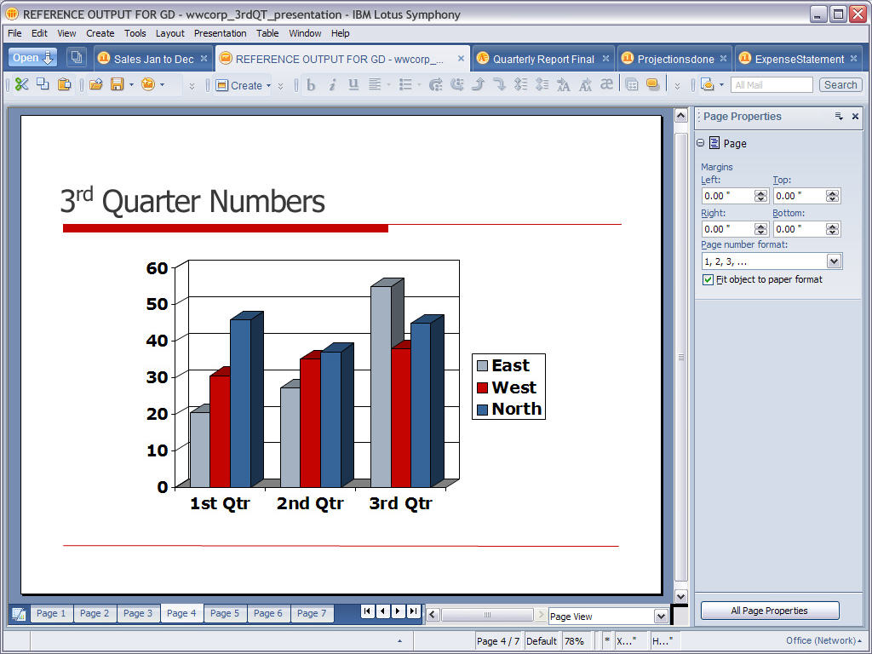

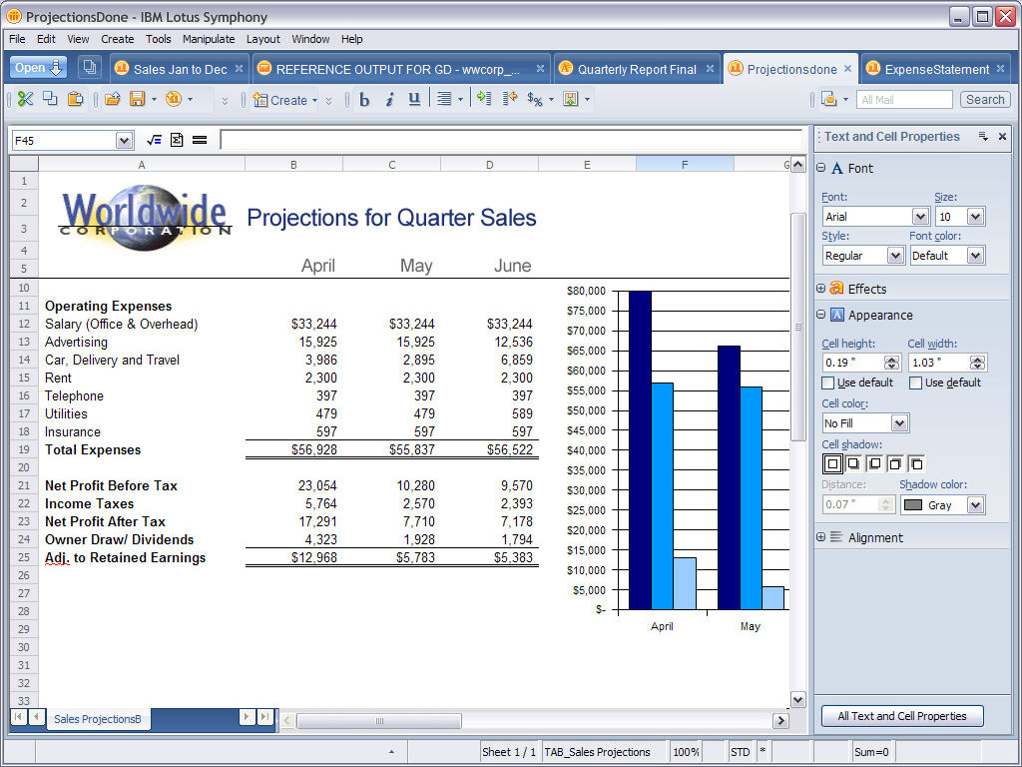

IBM IT Document Interchange Strategy
Objective
Long term, strategic effort in support of our Open Computing strategy
Enable the IBM business to author and exchange documents today and into the future without concern for file format
Provide a rich productivity suite that will enable IBM to shift to a format based on strategic open standards for document authoring and interchange in an accelerated time frame...
Lower IT costs by using IBM products
Save money in our own IT budgets to invest elsewhere
1

Slide 10
Lotus Symphony Deployment Showcase
Goals
Partnership between Lotus and IBM IT
Accelerate the development and maturity of IBM products
by engaging with the internal IBM Early Adopter communities (TAP)
Identify gaps early and assist Lotus on prioritization of features - Influence their roadmap to meet the IBM Enterprise requirements
Lead the industry in the adoption of open standards based technologies
Focus on Open Standards based solutions
Demonstrate to customers how to deploy ODF and Lotus Symphony
Help our customers with their adoption through best practices
Align with IBM Lotus product strategy and exploit IBM Research technology
Improve business process integration and decrease TCO
1

Slide 11
Execute a 3 year phased Symphony deployment
Phase 1
Current State
Phase 2
Y2009-10
Phase 3
Y2010+
Plan the introduction of Lotus Symphony
Deployment and software distribution methodology
Enable IBMers to exchange ODF Documents
User segmentation
Metrics / Tracking / Reporting
Communications Plan
User Support / Education
Drive Network Effect
Business Application assessment / inventory
Map Symphony capabilities to business unit user segments
Business Process reengineering to create / emit ODF
Developer Education
Extend the user experience via Plugins
Broad adoption of Lotus Symphony and ODF within IBM
Continued support for legacy file formats
1

Slide 12
User Segmentation
1

Slide 13

Work is not a place
385,000 employees world-wide in 64 countries
  Americas - 157,000
  Europe - 93,000
  Asia Pacific - 135,000
~40% of our workforce conducts work away from an IBM office
~12% work solely from home
~About 23% “road warriors” – mobile/frequent travelers
~About 4% based entirely at client sites
~About 2% work in manufacturing settings
~About 85% have laptops

Slide 14
User Segmentation and Deployment Strategy
Identify the IBM user segments that are good candidates for Symphony deployment
  By Business Unit
  By Geography
  By Job Family
  By customer facing requirements
Japan
France
USA
Mktg
Sales
Architect
GBS
STG
CHQ
SWG
GF
1

Slide 15
User Segmentation and Feasibility Studies
Which segments are good candidates
  Split deployment into Phases
  Assess which Business Units can start today
    SWG – SWG Marketing
    GBS – Customer facing consultants
  Job Roles
    Linux users – already using Symphony
    Finance – Financial spreadsheets
Document Authoring vs Document consuming
  Authoring needs are a higher requirement
  Users that simply read documents
Run Feasibility Studies and Assessments
  GBS / SWG / CIO / SWG Finance
1

Slide 16
User Segmentation and Feasibility Studies
Which segments are good candidates
  Develop deployment plans to a progression of user segments
    Match the capabilities of Symphony with the needs of each user population
    Comparison of the feature gaps between Symphony and MS Office 2003 and MS Office 2007
    As the Lotus Symphony roadmap closes user requirement gaps plan the order of the migration
    If particular features are not included in Symphony, identify implications for some user segments
  Assessment of internal applications that use/generate Excel spreadsheets / VBA Macros
1

Slide 17
Symphony Software Provisioning within IBM
1

Slide 18
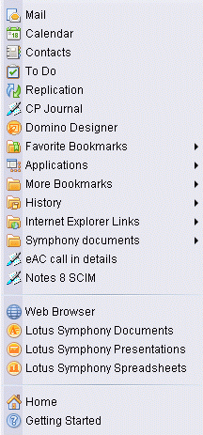
Provisioning IBMers with Lotus Symphony
Notes 8.0.1 Deployment
  Accelerate Deployment of Notes 8.0.1 to broad IBM user population
  Users with sufficiently powerful systems
  Fully integrated email / Collaboration / Productivity
  Converged document interchange platform
  Embedded Symphony 1.0 capabilities
  Embedded Symphony 1.1 refresh
Symphony Standalone
  Available via IBM Standards Software Installer (ISSI)
  Internal web based software shopping catalog
  Symphony 1.0 / 1.1 packages / Quarterly cycle
Technology Adoption Program (TAP)
  IBM internal Early Adopters willing to run beta software releases
Automatic refreshes
  EzUpdate for users that have Symphony
Preload - Windows / Linux
  100K / year worldwide
  Add Symphony to the Windows Client preload
  New hardware with sufficient memory
  Add Symphony to Open Client for Linux image
1

Slide 19
Symphony Deployment Project Management
1

Slide 20
Symphony Project Office
Establish a Symphony Project Office
  CIO / IGS program managers, architects and mgmt
  Funding
Coordinate all Symphony activities
  Deployment
  Business Units
  Internal communications
Facilitate partnership with Lotus Development
  Interlock with WPLC on rapid release rate schedule and activity
  Identify within Business Units and Geographies feature requests vs problems
  Identify within Business Units and Geographies critical applications and dependencies on Symphony
  Continuous feedback mechanism to feed critical defects and requirements to the development team for inclusion in future releases

Slide 21
Symphony Training and Education
1

Slide 22

Education and Training
Education
  Engage IBM Education team
  Develop "Symphony Essentials” course curriculum
Personal Productivity
  Migration to Symphony is a learning curve and requires some retraining for the new interface
  Provide assurances there is a migration path for access to legacy documents
Training
  Offer education and support to employees during migration phase
    Classroom courses, self help tutorials, reference cards, demos
    Continue w3 Communications with HowTo Tips
Culture – Change user behavior
  Drive Communications and Awareness
  Explain to IBMers why a transition to Symphony is beneficial
  Avoid edicts and forced migrations that cause employee dissatisfaction

Slide 23

Helping users get started with Symphony
Adopt Symphony document format for 1 meeting
  Migration does not need to be cold turkey
  Enable all participants with the Symphony Editors
  Drive read only usage / familiarization
  Drive Network Effect
  Observe / Test readiness of documents
1

Slide 24
Communications
1

Slide 25
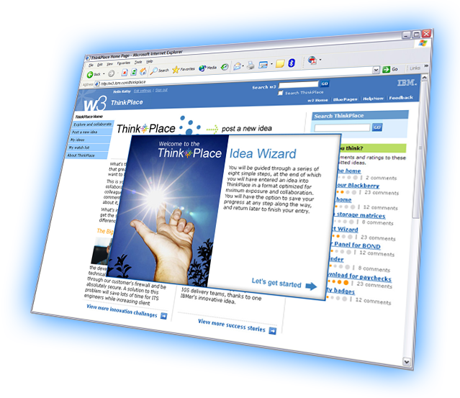
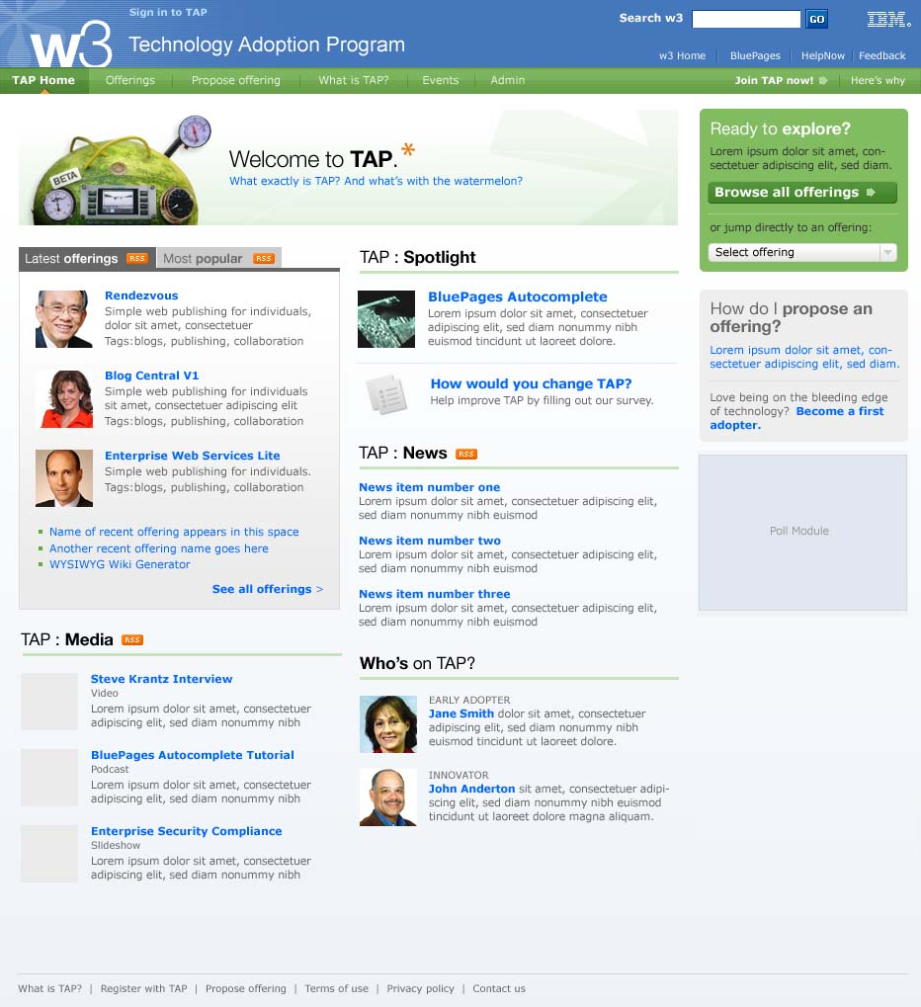
IBM Early Adopter Community Symphony pilot
Partnership
  Continue the development partnership between the IBM I/T and IBM Lotus CSDL Symphony Development team
TAP Early Adopters
  Pilot Symphony Beta releases
  30,000 users
  Bug Reports / Feedback
1

Slide 26
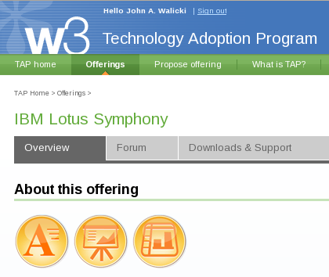
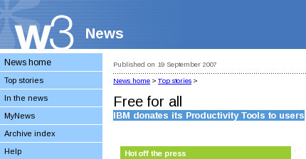
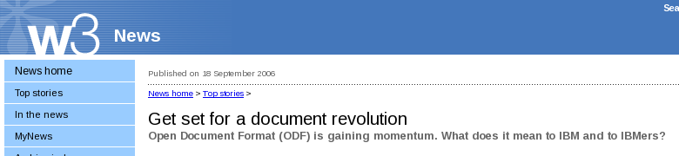
Communications
Continue awareness campaign through w3 Communications
Prepare w3 communication articles
Highlighting IBM plans to adopt ODF
Launch a Symphony wiki
Create a Symphony Blog
Establish a “Get Symphony” campaign
  Symphony Week
IBM Presentation Central templates
Lead by example
  Executive Challenges to teams

Slide 27
Metrics / Tracking / Reporting
1

Slide 28
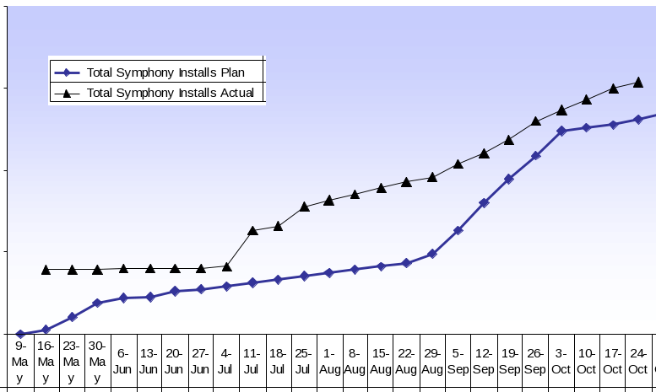
Symphony Deployment Adoption Metrics
1

Slide 29
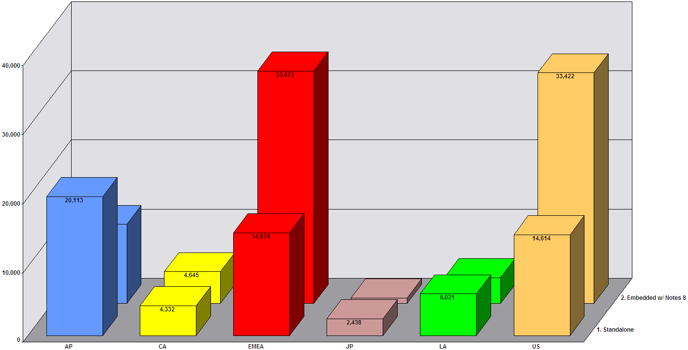
Symphony Deployment Adoption Metrics – by Geo
1

Slide 30
Symphony integration into IBM business processes
1

Slide 31
ODF Integration into IBM business applications
Business Application assessment / inventory
  Coordinate with the business units to create an inventory of business processes that generate legacy documents
  Track remediation efforts
Establish a "Porting Center" to assist Business Units in their remediation
  Application Development/Maintenance funding to adopt ODF across existing IBM internal application portfolio
  Business Process reengineering to create / emit ODF
  Dedicated "consulting" developers to help application developers in their transition to ODF
  Prioritize and fund the remediation of new business processes that have high/broad impact to the corporation
Developer Training
  Symphony Programmability training for Application Developers which will allow IBM business units to convert business processes that generate legacy formatted documents to create ODF documents
1

Slide 32
Lotus Symphony Plugins
Symphony can be extended and customized
  To extend the user interface with new capabilities
  To move data between Symphony and other applications
Symphony has API's for different developer communities
  Java developers on Eclipse/Expeditor
  Notes developers using LotusScript
  OpenOffice developers
Encourage developers to create plugins for Symphony
  Extension interfaces will be added to Symphony and to Notes over time
  Collaborative Innovation to make Symphony better
  IBM plugins for: Quickr, Unyte, Connections, Websphere Translation Server...
Enhance the user experience through Symphony Plugins
1

Slide 33
Lotus Symphony Programmability
Toolkit -- Developer’s guide, API references, sample, tutorial and utilities
Symphony programming model -- public APIs, extension points
Eclipse plug-in support in stand-alone Symphony
Composite Application support (Java™ & Lotuscript) in Notes 8.0 & 8.0.1 embedded Symphony
Symphony website
  New dedicated Developer Forum
  IBM Plug-ins published on website.
  Allow 3rd parties to publish descriptions & links to the plug-ins hosted on their own website.
  New support forum dedicated to plug-ins users
1

Slide 34

Summary
IBM IT Deployment of Lotus Symphony is a multi-year initiative
Lotus Symphony supports the IBM IT Transformation toward Open Computing
IBM IT Document Interchange strategy is built on ODF
2008 Highlights
  Enablement
  User Segmentation
  Education / Support
  Adoption
1

Slide 35
Thanks!
John Walicki/Watson/IBM
walicki@us.ibm.com

