Slide 1

OpenOffice.org 2.x... and beyond
Michael Bemmer
  Director Software Engineering
  StarOffice/OpenOffice.org
    Sun Microsystems

Slide 2
Focus areas
There are two focus areas:
Community Building
Improvements / Features
Notes:
Concernrs about Sun's commitment: resolved!

Slide 3
Community Building

Slide 4
Community Building
What has been done already after OOo conf Koper 05
A week long OpenOffice.org developer meeting in Hamburg with developers from Novell, Intel, Red Hat, Google, Propylon
More Sun employees present on IRC channel
Setup of a Wiki as a content collaboration platform
  http://wiki.services.openoffice.org/
OpenOffice.org QA meeting in Germany: ~20 participants
Conducted another OOo survey
Increased priority for integrating community patches

Slide 5
Patch handling
Defined two metrics to measure patch handling:
Initial Response Time
(IRT, describes the time between submission and first comment or status change from someone else than the submitter for open issues of type PATCH):
  Average IRT September 2005: 50-60 days
  IRT Goal: less than a week
  Status IRT September 2006: 3-5 days
Issue Inactivity Time
(IIT, describes the time since the last addition of a comment or status change for open issues of type PATCH.
  Average IIT September 2005: 130 days
  IIT Goal: 2-3 weeks
  Status IIT September 2006: 40 days

Slide 6
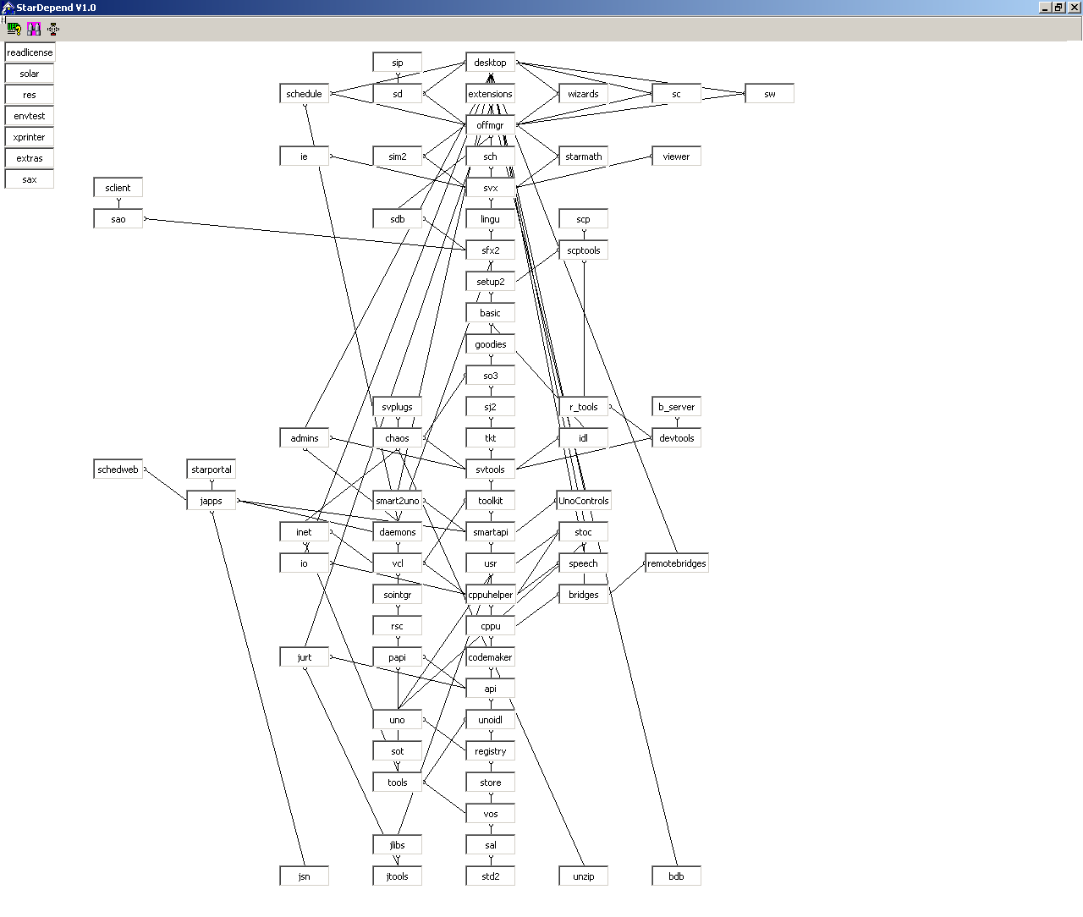
Build dependencies SO 5.2 (2000)

Slide 7
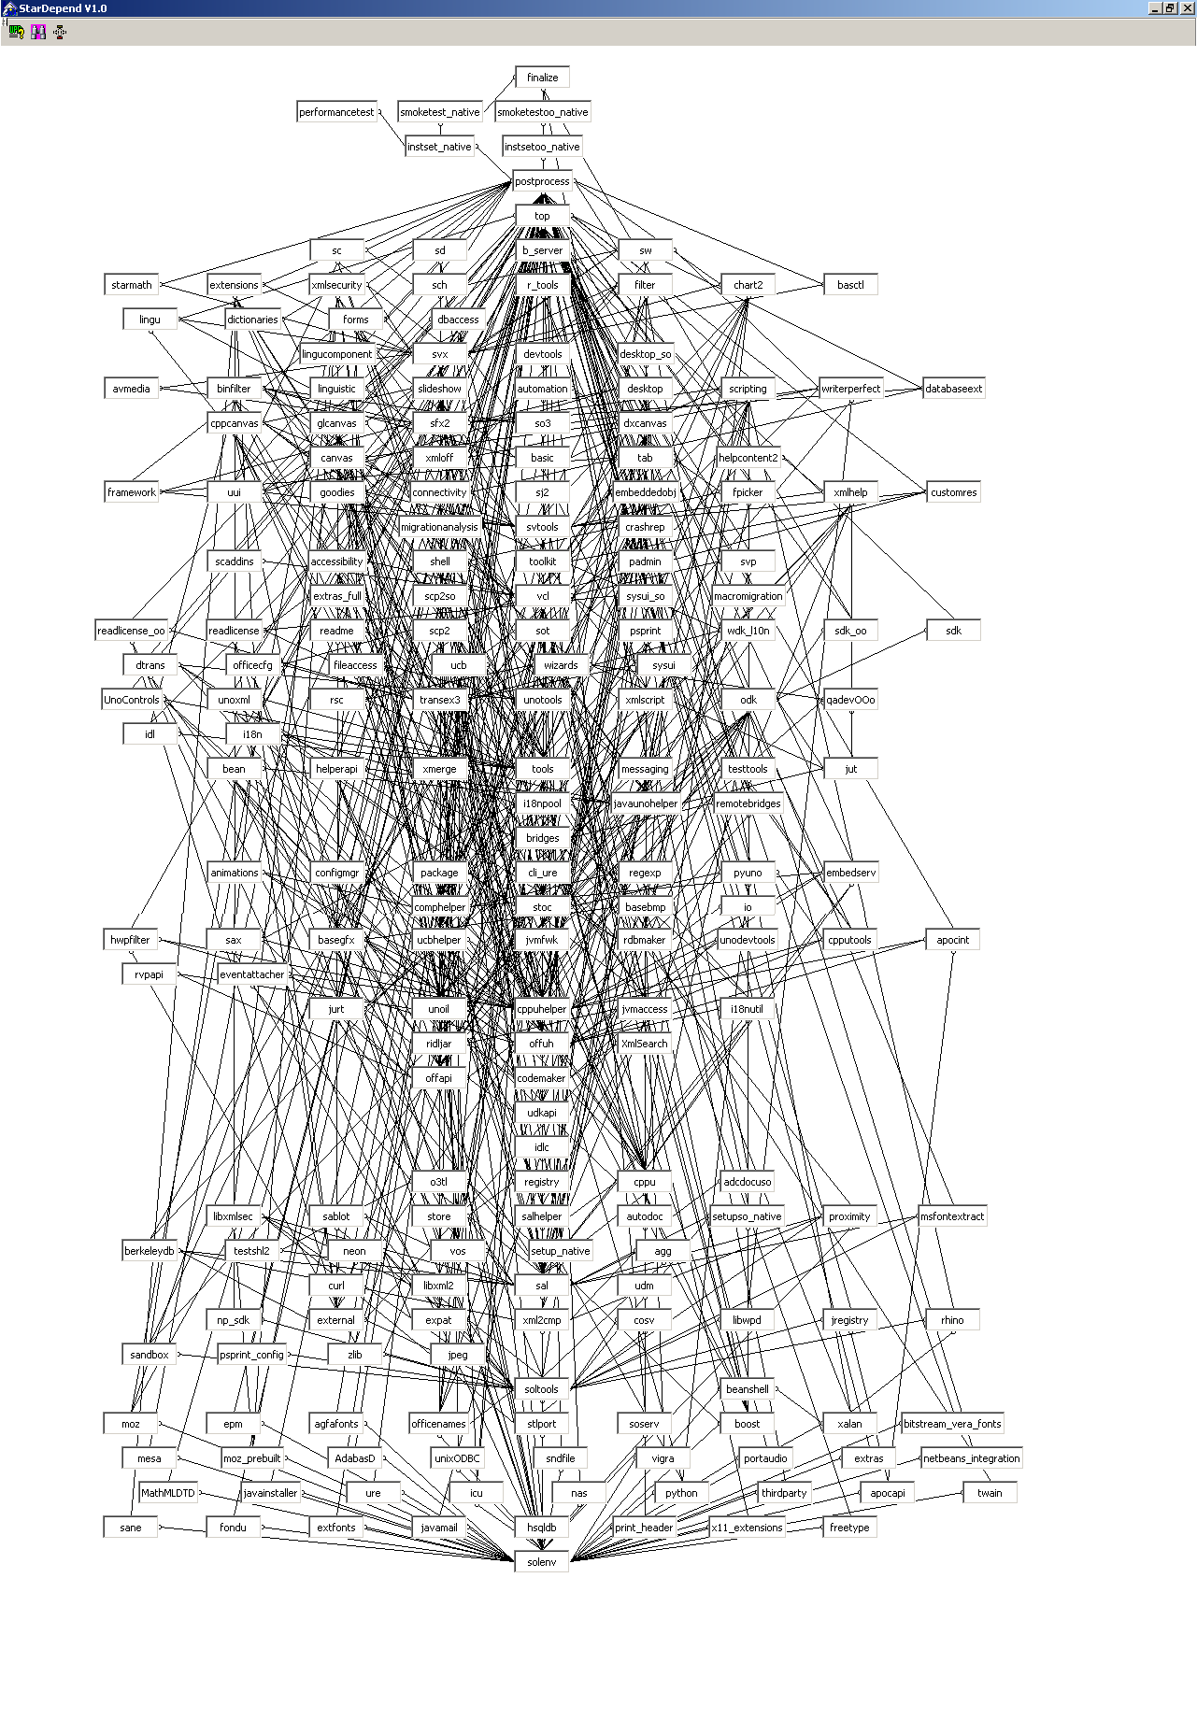
Build dependencies OOo 2.0 (2005)

Slide 8
Community building
Build environment improvements (Kai Backman from Google, Volker Quetschke and Novell involved)
Reduction of Code Complexity
Mentoring in the Google Summer of Code
Further improvement of patch handling
More transparency
  Updating current project sites
  Wiki
  Group blog
Online trainings, hands-ons for different skill levels
Mentoring newbies

Slide 9
Improvements / Features in OpenOffice.org 2.x and beyond

Slide 10
Performance
Startup
  30% - 50% faster than OpenOffice.org 2.0
    Depends on Application (Writer, Calc, Impress)
Loading / Saving documents
  Up to 50% faster that OpenOffice.org 2.0
Automatic CWS Performance Tests before integration into Master to prevent decreasing performance
Ongoing effort to increase the performance significantly
Intel and Novell contributing significantly to this effort

Slide 11
Extension Development
Extension Development Toolkit
  To be able to implement OpenOffice.org extensions with appealing GUI look and feel
  Smart integration in OpenOffice.org help system
  Smart integration in “Tools / Options” dialog
  Online update capability
Extension Development
  Netbeans integration

Slide 12
ODF Support
XML Strategy
  Strengthening our OpenDocument Format standard
    OASIS -> ISO
      Publishing by ISO expected in a few weeks
    ODF 1.1: Accessibility
      Expected for OOo 2.1
    ODF 1.2: Spreadsheet Formulas
      Expected for OOo 2.3
    ODF Viewer for Mozilla Firefox
  XML Forms using XForms
    Planned integration in 3rd Party form workflow for Enterprise customers
  Custom schemas, Meta Data

Slide 13
Microsoft Office Interoperability
Writer
  Complete redesign of MS Word import / export filter
  Complete redesign of RTF filter
  Core enhancements
    New Table implementation, Page break, Section, Numbering, ...
Calc
  Core enhancements
    New Business Chart import/export, Data Pilot enhancements, ...
Impress
  Core enhancements
    New Table support using Calc table engine, Presentation Engine enhancements, ...

Slide 14
Deployment
Online Update
  OpenOffice.org 2.0.3
    Semi-automated Online Update notification mechanism
    Available Now
  OpenOffice.org 2.0.4
    Automated on-line update, product will look for available updates
    Planned Availability: mid Sep 2006
  OpenOffice.org 2.x
    Fully featured, fully automated Online Update for OpenOffice.org and StarOffice on Windows, Linux and Solaris.
  “Market place” will be open. Independent US legal entity will be created to handle revenue stream (as decided by the Community Council)

Slide 15
Usability
Continue to improve ease of use for users who migrate from other office suites to OOo
Improve usability of everyday features
Simplify the user interface, reduce UI clutter, eliminate option-mania
Drive & incorporate user experience focussed contribution from the community
Build up user experience community on OOo

Slide 16
Personal Information Manager (PIM)
Completes OpenOffice.org Productivity Offerings
  OpenOffice.org + Calendaring / eMail / Address book
  Allows for a complete migration to open solutions
  Solves MS License issues
  Addresses user demand proven by OOo surveys
Based on Mozilla Thunderbird / Lightning
  Open source
  Well accepted platform

Slide 17
PIM
Schedule appointments / meetings
  Address book, Invitations, Free / Busy information
  Timezone support
Configuration / Administration
  Access rights incl. delegation
  Backup / Restore of calendar and config data
Calendar Server support
  Sun Java System Calendar Server
  Microsoft Exchange (later)
Offline mode to sync with Notebook / PDA (later)

Slide 18
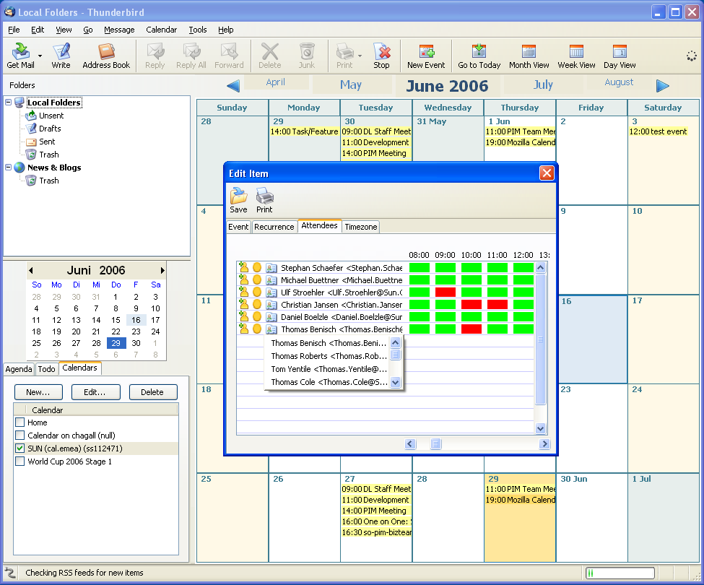
PIM - Working Prototype
Based on community build
Schedule a meeting using corporate address book and free / busy
Sun JS Calendar Server connector

Slide 19
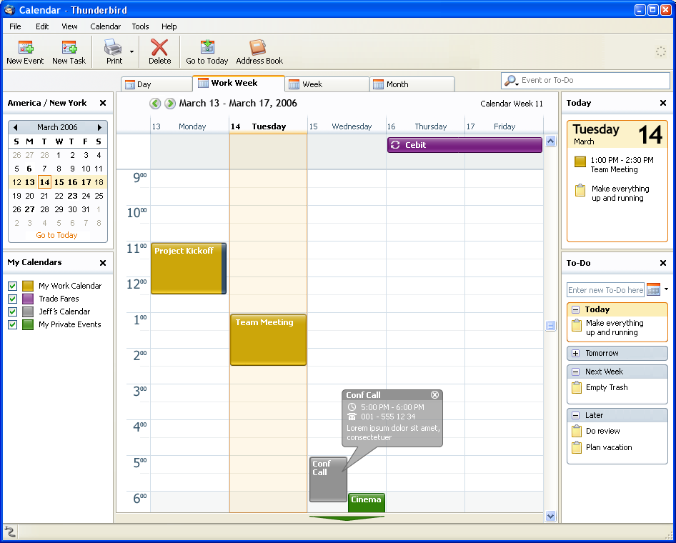
PIM - Planned UI Improvements
Modern look
Event / Task attributes
Agenda / ToDo's
Navigation
  Mini month
  Scrolling
  Keyboard
Integration
  Search box
  Toolbar

Slide 20
We can never be enough.
              Join!
Notes:
Concernrs about Sun's commitment: resolved!

Slide 21

Thank you!
  michael.bemmer@sun.com

