Slide 1
Lightning Fast Startup
Michael Meeks
& Jan Holesovsky
“Stand at the crossroads and look; ask for the ancient paths, ask where the good way is, and walk in it, and you will find rest for your souls...” - Jeremiah 6:16

Slide 2
Overview
Performance problems
Some approaches
  genuine speedups / round-up from last year.
  fast splash / 2nd starter
  systray app
Memory savings / profiling.
Conclusions / Questions

Slide 3
The problem archetypes
scraping data off the spinning oxide
  Intel doing some work here
algorithmic sillies
  linking
  poor I/O management
  bad code
    legacy optimisations, 'clever' hacks etc.
memory burn

Slide 4
Startup profile / linking

Slide 5
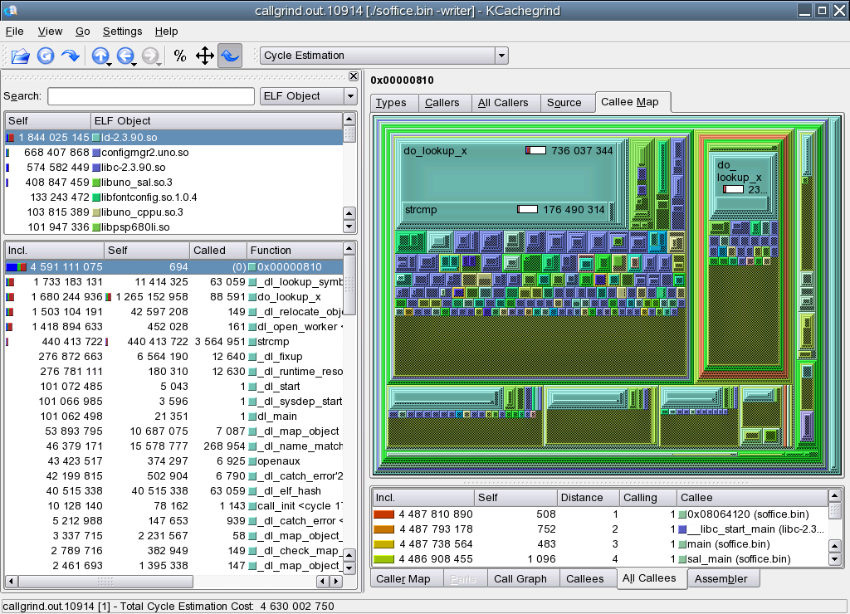
Before:

Slide 6
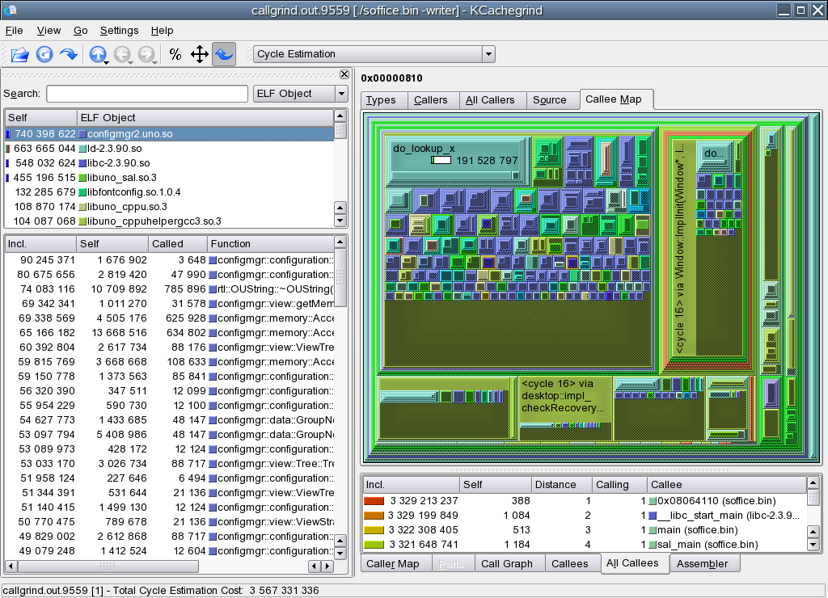
After

Slide 7
Linking fixes
-zdynsort
  re-written by RedHat - --hash-style – in new glibc / binutils - ~50% linking win
-Bdirect
  direct linking variant – still in wilderness, Ulrich Drepper refuses to discuss it, or even read the patch carefully.
  75% linking speedup
reduced linking scope
  a hack to deal with vague linkage
  substantial win.

Slide 8
Reduced linking scope
Special case Internal components to shrink lookups
    an evil hacked to defeat the ODR, and lookup only in a small scope.
Before:
soffice.bin
libc
sal
configmgr
libstdc++
typemgr
ucb1
...omit 75 ...
...omit 75 ...
After:
soffice.bin
libc
sal
libExcept
libstdc++
...omit 20 ...
...omit ~10 ...
configmgr
Assumptions:
  all cross-shlib exceptions
    [ in internal code ]
  declared using UNO & hence compiled into 'libExcept'
Substantial speedup.
typemgr
svx
...omit 100+ ...

Slide 9
Slight of hand speedups

Slide 10
How other people cheat
Firefox
  statically links
  still slow to read
  factory process
KDE – kdeinit
  kills link issues
MS Office
  greater fragmentation into components
    runs up against link times O(num-libraries)
  I/O re-ordering
    not present on Linux, cf. Intel's talk.

Slide 11
Ways we cheat already
Factory process
  OO.o sits in the background
  the 2nd time we run it – we start quicker
Caches
  configmgr stores big caches in ~/.ooo-2.0
  imagemgr stores big cache in ~/.ooo-2.0

Slide 12

Apparently faster startup
Quick 2nd starter:
  detects factory process
  if not – starts splash ~immediately
  else pipes arguments to main process
Perception rather than reality: Marketing.

Slide 13
Timings / data: (warm)

Slide 14
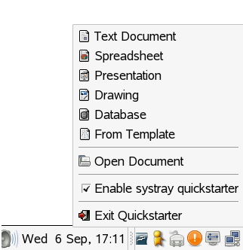
Making it usable: the systray ...
UI for lifecycle control
cheesy buttons
semi-instant apply
freedesktop spec.
1st cut in 2.1 (?)

Slide 15
Memory issues ...

Slide 16
Memory tools ...
Massif
  space time not a useful measure
    blighted by full-run-then-analyse design.
speedprof / memprof
  ideal, accurate, full-stack information
  no re-compile necessary, interactive profile request
  http://wiki.services.openoffice.org/wiki/Speedprof

Slide 17
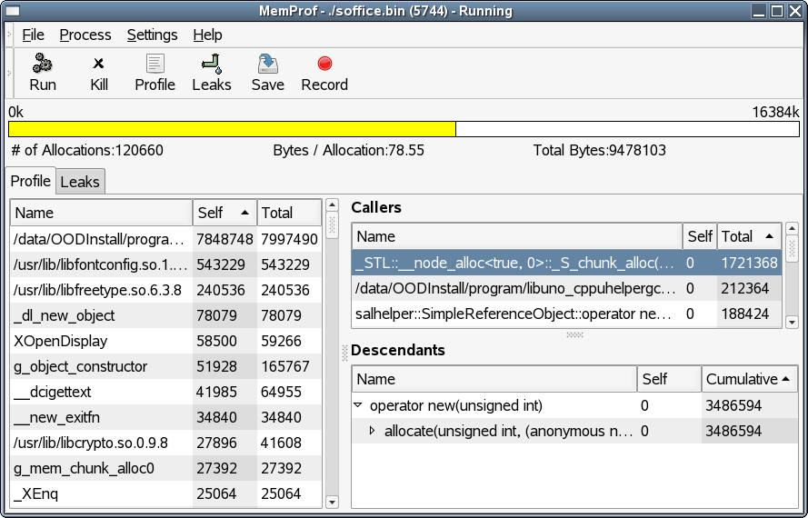
Memory tools ...

Slide 18
Image strips / lists ....
3 problems:
  images.zip file read every start anyway
  large ~2.4Mb of image cache in ~/.ooo-2.0
  image strips in cache – horizontal
    extremely poor working set effects:
Re-worked ImageList - (cws ka009)
  saved 3 Mb overall, and ~Mb per window
    lost multi-Mb in ~/.ooo-2.0
    each images.zip entry – appears just once
  scripts to re-sort images.zip – to avoid seek problems
  startup performance neutral, but some 1st time latency

Slide 19
Strings ...
Lots of strings are allocated repeatedly
  makeAny(rtl::OUString::createFromAscii(“Foo”))); etc.
>90% of strings are duplicates
  a number of scattered patches
  configmgr yet to go
    lots of fat there ...
malloc overhead
  real savings: larger

Slide 20
Future work ...
Code/shared size: still most significant: ~100Mb.
Configmgr
  remove custom structures and shared memory arch.
  new chunky API
ScCell
  huge vs. Excel
  patch to remove ScPostIt * from base cell
  each cell has a row-index in column*.cxx
    better sparse array needed.
  string duplication needs fixing
  Data Pilot representation not efficient

Slide 21
Conclusion
Startup:
  linking getting slowly fixed
  configmgr a large issue
Memory
  code-size still critical
  configmgr needs love
Strings:
  getting fixed.
  check your code for offenders
    http://go-oo.org/~michael/ustrings.ods
Oh, that my words were recorded, that they were written on a scroll, that they were inscribed with an iron tool on lead, or engraved in rock for ever! I know that my Redeemer lives, and that in the end he will stand upon the earth. And though this body has been destroyed yet in my flesh I will see God, I myself will see him, with my own eyes - I and not another. How my heart yearns within me. - Job 19: 23-27

